Slide 1
Guidance for Video/Audio in PowerPoints
1. Open the folder and copy all the files.
2. Paste the copied files into a new folder.
3. Open the PowerPoint file, enable editing and enter presentation mode (start the slide show).
Please note the embedded audio may not be compatible with early versions of PowerPoint.
You may wish to delete this slide before beginning the presentation.

Slide 3
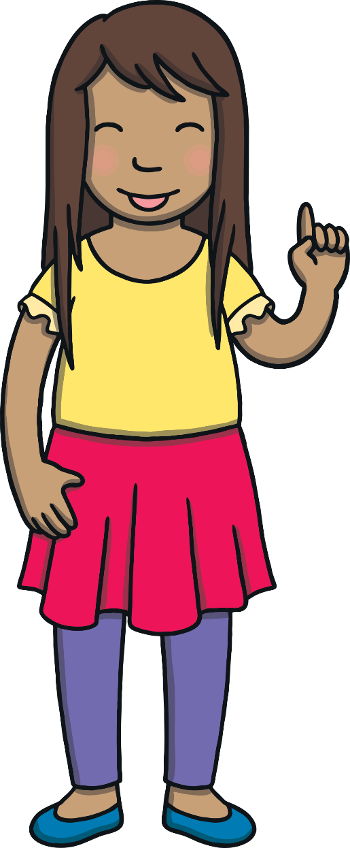
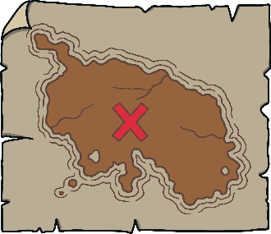
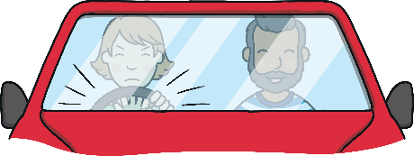
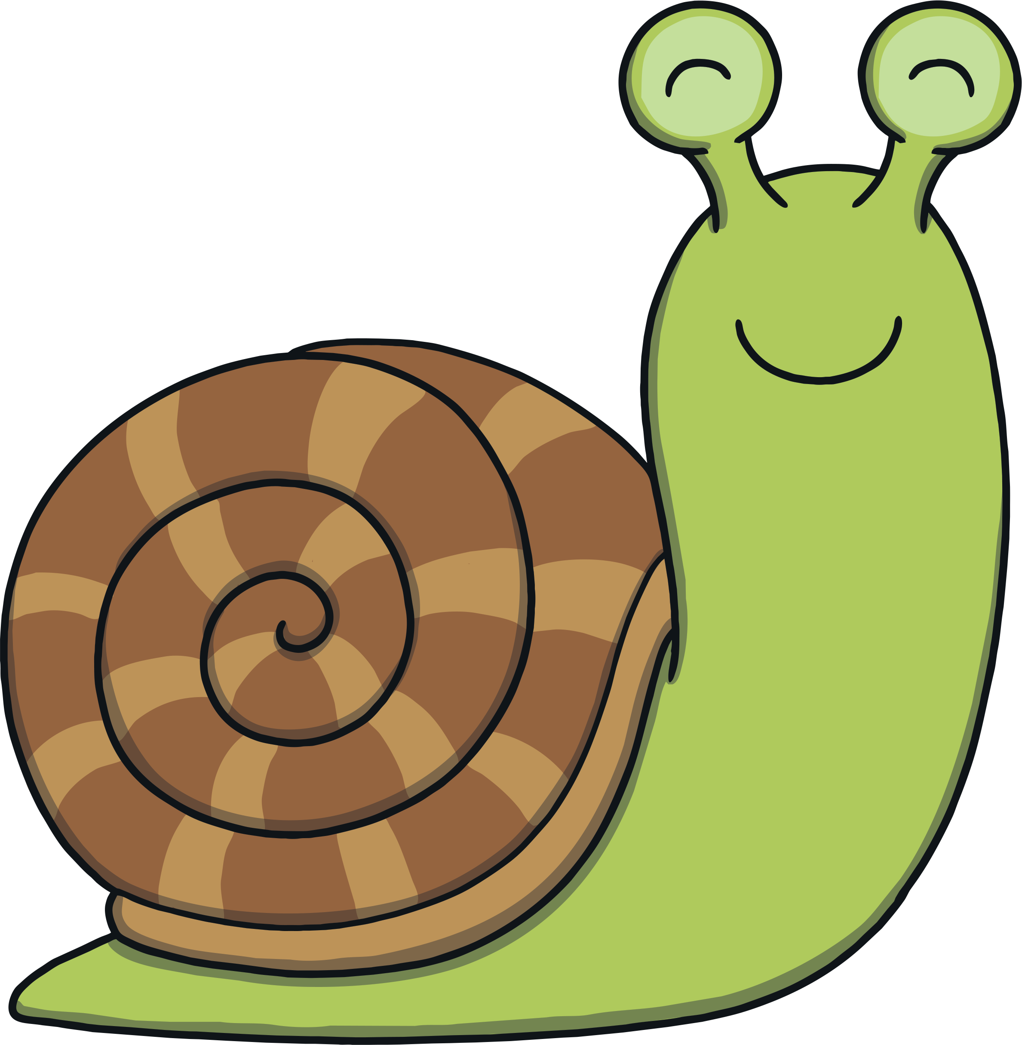
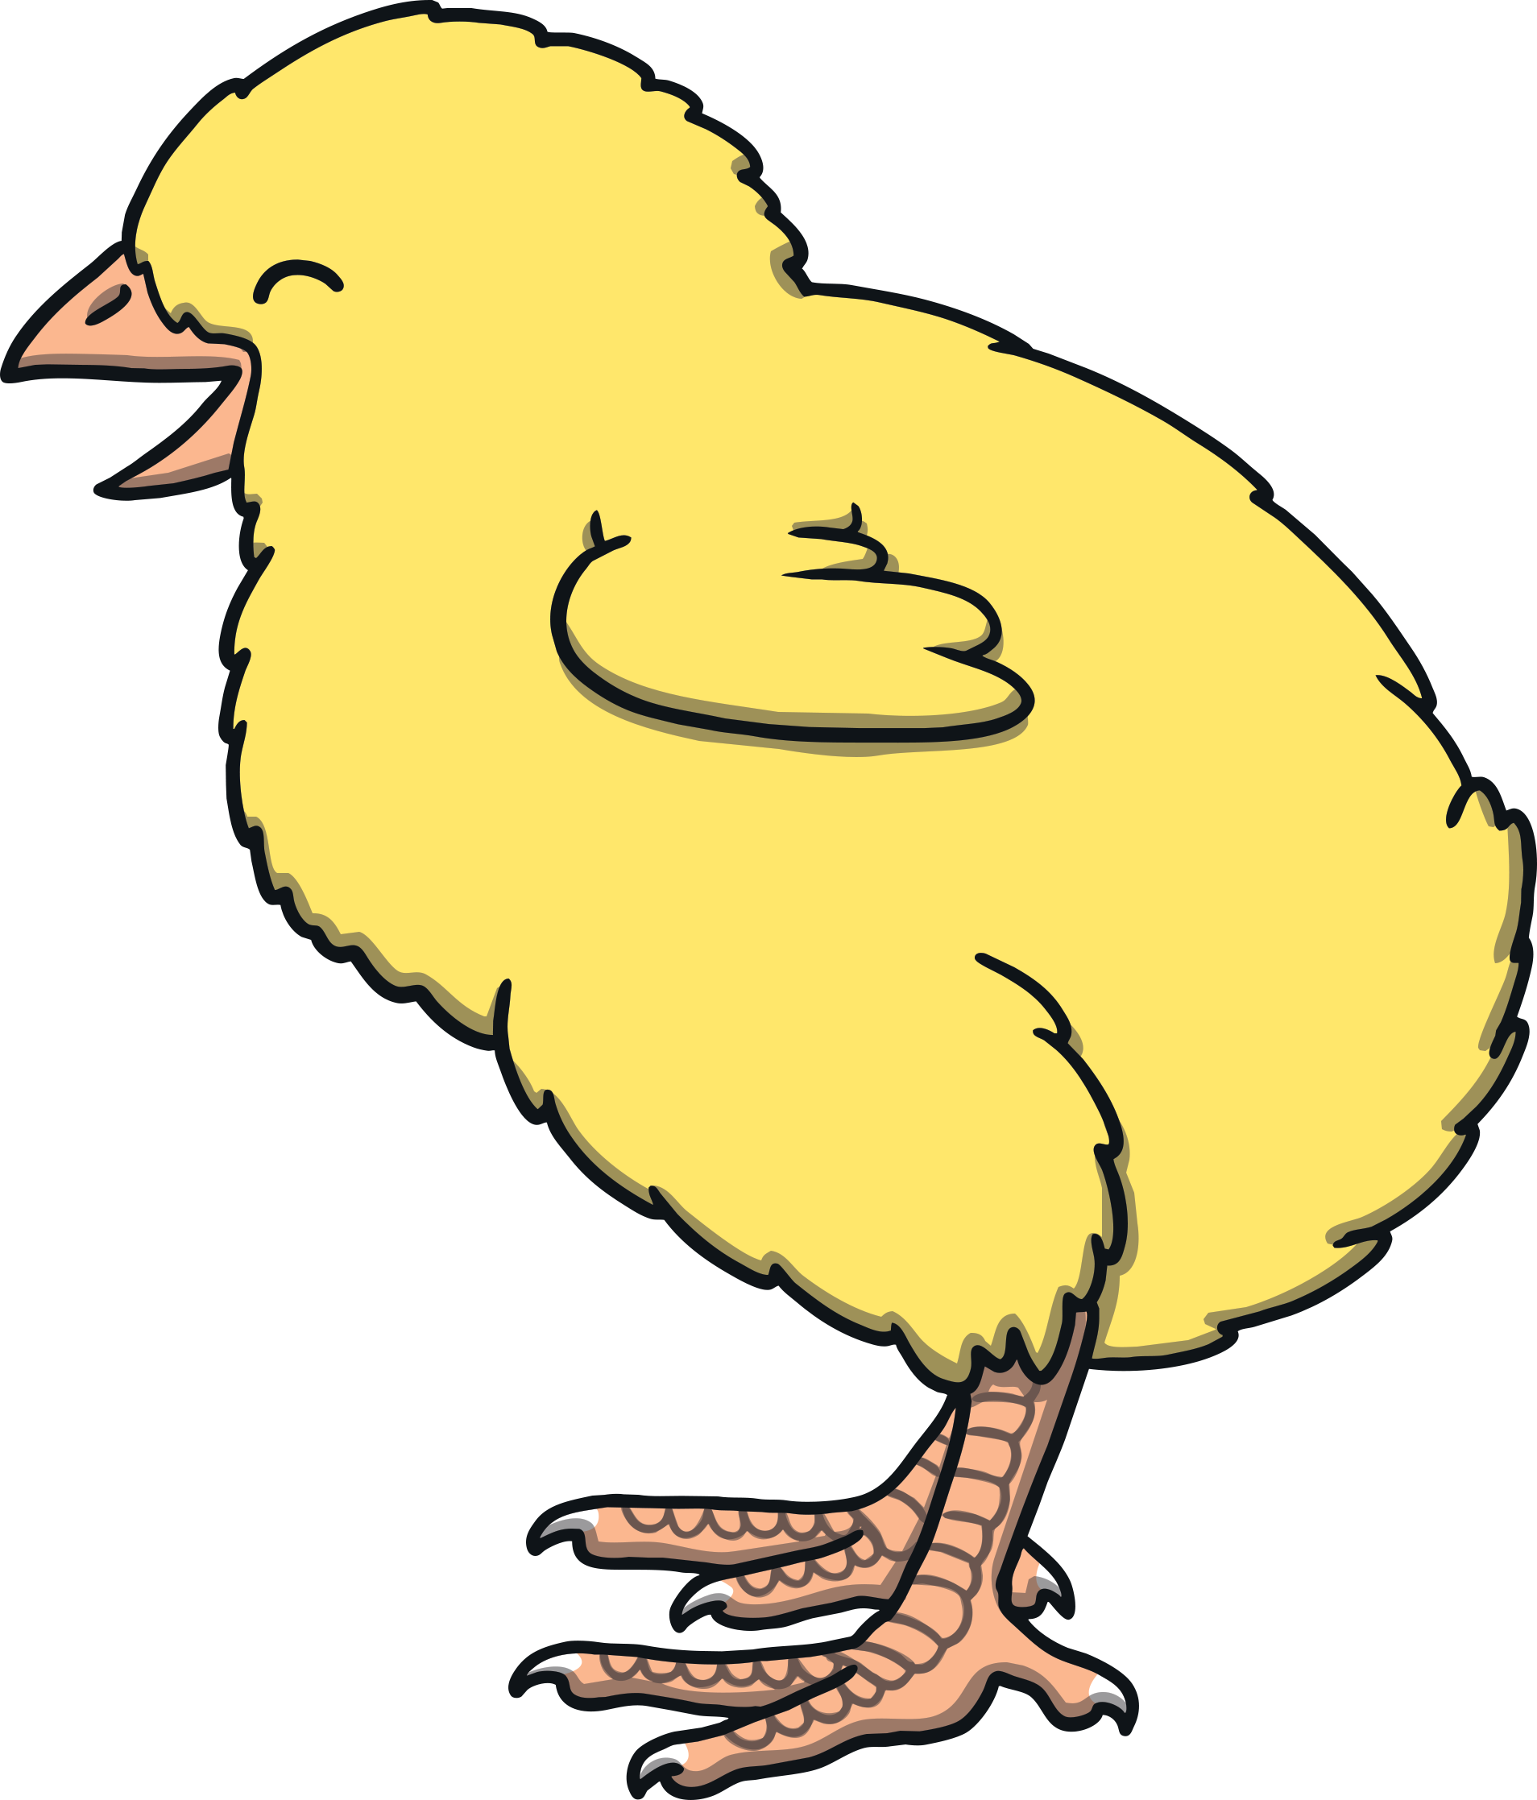
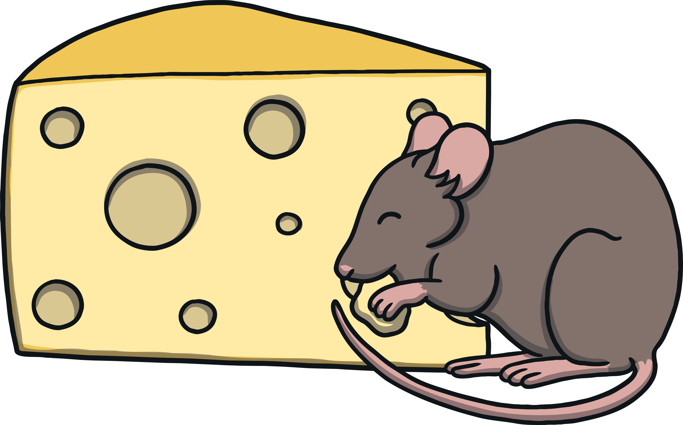
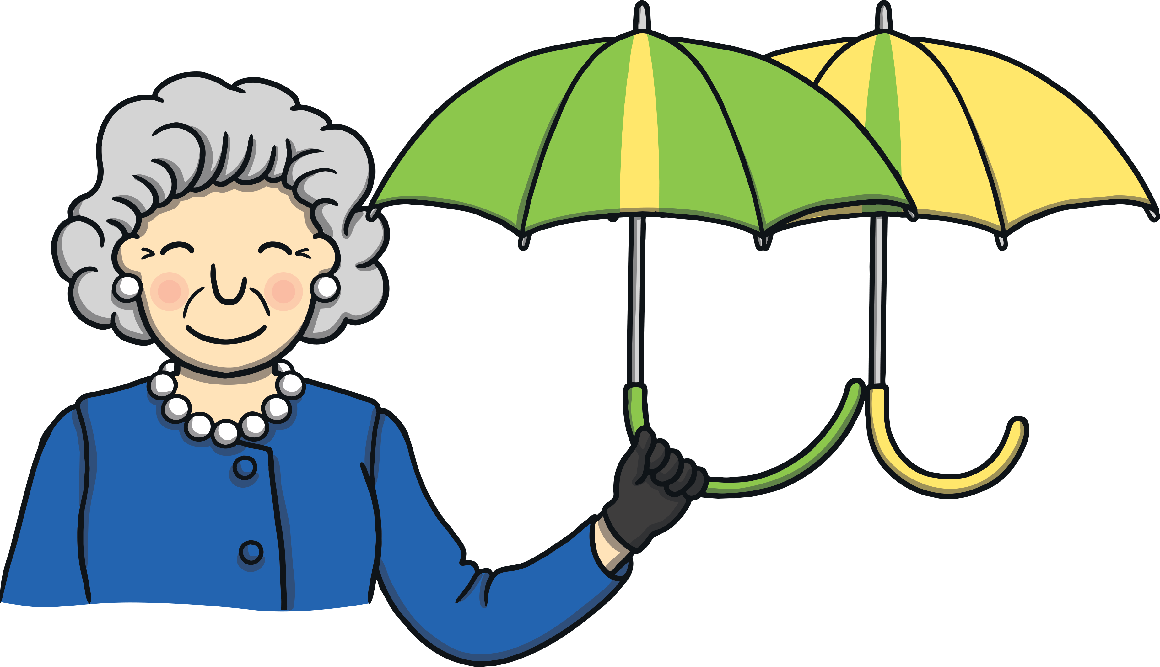
Revisit and Review
Let’s practise Sam’s Sounds and Tricky Words!
j
zz
oo
ur
ar
oo
or
v
ch
ng
z
igh
y
qu
x
th
ai
ee
oa
w
th
sh
was
he
she
we
me
be
you
my

Slide 4
Letter Name Time Challenge
Revisit and Review
J
H
V
C
B
A
Z
Y
W
U
T
S
R
Q
P
O
N
M
K
L
X
I
F
G
D
E
Start
00:01
00:06
00:10
00:13
00:12
00:09
00:00
00:08
00:03
00:04
00:14
00:53
00:20
00:07
00:05
00:15
00:16
00:02
00:41
00:11
00:56 0
00:19
00:26
00:24
00:25
00:17
00:18
00:39
00:40
00:21
00:49
00:47
00:52
00:50
00:30
00:34
00:28
00:31
00:58
00:33
00:29
00:46
00:27
00:22
00:23
00:48
00:37
00:54
00:35
00:32
00:43
00:55
01:00
00:44
00:38
00:51
00:57
00:45
00:42
00:36
00:59
Stop

Slide 5
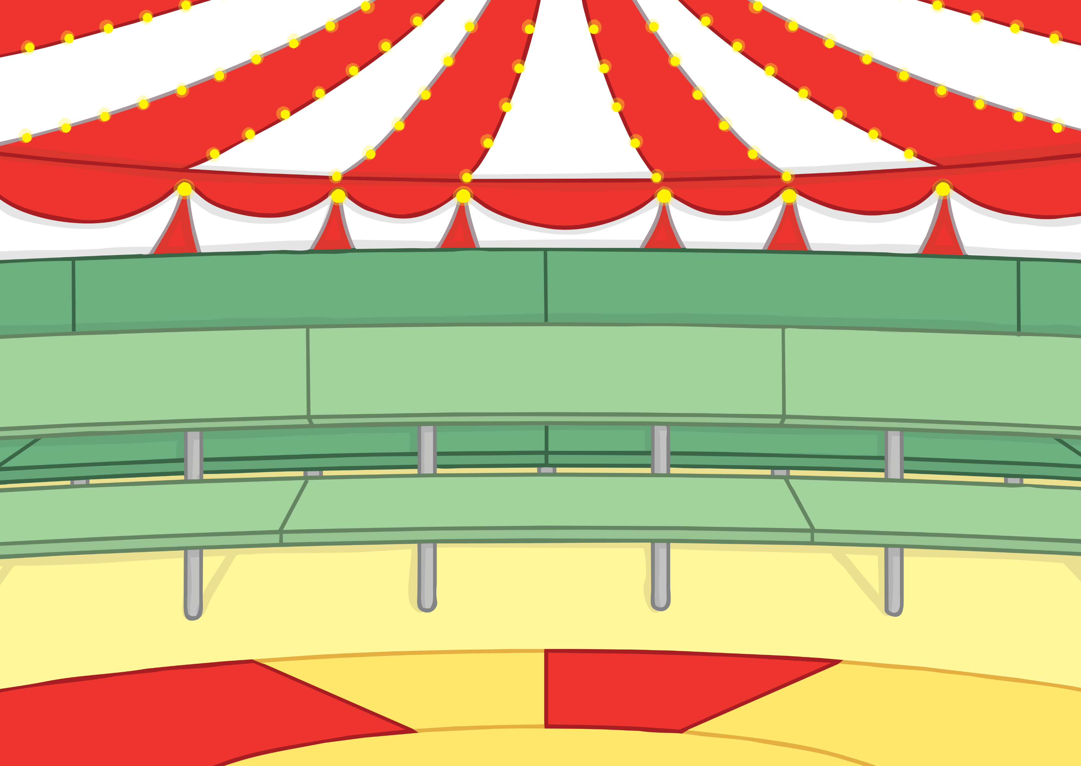
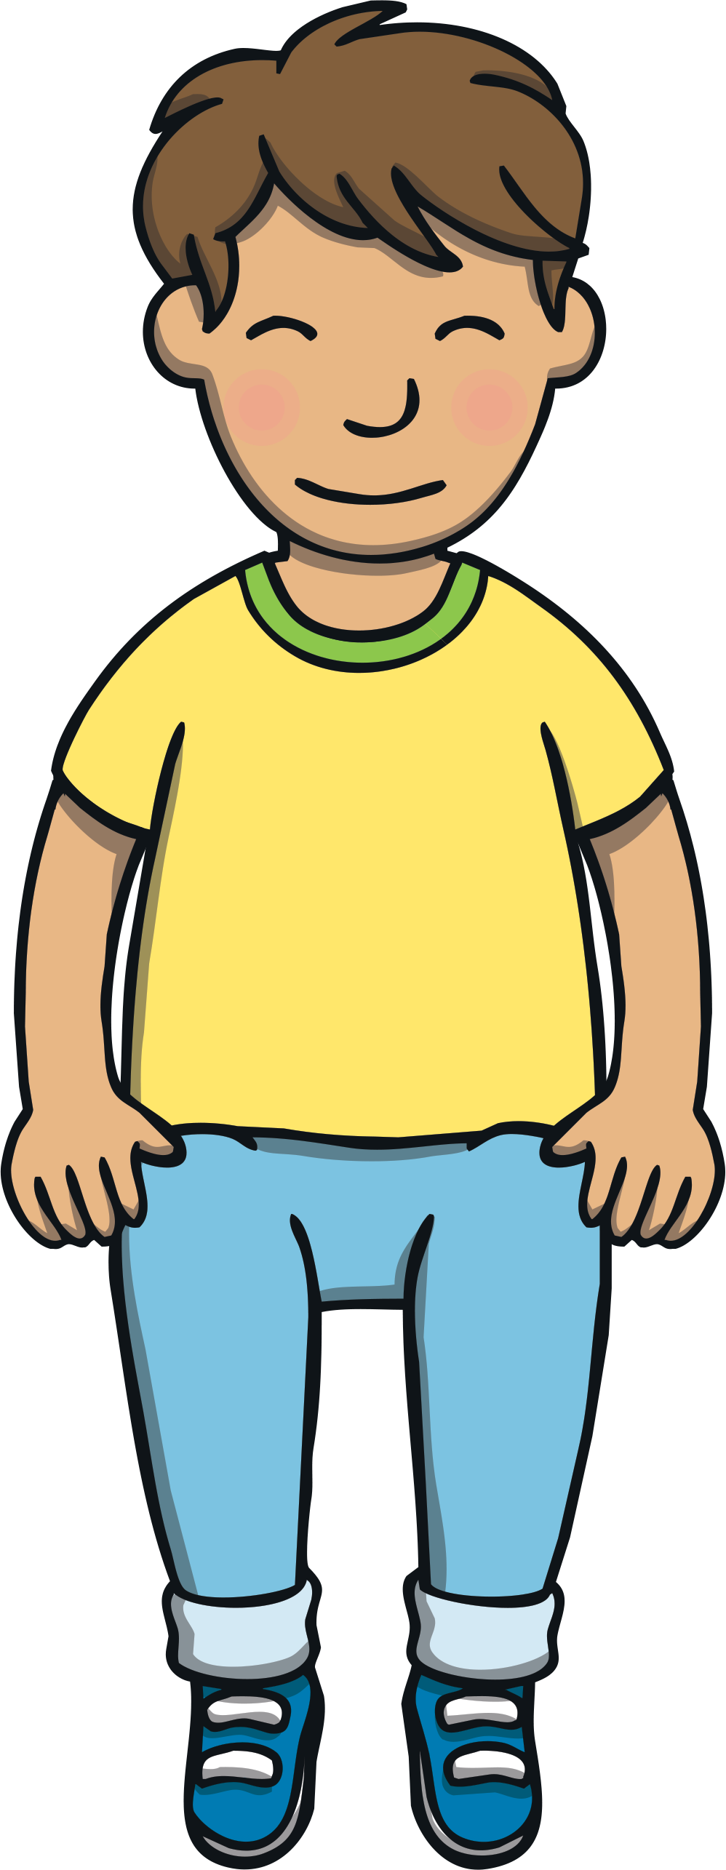
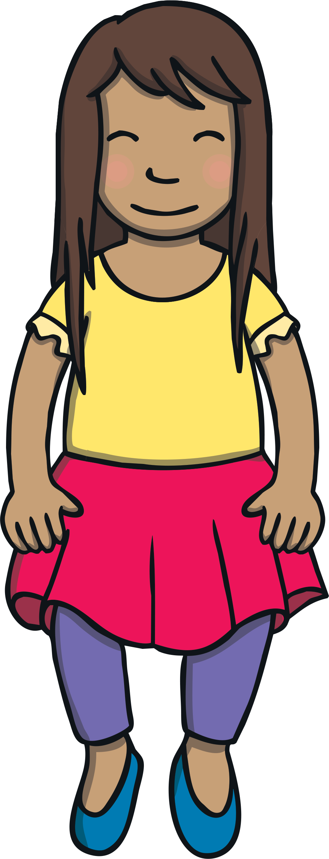
Teach
One day, the circus arrived in town. The family went to watch. It was amazing! They saw someone walking the tightrope, a trapeze artist and some clowns.

Slide 6
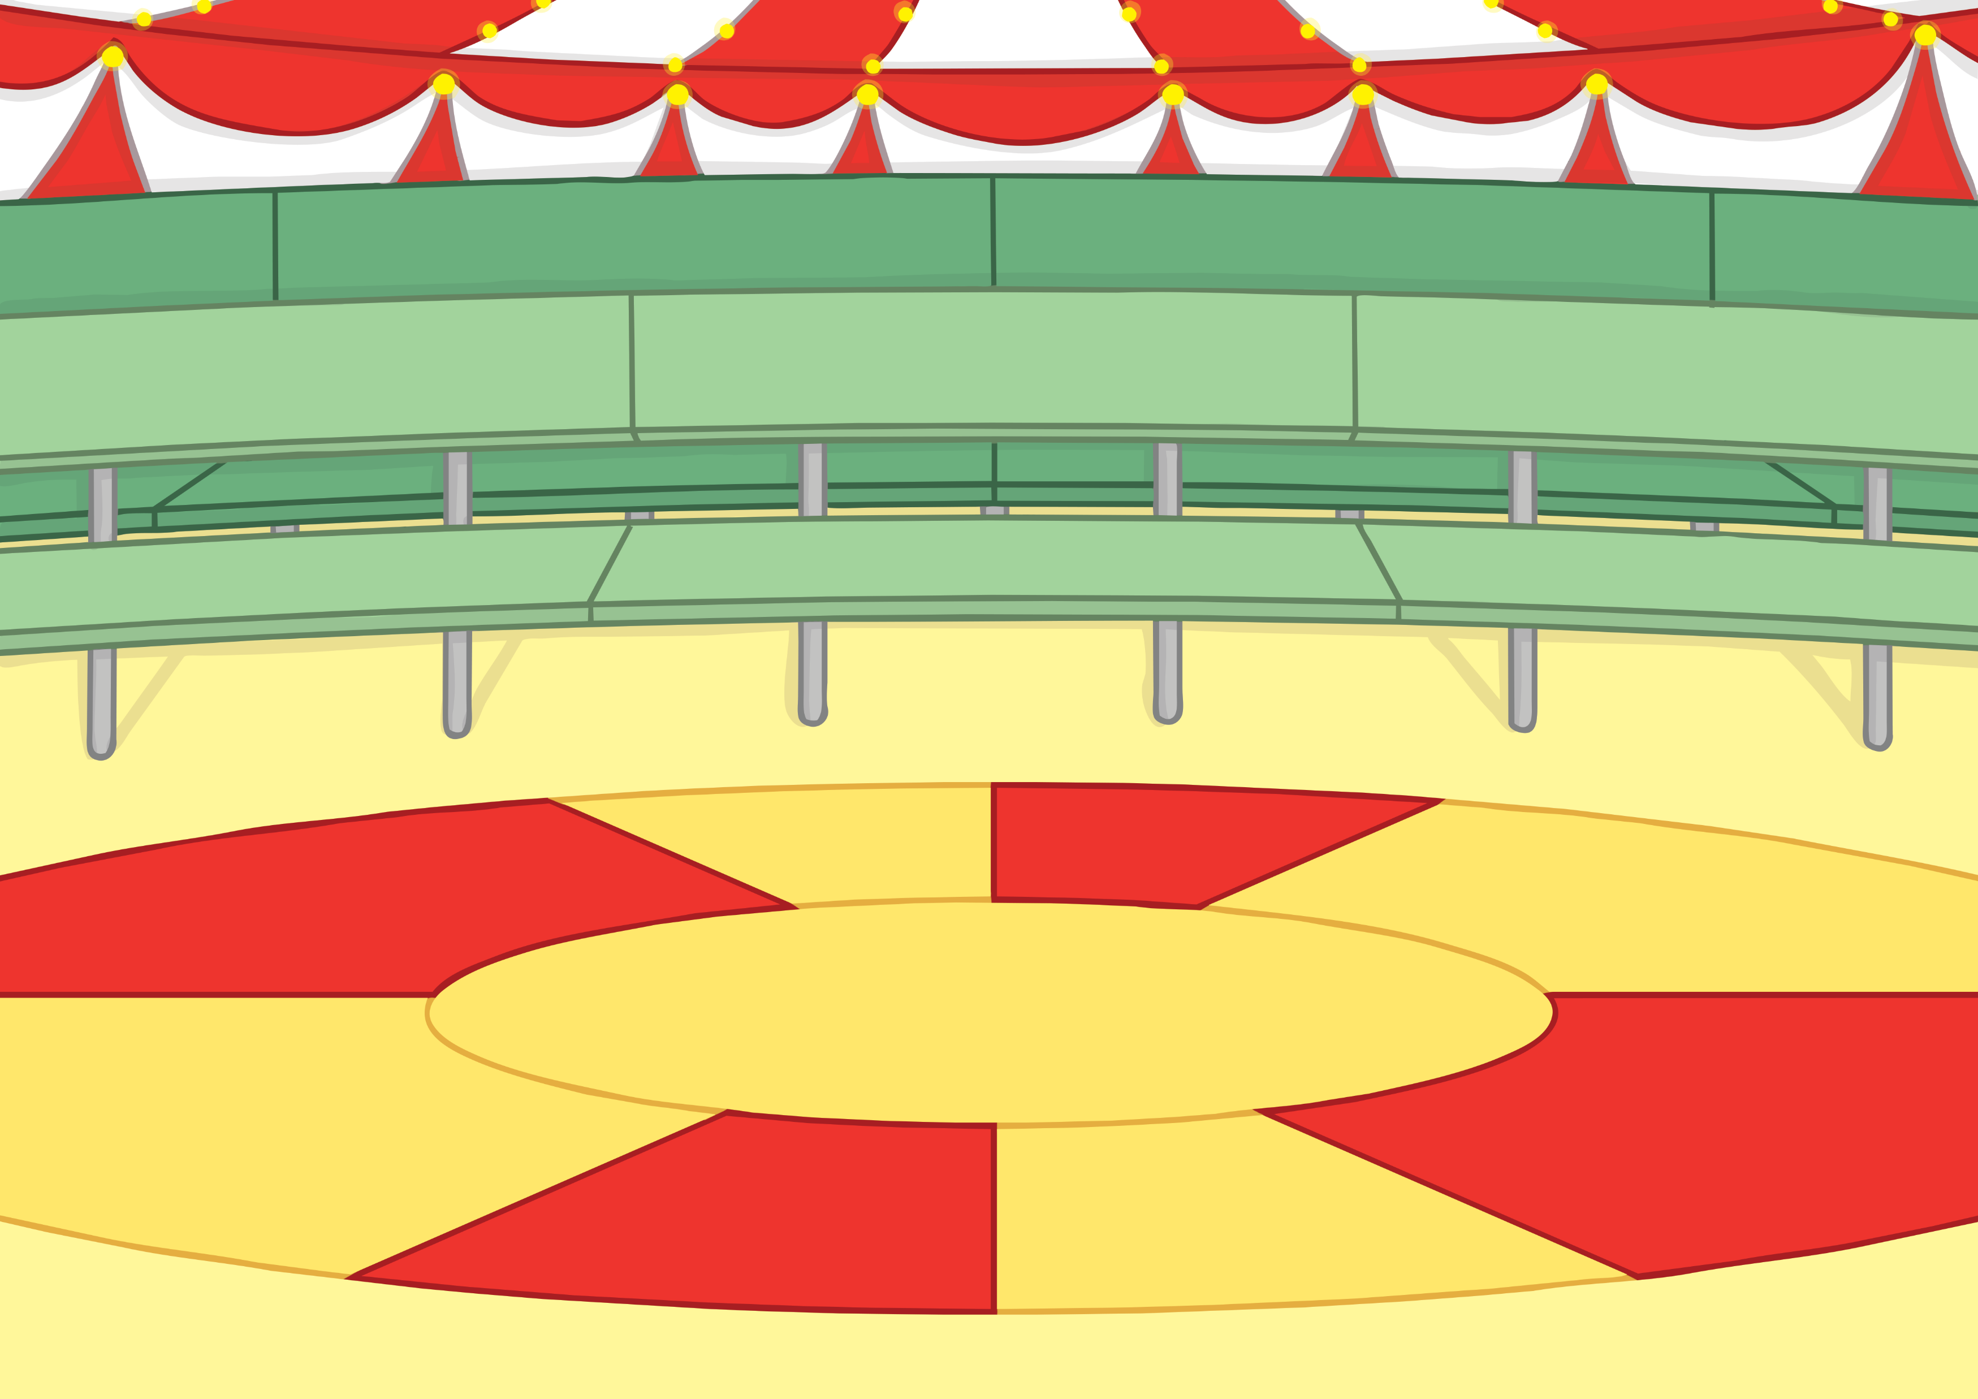
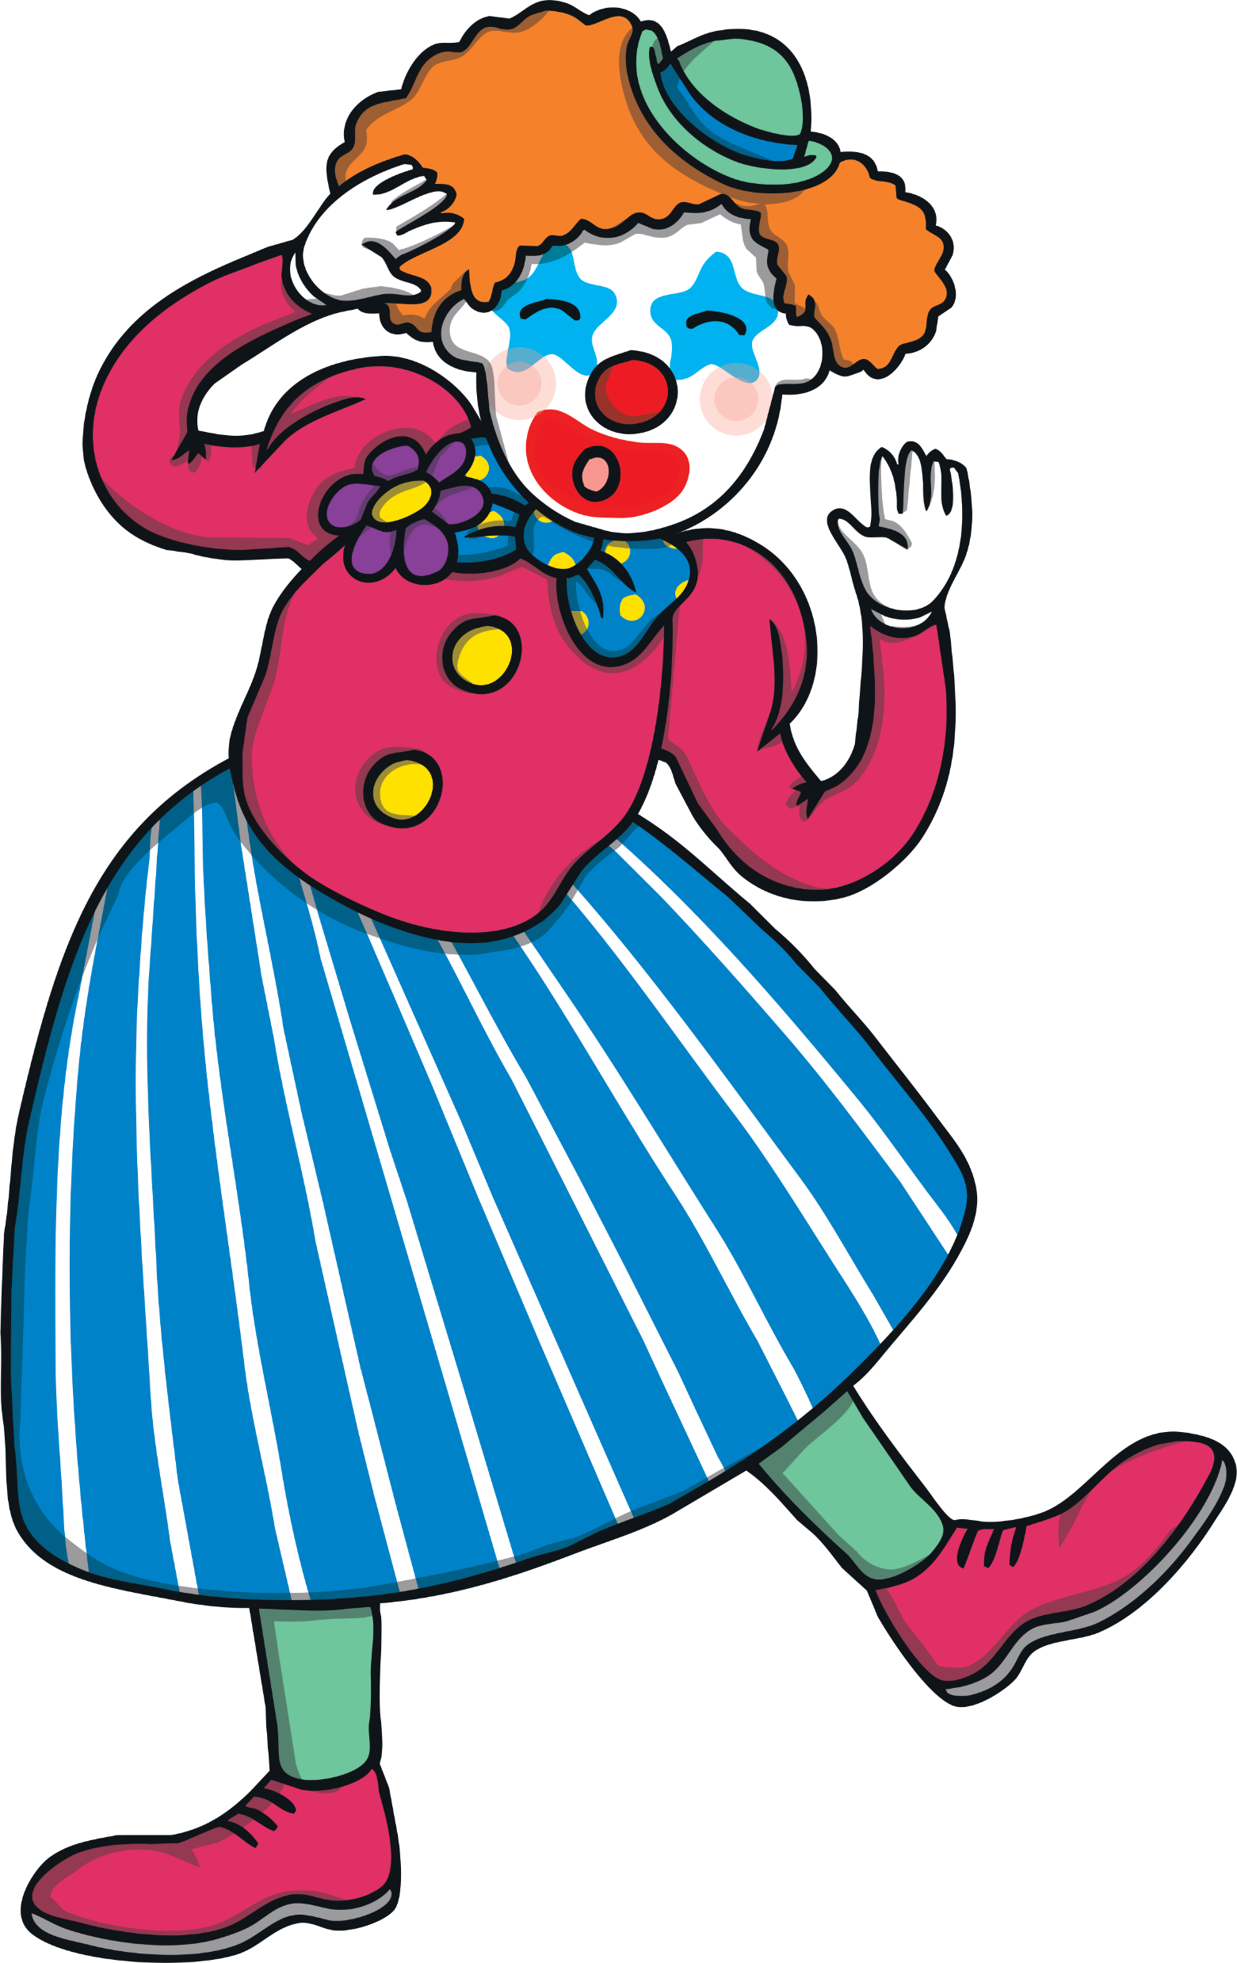
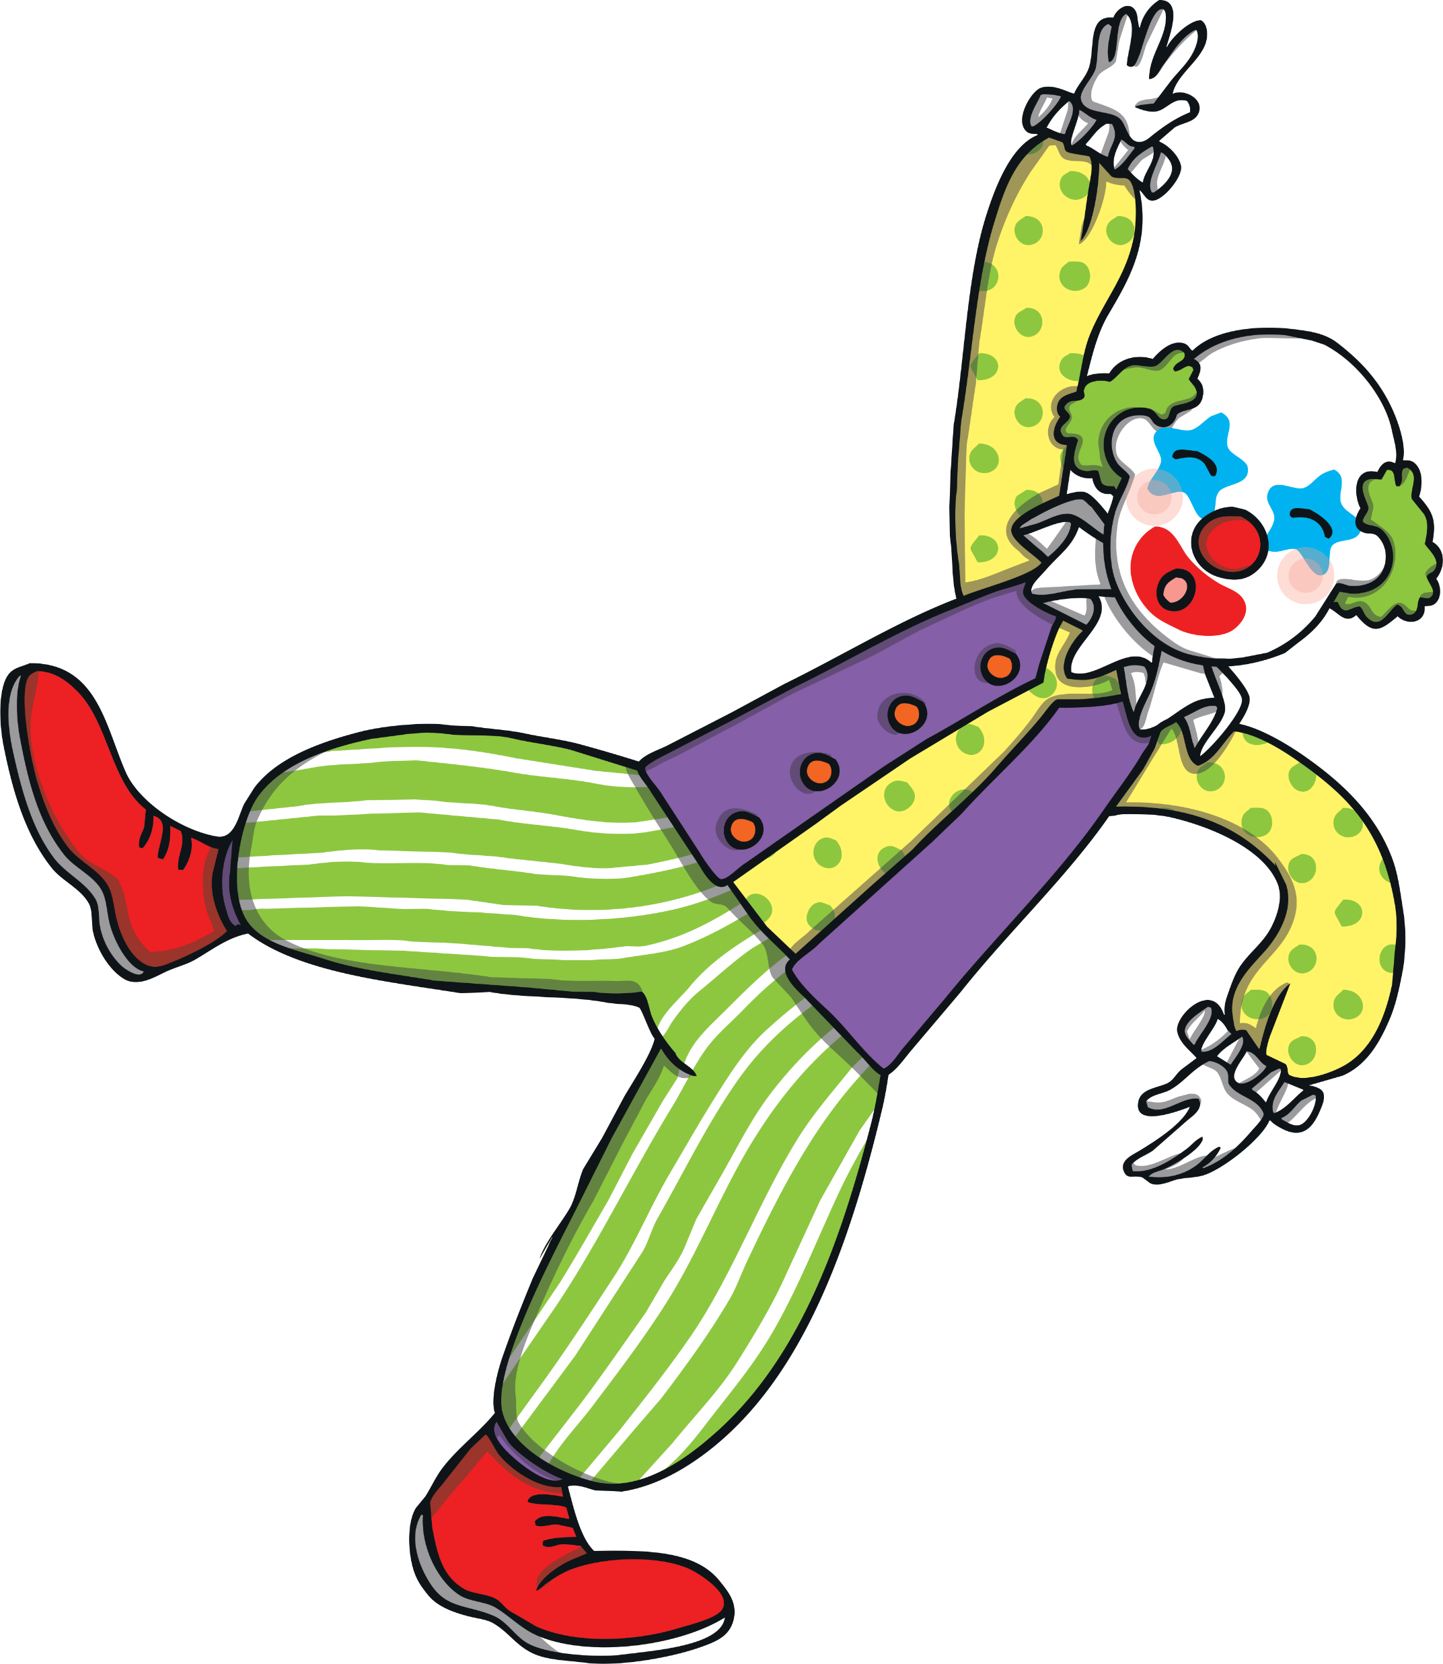
Teach
The clowns were very funny. They kept falling over and bumping into each other! Kit and Sam laughed and laughed.

Slide 7
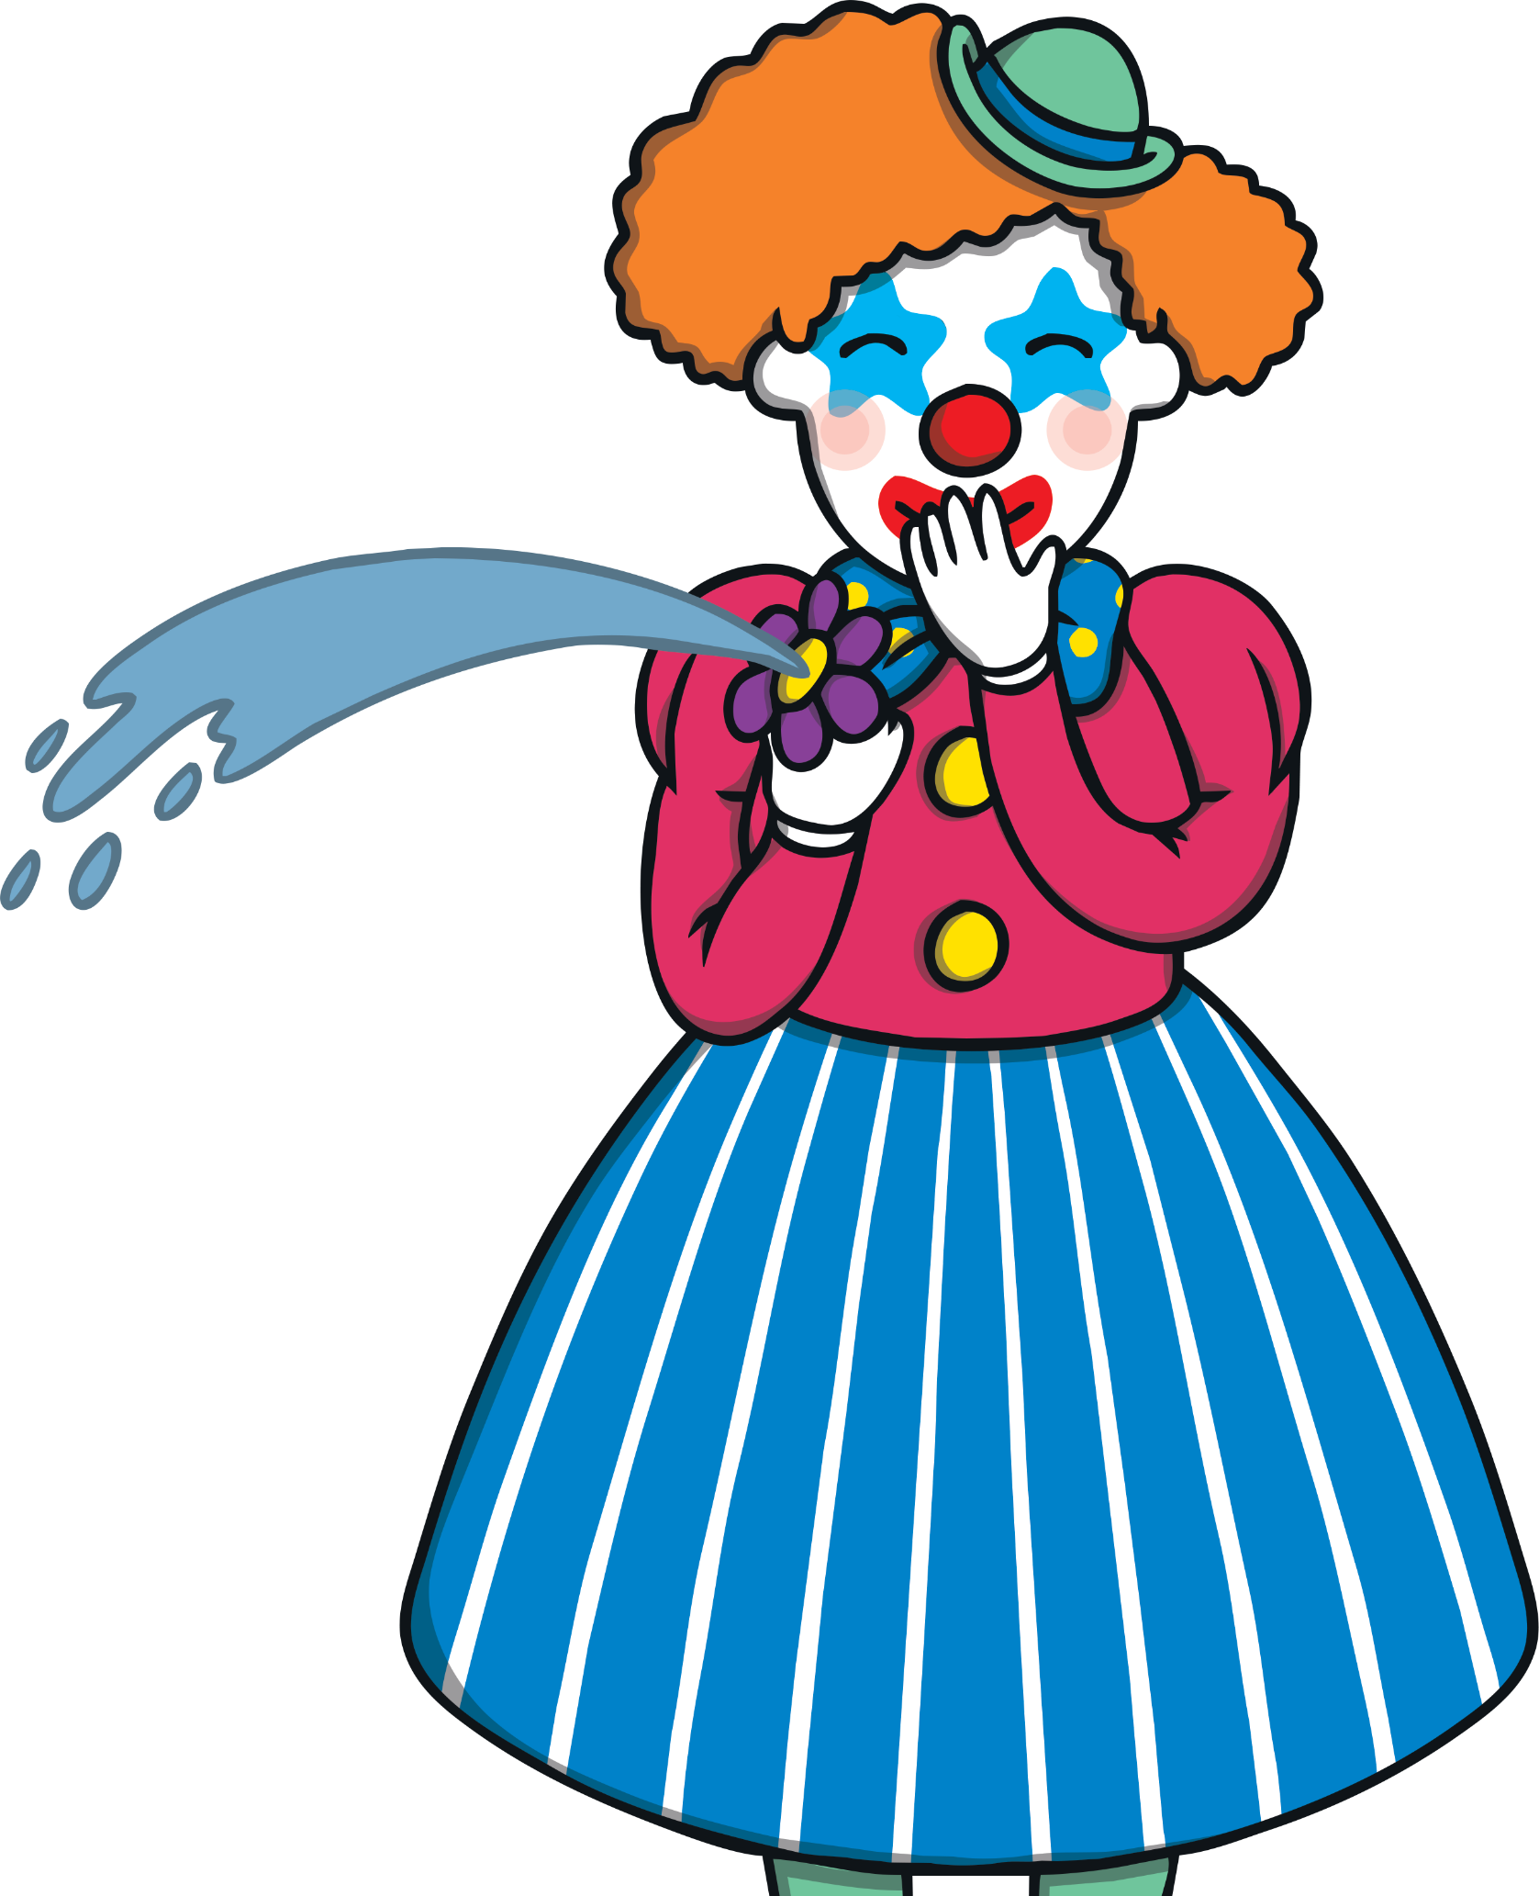
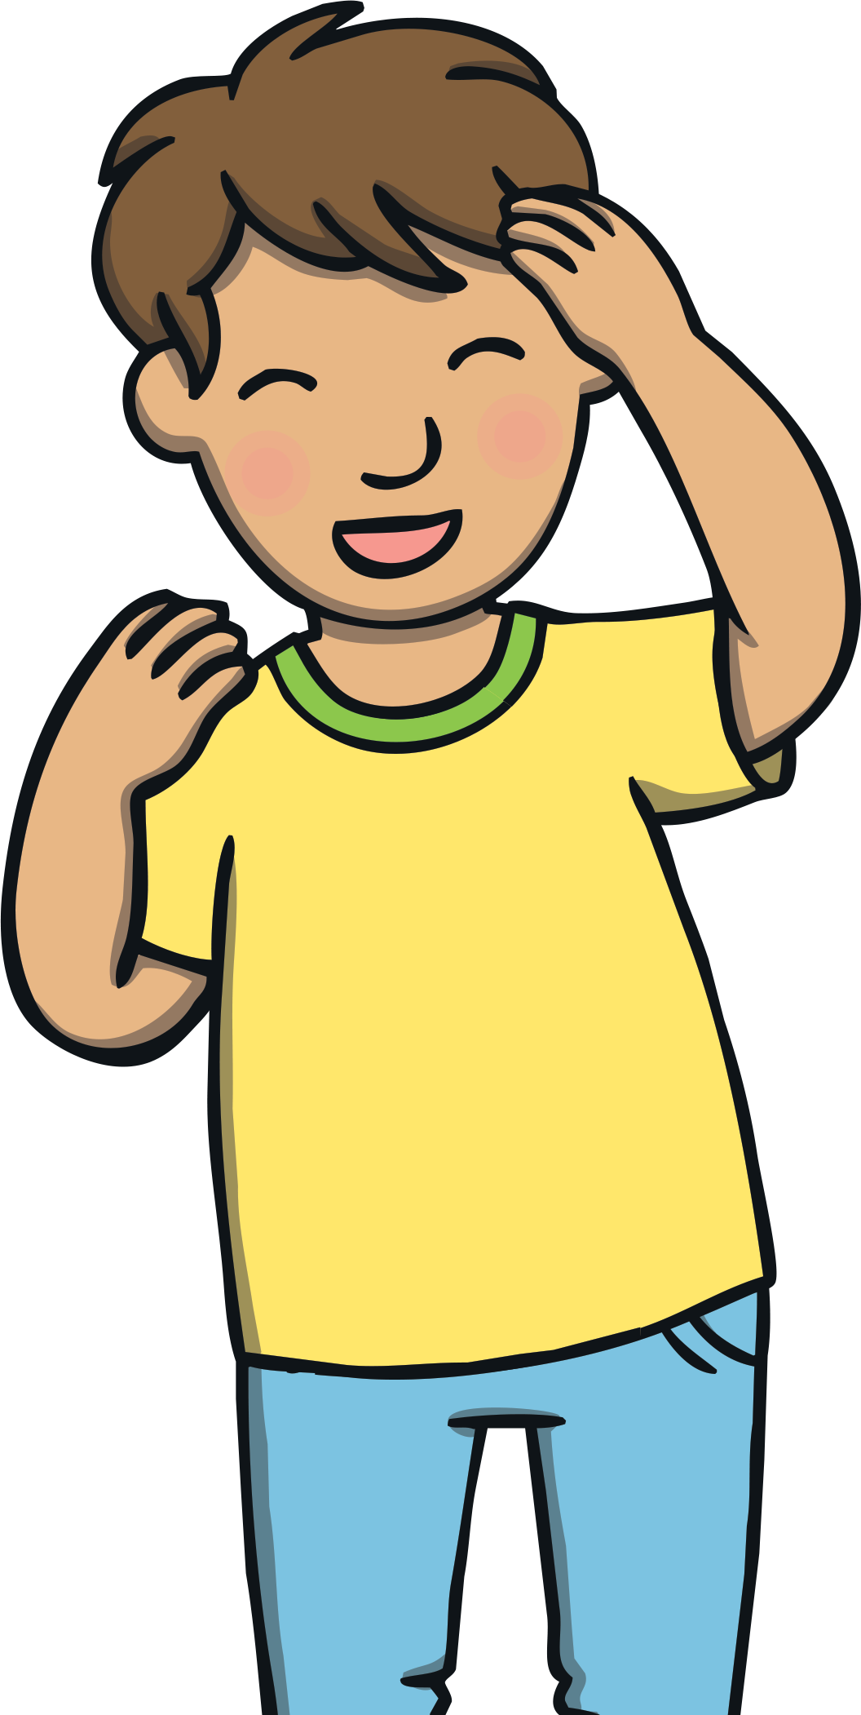
Teach
One of the clowns had a flower on his coat and when she squeezed it, water squirted out - all over Kit! Sam began to howl with laughter! Kit started to giggle too.

Slide 8
o
w
Teach
o and w are partners. They say ow.

Slide 9
Teach
Teach
ow

Slide 10
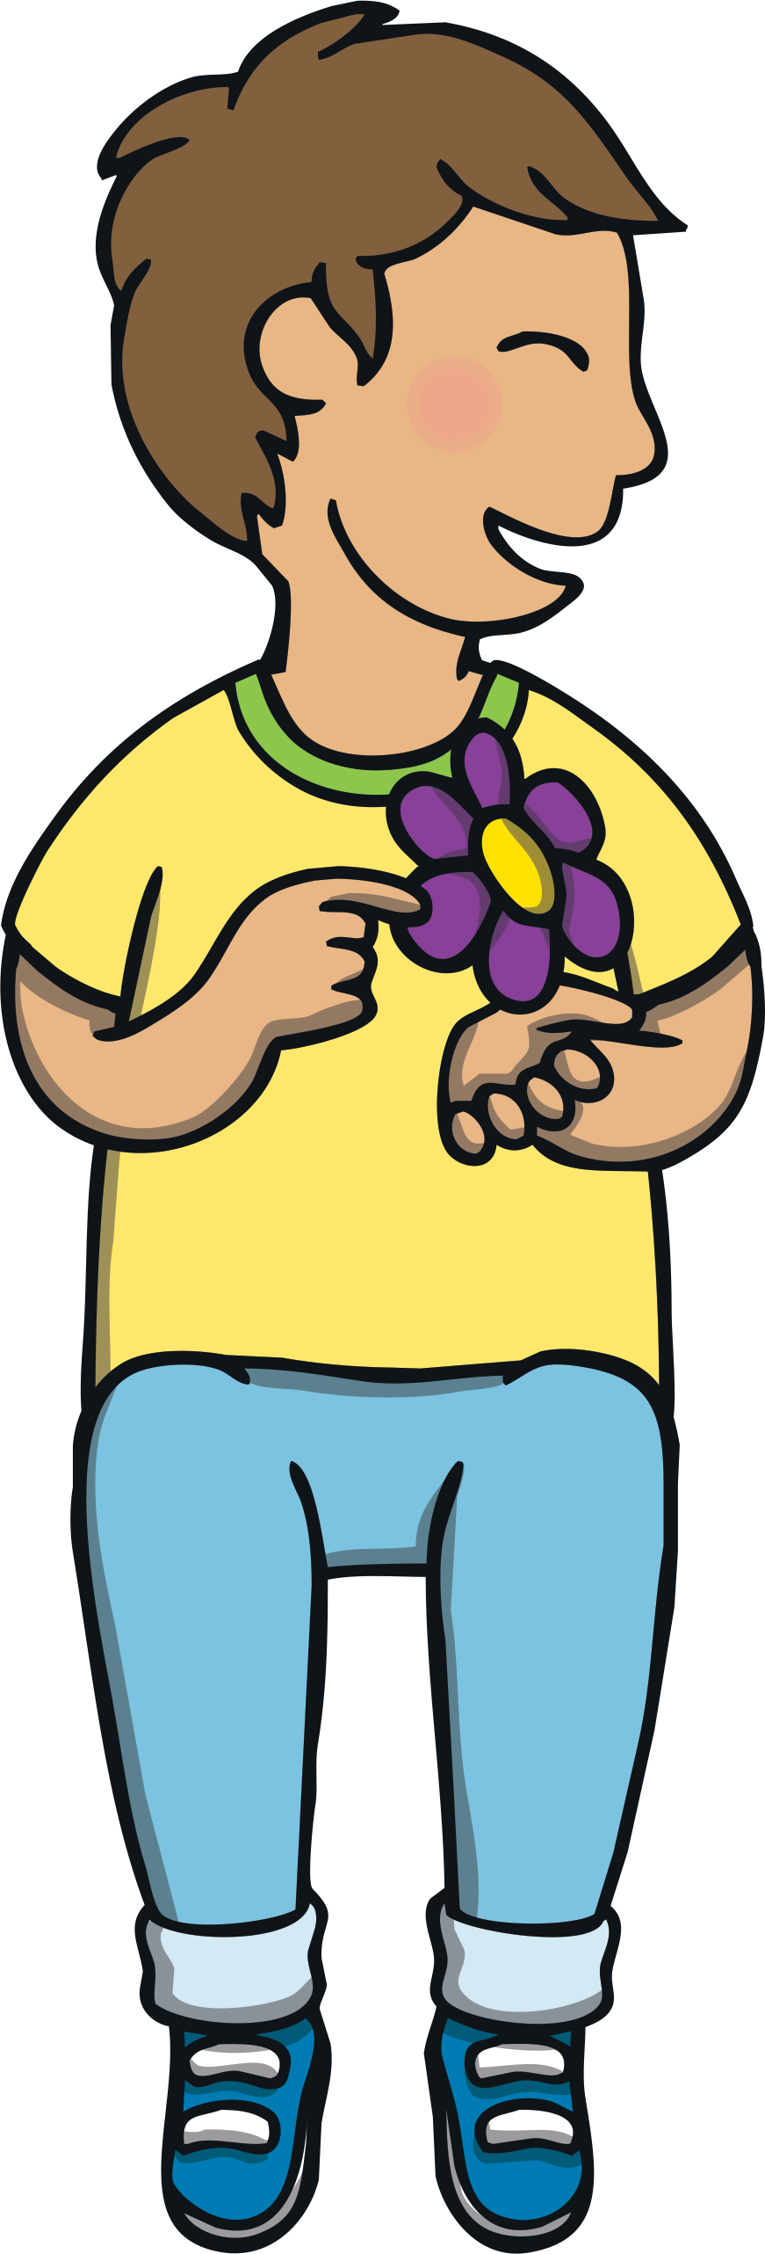
Teach
Teach
Action
Pretend to squeeze the squirty flower on your coat.
Say ‘ow, ow, ow’.

Slide 11
Teach
Teach
Write the Letters
ow
Around the orange.
Down the wave, up the wave,down the wave, up the wave.
Play

Slide 12
Let’s Sing!
Teach
(To the tune of ‘The Drunken Sailor’)
Look out, the clown has a squirty flower!
Look out, the clown has a squirty flower!
Look out, the clown has a squirty flower,
ow - ow - ow - we’re all wet!
Play Song

Slide 13
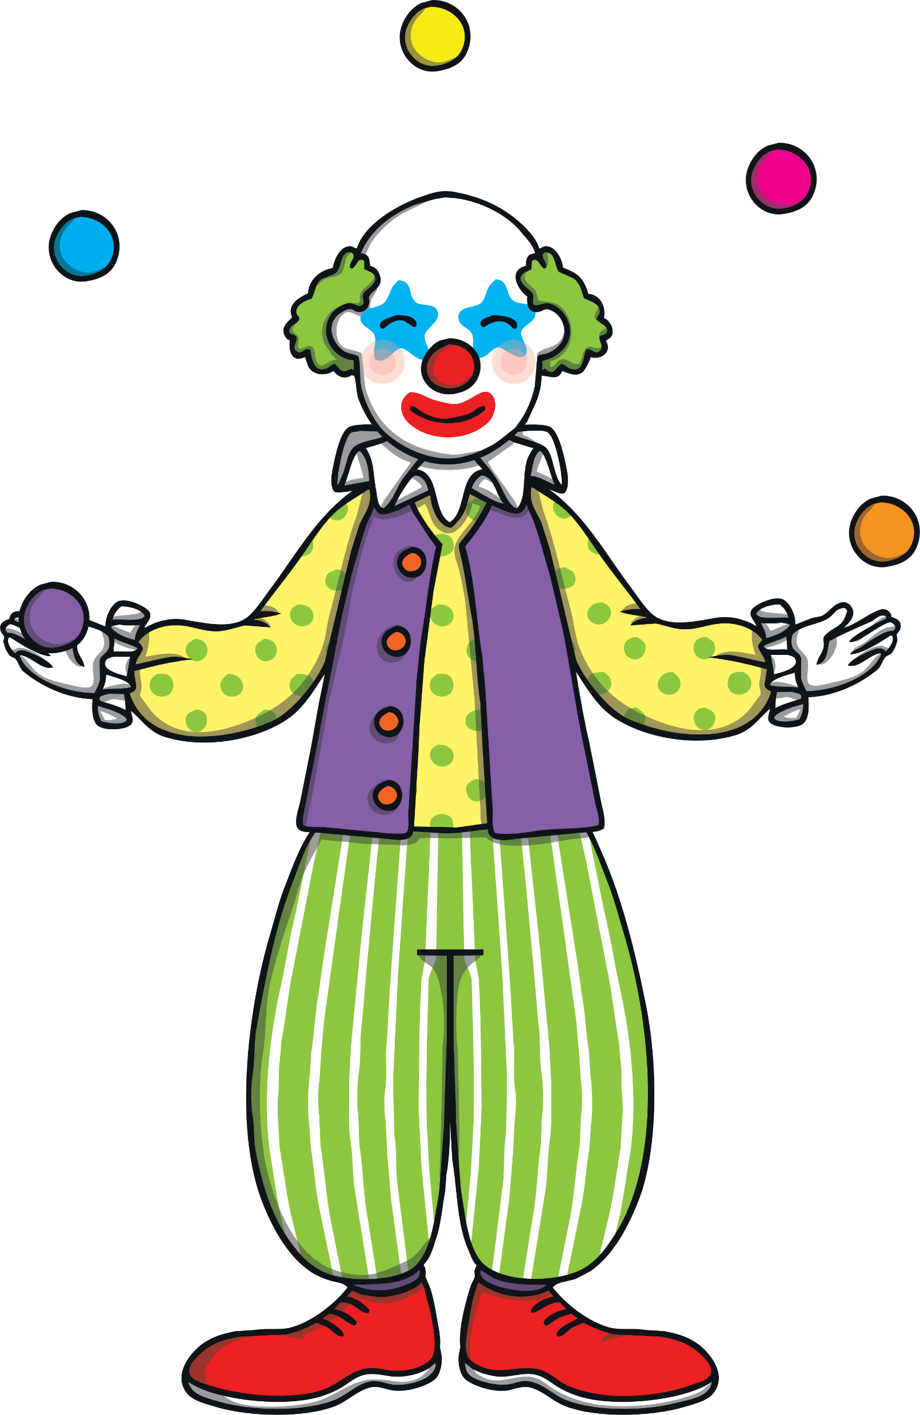
Juggling Clown
Practise
The clown is juggling and the balls are making a word! Can you help Kit and Sam to read the word?

Slide 14
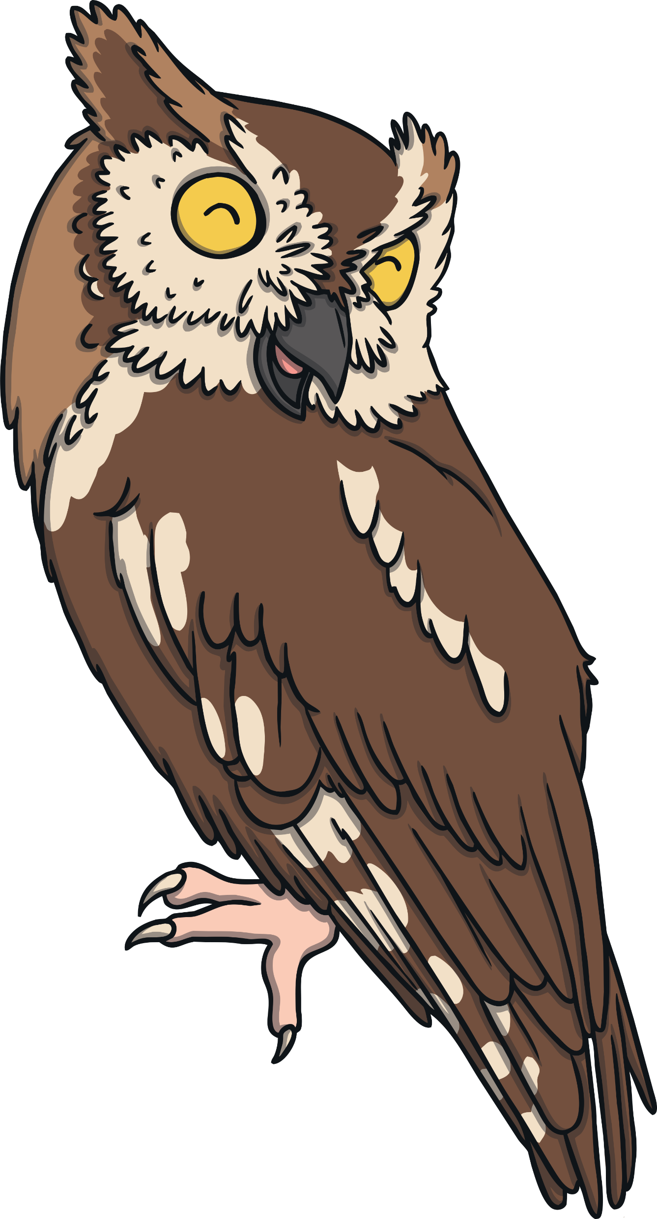
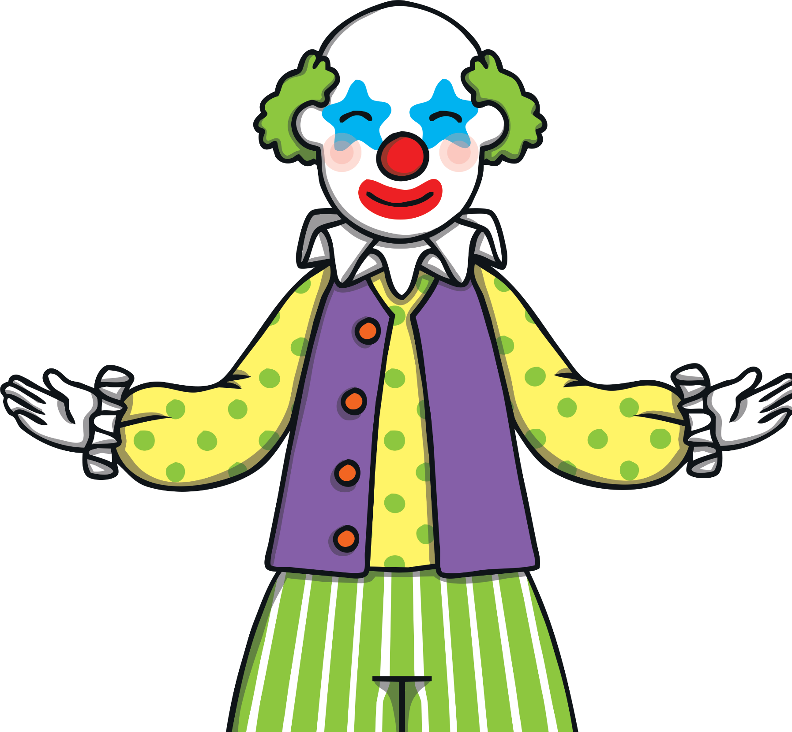
Practise
o
w
l
Check

Slide 15
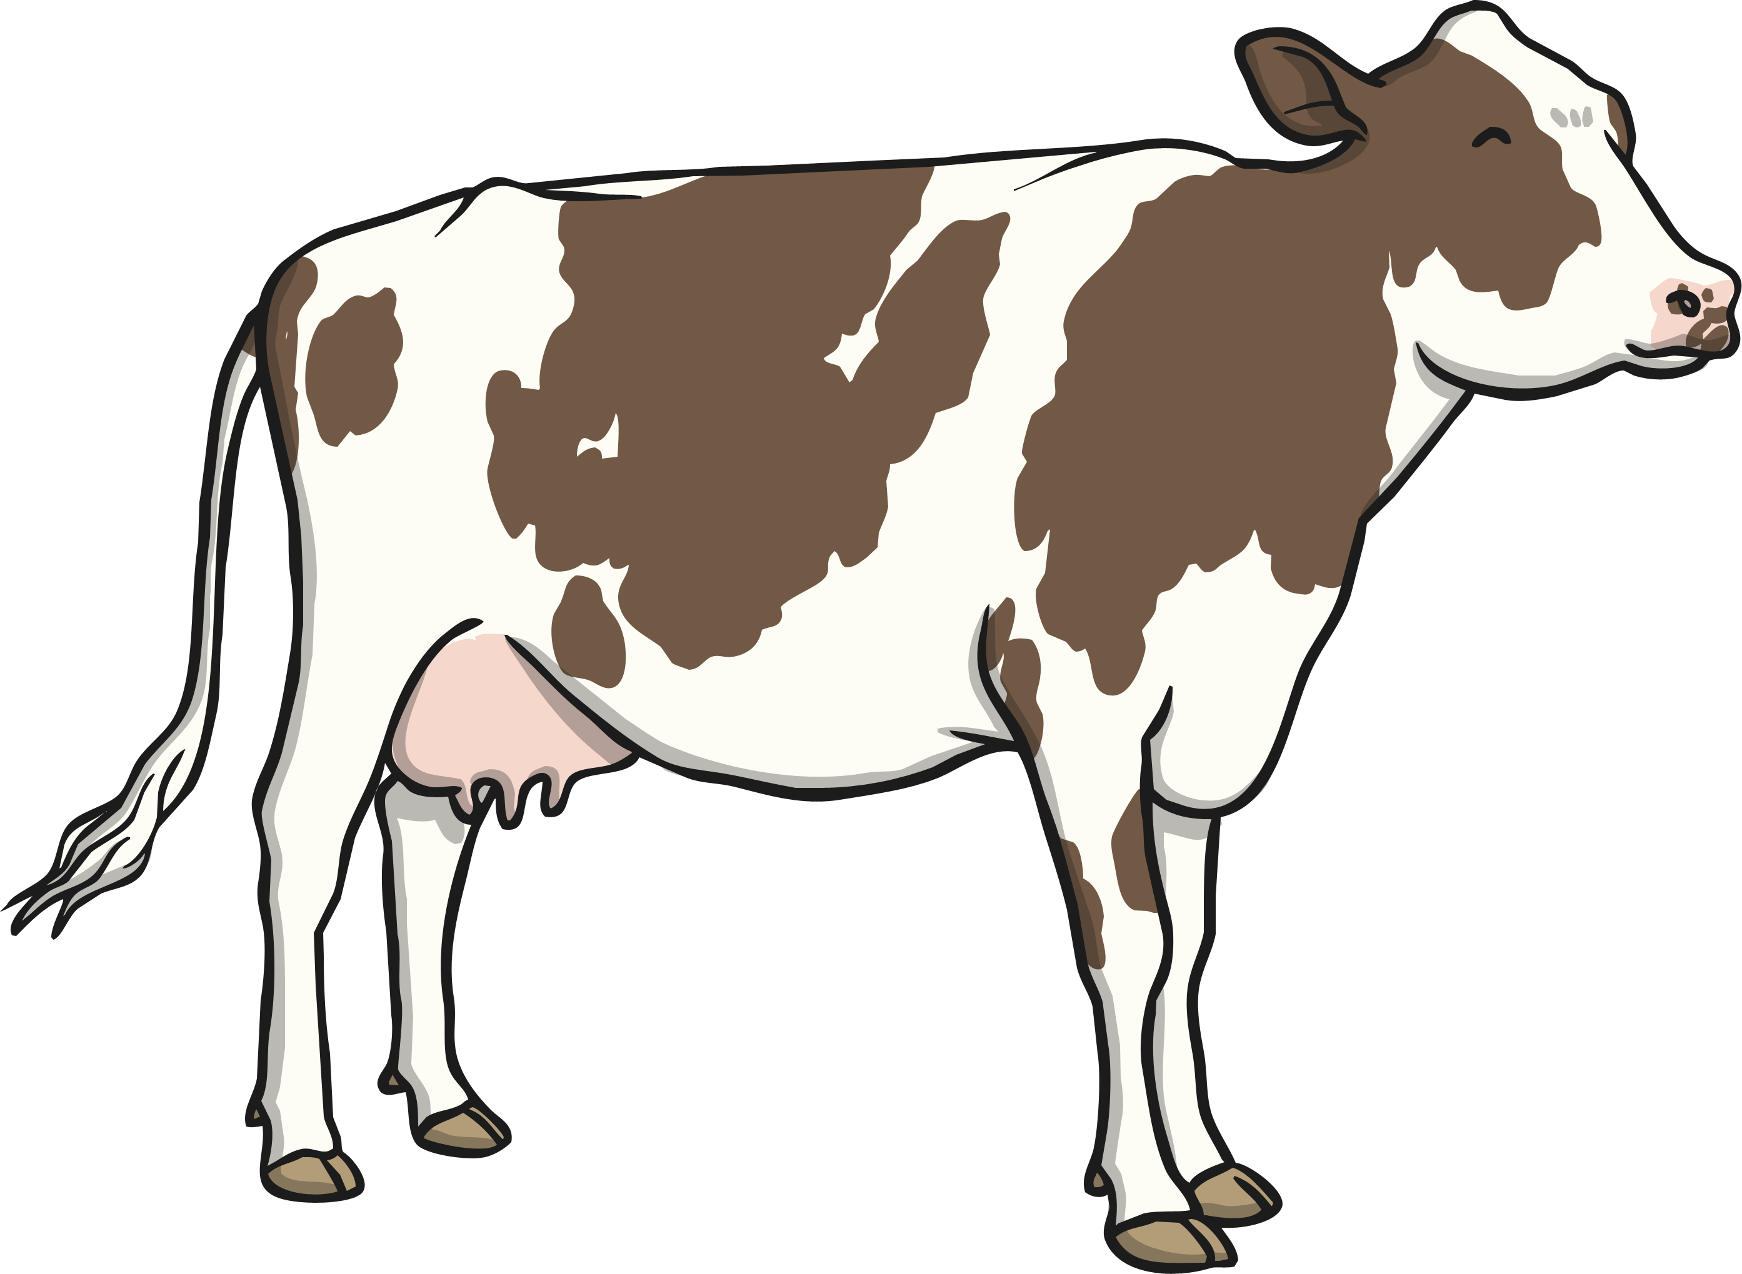
Practise
c
o
w
Check

Slide 16
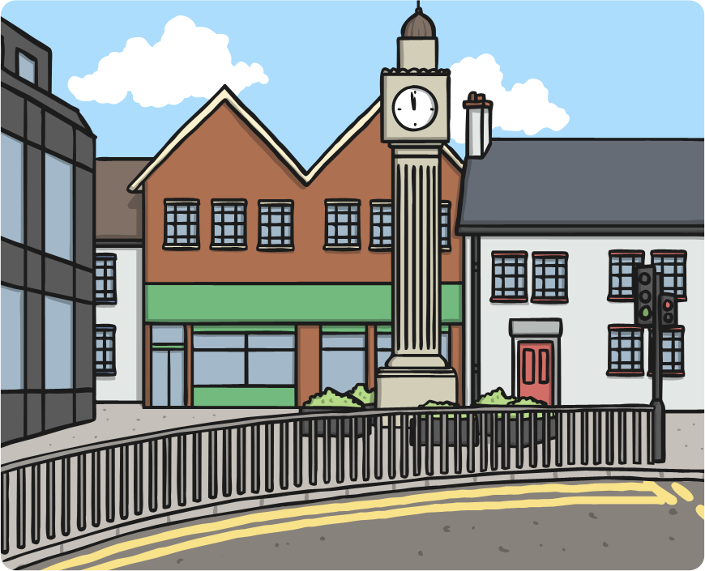
Practise
t
o
w
n
Check

Slide 17
Practise
p
o
w
Check

Slide 18
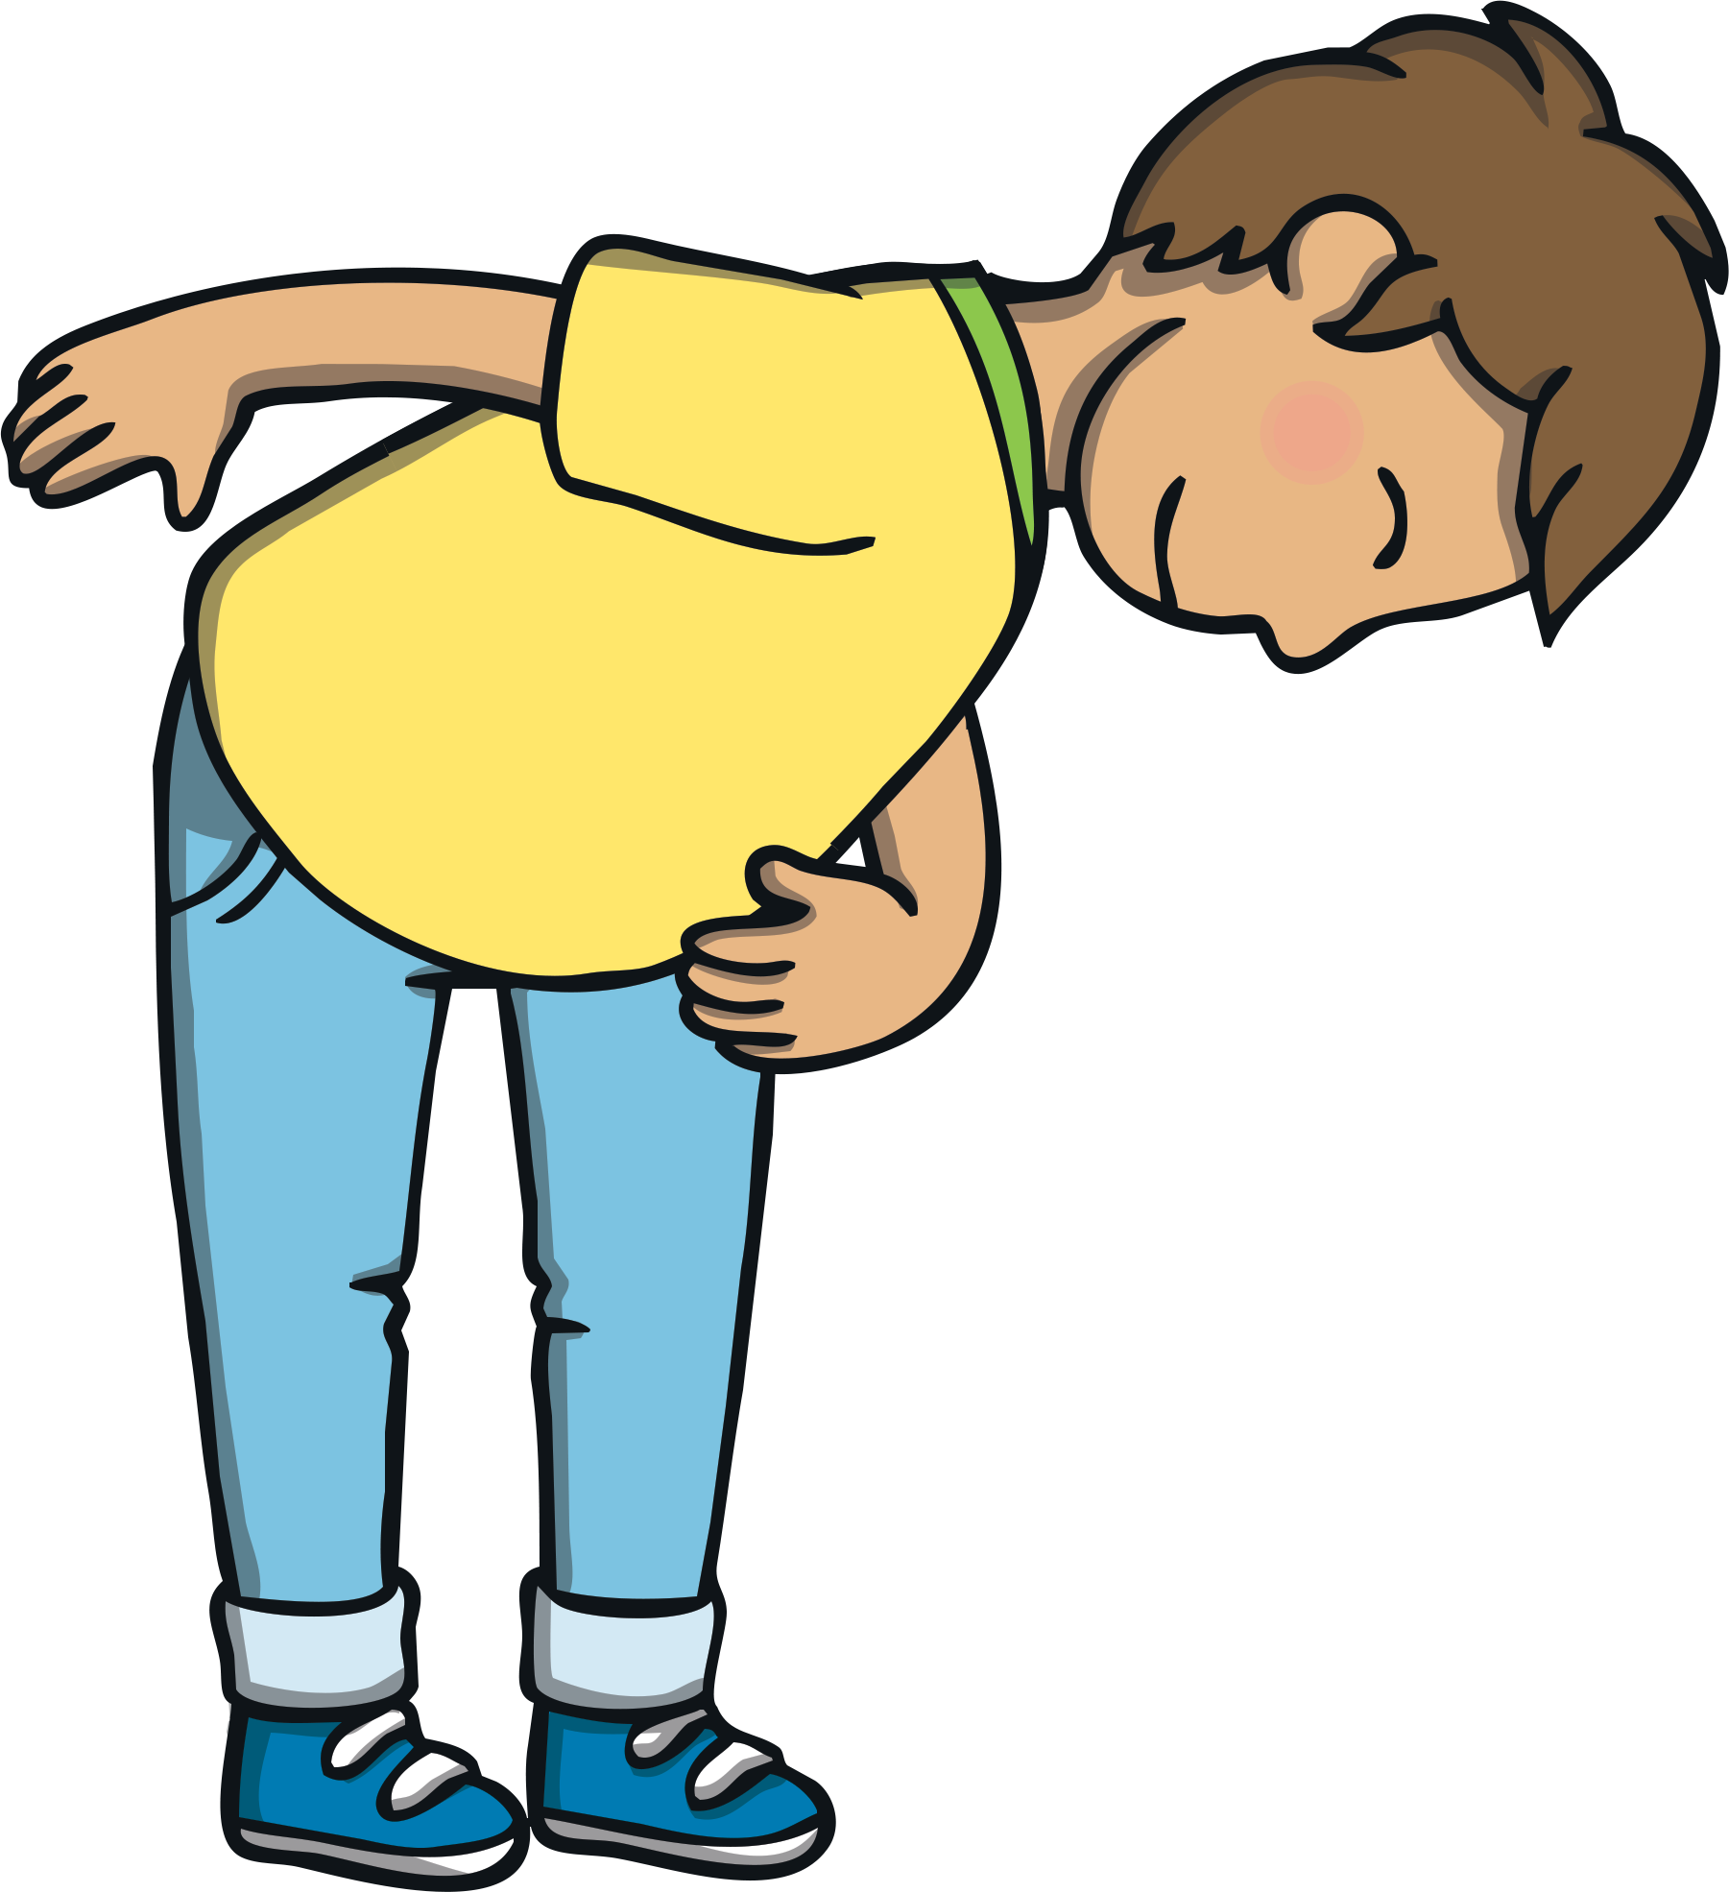
Practise
b
o
w
Check

Slide 19
Practise
d
o
w
n
Check

Slide 20
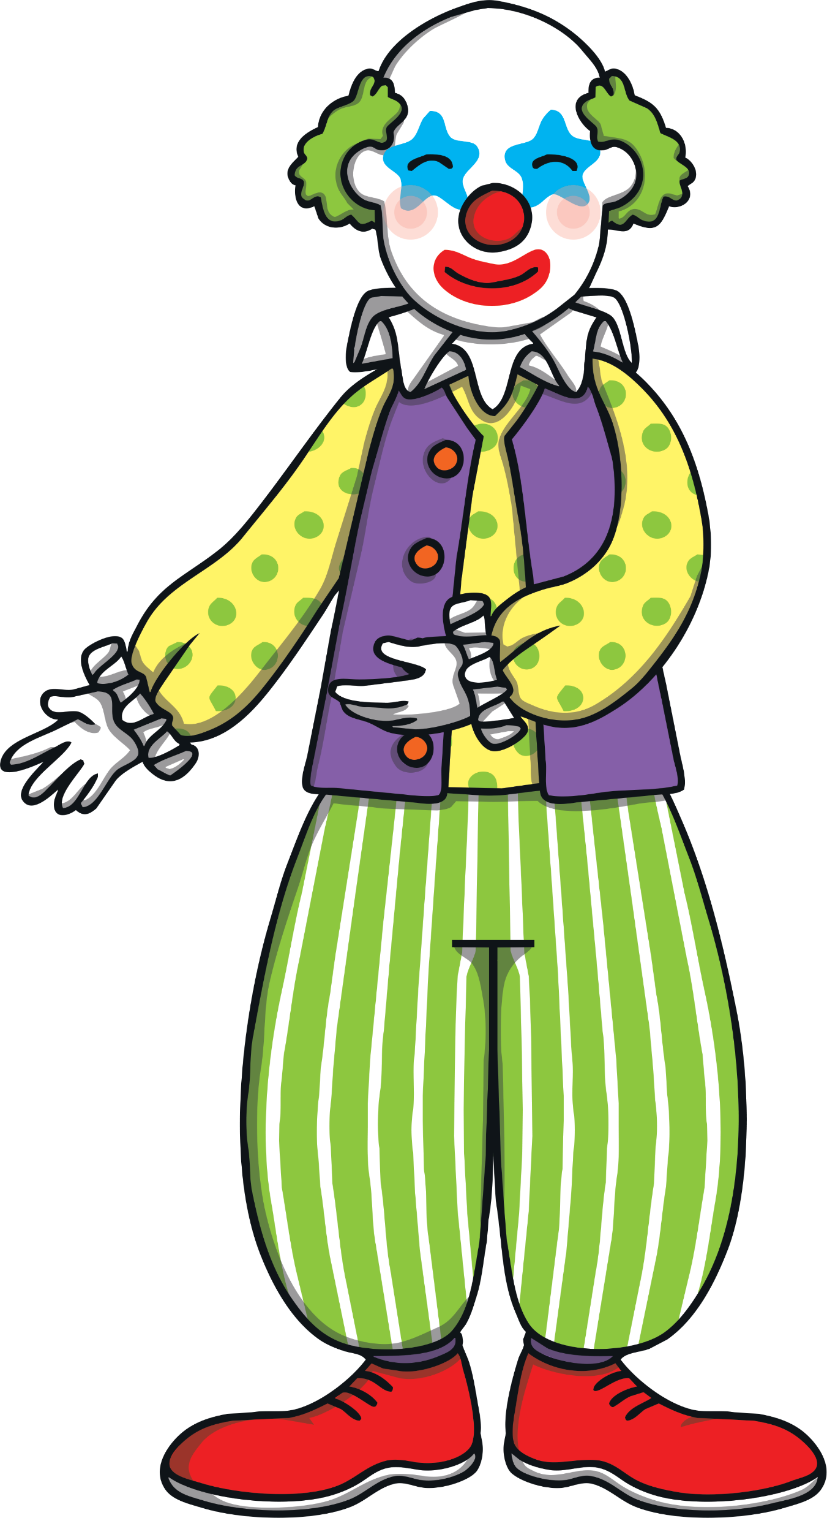
Apply
Near the end of the performance, the clowns came and asked Kit if he would like to come on the stage in front of the crowd with them. “I’d love to!” replied Kit.

Slide 21
Apply
Sentence Time
What happened when the clowns took Kit on stage? Read the sentence to find out!
X
Click ‘Sound Buttons On/Off’ to select whether you want to show sound buttons under the caption.
Click me for Kit’s teaching tips!

Slide 22
Apply
He took a big bow.
Sound Buttons On/Off
Show

Slide 23
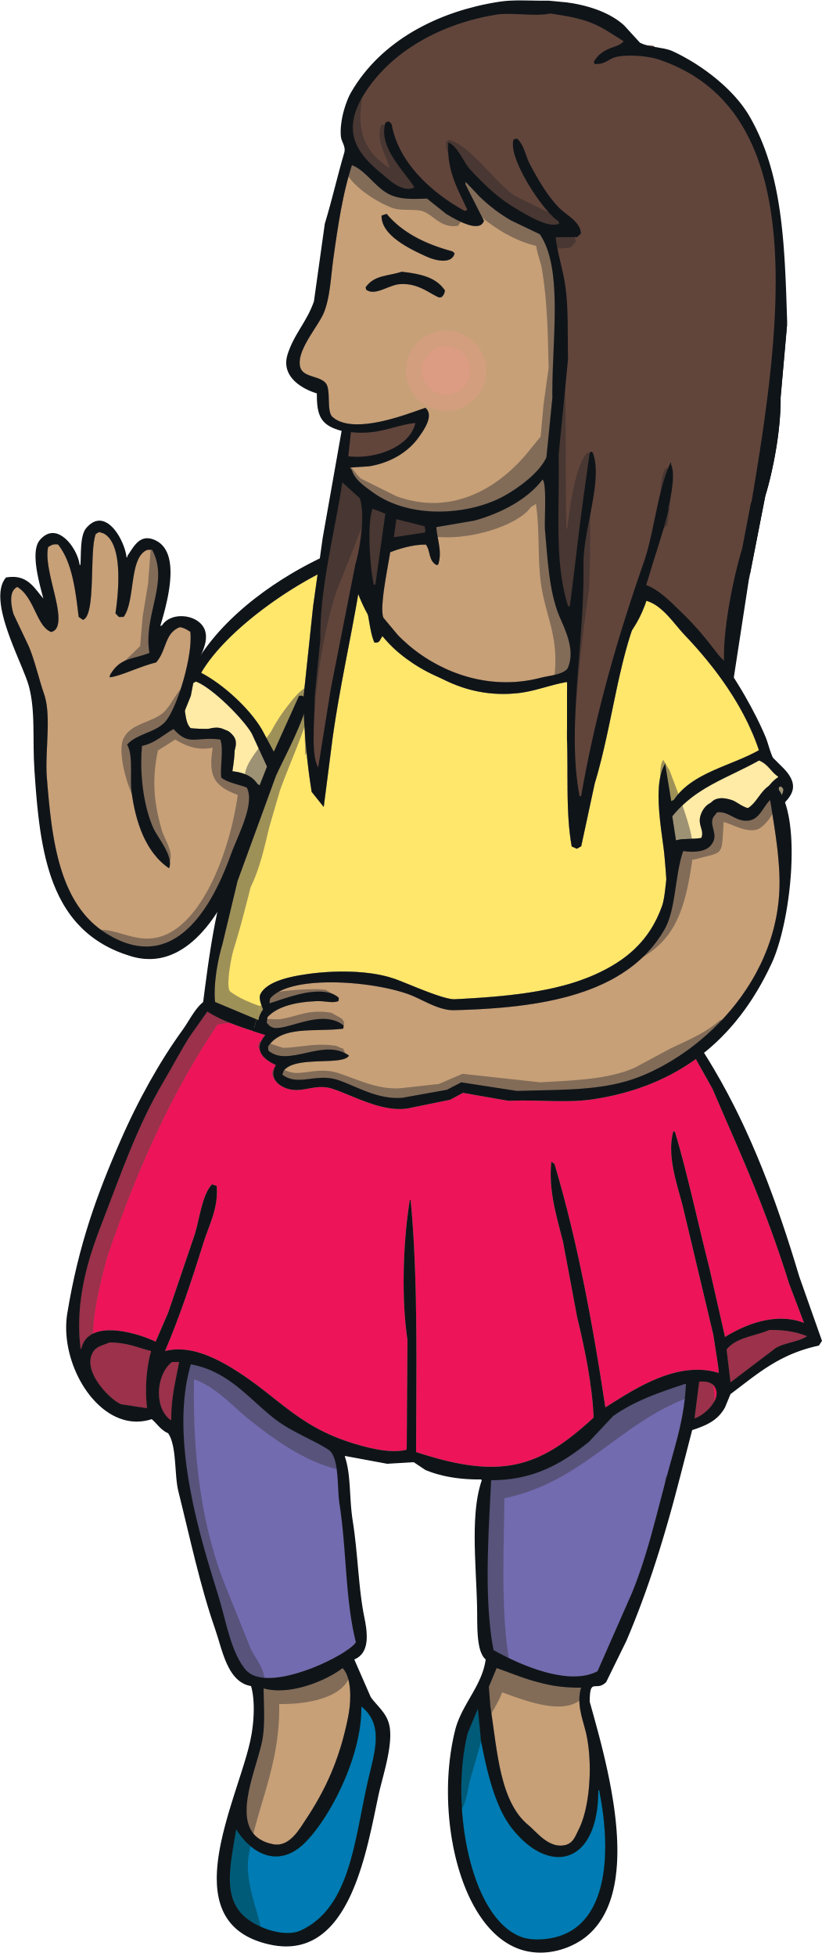
Apply
As the clowns and Kit took their bow, the crowd clapped and cheered. “You were fantastic, Kit!” said Sam when he got back to his seat.
“The clowns gave me a flower to say thank you,” said Kit. “Would you like to smell it now?”
“No, thanks!” said Sam.

Slide 24
Today, we have learnt...
ow

