Slide 1
Year 2
Goldilocks and the Three Bears

Slide 2
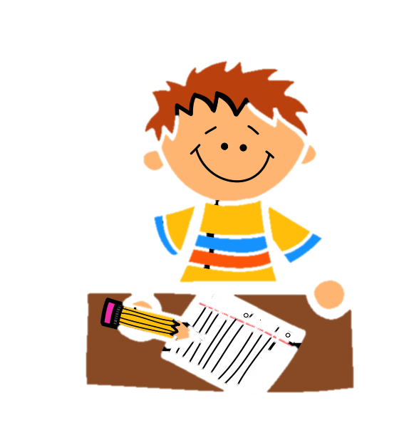
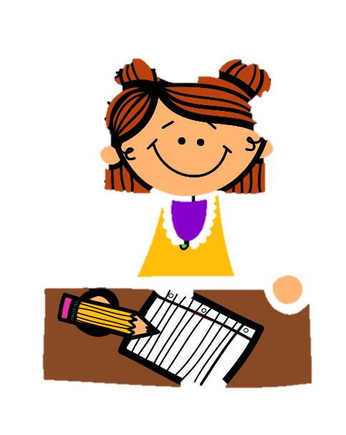
End Result
Silver and Gold: Write a letter from Goldilocks to apologise for the chaos she caused at the Three Bear’s home.
Bronze: Write a shorter letter from Goldilocks.
You will write your story in the first person as if you were Goldilocks. You will use I rather than he/she.

Slide 3
Sit back, relax and enjoy…
You probably already know the story of Goldilocks and the Three Bears very well.
Watch the video for a little reminder:
https://www.youtube.com/watch?v=d1W0aOwYJ9U
You may want to watch the clip more than once to ensure you haven’t missed anything.

Slide 4
What did you think of the story?
Monday 8th February
What has happened?
Which characters have we met?
Where and when do you think the story has taken place?
In your own words, either tell somebody in your house what happened or write down a brief summary of the video.

Slide 5
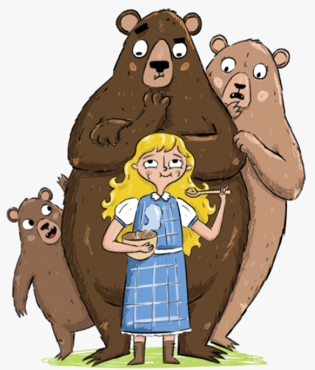
Time for your first task!
Monday 8th February
Your first task is a drama task. Choose six key moments from the story and create six freeze frames to represent them. Ask an adult to take a photo of each one. You may use props and other people in your house as part of your freeze frames. If your mummy and daddy are busy, then draw out the six moments and colour them in.
A freeze-frame is a drama technique that freezes the action of the story into a picture (as if the pause button has been pushed!)

Slide 6
Tuesday 9th February
Last time, we learnt about apostrophes.
To shorten some words, we can replace letters with an apostrophe.
we are
I will
you had
could not
=
=
=
=
we’re
I’ll
you’d
couldn’t
Can you give anymore examples of words that contain apostrophes?

Slide 7
Task Two
Tuesday 9th February
Task One
Answer the questions. Don’t forget to write in full sentences.
Task Two
Write out the paragraph. Add in the missing punctuation.
Bronze: Add the full stops and capital letters to the sentences.
The task can be found on page 1 of the document.

Slide 8
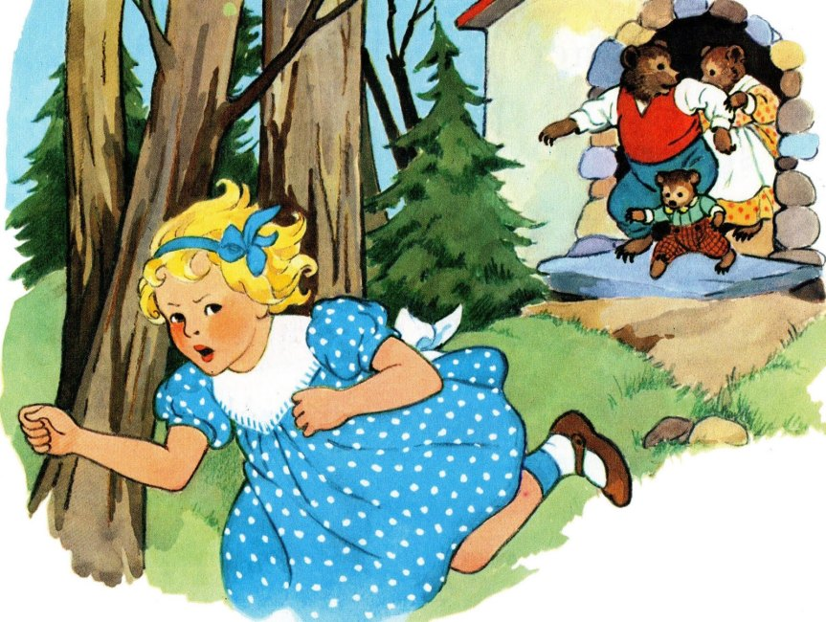
She decided to write a letter to the three bears in the hope that they would forgive her.
Wednesday 10th February
Imagine the little girl ran home to her mummy and daddy. After thinking about what she had done, she felt very guilty.

Slide 9
There are two things I’d like you to think about:
Wednesday 10th February
The Audience
Who are we writing this letter to?
The Purpose
Why are we writing this letter?

Slide 10
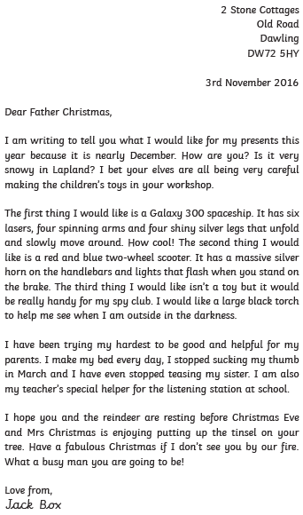
Before we can write a letter, we need to take a look at the features.
Wednesday 10th February

Slide 11
In the top, right-hand corner of the letter, you need to write your address. This is so the person you are writing to can write back.
Wednesday 10th February
Just below it, you need to write today’s date.

Slide 12
To start a letter, we need to use the word ‘dear’ followed by the name of the person you are writing to.
Wednesday 10th February
This is the introduction. In this paragraph, you need to explain why you are writing the letter.

Slide 13
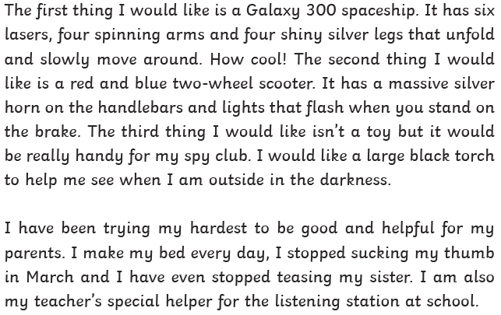
Then, it’s time to write the main body of your letter. Remember to include all the points you wanted to make.
Wednesday 10th February

Slide 14
Finally, you need to write a conclusion. This is where you sum up everything you have said and make your main point one more time.
Wednesday 10th February
Finish off your letter by signing your name. This is an informal letter so it can be signed with ‘from’ or ‘love from’.
Formal letters are signed off with Yours Faithfully or Yours Sincerely. You may have seen these before!

Slide 15
Task Three Now it’s time to spot the features yourself. Read through the example letter. Label the features of a letter that we have discussed.
Wednesday 10th February
Please use page 2 of the document.

Slide 16
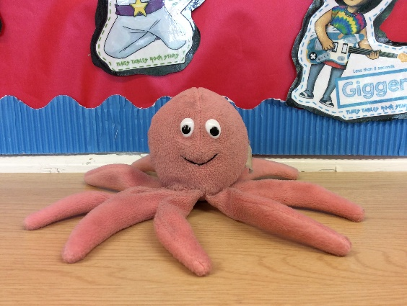
Task Four In the night, Stewart cut up one of the school letters! For your next task, I’d like you to order the various parts of the letter.
Thursday 11th February
Please use page 3 of the document.

Slide 17
Introduction This is the first chunk of writing (the first paragraph). You need to explain why you are writing the letter.
Friday 12th February
Let’s remind ourselves about two key parts of a letter.
Conclusion This is the last chunk of writing (the first paragraph). You need to sum up everything you have said.

Slide 18
Task Five Complete both of the cloze activities to help you practise writing introductions and conclusions. Bronze – Unjumble the sentences.
Friday 12th February
Please use page 4 of the document.

Slide 19
We are going to collect some super vocabulary
Monday 22nd February
Below are some examples of vocabulary that may be useful for our letter. Can you think of any more?
regret
from
apologise
dear
forgive
Adjective | An adjective is a describing word. It describes a noun.
Noun | A noun is a naming word. It can name a person, place or thing.
Verb | Verbs are action words. They show what someone is doing.
Adverbs | An adverb is a word that describes a verb

Slide 20
Task Six Look at my example letter. 1. Write a list of powerful words from the letter that you could use in your letter. 2. Underline any words that you think could be improved and suggest a better one. There are some extra words you may want to use on page 6.
Monday 22nd February
Please use page 5 and 6 of the document.

Slide 21
It’s time to plan your story!
Tuesday 23rd February
Complete the planning sheet for your apology letter to the three bears.
If you are completing Bronze, rather than writing your planning down, discuss the things that Goldilocks did wrong.
Please use page 7 of the document.

Slide 22
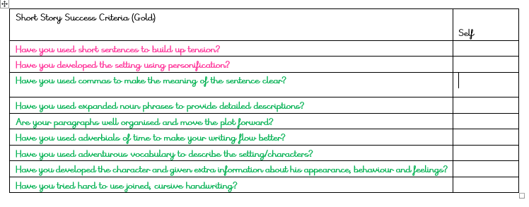
Success Criteria
Wednesday 24th February
Thursday 25th February
Read the different success criteria. Decide whether Bronze, Silver or Gold is most suitable for you.
Bronze – Write a shorter letter based on the Bronze example on page 10.
Check page 8 for differentiated success criteria.

Slide 23
Now it’s time to write…
Wednesday 24th February
Thursday 25th February
Use your planning sheet to write your letter.
Normally in class, we’d come up with a sentence tracker together to give us some ideas. Today, I have done one for you to follow. It can be found on page 9. There is a Bronze example on page 10.
Use the success criteria to guide your writing.
Remember, the purpose of the letter is to apologise. Make sure your points are clear.
Take a look at the example on page 5 to give you some ideas.

Slide 24
Is your letter complete?
Friday 26th February
Once you have finished your writing, check through carefully. Have you achieved all of your success criteria?
Leave a self-assessment at the bottom of your work.
Your final task is to read out your writing to somebody you know. Practise a few times first to make sure you are reading fluently.
You may also want to write it up neatly and put it on your wall!
Ask a grown up in your house to send your writing to the home learning email and I will reply back.
Well done!

