Slide 1
The following words are your spellings for this week:
pie | tie
lie | tries
cries
Week 1 – ‘ie’ sound

Slide 2
Review
Last week, you did a great job learning the following words:
proud | sound
about | cloud
our
For your review, write or tell an adult 3 sentences including some of the words above.
Monday 8th February
‘ie’ sound

Slide 3
Teach
The i and e can be put together to make the ‘ie’ sound. The ‘ie’ sound mostly comes at the end of words.
pie
tries
tie
lie
cries
Read the words aloud. Then, write them out in your neatest cursive handwriting.
Tuesday 9th February
‘ie’ sound

Slide 4
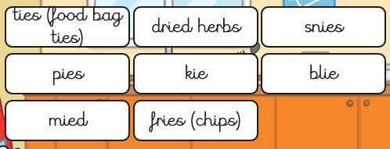
Practise
The children need to tidy the table. Sort the words into real words and nonsense words.
Wednesday 10th February
‘ie’ sound

Slide 5
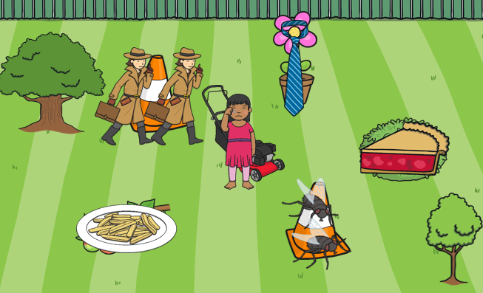
Apply
On the left is a picture that contains a variety of items. Find words that have the ‘ie’ sound in and write a sentence about them.
Thursday 11th February
‘ie’ sound

Slide 6
Activities
It’s Friday!
Well done for working hard this week. Complete one, two or all of the following tasks:
Practise the spelling rule on Spelling Frame.
If an adult has time, read a book to them.
Read a book to yourself. Keep an eye out for our sound!
Friday 12th February
‘ie’ sound

Slide 7
The following words are your spellings for this week:
least | treat
meat | read
sea
Week 2 – ‘ea’ sound

Slide 8
Review
Below are last week’s spelling words but some of the letters are missing! Write out the words in your neatest cursive handwriting with the missing letters.
pi__ | __ie
l__e | trie__
c__ies
Monday 22nd February
‘ea’ sound

Slide 9
Teach
The e and a can be put together to make the ‘ea’ sound. The ‘ea’ sound mostly comes in the middle of words.
least
sea
treat
meat
This ‘ea’ is a rare one at the end!
read
Read the words aloud. Then, write them out in your neatest cursive handwriting.
Tuesday 23rd February
‘ea’ sound

Slide 10
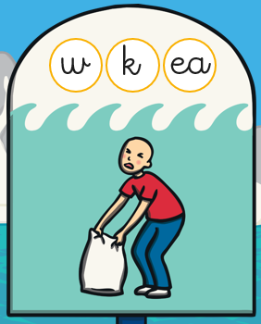
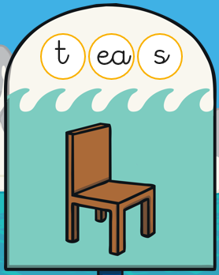
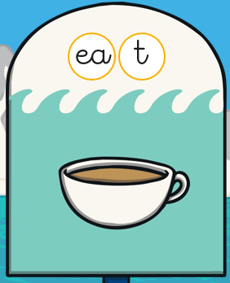
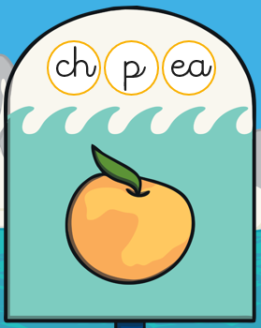
Practise
Unjumble the letters to create words containing ‘ea’.
Wednesday 24th February
‘ea’ sound

Slide 11
Apply
As part of phase 3, you learned the ‘ee’ sound. This sounds the same as the ‘ea’ sound but is spelt differently. Make a list of ‘ea’ words and ‘ee’ words..
ea
ee
Thursday 25th February
‘ea’ sound

Slide 12
Activities
It’s Friday!
Well done for working hard this week. Complete one, two or all of the following tasks:
Practise the spelling rule on Spelling Frame.
If an adult has time, read a book to them.
Read a book to yourself. Keep an eye out for our sound!
Friday 26th February
‘ea’ sound

