Slide 1
The following words are your spellings for this week:
I’m | they’re | it’s
we’re | he’s
 |  | that’s
you’re | she’s
Week 1 – Contractions

Slide 2
Review
Last week, you did a great job learning the following words:
brother | wonder | money
above | other | month
some | love | come
For your review, write 5 sentences including some of the words above.
Monday 8th February
Contractions

Slide 3
Teach
We are learning to read and spell contracted words with apostrophes.
When shortening ‘am’ with ‘I’, remove the ‘a’ and replace it with an apostrophe.
I am
If ‘I’ is one of the words in the contraction, the ‘I’ must be a capital letter.
=
I’m
Tuesday 9th February
Contractions

Slide 4
Teach
We are learning to read and spell contracted words with apostrophes.
If ‘are’ is one of the words in the contraction, remove the ‘a’ and replace it with an apostrophe.
we are
you are
they are
=
=
=
we’re
you’re
they’re
Tuesday 9th February
Contractions

Slide 5
Teach
We are learning to read and spell contracted words with apostrophes.
If ‘is’ is one of the words in the contraction, remove the ‘i’ and replace it with an apostrophe.
he is
she is
it is
that is
=
=
=
=
he’s
she’s
it’s
that’s
Tuesday 9th February
Contractions

Slide 6
Teach
Write out the contracted versions of the following words:
1. I am | 4. They are | 7. It is
2. We are | 5. He is
 |  | 8. That is
3. You are | 6. She is
Tuesday 9th February
Contractions

Slide 7
Practise
Below are three versions of one of your spelling words. One has used an apostrophe correctly and two haven’t. Write out the correct one in your book. Talk to a grown up about what went wrong with the other two.
I’m
Im
Im’
wer’e
w’ere
we’re
thats
that’s
that’s’
Wednesday 10th February
Contractions

Slide 8
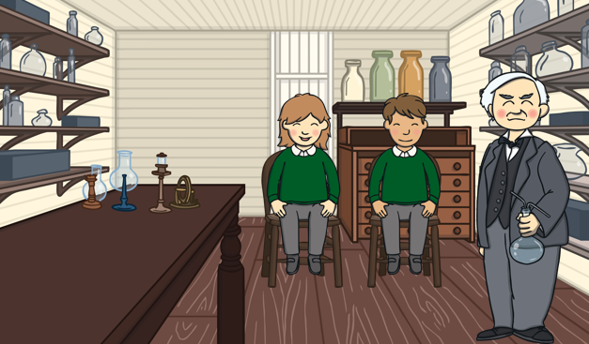
Apply
To the right is a picture of a magic potion school. Use the picture to write sentences using some of this week’s spelling words.
Thursday 11th February
Contractions

Slide 9
Activities
It’s Friday!
Well done for working hard this week. Complete one, two or all of the following tasks:
Practise the spelling rule on Spelling Frame.
If an adult has time, read a book to them.
Read a book to yourself. Keep an eye out for our spelling rule.
Friday 12th February
Contractions

Slide 10
The following words are your spellings for this week:
it’s | I’d | I’ve
that’s | you’d | you’ve
she’s | they’d | they’ve
Week 2 – Contractions

Slide 11
Review
Below are last week’s words but the apostrophes are missing! Add them back in and write them out neatly.
Im | theyre | its
were | hes
 |  | thats
youre | shes
Monday 22nd February
Contractions

Slide 12
Teach
We are learning to read and spell contracted words with apostrophes.
If ‘has’ is one of the words in the contraction, remove the ‘h’ and the ‘a’ and replace them both with an apostrophe.
she has
he has
it has
that has
=
=
=
=
she’s
he’s
it’s
that’s
Tuesday 23rd February
Contractions

Slide 13
Teach
We are learning to read and spell contracted words with apostrophes.
If ‘had’ is one of the words in the contraction, remove the ‘h’ and the ‘a’ and replace them both with an apostrophe.
I had
you had
she had
=
=
=
I’d
you’d
she’d
Tuesday 23rd February
Contractions

Slide 14
Teach
We are learning to read and spell contracted words with apostrophes.
If ‘have’ is one of the words in the contraction, remove the ‘h’ and the ‘a’ and replace them both with an apostrophe.
I have
you have
we have
they have
=
=
=
=
I’ve
you’ve
we’ve
they’ve
Tuesday 23rd February
Contractions

Slide 15
Teach
Write out the contracted versions of the following words:
1. It has | 4. I had | 7. I have
2. That has | 5. You had | 8. You have
3. She has | 6. They had | 9. They have
Tuesday 23rd February
Contractions

Slide 16
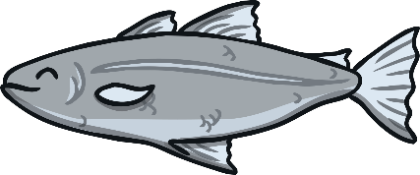
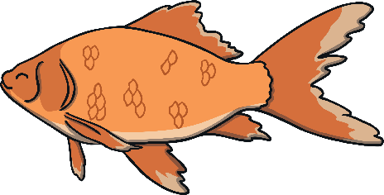
Practise
Unjumble the letters and add an apostrophe to create one of our spelling words.
e
I
v
y
d
t
e
h
s
h
s
e
Wednesday 24th February
Contractions

Slide 17
Apply
Correct any mistakes in the paragraph below.
Welcome to the magic school. Yo’ud better prepare yourself because the school has so much to see. I’ts got twenty-five rooms and the’yve all got a new spell to learn. Ive prepared your timetable. Enjoy your day!
Thursday 25th February
Contractions

Slide 18
Activities
It’s Friday!
Well done for working hard this week. Complete one, two or all of the following tasks:
Practise the spelling rule on Spelling Frame.
If an adult has time, read a book to them.
Read a book to yourself. Keep an eye out for our spelling rule.
Friday 26th February
Contractions

