Slide 1
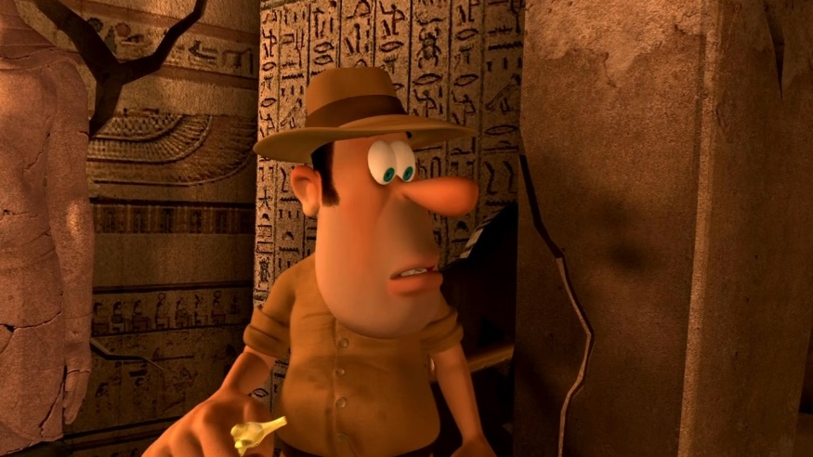
Year 3
Writing Unit 3
Weeks Commencing 8.2.21 and 22.2.21

Slide 2
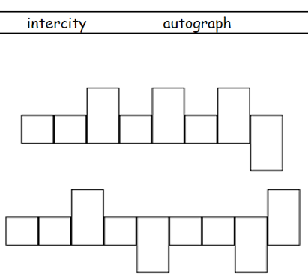
Day 1
Monday 8th February
Spelling Review
Use 6 of last fortnight’s spellings to complete the spelling shapes.
Complete the spellings shapes using the given ‘anti’, ‘auto’ and ‘inter’ spellings.

Slide 3
Day 1
The prefixes we need for this fortnight’s spelling rule are mis, sub, and re.
Remember that prefixes are added to the beginning of root words to make a new word.
For example:
mis + spell = misspell

Slide 4
Day 1
Adding mis changes the word to mean that something is done wrong wrongly.
Misspell means to spell something wrong.

Slide 5
Day 1
The prefix re means to do something again.
re + do = redo
Redo means to do something again.
prefix
root word

Slide 6
Day 1
The prefix sub means ‘under’ or ‘below’.
sub + marine = submarine
A submarine is a ship which travels below sea level.
prefix
root word

Slide 7
Day 1
Practise
Have a go at adding the prefixes to the root words to make your spelling words.
Write out like this:
sub + merge = submerge.
You can use different colours if you like but you don’t need to.
re
do
decorate
turn
appear
mis
spell
lead
behave
sub
merge
heading
marine

Slide 8
Day 1
Spelling List
redo
redecorate
return
reappear
misspell
mislead
misbehave
submerge
subheading
submarine

Slide 9
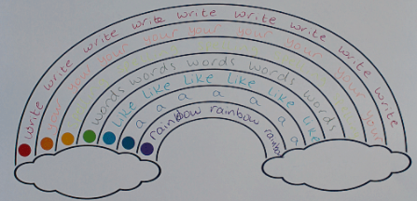
Day 1
Apply
Complete a ‘Spelling Rainbow’. Choose 7 of your spellings and write them in the rainbow outline using different colours for each word.

Slide 10
Day 2
Year 3 Writing Unit
Tadeo Jones
End Result: Write the opening of an adventure story.

Slide 11
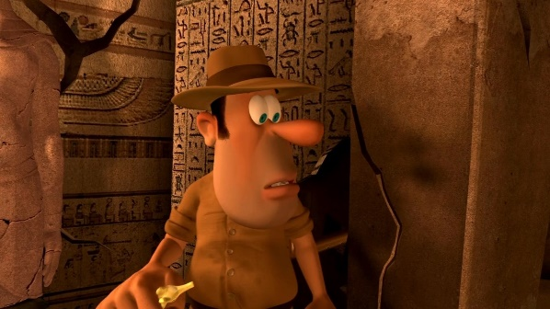
Day 2
Tuesday 9th February
Sit back, relax and enjoy…
Use the following link to watch the animation ‘Tadeo Jones’ up to 2:45.
https://www.literacyshed.com/the-egyptian-pyramids.html#
You must stop the video at 2 minutes and 45 seconds to be able to complete the first task.

Slide 12
Initial Thoughts…
Day 2
What do you think Tadeo Jones’ job is?
How do you think Tadeo is feeling?
What do you think he is looking for?
?
After watching the video up to 2:45, record your initial thoughts by answering the questions on both Day 2 sheets in full sentences explaining your answers fully.

Slide 13
Wednesday 10th January
Day 3
Expanded Noun Phrases
Today, we’re going to be constructing expanded noun phrases. We can use expanded noun phrases to add extra detail to our descriptive writing. They may sound complicated, but they can be very simple to create.
You can take a simple noun phrase and expand it using adjectives.
the road – the long, winding road
the spider – the miniature, terrifying spider

Slide 14
Day 3
Expanded Noun Phrases
You can also add prepositional phrases noun phrases to give even more detail. A prepositional phrase usually includes a preposition, a noun and may include an adjective. It does not include a verb!
Noun phrase: A house
Expanded noun phrase: A derelict, haunted house
Expanded noun phrase with prepositional phrase:
A derelict, haunted house with broken, jagged windows
On your Day 3 sheets, you will find the bronze, silver and gold tasks. Follow the instructions and write the expanded noun phrases or sentences on the lined paper provided.

Slide 15
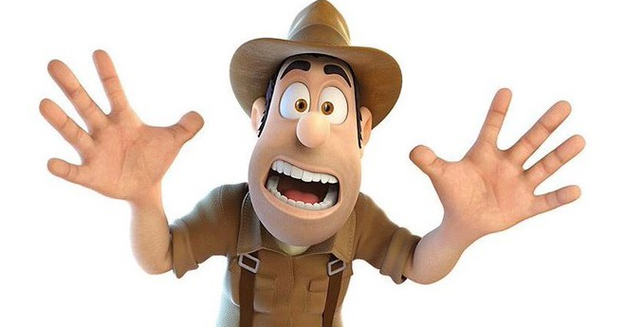
Thursday 11th January
Day 4
Describing Tadeo Jones
Watch the Tadeo Jones video clip again from the beginning, this time stopping at 3 minutes and 30 seconds. Please make sure you do not watch past this point. https://www.literacyshed.com/the-egyptian-pyramids.html#
Today, we’re going to be describing the character of Tadeo Jones. Whilst you’re watching the clip, pay close attention to his appearance, movements and what kind of person he is.

Slide 16
Thursday 11th January
Day 4
Describing Tadeo Jones
On the Day 4 sheet provided, add descriptions to each of the boxes to describe Tadeo’s appearance, character traits and actions.
Add ambitious adjectives and verbs, expanded noun phrases and similes. Why not use an online thesaurus to up-level some of your word choices?

Slide 17
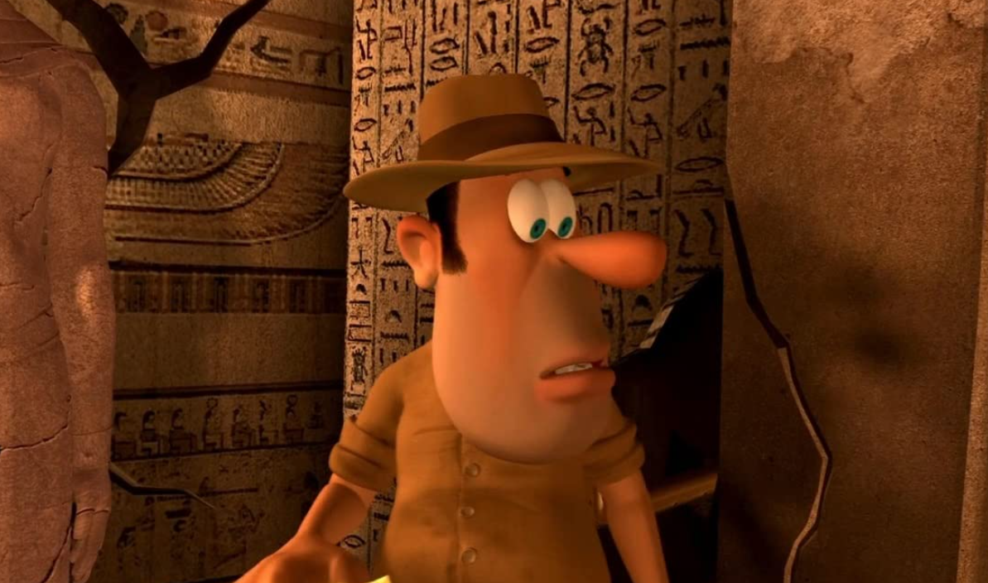
Friday 12th February
Day 5
Setting Description
Today we’re going to be focusing on the section of the video 2:35 to 3:30.
https://www.literacyshed.com/the-egyptian-pyramids.html#
As you watch, imagine that you are Tadeo Jones. Consider all of his senses. What can he see, smell, hear and feel around him?

Slide 18
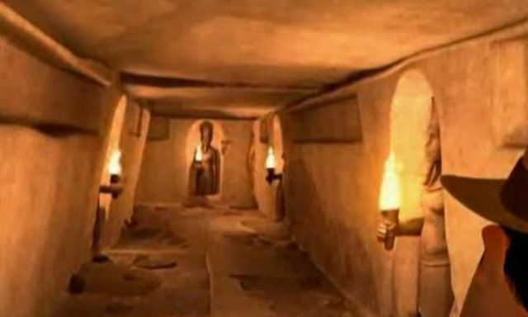
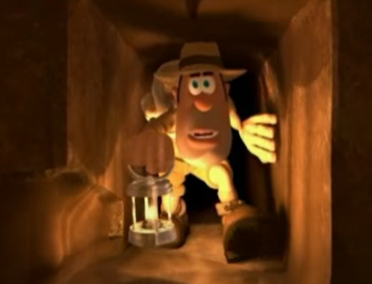
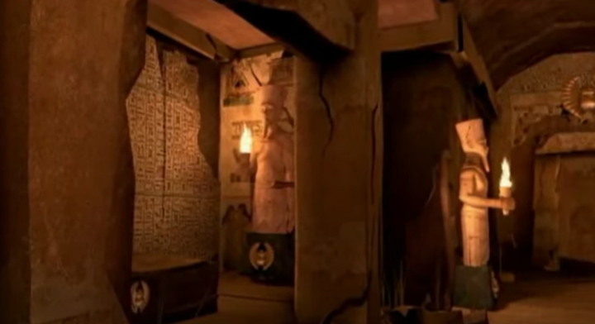
Day 5
Setting Description
Location 1 – The tunnels
Location 2 – The mummies’ crypt

Slide 19
Day 5
Describing the Setting
In your pack you will find two Day 5 sheets. One is to record description for the tunnels, the other is to record description for the mummies’ crypt. Add ambitious adjectives, expanded noun phrases and similes to these boxes.
Silver – Complete 2 senses on both pages.
Gold – Complete all senses on both pages.

Slide 20
Monday 22nd February
Day 6
Welcome back Year 3!
Today, we’re going to remind ourselves of what happens during the opening of our adventure story. Remember that we are only focusing on the video clip between 2:35 to 3:30.
https://www.literacyshed.com/the-egyptian-pyramids.html#

Slide 21
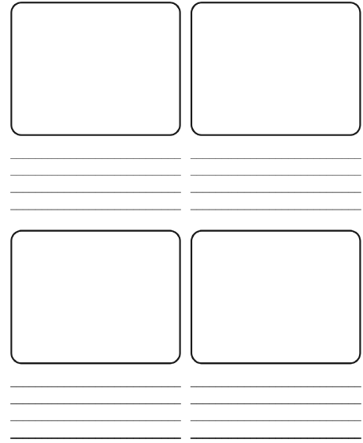
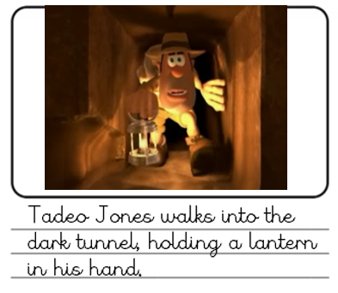
Monday 22nd February
Day 6
Create a storyboard of the events which happen between 2:35 and 3:30 of the video. I have given you the first and last events, you need to add the pictures and then fill in 4 events which happen in between them.

Slide 22
Tuesday 23rd February
Day 7
Fronted Adverbials
In our writing, it is important to start our sentences differently, so that it is not repetitive and boring.
Today, we’re going to be looking at using fronted adverbials at the start of our sentences.
Early one morning, Josh went for a run in the park.
This fronted adverbial tells us when something happened.

Slide 23
Day 7
Where Did It Happen?
Fronted Adverbials to Show Location
Fronted adverbials can be added to sentences to tell the reader where something happens.
For example:
In class, the boy sat listening to his teacher.
The fronted adverbial in this sentences is ‘In class’ because it tells the reader where the boy is.

Slide 24
Day 7
When Did It Happen?
Fronted Adverbials to Show Time
Fronted adverbials can be added to sentences to tell the reader when something takes place.
For example:
Early in the morning, I went for a stroll.
The fronted adverbial in this sentences is ‘Early in the morning’ because it tells the reader when the stroll took place.

Slide 25
Day 7
How Did It Happen?
Fronted Adverbials to Show Manner
Fronted adverbials can be added to sentences to tell the reader how something happens.
For example:
Without a sound, the boy entered the room.
The fronted adverbial in this sentences is ‘Without a sound’ because it tells the reader how the boy entered the room.

Slide 26
Day 7
Fronted Adverbials
Silver – For where and when, match the most appropriate fronted adverbial to the rest of the sentence. For how, choose the best one from the box and write it at the start of the sentence.
Gold – Add your own time and fronted adverbials to the start of the sentences. For how, choose the best one from the box and write it at the start of the sentence.

Slide 27
Day 8
Wednesday 24th February
Choose your Success Criteria.
Read the different success criteria. Decide whether bronze, silver or gold is right for you.
The success criteria can be found in Day 8 of your pack.

Slide 28
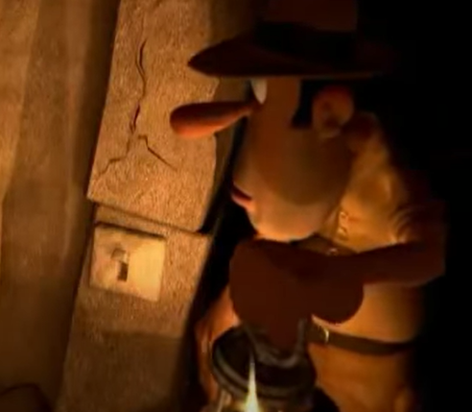
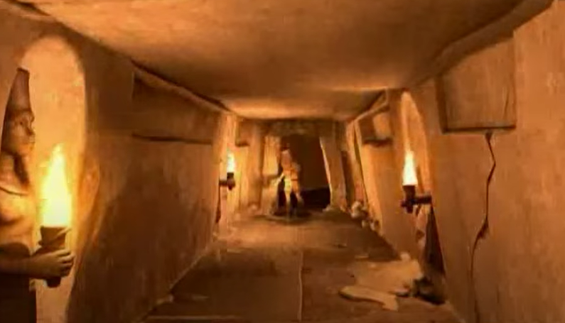
Day 8
Writing the First Paragraph
Today, we’re going to write the first paragraph of our adventure story opening. It will include the first 3 events from Monday’s storyboard. Remember to include the success criteria you have chosen.
Look back to your Day 6 storyboard to see your first 3 events.

Slide 29
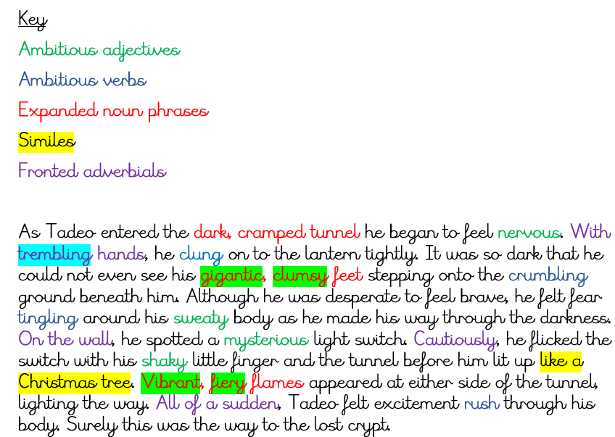
Day 8
First paragraph WAGOLL
Remember to use the WAGOLL for ideas. You can magpie phrases from it to use in your own paragraph.
You will find this on Day 8 of your pack.

Slide 30
Day 8
Now it’s time to get writing!
Have to hand your storyboard, your expanded noun phrases, your character description, your setting descriptions, your fronted adverbial work and the WAGOLL. You can use all of these things to help you.
After each sentence, stop and check that it makes sense, that you have used the correct punctuation and spellings.
Remember that I only want to see one paragraph and it needs to include the first 3 events.
Use the lined paper from your pack.

Slide 31
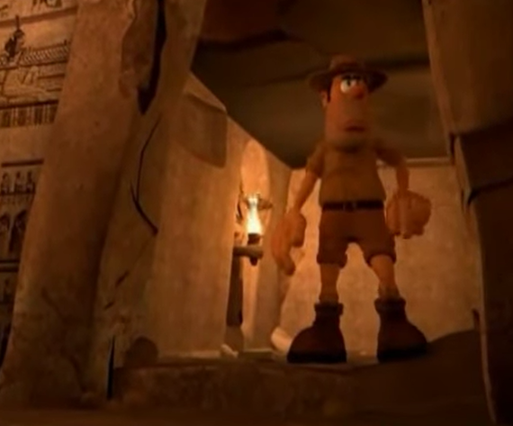
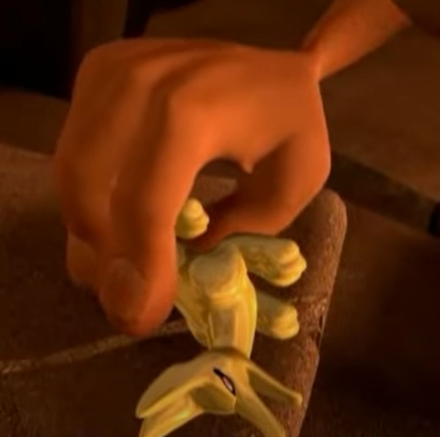
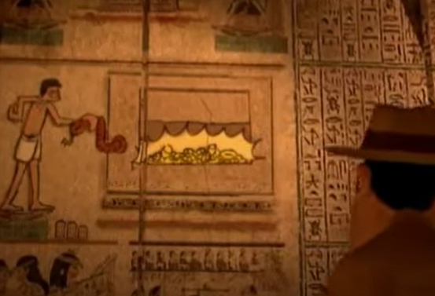
Day 9
Thursday 25th February
Writing the Second Paragraph
Today, we’re going to write the second paragraph of our adventure story opening. It will include the final 3 events from Monday’s storyboard. Remember to include the success criteria you have chosen.
Look back to your Day 6 storyboard to see your final 3 events.

Slide 32
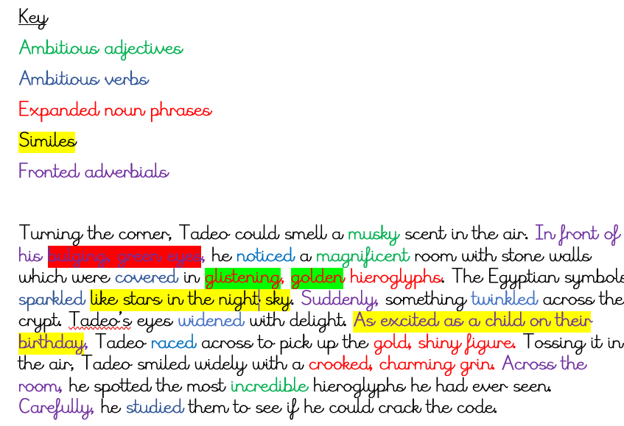
Day 9
Second Paragraph WAGOLL
Remember to use the WAGOLL for ideas. You can magpie phrases from it to use in your own paragraph.
You will find this on Day 9 of your pack.

Slide 33
Day 9
Writing Your Second Paragraph
Have to hand your storyboard, your expanded noun phrases, your character description, your setting descriptions, your fronted adverbial work and the WAGOLL. You can use all of these things to help you.
After each sentence, stop and check that it makes sense, that you have used the correct punctuation and spellings.
Remember to include the final 3 events and the success criteria that you chose yesterday.
.
Use the lined paper from your pack.

Slide 34
Day 10
Friday 26th February
Writing and Editing Your Writing
Today’s task is to finish your two paragraph opening, ensuring that you have met all of your success criteria.
If you have sent in yesterday’s writing and received some feedback, fix this in your work before you add any more. You could use a coloured pen to do this.
If you have finished, now check your success criteria to make sure you have included everything. Add in any success criteria you have missed. Check your punctuation, your spelling and that each sentence makes sense!

Slide 35
Day 10
Think you have finished?
Read through your work and fix any mistakes you may have made.
Can you make any improvements? Can you up-level some word choices? If so, you can add these using a coloured pen.
When you are sure that your two paragraphs are finished to the best of your ability, tick off the success criteria that you think you have included in the ‘self’ column.
Now you need to send your work to me! I can’t wait to read your writing.

