Slide 1
Year 3
Weeks Commencing 1.3.21

Slide 2
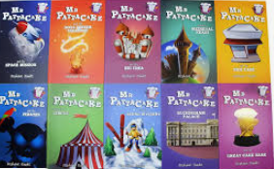
Day 1
Monday 1st March
Book Tasting
In your pack, you will find a book from the ‘Mr Pattacake’ series. Which one do you have?

Slide 3
Day 1
Book Tasting
Using the ‘tasting menu’ in your pack, have a taste of your new book.
Before you start reading, complete the ‘Starter’ section by looking at the cover. Then read 3 pages and complete your ‘Main Course’ section.

Slide 4
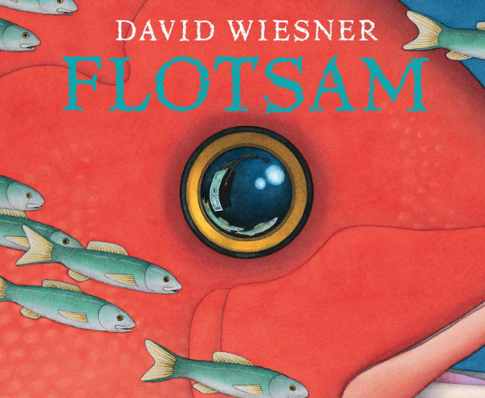
Day 2
Tuesday 2nd March
Flotsam
https://www.youtube.com/watch?app=desktop&v=3MTKWnxzqvM&safe=true
This week, the whole school is looking at ‘Flotsam’ by Davide Wiesner. This is a graphic novel which means it has no words. Instead, the illustrations tell the story. Click on the link below to ‘read’ the book.

Slide 5
Day 2
Flotsam Comprehension
In your pack, you will find some comprehension questions to answer. As there are no words, you will not be looking for the answers in a text, but instead using the pictures. Have the ‘Flotsam’ video open so that you can look through the pictures to help you to answer the questions.
Please answer the questions on both of the Day 2 sheets using full sentences.

Slide 6
Day 3
Wednesday 3rd March
Flotsam Description
Today, we’re going to be describing some of the photos taken by the underwater camera.
In your pack you have 3 photos to choose from, taken from ‘Flotsam’. Pick 2 of them to add description to, including ambitious adjectives, expanded noun phrases and similes. See my example on the next page to show you how.

Slide 7
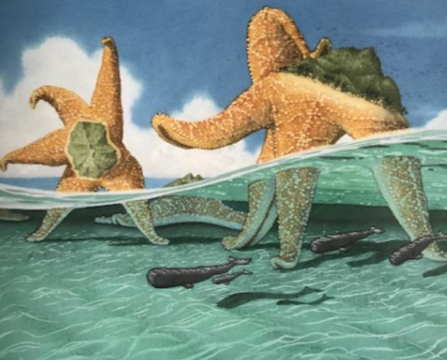
Day 3
The huge starfish stood as tall as giants stretching up to the sky.
white, fluffy clouds in the sky
rippling waves
wavy water as clear as crystal
Miniature fish as tiny as tadpoles swam around their feet.
glistening turquoise ocean

Slide 8
Thursday 4th March Story Planning
Day 4
We’re going to be using ‘Flotsam’ to inspire our own story writing. Tomorrow, we will have lots of time to write our own stories using our own ideas.
Today, we’re going to plan what our stories will be about, using a storyboard to help us.
Everyone’s story will start with a boy playing on the beach. After that, it’s up to you!

Slide 9
Thursday 4th March Story Planning
Day 4
Silver - complete 4 sections of a storyboard.
Gold – complete 6 sections of a storyboard.
You will notice that I have started the first one for you, but you can add more information to it. What could he be playing with? Does he spot something unusual?

Slide 10
Friday 5th March Story Writing
Day 5
Today, we are going to be writing the stories that we planned yesterday.
Remember, that this is a story of your choice but I want to see amazing description and super punctuation. Think carefully about where your sentences begin and end and remember those very important full stops and capital letters.

Slide 11
Things which will help you:
Day 5
Yesterday’s plan - follow it to remind yourself what happens next.
Wednesday’s golden lines - can you use some of these in your story writing?
Common exception words - use this sheet in your pack to help your spelling.
The starters on the next slide.

Slide 12
Starting your story
Day 5
To help you to start your story, I have written two starters which you could use. You don’t need to use one of these, but it is a good way to get started.
Silver – One sunny morning, a small boy was sitting on the sand. He felt bored and wanted something to cheer up his day. Suddenly…
Gold – One bright, sunny morning, a young boy was sitting quietly on the beach. Bored and lonely, he was desperate for some adventure to liven up his day. Suddenly…

Slide 13
Get Writing!
Day 5
Now it’s time to get started. I can’t wait to read your amazing stories!
Remember that there is a prize up for grabs for one very special story. I wonder who will be the prize winner?
Good luck!

