Slide 1
Year 1
World Book Week 2021

Slide 2
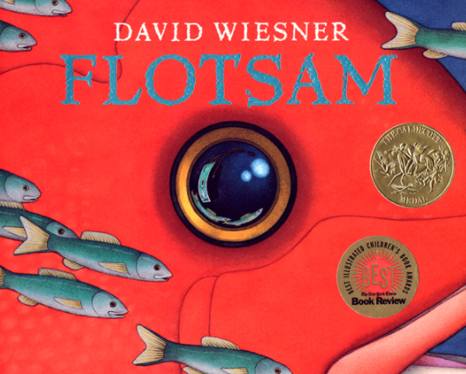
End Result
To write a short story using only 100 words for our school competition!
The following slides will support you.
Your main task (starting on Tuesday) will be based on the story ‘Flotsam’ which you can read tomorrow if you have the book, or watch the story being told using the link in tomorrow’s lesson. The whole school are using this story this week!

Slide 3
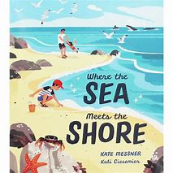
Day 1
Hillside’s Book Tasting!
Every year we have a delicious menu of books to choose from! This year you have been gifted the story ‘Where the Sea Meets the Shore’ by Kate Messner. Share the story together – here is a link to watch it too if you would like.
Where the Sea Meets the Shore, as read by Miss Read - YouTube

Slide 4
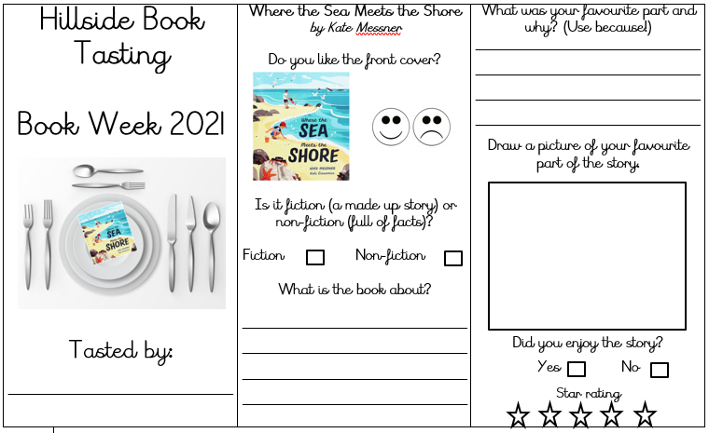
Day 1
Hillside’s Book Tasting!
Complete your book tasting! Set your table and put your book-meal on the top! Fill in the review and then you could design your own plate of food linked to the story or for one of the creatures you meet if you wish.
Page 1 and 2 of the document

Slide 5
Sit back, relax and enjoy…
Day 2
Use the following link to watch the story of ‘Flotsam’ or read the book if you have it.
Flotsam By David Wiesner - YouTube
You may want to watch or read it several times to make sure that you haven’t missed anything and to help you remember the story.
The word ‘flotsam’ means the floating wreckage of a ship or cargo, or floating debris

Slide 6
The Flotsam Story
Day 2
The book has no words, but is told through pictures. A boy is at the beach and finds an old camera. He takes the film to get it developed, and sees photos of fantastical undersea cities and inventions. The final section of the book consists of a girl, who is holding a photo of a child, who is holding a photo of a child, who is holding a photo of a child, and so on. The boy figures out that he is one in a long line of photographers who have found this camera. He takes a picture of himself holding this photo and tosses the camera back into the ocean; it is carried across the ocean by a variety of fish and sea life, until it again washes ashore and another child finds it.

Slide 7
What did you think of the story?
Day 2
What happened?
Who did you meet?
Where did the story happen?
How did you feel during the different parts of the story?
Were you happy at the end? Why?

Slide 8
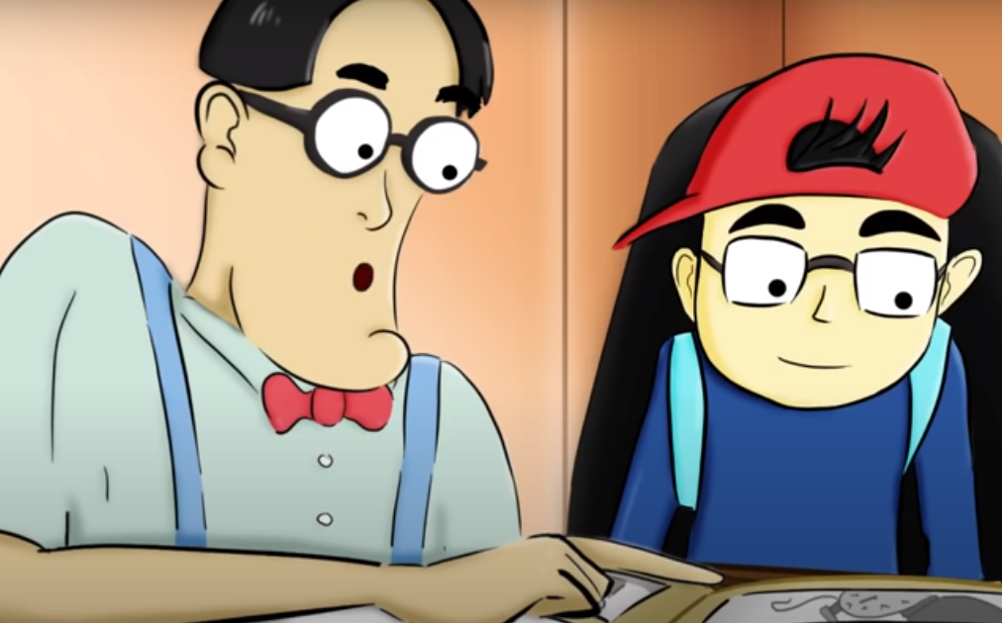
Find out more about old-fashioned cameras!
Day 2
You may never have seen a camera with film in. Nowadays, most cameras are digital and you’ve probably seen them or used them on a grown-ups phone!
Watch this little video if you wish to find out more about old-fashioned cameras.
Simple explanation of how a camera works - YouTube

Slide 9
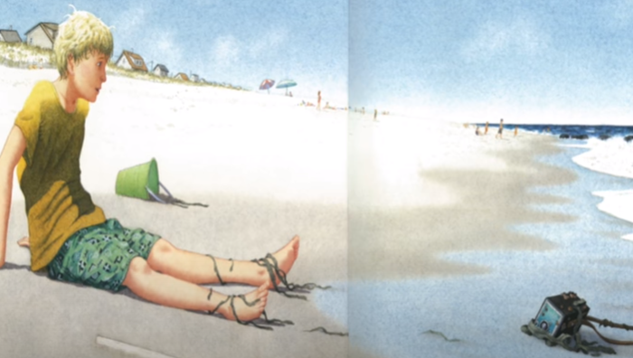
Lesson Two
Day 2
Can you retell the story to a friend or someone in your family?
Imagine you are on the seashore and some flotsam floats to shore.
What might you find?
Create your own acrostic poem based on Flotsam! The first letter of each line in an acrostic poem spells a word. Acrostic poems do not need to rhyme (although you can make it rhyme if you want it to!) Have a look at the example on the next slide. You could find the camera too or any other item you like on the seashore!
Page 3 of the document

Slide 10
Flotsam Acrostic Poem
Day 2
Floating to the shore
Lying in the waves
Oh it’s a camera!
Travelling to the camera shop
Sharing underwater scenes
Adventures seen in photographs
Maybe a new picture tomorrow?

Slide 11
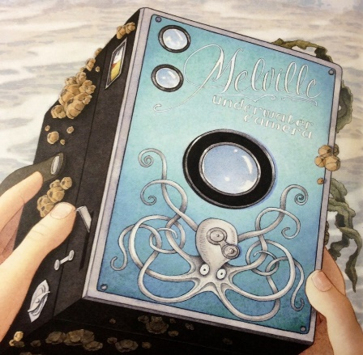
Lesson Three Imagine you have just found a camera on the beach! Have a look at two of the pictures taken on the next two slides. Can you think of any more adjectives you could use to describe the creatures, the colours or the shapes you can see?
Day 3
How could you describe how the creatures move?

Slide 12
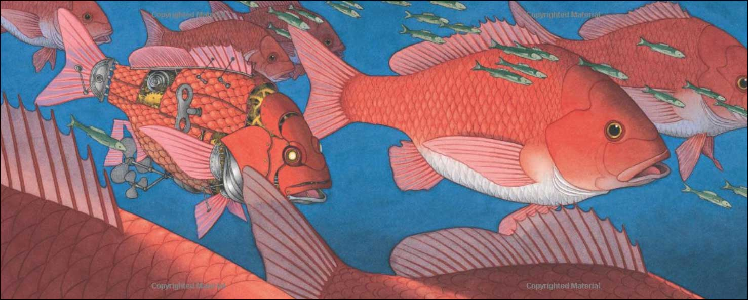
fish
robotic
fins
scales
cogs
tiny
enormous
key

Slide 13
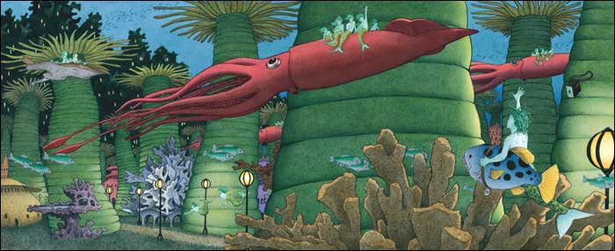
slim
long
gliding
lamps
creatures
mysterious
coral
spiky

Slide 14
To remind ourselves…
Day 5
Adjective | An adjective is a describing word. It describes a noun.
Noun | A noun is a naming word. It can name a person, place or thing.
Verb | Verbs are action words. They show what someone is doing.
We use adjectives to make our writing more interesting!

Slide 15
Lesson Three Now take the camera under the water! Take three photos and then add labels using adjectives to describe what you can see. If you use two adjectives together, remember to use a comma in between. There are word mats to help you on page 5.
Day 3
long, wavy tentacles
shady, underwater cave
huge, grey fins
Page 4 and 5 of the document

Slide 16
Day 4
Sentences need punctuation to make sense. If a sentence is jumbled or does not have punctuation, it is not a sentence!
Exciting sentences need an exclamation mark like this:
The camera had incredible photographs hidden away!
If you ask a question to find out something, you need to use a question mark like this:
Where did it come from? What will I see next?

Slide 17
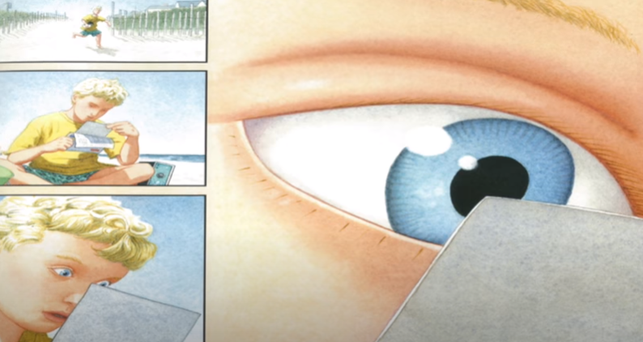
Lesson Four Imagine what the boy may be thinking after the camera washes up as flotsam on the seashore. Write down three things he may think or say. Write sentences using capitals, full stops, exclamation marks and if he asks a question, remember to use ? too! What is that small, black box? Wow! There are more children, just like me! I wonder how old these people are now.
Day 4
Page 6 of the document

Slide 18
Lesson Five – competition time!
Day 5
Time to rise to the challenge!
By the end of today, you will have written a short story – only 100 words or less!
Use the mini-plan to work out the beginning, middle and end to your story. The short notes or ideas you make can then be used to write your story (you may want an adult to help you jot down your ideas here and then you can write the story as you work together). You can write the story of Flotsam or you can think of your own underwater or seaside adventure – you choose!
Page 7 of the document.

Slide 19
Lesson Five – competition time!
Day 5
Time to rise to the challenge!
When you have completed your plan, write your short story. You may need to keep going back and checking how many words you have used – it can be any number less than 100 or exactly 100 but not a single word more than 100!
There is a frame for you to use although you can use your book and illustrate your story too or turn your writing in to a real book if you wish! Again, you choose!
Page 8 of the document.

Slide 20
All done – well done!
Day 9 and 10
Once you have finished your writing, check through carefully and ask an adult to help you to check your spellings, punctuation and counting!
Send your competition entry to the Home Learning email address. A winner will be chosen and a prize awarded so a big well done for creating a super story and good luck! ☺

