Slide 1
Year 1
Giraffes Can’t Dance

Slide 2
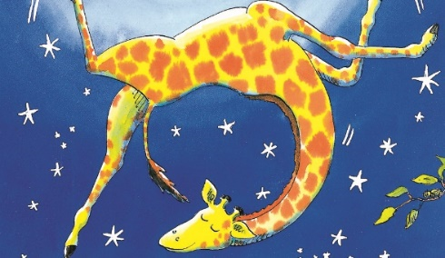
End Result
To write a character description
for Gerald the Giraffe!
The following slides will support you.
It will be based on the story ‘Giraffes Can’t Dance’ which you can read if you have the book, or watch the story being told, using the link on the next page.

Slide 3
Sit back, relax and enjoy…
Day 1
Use the following link to watch the story of ‘Giraffes Can’t Dance’ or read the book if you have it.
Giraffes Can't Dance - Giles Andreae - YouTube
You may want to watch or read it several times to make sure that you haven’t missed anything and to help you remember the story.

Slide 4
What did you think of the story?
Day 1
What happened?
Who did you meet?
Where did the story happen?
How did you feel during the different parts of the story?
Were you happy at the end? Why?

Slide 5
Lesson One
Day 1
Can you retell the story to a friend or someone in your family?
Imagine you are in the jungle and you see the dance! How would the animals move?
Use drama to act out some of the dances. Take three photos of your self dancing or draw three pictures of you dancing like the different animals and add labels describing their movements!
Use the verb sheet to help you think of words for how they move – wiggled, jiggled, leaped, hopped, crazy, busy, sluggish… there are lots of different ways to move!
Page 1 and 2 of the document

Slide 6
Lesson Two Re-read or watch Giraffes Can’t Dance then use the pictures to sequence the main parts of the story. Choose three of the pictures and write a sentence explaining what is happening in the picture. You can either use printed copies or draw your own versions.
Day 2
Page 3 of the document

Slide 7
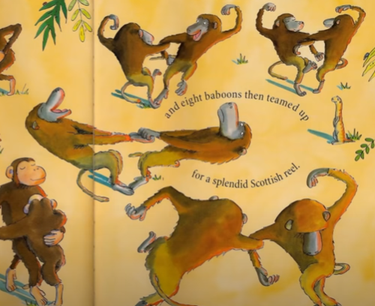
Lesson Three Re-read or watch the video again. Someone has jumbled up my sentences from the start of the story! Can you unjumble the sentences so that they make sense? Use the capitals, full stops and exclamation marks to help you.
Day 3
This should be…
Gerald was a tall, thin giraffe.
Page 4 of the document

Slide 8
Day 4
Sentences need punctuation to make sense. If a sentence is jumbled or does not have punctuation, it is not a sentence!
Exciting sentences need an exclamation mark like this:
Gerald’s dancing was tremendous! Wow!
If you ask a question to find out something, you need to use a question mark like this:
Why can’t I dance? What shall I do?

Slide 9
Lesson Four Rewrite the sentences from the Giraffes Can’t Dance story using capital letters, full stops, exclamation marks and question marks. Read the sentences aloud to help you and use your best cursive handwriting!
Day 4
Page 5 of the document

Slide 10
To remind ourselves…
Day 5
Adjective | An adjective is a describing word. It describes a noun.
Noun | A noun is a naming word. It can name a person, place or thing.
Verb | Verbs are action words. They show what someone is doing.
We use adjectives to make our writing more interesting!

Slide 11
Our writing is more exciting if we use adjectives (describing words) to paint a picture for the reader.
Day 5
An expanded noun phrase is a phrase made up of a noun and at least one adjective.

Slide 12
Lesson Five Adjectives add detail to our writing and make it more interesting. They help us to paint a picture in our mind! Which sentence do you prefer? Gerald was a giraffe. Gerald was a tall giraffe with a long, bendy neck that stretched right up to the sky1 Spot the adjectives in the sentences and underline them. Then swap them! Think of different words you could use to describe instead!
Day 5
Page 6 of the document

Slide 13
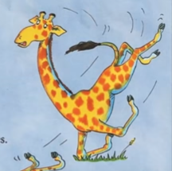
Lesson Six Imagine what Gerald is thinking or saying during different parts of the story. He probably feels quite differently at the beginning and the end of the story. Using the pictures to help you, write down three things he may think or say. Write sentences using capitals, full stops, exclamation marks and if he asks a question, remember to use ? too!
Day 6
Page 7 of the document

Slide 14
Lesson Seven When you write about a character, you have to add lots of little details! Talk to a friend or someone in your family about what Gerald looks like and what he is like! Read or watch the story to help you. Then add labels to describe how Gerald looks – you do not need capital letters or full stops as they are not full sentences. Try to use two adjectives together, with a comma between them if you can! (For example, ‘long, slim neck’, ‘large, brown spots’) After, think of two sentences to describe what he is like as a character. Is he kind? Cruel? Funny? Cheerful? Use ‘because’ to explain why you think that. For example, Gerald is brave because he carries on, even when they are cruel to him. Use the word mats on page 9 to help you.
Day 7
Page 8 and 9 of the document.

Slide 15
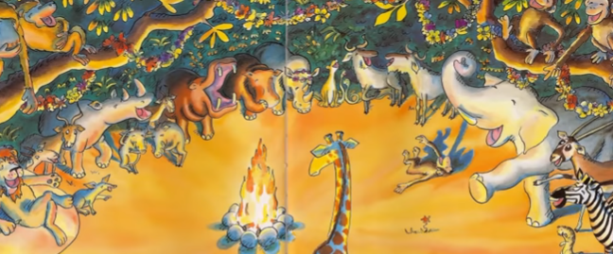
Lesson Eight Gerald is feeling very sad and upset during different parts of the story. What would you do to cheer him up? Tell me in a few sentences and draw a picture of you and Gerald having a wonderful, cheery time!
Day 8
Please use page 10 of the document.

Slide 16
Lesson Nine and Ten – Character description time!
Day 9 and 10
You have worked so hard thinking all about Gerald! Now it is time to write all about him, using my example as a guide. Choose a Bronze, Silver or Gold success criteria from page 11. Look back at the writing and description you have already created and then use it to write your own longer piece.. Talk to a grown up as you work through the example, creating your own, taking your time to check your work and completing it section by section – that’s why we might write it over two days.
Choose a success criteria from page 11. Then use pages 12 and 13 to guide you. You can write on the frame on page 14 if you wish.

Slide 17
All done – well done!
Day 9 and 10
Once you have finished your writing, check through carefully and ask as adult to help you to check your spellings. Have you achieved all of your success criteria? Tick it off and ask an adult to do the same!
Self assess your work (with A1 or A2) and send it to me via the Home Learning email address! I will look forward to reading your description of Gerald!
If you have time left in your final lesson, take some time to illustrate your writing! Read it to your family as I think they would love to hear about Gerald!
Well done! ☺

