Slide 1
Year 2
Book Week

Slide 2
End Result
You will be writing a short story based on the book Flotsom. Your writing will then be entered into our school competition.
You will write your story in the third person as if you were watching the action from above. You will use he/she/they rather than I.
This is different to the previous pieces of writing.
Notes:
Hello everyone! Happy Book Week! This week, your writing tasks will be based around a book called Flotsom. It’s a strange word. In a few slides time, you will learn what the word means and you will have the opportunity to read the book. Your final piece of writing will be your own magical underwater adventure story. We will spend the week preparing for this writing. It will be a little different than the other pieces of writing you have done at home because it will be in the third person. This means that you will be writing as if you were watching from above with words like he and she rather than I.

Slide 3
Monday 1st March
Hillside’s Book Tasting!
This is an activity we complete every year. Normally, we have a delicious menu of books to choose from! This year, you will have one.
You have been gifted a Mr Majeika book by our author of the term Humphrey Carpenter.
Spend some time reading your book.
Notes:
Before we get into our writing this week, we are going to start the week in the same way as we always start Book Week at Hillside. We are going to be book tasting! Now, I don’t want to have any mummys and daddys emailing the home learning account telling me you’ve been licking your books! It’s a very different type of tasting. You have all been gifted a Mr Majeika book by our author of the term Humphrey Carpenter. First, spend some time reading the book and then move on to the next slide to introduce your book tasting task.

Slide 4
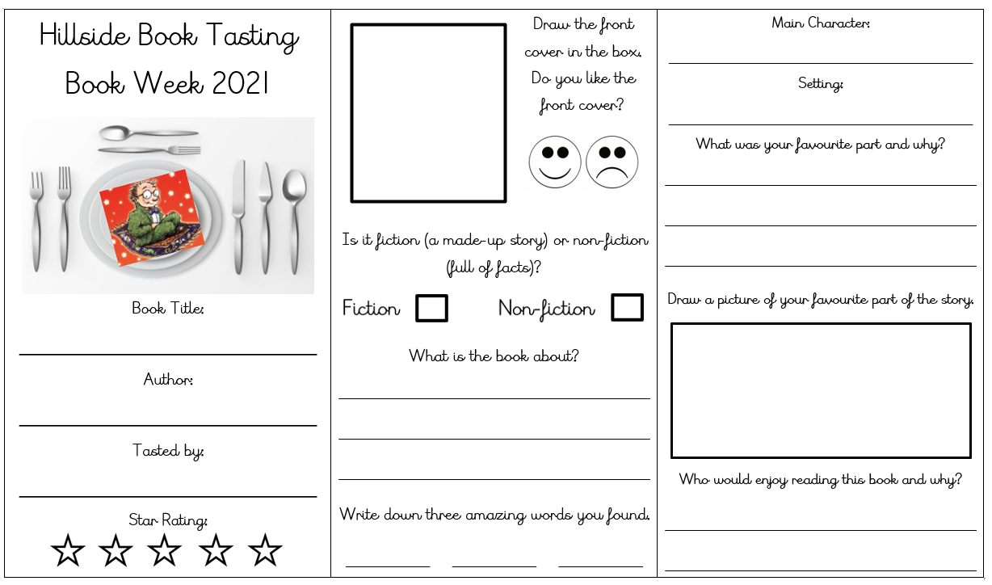
Monday 1st March
Task One
Complete your book tasting! Set your table and put your book-meal on the top! Fill in the review and then you could design your own plate of food linked to the story or for one of the creatures you meet if you wish.
Please use the book tasting resources.

Slide 5
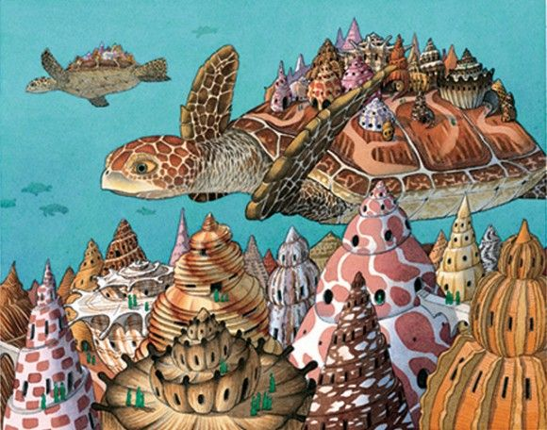
Sit back, relax and enjoy…
Tuesday 2nd March
Use the following link to watch the story of ‘Flotsam’ or read the book if you have it.
https://youtu.be/3MTKWnxzqvM
The word ‘flotsam’ means the floating wreckage of a ship or cargo, or floating debris.
You may want to watch the clip more than once to ensure you haven’t missed anything.

Slide 6
What did you think of the story?
Tuesday 2nd March
What has happened?
Which characters have we met?
Where and when do you think the story has taken place?

Slide 7
The Flotsom Story
Tuesday 2nd March
Beginning The book has no words, but is told through pictures. A boy is at the beach and finds an old camera. He takes the film to get it developed, and sees photos of fantastical undersea cities and inventions.
Middle
The boy finds a photo of a girl, who is holding a photo of a child, who is holding a photo of a child, who is holding a photo of a child, and so on. The boy figures out that he is one in a long line of photographers who have found this camera. He takes a picture of himself holding this photo.
End He tosses the camera back into the ocean. It is carried across the ocean by a variety of fish and sea life, until it again washes ashore and another child finds it.

Slide 8
There are two things I’d like you to think about:
Tuesday 2nd March
Action
This is what is happening in the story. What do the characters do in your story? Where do they go? What happens?
Description
This is the painting you must do in the reader’s mind. Which objects, people or places have you described with your choice of adjectives, verbs and adverbs? Have you described how your characters feel?
As we have spoken about in class, when writing a story, we must use a mix of action and description.
The tasks this week will help you to plan these important aspects.
Notes:
This is something we have discussed in class. If you’re only telling the reader about what happens in the story (the action), it is hard for them to picture in their head what is going on. Equally, if you only describe things in your story, then the reader will get confused because nothing seems to be happening! It’s important that you use a mix of action and description when writing a story.

Slide 9
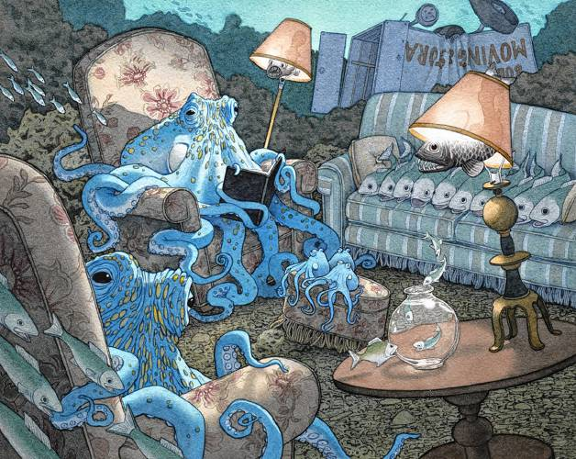
Task Two
Tuesday 2nd March
It’s time to use your imagination!
What amazing and crazy things could be taking place under the sea?
Could there be a seahorse race? A shark going shopping? A turtle swimming lesson?
Think of three things and draw a picture for each. Write a couple of sentences underneath to describe the action taking place.
Bronze: If you wish, you can use the pictures from the story.
Please use page 1 of the document.
Notes:
Start to have your story in mind with this task. This is the beginning of your planning. You are thinking of ideas to base your story on.

Slide 10
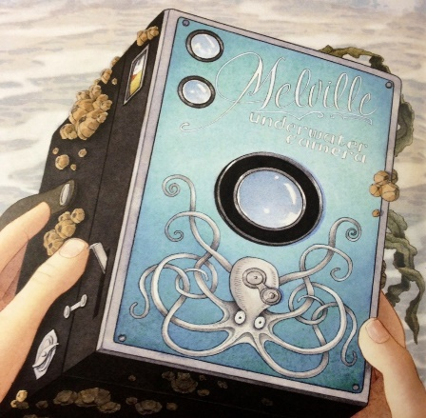
We are going to collect some super vocabulary
Wednesday 3rd March
Adjective | An adjective is a describing word. It describes a noun.
Noun | A noun is a naming word. It can name a person, place or thing.
Verb | Verbs are action words. They show what someone is doing.
Adverb | An adverb is a word that describes a verb
Have a look at two of the pictures taken on the next two slides. Can you think of any more words or phrases you could use to describe the creatures?

Slide 11
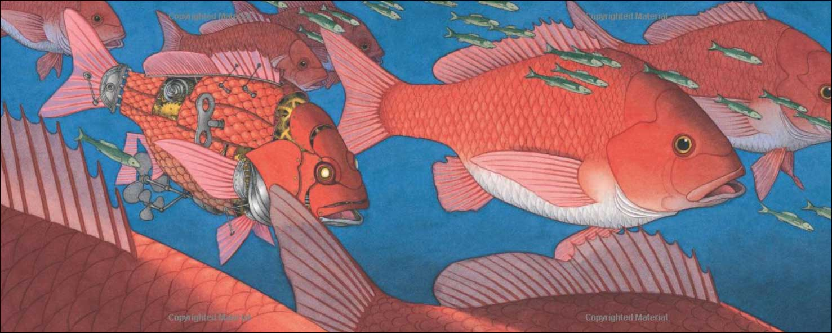
fish
robotic
fins
scales
enormous
cogs
tiny
key

Slide 12
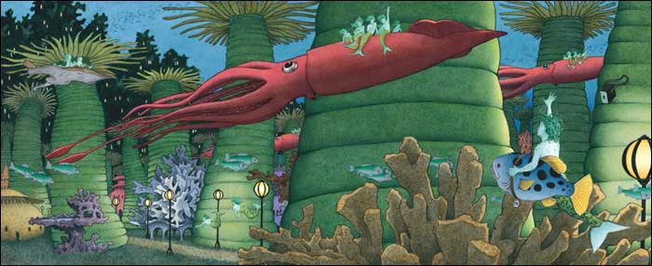
slim
long
gliding
lamps
creatures
mysterious
coral
spiky

Slide 13
Look at the pictures you drew yesterday. Pick your favourite one that you’d like to write a story about. Draw out your main character, your setting and another character you meet who has a problem. Use the word mats to write three descriptive sentences about each of these new pictures. You may want to think of some of your own powerful words.
Wednesday 3rd March
Task Three
Please use page 2 and 3 of the document.

Slide 14
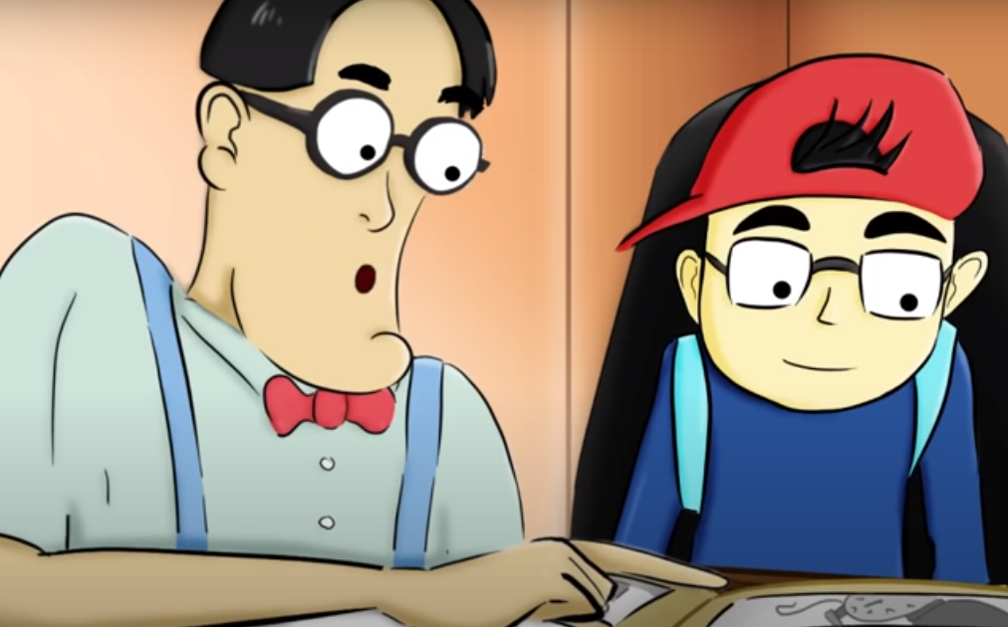
Find out more about old-fashioned cameras!
Thursday 4th March
You may never have seen a camera with film in. Nowadays, most cameras are digital and you’ve probably only seen them or used them on a grown-up’s phone!
Watch this little video if you wish to find out more about old-fashioned cameras:
https://youtu.be/BNA97LaWLF0

Slide 15
Something to think about…
Thursday 4th March
This week, I’d like you to pay special attention to your use of conjunctions. We looked at these before Christmas.
And, but and or help us to link our ideas together.
Because, when and if help us to extend our ideas and give extra information.
because
and
but
when
or
if
Can you give an example of a sentence including one of these six words?
Notes:
You may remember us talking about conjunctions before Christmas. Some of these words, especially the ones on the left, you will recognise from using in year 1. It’s important we use these words as our writing can becoming very boring to listen to without them. During your writing this week, I’d like you to focus on including some of these conjunctions.

Slide 16
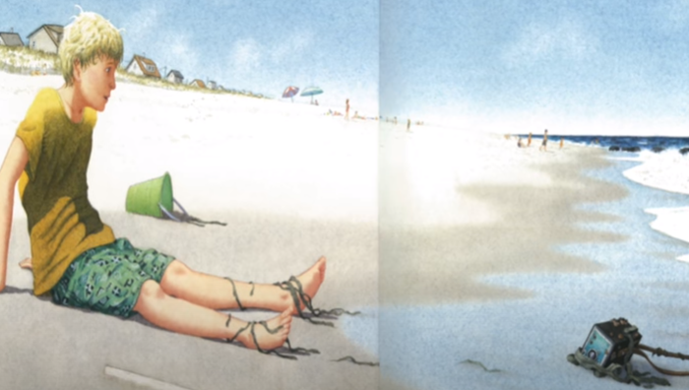
Task Four
Thursday 4th March
The boy has thrown the camera back into the water. Who finds the camera first and where does it take it? What does it see?
Complete the planning sheet for your story. This hopefully should be easier because you’ve planned some of your ideas this week.
Think carefully about the beginning, middle and end of your story. What action will take place? What will you describe?
Please use page 4 of the document.

Slide 17
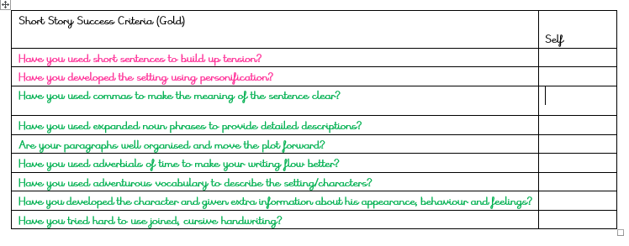
Success Criteria
Friday 5th March
Read the different success criteria. Decide whether Bronze, Silver or Gold is most suitable for you.
Story Length
Bronze: Draw out pictures to go with your story and write a sentence or two next to each one.
Silver and Gold: Try to write between 2 and 4 paragraphs (sections of your story)
The success criterias can be found on page 5 of the document.
Notes:
Don’t forget to choose a success criteria to go with your work. If you normally choose bronze when writing, then you may wish to draw out the pictures of your story and write a sentence or two next to each picture like we do in class. You can use your own ideas or the ideas from the story. As long as you are writing sentences that make sense with capital letters and full stops, I’ll be happy. Silver and Gold children, try to write between 2 and 4 paragraphs. Don’t rush your story!

Slide 18
Now it’s time to write…
Friday 5th March
Use your planning sheet and your work this week to write your story. Remember these key points:
It needs to be written in the third person (as if you were watching the action from above) and in the past tense.
Don’t rush! Try to include a mix of action and description.
Always think about how you can show off. It would be great to see you using those conjunctions!
Write your story on the under the sea paper provided on page 7 and 8.
Take a look at the example on page 6 to give you some ideas.
Notes:
The time has come! It’s time to write. Read through the three reminders on the screen. Use your planning sheet and the work you have done this week to produce a super piece of writing. You have the English lesson and the afternoon to do your writing so you may want to write the first part, take a break, and then come back to your writing after you have had your dinner. A fresh mind really helps when concentrating on writing. Good luck. I can’t wait to read your writing.

Slide 19
Is your story complete?
Friday 5th March
Once you have finished your writing, check through carefully. Have you achieved all of your success criteria?
Leave a self-assessment at the bottom of your work.
It would be great if you could read out your writing to somebody you know. Practise a few times first to make sure you are reading fluently.
Ask a grown up in your house to send your writing to the home learning email and I will reply back.
Good luck in the competition. Well done!
Notes:
Well done year 2! Another piece of amazing writing complete. Go through your success criteria, self-assess and check through it one final time. When your mummy or daddy has a moment, ask them to send it in to the home learning account. Good luck in the writing competition!

