Slide 1
Year 5
The Vikings: Non-Chronological Report
Notes:
Our new writing unit for this cycle is non-chronological reports. A non-chronological report is a non-fictional report which is not written in time order, they are usually focused on a single topic and include lots of interesting facts. The non-chronological report we are going to write is based on our topic of the Vikings which we have already learnt lots about throughout our topic lessons. Over the next couple of weeks, we will be learning about a range of different features which are vital to writing a successful non-chronological report such as: subheadings, subject specific vocabulary and parenthesis in the form of brackets.

Slide 2
End Result: To write a detailed and accurate non-chronological report which informs people about the Vikings. You may wish to include: why the Vikings came to Britain, where they lived and how they travelled to Britain.
The following slides will support you in writing a formal non-chronological report. There is a short clip to summarise the Vikings.

Slide 3
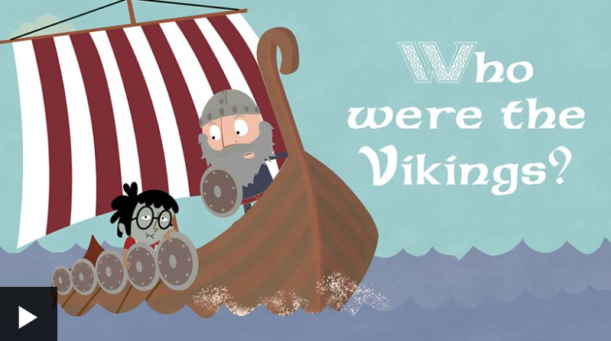
Sit back, relax and enjoy…
Use the following link to access the BBC Bitesize page, ‘Who were the Vikings?’. If the link does not work, type into Google ‘Who were the Vikings BBC Bitesize’ and select the first link.
https://www.bbc.co.uk/bitesize/topics/ztyr9j6/articles/zjcxwty
Watch the clip ‘Who were the Vikings?’

Slide 4
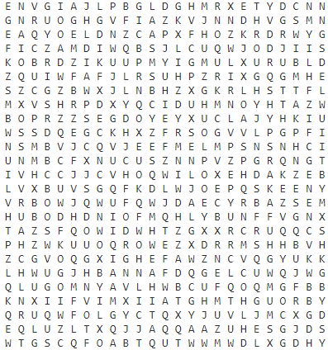
Lesson 1
Spellings
Review of last fortnight’s spellings: word-search
Words with silent letters
doubet
island
lanb
knight
linb
tomb
whisle
plumber
colum
TASK: Complete the Gold word-search which includes the spellings from the last fortnight.
Notes:
Lesson One - As always, we are going to start our spelling lesson by revisiting our previous spelling rule. Our rule last time was words with silent letters. For your task, complete the word-search. Only find the words in the word search which are spelt correctly, five of them are spelt incorrectly!

Slide 5
Lesson 1
Common exception words – a to av
Here are our spellings for this cycle:
accompany
according
achieve
aggressive
amateur
ancient
apparent
appreciated
attached
available
average
Notes:
This week our spelling rule is to learn common exception words from a to av in the alphabet. There are no specific spellings rules applied to these words, so we must come up with strategies to recall how they are spelt. We will do this by memorising them through completing our look, say, cover, write and check sheet and then using our creative flair to design some picture it spellings.

Slide 6
Lesson 1
Practise
Complete your look, say, cover, write and check practise activity
Here are your spellings for this week -
accompany
according
achieve
aggressive
amateur
ancient
apparent
appreciated
attached
available
average
Complete the look, say, cover, write and check sheet.
Challenge: Log on to spelling frame and complete the ‘Segment cards’ activity, then complete 2 games of your choice.

Slide 7
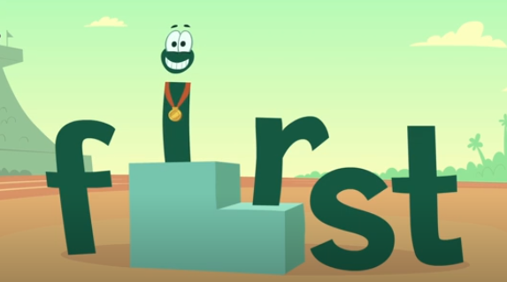
Lesson 1
Apply
Complete your picture-it spellings. For this activity you must draw one of your spelling words out but designing the letters into things which remind you of the words meaning.
Notes:
Finally, let’s apply our spellings – we do this through completing our picture it spellings. You might draw the word achieve in bubble writing, making the letter v a trophy. This is only one idea, use your vast creativity to think of more!

Slide 8
Summarise your initial ideas from the clip…
Lesson 2
Who were the Vikings?
Why did the Vikings come to Britain?
Where did the Vikings come from?
How long did the Vikings stay in Britain?
What did they do whilst they were in Britain?
https://www.bbc.co.uk/bitesize/topics/ztyr9j6/articles/zjcxwty
TASK: First watch the informative clip. Secondly, record any details you learn about the Vikings from the clip, you may wish to use the spider diagram in document 1 for ideas.
Notes:
Lesson Two – Watch the clip which is an introduction all about the Vikings. Discuss with your grown up what you have learnt from the clip about the Vikings. Were you surprised by anything? Use the speech bubbles as possible discussion points i.e. Why did the Vikings come to Britain? Afterwards, add any new information you have learnt about the Vikings in a spider diagram, use document one for some ideas of how to set up your spider diagram.

Slide 9
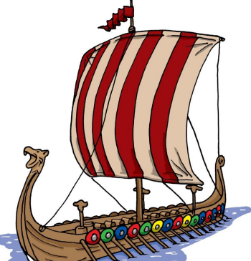
Comprehension Task – Read the Non-chronological report in document two: ‘Who Were The Vikings and Where Did They Come From?’.
Lesson 2
This will help us to absorb even more useful information about the Vikings which will come in useful throughout this unit of work.
Example Q+A:
Q: Where did the Vikings come from?
A: The Vikings came from an area known as Scandinavia. Scandinavia is made up of three countries: Norway, Sweden and Denmark.
TASK: Look at document three. Choose a set of questions to answer about the text. Remember to write your answers in full sentences.
Notes:
For our second task today, we are going to complete a comprehension task which will help us to absorb even more information about the Vikings. Read document two carefully and pick a set of questions (either silver, gold or platinum) from document three. Remember to answer your questions in full sentences.

Slide 10
Features of the Text Type…
Lesson 3
Sub-headings – These may include: Who are the Vikings and where were they from, Why did the Vikings choose to come to Britain, Viking raids, Viking longboats.
Subject specific vocabulary – The Vikings were also known as Norsemen, they originated from Scandinavian countries during medieval teams.
Formal language - Historians accept that Vikings travelled on longboats across the North Sea.
Use of subordinating conjunctions – Before they settled in Britain, Vikings were considered blood thirsty raiders.
Fronted adverbials – Surprisingly, some historians describe the Vikings as settlers as they began to farm British land.
To use brackets for additional detail – The Vikings originated from Scandinavia (Norway, Sweden and Denmark).
Check document 4 for features of the text type.

Slide 11
Features of the Text Type…
Lesson 3
Use the following key to identify the features of the text type in document five. Highlight or colour where the features appear in the text.
Feature | Colour
Have they used sub-headings? | 1
Have they used subject specific vocabulary? | 2
Have they used fronted adverbials to begin sentences? | 3
Have they used parenthesis in the form of brackets? | 4
Have they used subordinating conjunctions? | 5
TASK: Find the skills from the Success Criteria in the text in Document 5. You may highlight, underline with number annotated, or copy out under headings.
Challenge – can you find other key literacy devices used in the text?
Notes:
Lesson Three – For today’s task, we are going to identify all of the different features of our text type non-chronological reports. Read document five closely and create a key which will enables us to identify all of the different features. Remember, we will need a different colour for each different feature. For your parenthesis search, identify the text inside the brackets, consider what additional information is given to you in the brackets. We hope to see these features in the non-chronological report you will write based on the Vikings.

Slide 12
Golden Lines Hunt…
Lesson 4
Read the texts in documents six and seven. Both texts are fantastic examples of non-chronological reports.
Identify any golden lines or vocabulary that is particularly effective and would work in our non chronological report on the Vikings.
Create a mind map of ideas.
Check document 6 and 7 for short stories that can be used to find golden lines.

Slide 13
Golden Lines
Lesson 4
They set out in boats called longships to ‘go Viking’ (which means to go travelling around looking for resources and land to claim as their own).

Slide 14
Research – The Vikings
Lesson 5
In order for us to write an informative, detailed and accurate non-chronological report on the Vikings, we must complete some research. As the Vikings are a civilisation from the past, we are going to conduct some historical secondary research. You may wish to use the internet, books or the WAGOLLS to provide your information.
Our research is going to cover three different areas:
Who the Vikings are and where did they come from?
Why did the Vikings choose to settle in Britain?
Viking longhouses and longships.
These will form our subheadings!
Can you identify some fun/interesting facts to place into your work?
Check document 8 and complete research for the different sub-headings. Complete your research in note form using bullet points.
Notes:
Lesson Five – Today we must complete our research to ensure we have enough detail to write an informative, detailed and accurate non-chronological report on the Vikings. We are going to use our subheadings to identify some key areas of our research. Our sub-headings will be: Who the Vikings are and where they come from, Why did the Vikings choose to settle in Britain and Viking longhouses and longships. As you are completing your research, you may wish to identify some fun and interesting facts about the Vikings to place into your work. Use document eight to help you to complete the research and remember to use bullet points to complete your notes.

Slide 15
Parenthesis using brackets
Lesson 6
We use parenthesis to add additional information to a sentence. Without the parenthesis, the sentence would still make sense. On it’s own, the information in the brackets wouldn't make sense.
Example –
Sentence without brackets – The vicious Vikings originated in the region of Scandinavia.
Sentence with additional information – The vicious Vikings originated in the region of Scandinavia (Sweden, Norway and Denmark).
Sentence without brackets – The Vikings pillaged lots of treasure from monasteries, especially in Lindisfarne.
Sentence with additional information – The Vikings pillaged lots of treasure (gold coins and jewels) from monasteries, especially in Lindisfarne.
Use your research from Friday and write a series of sentences using brackets to provide additional information. Use document 9 A to help to form some sentences using brackets
Notes:
Lesson Six – Today we are going to focus on an area of punctuation within our writing, this is parenthesis using brackets. We are going to be placing brackets within our sentences today. Parenthesis in the form of brackets adds extra information to a sentence therefore without the parenthesis the sentence should still make sense. However, on it’s own, the parenthesis in your brackets wouldn't make sense. See the two examples above which demonstrate how parenthesis can be placed within a non-fictional text. In the first sentence, parenthesis using brackets is applied to provide further details about Scandinavia, it tells us which countries makeup the region (Sweden, Norway and Denmark). Your task today is to use your research from Friday to write a series of sentences which use parenthesis in the form of brackets. Use document nine A to help you to identify some creative ways to get parenthesis into your writing.

Slide 16
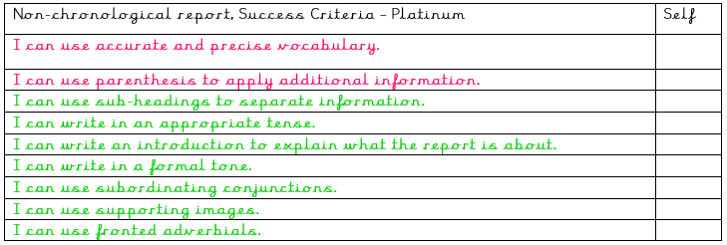
Now it’s time to write
Lesson 7
Read the different success criteria. Decide whether silver, gold or platinum is most suitable for you.
Check document 9 for differentiated success criteria.

Slide 17
Let’s begin our writing…
Lesson 7
Today, we are going to write our introduction paragraph for our non-chronological report on the Vikings. We are going to summarise the Vikings here using all of our research.
You must first select your title.
Your title must clearly explain the subject of our report and stand out to the reader.
As a challenge you may wish to include some alliteration.
For example –
The Vicious Vikings – Were they settlers and raiders?
Use document 10 for a plan of what you may wish to include in each paragraph.
Notes:
Lesson Seven – Today we are going to begin writing our non-chronological report on the Vikings. To ensure that this report is successful we are going to implement all of the planning which we have developed over the past week. You may wish to watch the short clip and re-read through your research to re-familiarise yourself with some of the key knowledge from our unit. The first thing we must decide when writing our non-chronological report is the title. This must summarise the subject of your report and your purpose for writing. As a challenge, you may wish to apply alliteration as we have in previous units of learning for example our news report on a volcano eruption. A good example of a title is – The Vicious Vikings – Were they settlers or raiders?

Slide 18
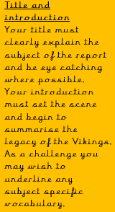
Introduction paragraph
Lesson 7
Use my modelled paragraph to portray your introduction paragraph. You can use my example for golden lines or write your own opening. Remember to use the success criteria to guide your writing.
For many centuries, the Vikings ruled huge swathes of England raiding and pillaging those who dared to stand in their path. Historically, the Vikings have established a reputation for being brutal savages however was this a truly accurate reputation of their priorities? This report will question that fundamental assumption, forwarding the idea that whilst the Vikings were violent and brutal in battle, their long term goal was to settle down in Britain.
Use document 10 for a plan of what you may wish to include in each paragraph.
Notes:
For our second task today, we are going to write our introduction for our non-chronological report on the Vikings. Read the example above for golden lines and some examples of subject specific vocabulary. Your introduction paragraph should set the scene of the report and highlight any key areas you need to discuss – you may wish to summarise the legacy of the Vikings here. The example above provides a fantastic example of a range of different sentence starters which are appropriate for a non-chronological report. For example, ‘For many centuries’ and ‘historically’.

Slide 19
Let’s continue our writing…
Lesson 8
Today, we are going to write our second and third paragraph of our non-chronological report on the Vikings.
Information to consider in paragraph - Who the Vikings are and where they came from:
Viking traditions and beliefs.
Why the Vikings left Scandinavia?
Climate conditions in Scandinavia.
How were the Vikings received in Britain?
Information to consider in paragraph – Why did the Vikings choose to settle in Britain?
What did Britain have which the Vikings wanted?
Identify Viking jobs in Britain.
Who did the Vikings battle with in Britain?
Should the Vikings be considered raiders or settlers?
Use document 10 for a plan of what you may wish to include in each paragraph. Today we are going to write paragraphs two and three.

Slide 20
Let’s continue our writing…
Lesson 8
Use my modelled paragraph to portray your second paragraph. You can use my example for golden lines or write your own based on our research. Remember to use the success criteria to guide your writing.
Who are the Vikings and where did they come from?
The Viking era began to define Europe in the year 700AD. During this period, many Vikings left their homeland in Scandinavia (Sweden, Norway and Denmark) and made the risky and perilous journey to Britain in search of fame and fortune. Scandinavia was becoming overcrowded and therefore resources in their home country were beginning to fall short in supply. Initially, the Vikings were welcomed by the inhabitants of Britain however this was short lived as the Vikings violently demonstrated that they came in search of personal gain at the expense of others.
First sub-heading
Use subject specific vocabulary throughout your writing.
Apply parenthesis for additional information.
Where is Scandinavia?
What is the climate like?
Why did the Vikings choose to leave?
Use document 10 for a plan of what you may wish to include in each paragraph. Today we are going to write paragraphs two and three.
Notes:
Lesson Eight - Our first task today is to write our section on ‘Who are the Vikings and where did they come from?’ We must first miss a line from our introduction paragraph and write our first subheading. We can choose to underline this so it stands out to the reader. Now it is time to write our paragraph, remember to refer to your research in order to ensure we can write an accurate and informative report. Read the example above for a WAGOLL for your paragraph. The WAGOLL provides a fantastic example of parenthesis using brackets where it identifies the countries which form Scandinavia. Refer to document ten for other ideas of what to enter in this paragraph.

Slide 21
Let’s continue our writing…
Lesson 8
Use my modelled paragraph to portray your third paragraph. You can use my example for golden lines or write your own based on our research. Remember to use the success criteria to guide your writing.
Why did the Vikings choose to settle in Britain?
As a result of severe weather and the associated uncomfortable conditions, the Vikings grew increasingly unsettled in their homeland of Scandinavia. The cold weather made it exceptionally difficult to grow healthy crops leading to food shortages for an ever expanding population. Therefore, the Vikings began to broaden their horizons to lands across the Northern Sea. Initially, the Vikings often landed in Lindisfarne where they had iconic battles with it’s inhabitants and raided monks in their monasteries. However, this aggression was often short lived as the Vikings set up sustainable farms.
Second sub-heading
Use fronted adverbials.
Write in a formal tone.
What did Britain have which the Vikings wanted?
Identify Viking jobs in Britain.
Who did Vikings battle with in Britain?
Should the Vikings be considered raiders or settlers?
Use document 10 for a plan of what you may wish to include in each paragraph. Today we are going to write paragraphs two and three.
Notes:
Our second task today is to write our paragraph which is based on ‘Why did the Vikings choose to settle in Britain?’. To ensure that this paragraph is as descriptive as possible, re-read your research which you found on Friday for this section. A good idea to identify any key points you wish to mention may be to underline them in your research. Remember to miss a line from your previous paragraph and write the new subheading – ‘Why did the Vikings choose to settle in Britain?’. Have a look at the WAGOLL above, this provides a great example of lots of subject specific vocabulary you may wish to use. Refer to document ten for other ideas of what to enter in this paragraph.

Slide 22
Let’s Finish our writing…
Lesson 9
Today, we are going to write our fourth and final paragraph of our non-chronological report on the Vikings.
Information to consider in paragraph – Longhouses and longships
Key features of a Viking longhouse.
Key features of a Viking longship.
What were Viking villages like?
Information to consider in paragraph – Conclusion
Summarise your key information from the report.
Should the Vikings only be described as violent savages or were they more sophisticated.
Have you got any fun or interesting facts to enter here?
Use document 10 for a plan of what you may wish to include in each paragraph. Today we are going to write paragraphs four and five.

Slide 23
Let’s finish our writing…
Lesson 9
Use my modelled paragraph to portray your fourth paragraph. You can use my example for golden lines or write your own based on our research. Remember to use the success criteria to guide your writing.
Viking longhouses and longships
The Vikings made the rough and dangerous journey to Britain from Scandinavia on longships. Did you know, that even in good conditions, the journey would take on average six days? The primary aim of the longships was to provide a sleek and quick form of transport. Many longships had the capacity to hold around 120 men, this was vital to ensure that the Vikings had enough strength during raids. Both Viking longships and longhouses would be decorated with mythical creatures aimed to strike intimidation and fear in opponents.
Third subheading
Use of subject specific vocabulary.
Use of clear and reliable research throughout.
Key features of a Viking longhouse.
Key features of a Viking longship.
What were Viking villages like?
Use document 10 for a plan of what you may wish to include in each paragraph. Today we are going to write paragraphs four and five.
Notes:
Lesson Nine – For our first task today, we are going to write our paragraph based Viking longhouses and longships. Firstly, you must miss a line from your previous paragraph and write the subheading ‘Viking longhouses and longships’. You may wish to underline your subheading in order that it stands out to the reader. Once you have set this up, re-read your research from this section which you made on Friday and have a close read of the WAGOLL above. Throughout this paragraph think about the key features of both Viking longhouses and longships. If you haven't got a key literacy feature from your success criteria in your work yet, now is a great opportunity to add this in.

Slide 24
Let’s finish our writing…
Lesson 9
Use my modelled paragraph to portray your final paragraph. You can use my example for golden lines or write your own based on our research. Remember to use the success criteria to guide your writing.
Conclusion
Throughout this report, the Vikings have been described as both being raiders and settlers. On the one hand, there are several examples of the Vikings acting as blood-thirsty warriors who cared little for the inhabitants of Britain. Such examples include their raids on Lindisfarne. Although they did attack on a regular basis, they did not wear horned helmets which they are pictured to wear in lots of representations. On the other hand, they could also be considered settlers as they began to construct villages and sustainably farm the land.
Final subheading – Conclusion/summary
Use fronted adverbials to open your sentences..
Include any interesting facts you haven't been able to insert already.
Use document 10 for a plan of what you may wish to include in each paragraph. Today we are going to write paragraphs four and five.
Notes:
For our second task today, we are going to write the final paragraph of our non-chronological report, our summary. So before we start writing, ensure that you have missed a line from your final paragraph. Our summary/conclusion must provide an overview of our whole report. Before you begin to write your summary, read through your non-chronological report and absorb all of the detail you have mentioned. Read the WAGOLL above to identify any golden lines you may wish to use. You may want to leave the reader an interesting fact here which you have found out about the Vikings. A good sentence starter to begin this paragraph would be ‘Throughout this report…’.

Slide 25
Is your non chronological report complete? Prove-it
Lesson 10
Once you have finished your writing, check through carefully and use a dictionary to check spellings (online dictionaries can be very useful during this process). Have you achieved all of your success criteria?
Write down the sentences which demonstrate proof of the use of each feature on the success criteria.
If you haven't managed to get a feature in, now is a great time to insert it.
Leave a self assessment and get an adult to email your work through the home learning address.
Also, now is a great time to add any supporting images to your text.

