Slide 1
Document one:
Headings are an example only. You may wish to consider your own headings.
What did the Vikings do whilst they were in Britain?
Where did the Vikings come from?
Who were the Vikings?
Why did the Vikings come to Britain?
How long did the Vikings stay in Britain?

Slide 2
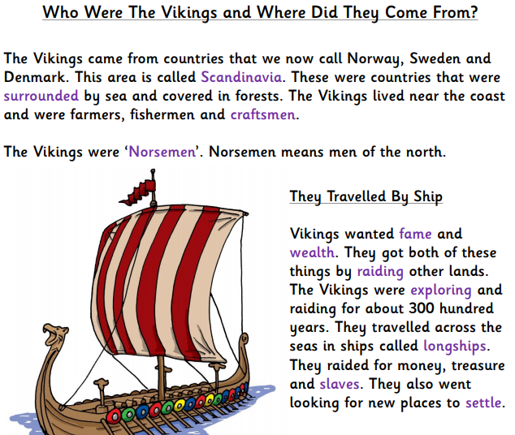
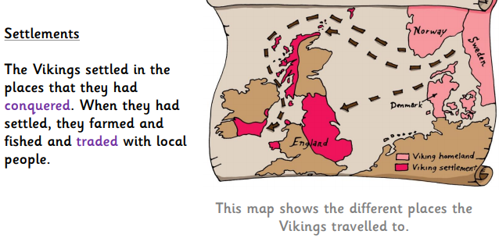
Document two –

Slide 3
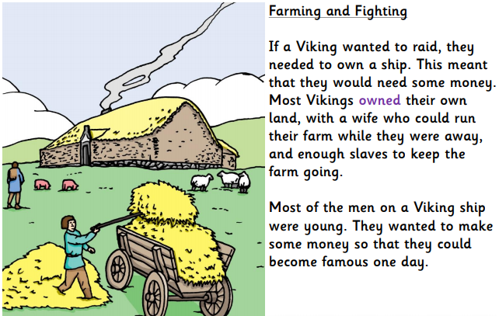
Document two –

Slide 4
Document three: Comprehension questions to ‘absorb’ key information.
Silver:
Where did the Vikings come from?
What does the term ‘Norsemen’ mean?
Why did the Vikings raid?
Choose one word which describes a Viking. Explain why you have chosen this word.
What did Viking smiths make?
Explain how we know so much information about the Vikings.
Platinum:
What type of text is this? Explain how you know.
Would you have liked to have been a Viking? Explain your answer.
What would it of been like to travel on a Viking longship?
Do you think that Vikings preferred farming or raiding? Why?
Can you think of any reasons why the Vikings might have wanted to settle in Britain?
Which do you think Vikings placed in greater importance fame or fortune?
Gold:
When they were in Scandinavia, what jobs did the Vikings have?
How did the Vikings gain their ambition of having both fame and wealth?
For how long did the Vikings explore and raid?
How were Viking farms ran?
Why were silver coins useful for Vikings?
What are the key features of a non-fiction text?

Slide 5
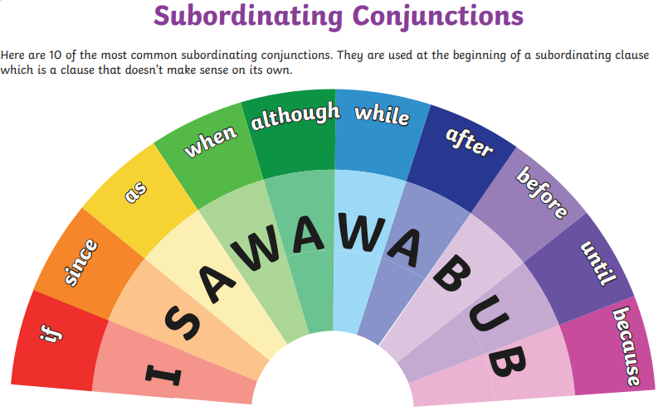
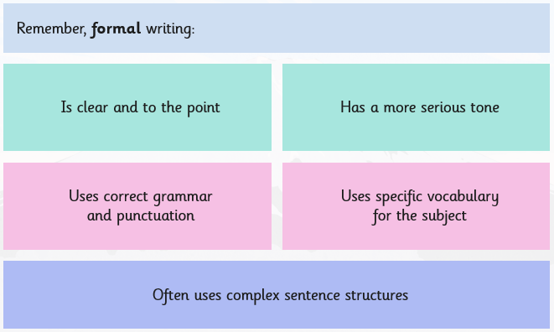
Document four
Features of text type -
Subordinating conjunctions -
Sub-headings –
Sub-headings are used to separate sections of text.
They can be used to capture the reader’s attention and inform the reader of what the section will be about –
Possible sub-headings to include in our non-chronological report on the Vikings –
- Who are the Vikings and where did they from?
- Why did the Vikings choose to come to Britain?
- Viking longhouses
- Viking longboats
Subject specific vocabulary –
These are words which are important to a specific topic. They are used throughout the study of the subject.
Look at the spider diagram below for some which are suitable for our topic of the Vikings, can you think of more?
Formal language –
Longship
The Vikings
Historians
Longhouse
Monasteries

Slide 6
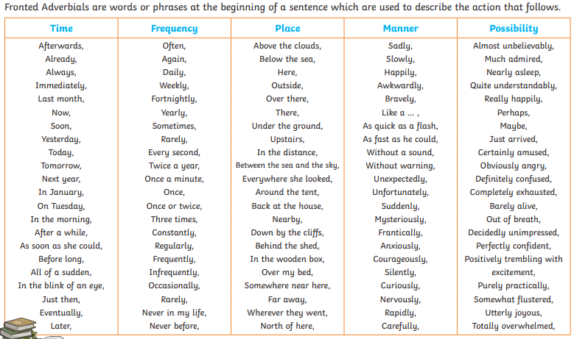
Document four
Features of text type -
Using brackets to add additional detail –
Using brackets in a sentence is a form of parenthesis.
They are used to add additional information.
The sentence must make sense without the words in inside the brackets
Examples in our topic –
The Vikings travelled from the region of Scandinavia (Sweden, Norway and Denmark).
Vikings settled in Britain and worked on the farms where they had lots of animals (including goats, sheep and chickens).
Fronted adverbials –

Slide 7
Document five
The Vicious Vikings
The Vikings have caused lots of debate amongst historians over the recent decades as to whether they should be classified as raiders or settlers. On the one hand they regularly took part in blood thirsty pillages but on the other they stayed in Britain for centuries and farmed the land. Incredibly, whilst the Vikings raided and attacked in Britain, Norse society was governed by strict law.
Who were the Viking and where were they from?
From the distant lands of Scandinavia, came a group of people called Vikings. They sailed across the North Sea towards Britain first arriving in 787AD. In order to arrive safely, the Vikings used their longships, which were long, wooden boats. The journey across the North Sea was often tough and would take them around six days (in good and favourable conditions).
Why did they choose to come to Britain?
Surprisingly, one of the main reasons the Vikings came to Britain was because our land was more fertile than theirs in Scandinavia. The Vikings wanted to grow their own crops successfully and in milder weather, so this was one of the main reasons they sailed over to Britain.
Unfortunately, there was another reason that some Vikings made the treacherous journey to Britain. This was so that they could steal valuable items (from monasteries and monks) and then sell them, helping them to become rich and famous.
Viking Raids
Violently, the Vikings would raid different buildings, mainly monasteries. A raid was a surprise attack, and the Vikings were merciless in their raiding, determined to get their hands on as many valuable things as they could. Often, a raid would be brutal, resulting in many deaths of unarmed people. The Vikings would often decorate their longships with intimidating creatures such as dragons since they wanted to strike fear in their foes.
Viking Warriors
Viking warriors were brave, daring and ruthless fighters and this is a reason why they were so successful in both raids and battles. Bravely, the warriors would storm into battle carrying a wooden shield, covered in leather and an axe. If a Viking warrior had been extremely brave, he would be rewarded with a sword, this was something which needed to be treasured.
To conclude, the Vikings were brave warriors and not afraid to fight until death. They were also clever as they knew invading Britain would allow them to grow more crops and become richer.

Slide 8
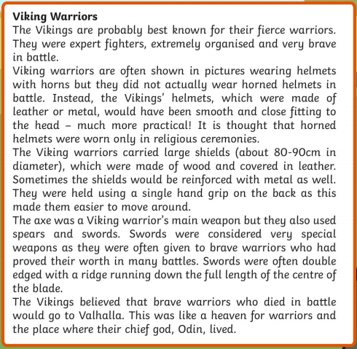
Document six:
“

Slide 9
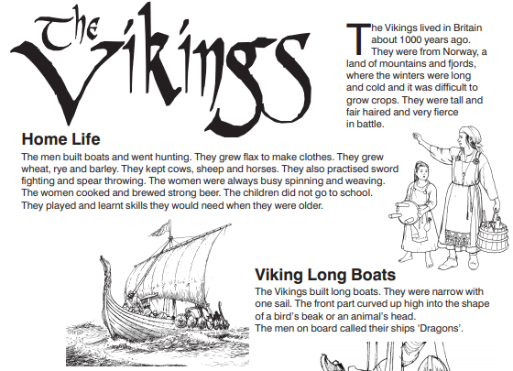
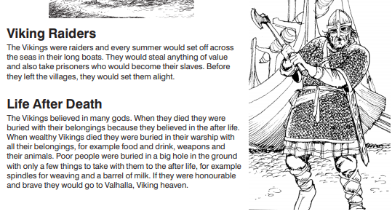
Document seven:

Slide 10
Document eight: Researching our non-chronological report
Who are the Vikings and where did they come from?
Areas to consider –
Viking traditions and beliefs.
Why the Vikings left Scandinavia?
Climate conditions in Scandinavia.
Why did the Vikings chose to settle in Britain?
Areas to consider –
What did Britain have which the Vikings wanted?
Who did the Vikings battle with in Britain?
Should the Vikings be considered raiders or settlers?

Slide 11
Document eight: Researching our non-chronological report
Viking longhouses and longships –
Areas to consider –
Key features of a Viking longhouse.
Key features of a Viking longship.
What were Viking villages like?
Interesting or fun facts about the Vikings -

Slide 12
Document nine A – Writing sentences using brackets to provide additional information.
These sentences are only ideas and you may wish to use your own ideas.
Use the information in the brackets to support you in the what to enter in the brackets.
Who are the Vikings and where did they come from?
Sentence without brackets – The Vikings travelled from Scandinavia to escape from the tough climate conditions.
Sentence with brackets – The Vikings travelled from Scandinavia to escape from the tough climate conditions (describe the climate conditions in Scandinavia here).
Why did the Vikings chose to settle in Britain?
Sentence without brackets – Throughout the medieval period, the Vikings battled with lots of people to establish their dominance in Britain.
Sentence with brackets – Throughout the medieval period, the Vikings battled with lots of people (insert people who the Vikings battled with i.e. Monks) to establish their dominance in Britain.
Viking longhouses and longships
Sentence without brackets – Vikings travelled to Britain on longships, the long journey was usually treacherous and rough.
Sentence with brackets – Vikings travelled to Britian on longships, the long journey (describe how long the journey was) was usually treacherous and rough.

Slide 13
Document nine:
Success criteria
Silver
Gold

Slide 14
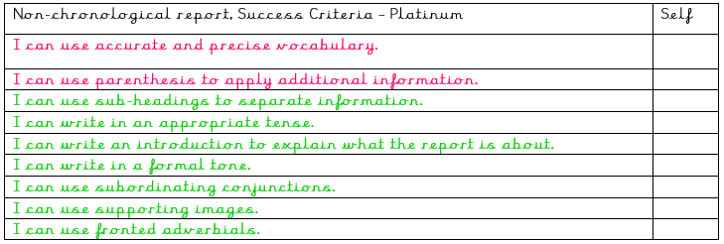
Document nine:
Success criteria
Platinum

Slide 15
Document ten:
Possible structure of writing
Title – The Vikings, were they raiders or settlers?
Set out what contents of the report.
What reputation do the Vikings have? Why do they have this reputation?
Challenge – Is this reputation accurate?
Subheading one – Who are the Vikings and where did they come from?
Viking traditions and beliefs.
Why the Vikings left Scandinavia?
Climate conditions in Scandinavia.
How were the Vikings received in Britain?
Subheading two – Why did the Vikings choose to settle in Britain?
What did Britain have which the Vikings wanted?
Identify Viking jobs in Britain.
Who did Vikings battle with in Britain?
Should the Vikings be considered raiders or settlers?
Subheading three – Vikings longhouses and longships
Key features of a Viking longhouse.
Key features of a Viking longship.
What were Viking villages like?
Conclusion – Summarise your report
- How should the Vikings be perceived, as raiders or settlers?

