Slide 1

Reception
Book Week Tasks
1st March 2021

Slide 2

World Book Week
This power point details the different tasks set for Hillside’s World Book week in Reception.
These tasks have been chosen to be fun, engaging and to continue to develop your child’s love of reading.
We hope you enjoy them.
Notes:
Hello Reception and welcome to world book week at hillside. We love celebrating book week at hillside and this year is no different. We have lots of exciting activities planned for you whether you are at home or school. So read on to find out where our journey begins.

Slide 3
Monday 1st March – Book Tasting
Today we would like you to explore the new book that you have been gifted from school.
Retell the story
Act out the story
Read the story over and over again
Talk about your favourite part in the story
Notes:
We’re starting our book week activities with a book tasting experience. You have all been gifted a book from school and this year, our books range from stories about princesses, stories about dragons and lots of other exciting characters. we would like you to share your book with your grown up making sure you read your story lots of times. Talk about your favourite part of the story, try acting it out or simply retelling it in your own words.

Slide 4
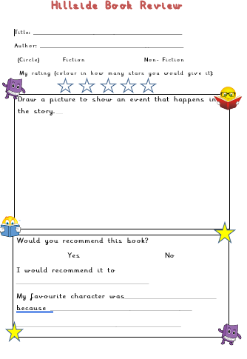
Monday
Hillside’s Book Tasting!
Complete your book tasting!
Set your table
and put your book-meal on the top!
Fill in the book review attached and then you could design your own plate of food linked to the story or for one of the creatures you meet, if you wish.
Notes:
Use your place mat for your book tasting experience and then afterwards you could design your own plate of food linked to the story. There is also a book review attached so that you can let me know what you thought of your story.

Slide 5
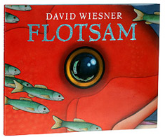
Tuesday 2nd March – Sit back, relax and enjoy!
Flotsam by David Weisner
Watch the story of Flotsam on youtube: https://www.youtube.com/watch?v=3MTKWnxzqvM&safe=true
Talk with your grown up about what
is happening in the pictures. Have you
ever been to the beach? Did you find
anything? Use the pictures to help you
think about your own adventures at
the beach.
Notes:
Sit back, relax and enjoy an exciting journey through the lense of a camera with the story ’ Flotsam’ by David weisner. Afterwards, talk about the story with a grown up. Did you like the story? What was it about? Have you ever been to the beach? What did you find.

Slide 6
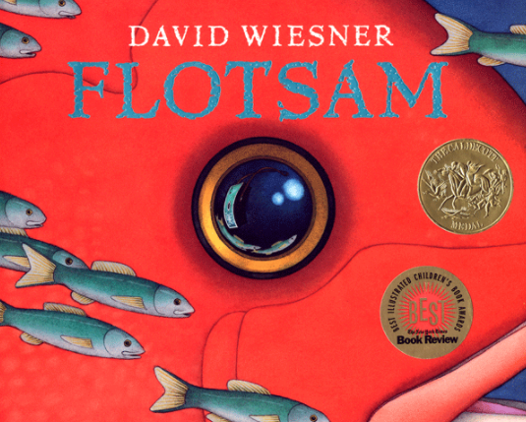
The Flotsam Story
The book has no words, but is told through pictures. A boy is at the beach and finds an old camera. He takes the film to get it developed, and sees photos of fantastical undersea cities and inventions. The final section of the book consists of a girl, who is holding a photo of a child, who is holding a photo of a child, who is holding a photo of a child, and so on. The boy figures out that he is one in a long line of photographers who have found this camera. He takes a picture of himself holding this photo and tosses the camera back into the ocean; it is carried across the ocean by a variety of fish and sea life, until it again washes ashore and another child finds it.
Notes:
This slide contains a summary of the story and it explains that ….

Slide 7
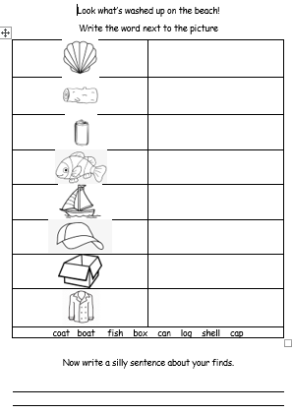
Wednesday 3rd March
Look what’s washed up on the beach!
Think about your adventures on the beach and what you might have found washed up there.
Discuss with an adult and then complete the sheet attached. Don’t forget to have a go at a ‘silly’ sentence using a capital letter, finger spaces and a full stop a the end.
Notes:
Today I’d would like you to think about the different objects that you have found or might find on a beach. There is a sheet attached with some ideas that you need to label and then use to make a silly sentence. Don’t forget to use a capital letter, finger spaces and a full stop

Slide 8
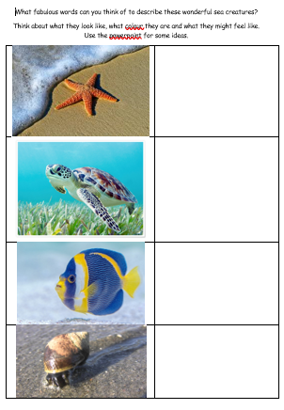
Thursday 4th March
Sea creature descriptions
Think about the range of sea creatures that you saw on the London Aquarium experience and also in the story
‘Flotsam’ and then think of your own describing words (adjectives) to describe the creatures on the sheet attached.
Can you think of more than one for each creature? Use the following two slides for some ideas.
The world was completely still. Nothing moved, not a leaf quivered, but over the silence brooded a ghostly calm and the whisper of his smoking breath as it rose in gasps and lingered in the frosty air.
Notes:
Today I would like you to get creative with words as well as artwork. After watching the videos of the London aquarium and the story Flotsam I want you to think of lots of exciting words to describe the creatures that you saw. Use the following two slides for some ideas and then note down these ideas ready to use in your story. There are also some Sea creature masks included to get your creative juices flowing.

Slide 9
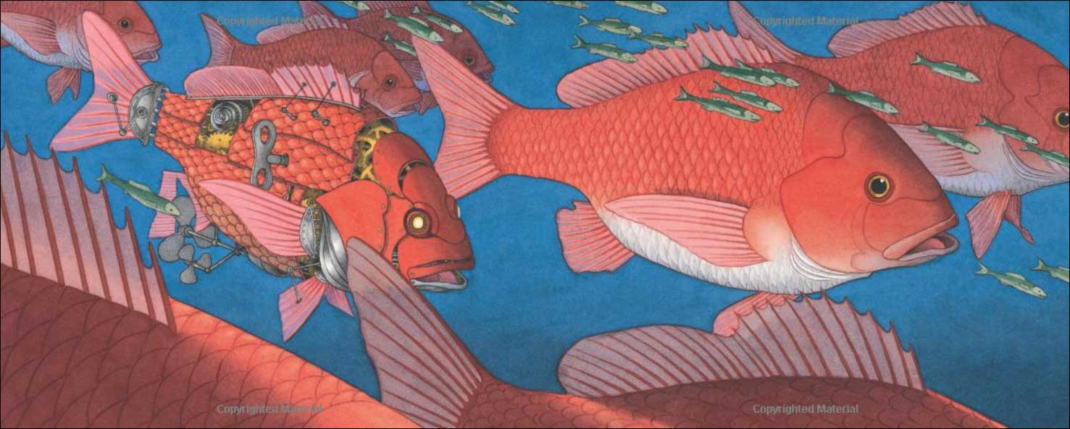
fish
scales
fins
tiny
enormous
orange
Notes:
What words can you use to describe the fish in the story?

Slide 10
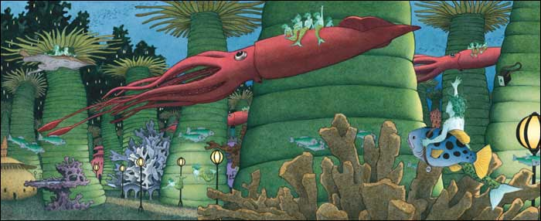
slim
gliding
long
creatures
strange
coral
spiky
Notes:
Can you think off any other words?

Slide 11
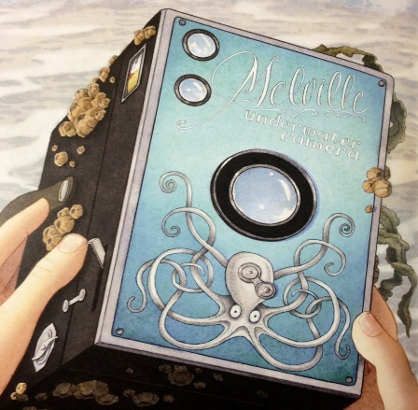
Friday 5th March
Now it’s time to write…
Imagine you have just found a camera on the beach! Take three photographs that tell your story. Use the sheet attached to set out and write your story. You may decide to draw the pictures yourself and then ask an adult to scribe the story for you. Or you may be brave enough to have a go yourself.
If you do write your own words or sentences, don’t forget to use capital letters, finger spaces and full stops where appropriate.
Notes:
Now its time to put all of your ideas down in one fantastic story. Imagine that you found the camera in the story. what will you see through the lense? Use the template provided to plan your story first, with a series of three pictures. Then decide what happens at the beginning of your story. Did you find something on the beach? Could you include some of the flotsam that you labelled. What happens next? Did you meet any of the fantastical sea creatures in your story. Can you use some of the powerful describing words in your sentence. And finally, where does your story take you ?? Good luck reception, I cant wait to see your stories!

Slide 12
All done – well done!
Once you have finished your writing, check through carefully and ask an adult to help you to check your writing makes sense and that you have used capital letters, finger spaces and full stops.
Send your competition entry to the Home Learning email address. A winner will be chosen and a prize awarded so a big well done for creating a super story and good luck! ☺
Notes:
Well done reception . What an exciting journey we’ve all been on this week. I hope you’ve enjoyed all of our lovely activities and developed your love of reading even more. If youre entering the story competition don’t forget to send your entries in to the home learning email. A winner will be announced and a prize award

