Slide 2
Children’s Mental Health Week
2021
It is Children’s Mental Health Week and the theme this year is EXPRESS YOURSELF! Over the week we will be completing a daily activity in school and we hope that children at home will join in too! Your physical and mental health is very important and the following powerpoint and activities will give you ideas about how to stay mentally healthy! We hope you enjoy them!
Each day there will be a different activity to have a go at in school or at home. They might be discussion activities, creative activities or activities that encourage you to talk and think about how you can keep yourself mentally healthy!
Last year we did a week long yoga course in school – how different that would look if we did it this week! Times are different now and we hope you join in as our mental health has never been so important!

Slide 3
The Big Questions Take your time to go through the different slides and each day, have a go at the activity suggested if you can! If you take any amazing pictures or create anything spectacular, please send it in to school via the Year 1 Home Learning email address – Mrs Rushton will be thrilled to see them!

Slide 4
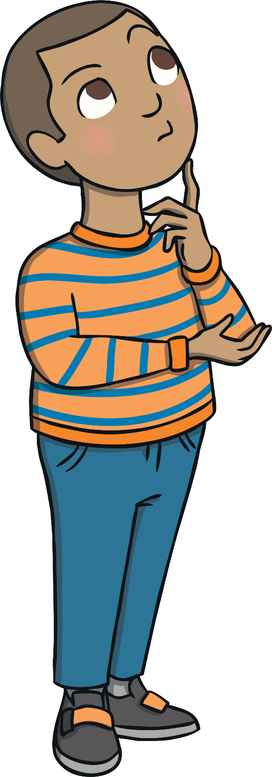
The Big Questions
How can we keep our minds healthy?
What is positive mental health?

Slide 5
Remind yourself of what you already know – reconnect with how to be healthy!

Slide 6
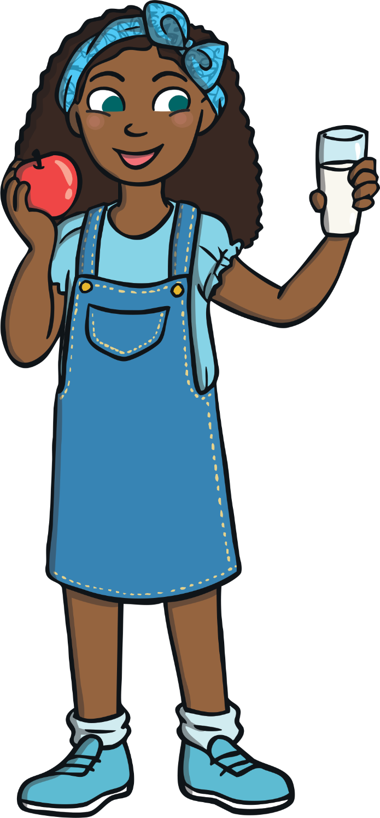
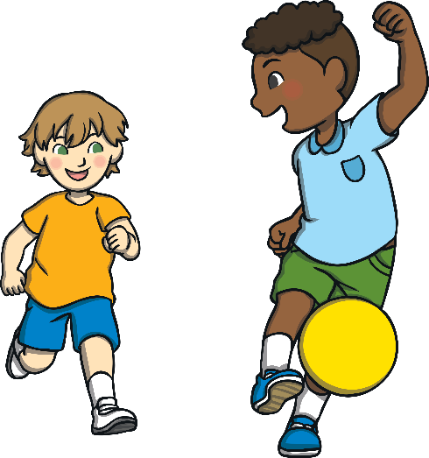
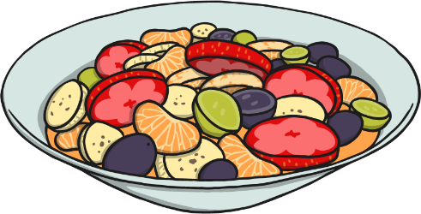
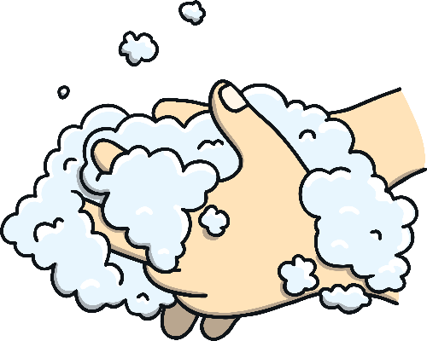
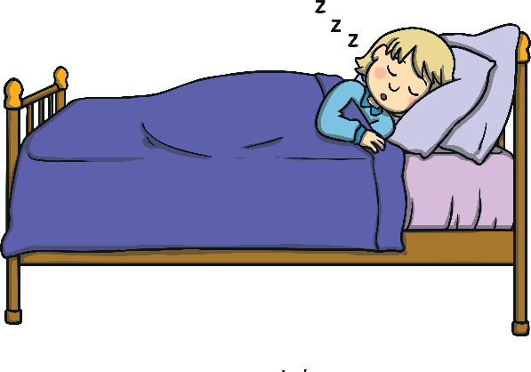
Healthy Bodies
Being healthy means that our body and our mind are in good condition and that we feel well.
What can we do to help our body to be healthy, be in good condition and
feel well?
With a friend or someone in your family, think of three different things that keep your body healthy!

Slide 7
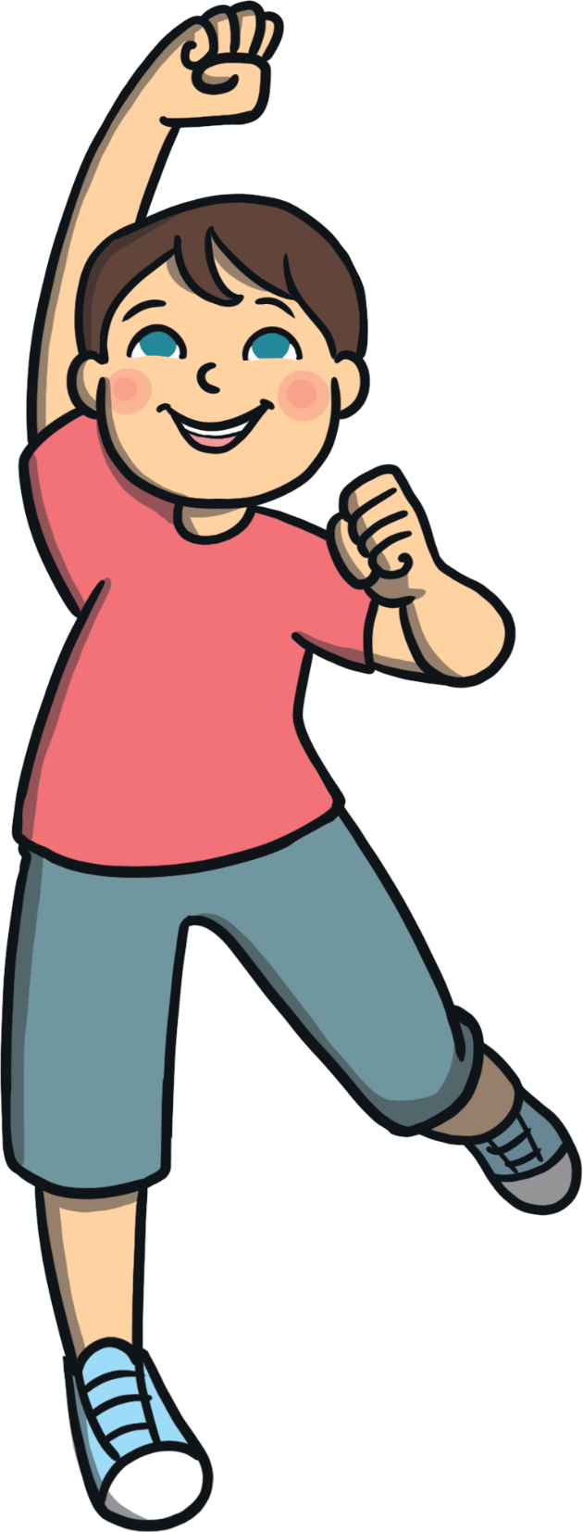
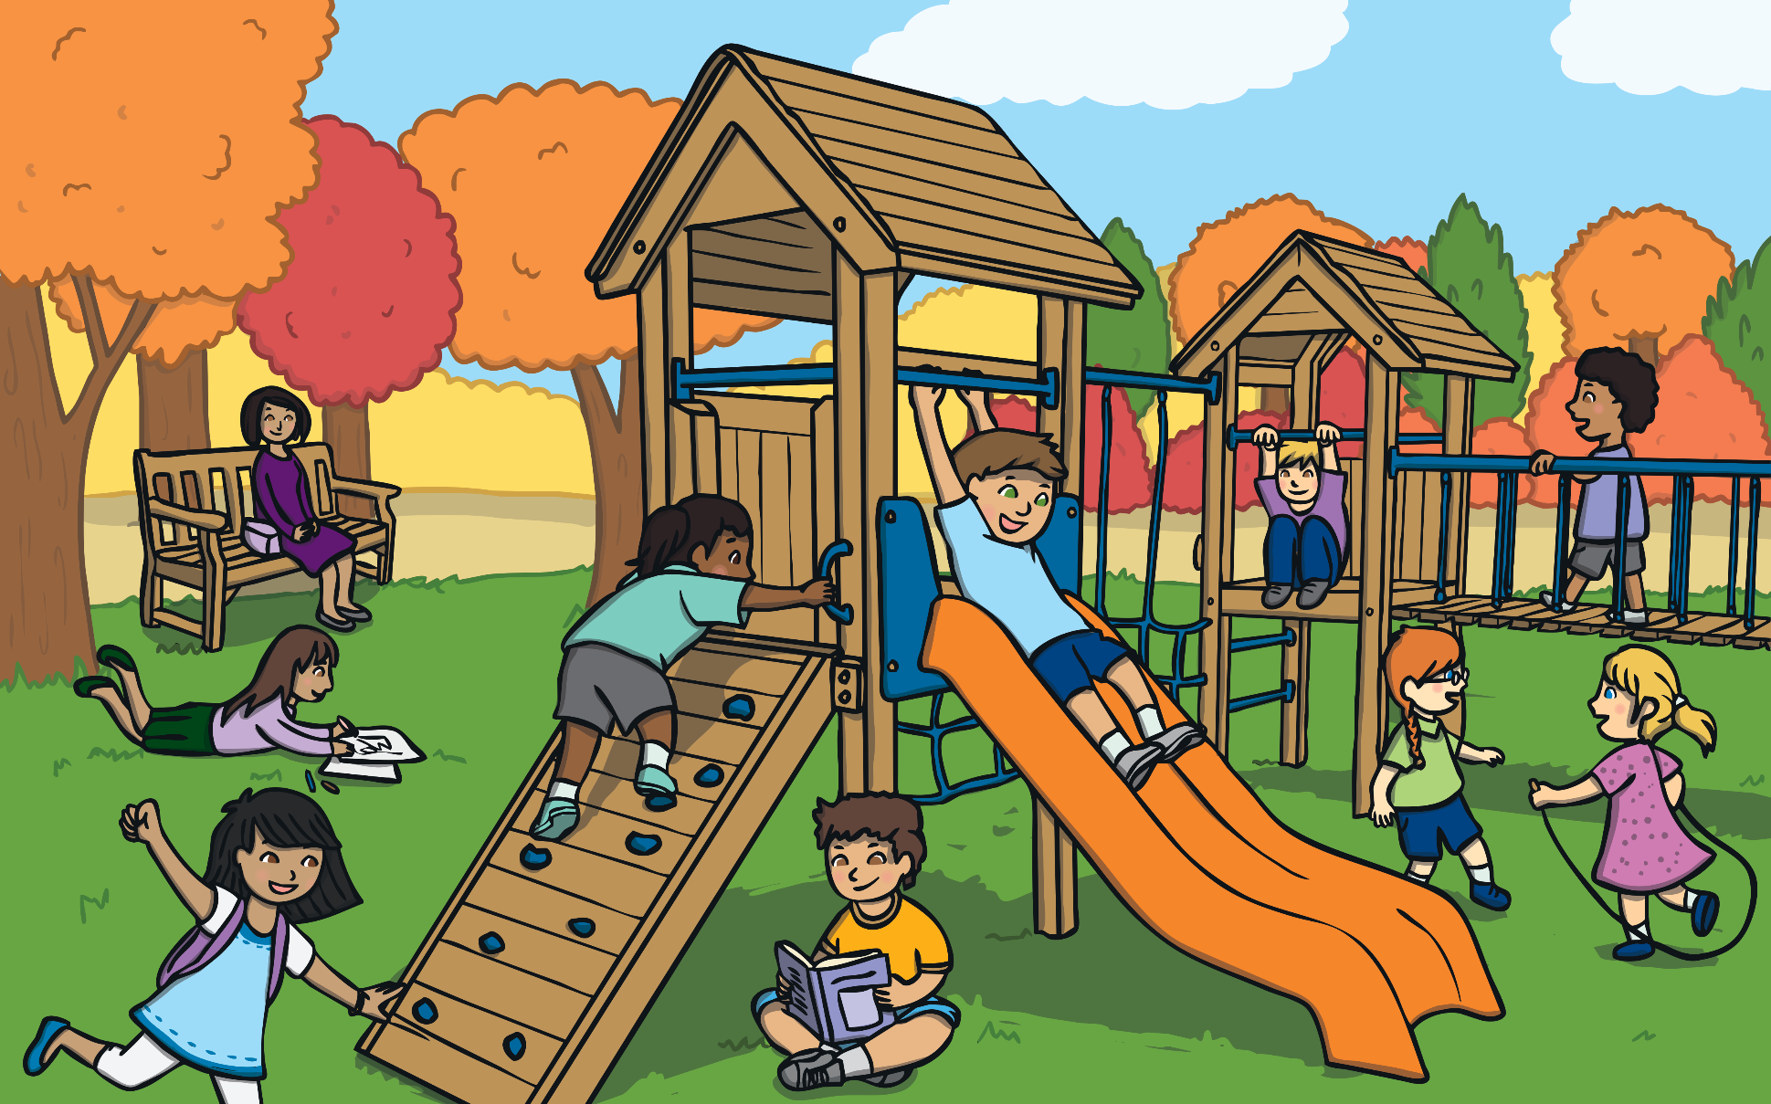
Healthy Bodies
Why do you think it is important to make choices and take actions to keep our bodies healthy?
It is important to make healthy choices so our body works as well as it can.
Doing all we can to keep our body healthy can help us to feel happy too.

Slide 8
Exploring our mental health

Slide 9
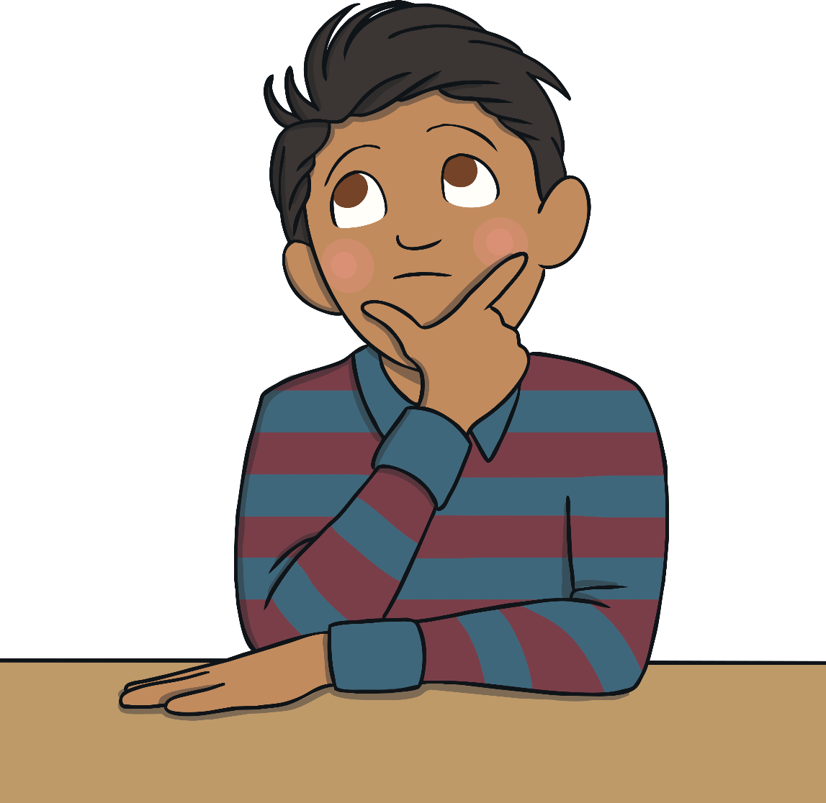
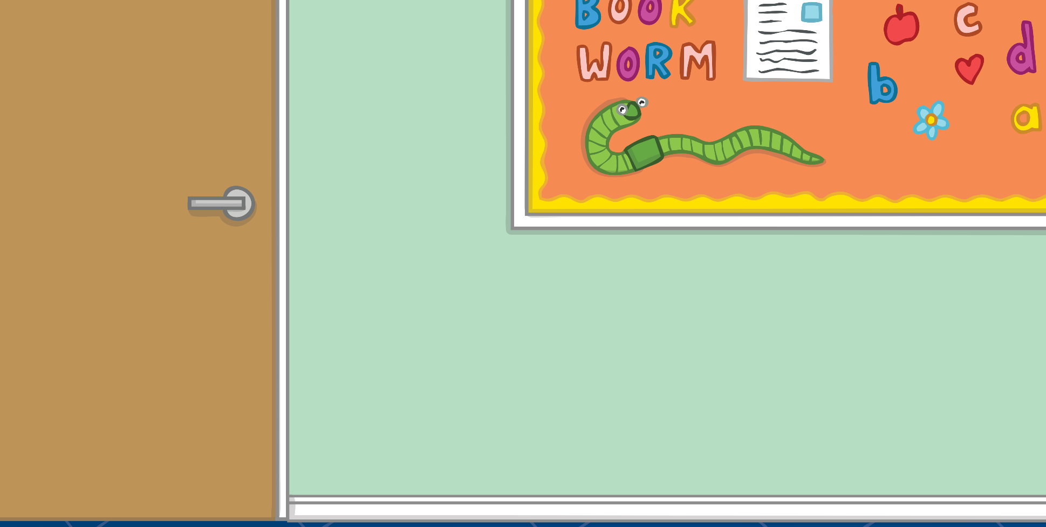
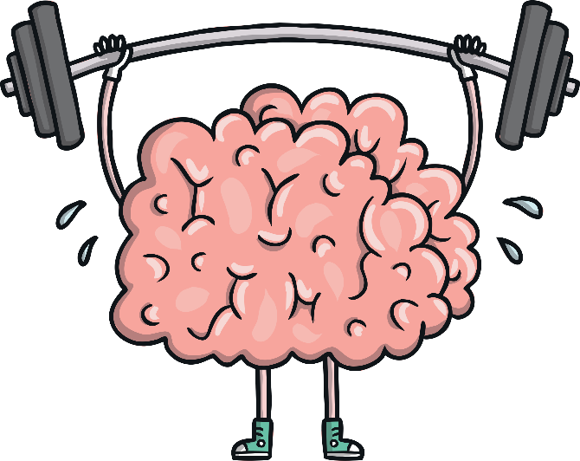
Healthy Minds
Mental health is all about how we are feeling and the thoughts we are having. It can affect how we behave and the choices we make.
Just like with our body, it is important we do things to help our minds to be healthy, be in good condition and feel well.

Slide 10
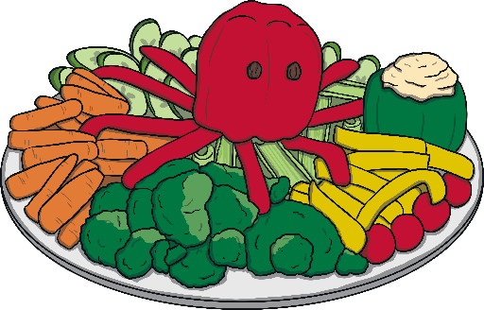
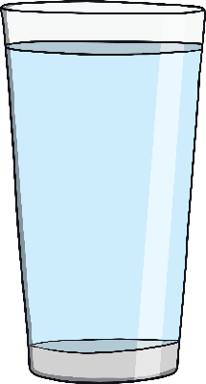
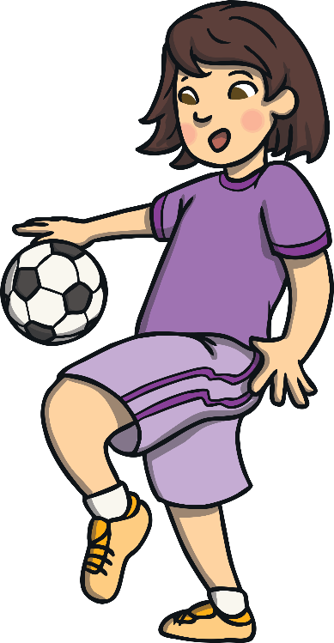
Healthy Minds
What can we do to help our minds be healthy?
We can keep active.
We can eat healthily.
We can drink enough water.
We can ask for help if something is troubling us.
We can make sure we have time each day when we can be calm and quiet.

Slide 11
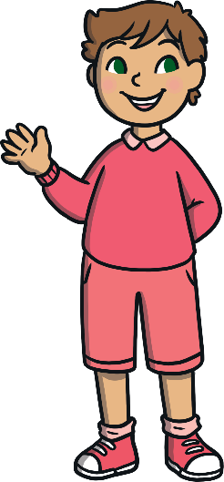
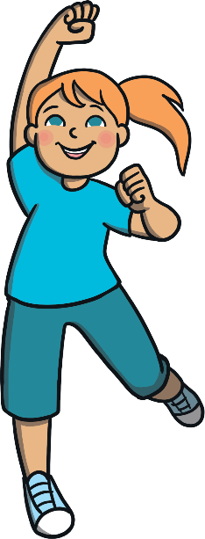
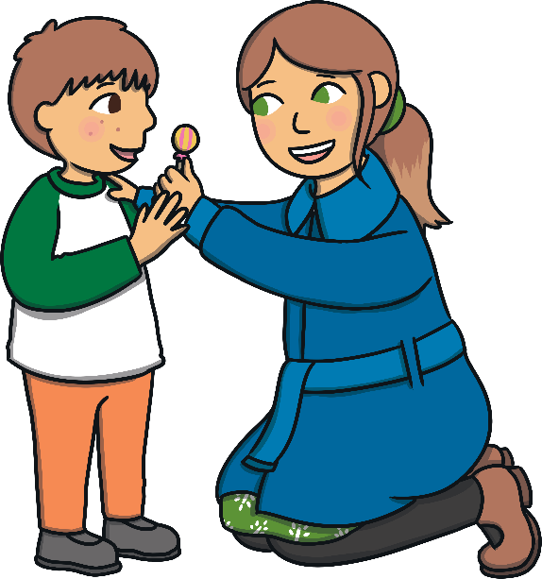
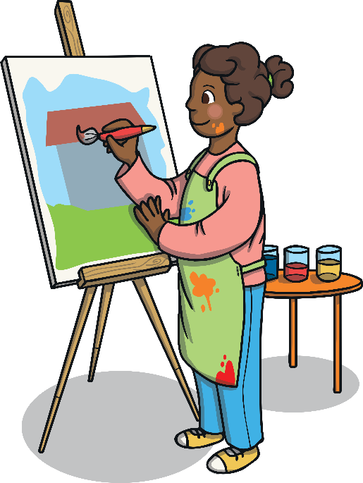
Healthy Minds
We can spend time each day doing something we love.
We can spend time outside.
We can be creative.
We can help others.
We can make sure we get enough sleep.
We can spend time with people who make us smile.
We can remember we are special just the way we are.

Slide 12
Healthy Minds
Sometimes, just like our body, our mind doesn’t feel well. We might feel very worried, frightened or extremely sad. We might have thoughts which feel uncomfortable and that make us behave in a way that hurts ourselves or others.
If you are feeling worried or sad, talking to someone you trust is a good place to start.
Positive mental health is not about being happy all of the time. It is about feeling well, being able to enjoy life and knowing what to do if we have troubling thoughts and feelings.

Slide 13
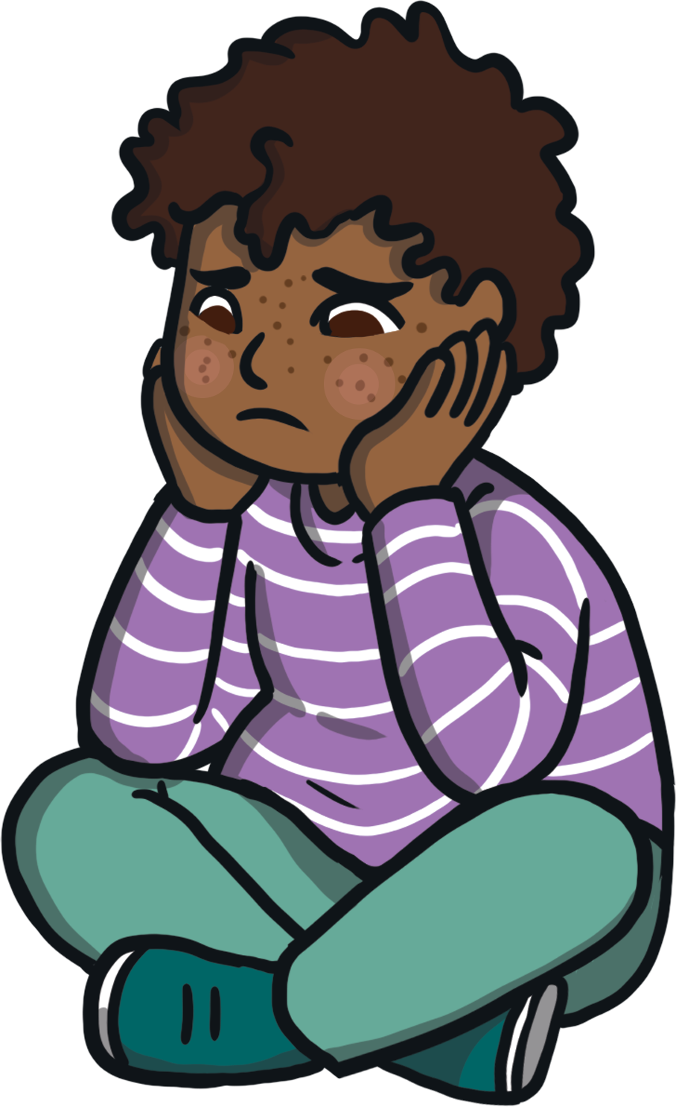
Monday’s Activity: Taking Positive Action
There are lots of things we can do to keep our minds healthy and to help us cope and feel better when we have uncomfortable thoughts and feelings.
Have a look at the pictures on the next few pages: match the feeling or situation with an action that could help.

Slide 14
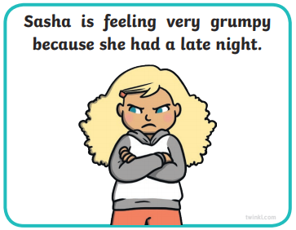
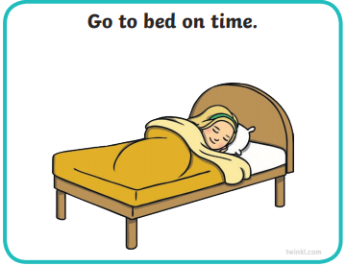
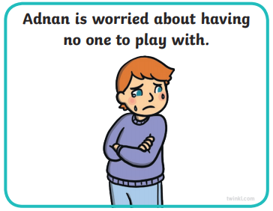
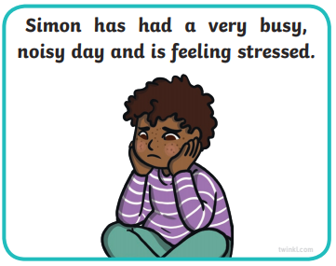
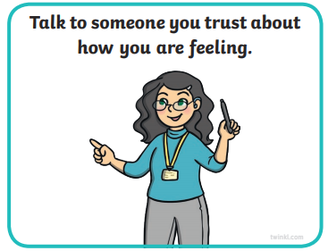
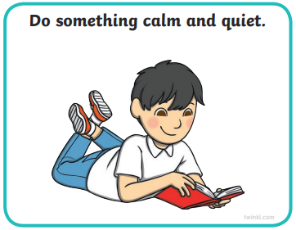
Monday’s Activity: Taking Positive Action
Match the cards to the possible solutions – talk about why you think they would work! Then carry on the presentation tomorrow! Have a great day!

Slide 15
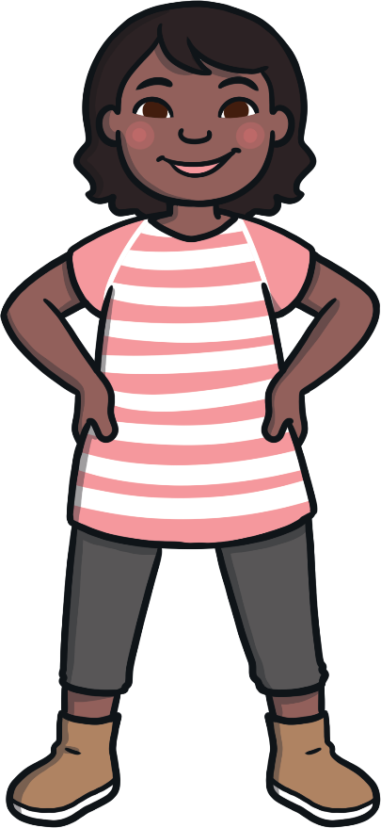
Tuesday: Taking Positive Action
It is important that we do all we can to look after our mental health.
Having a healthy mind can help us feel good on the inside and can help us do well in lots of different situations. Remind yourself of three things you can do to stay healthy physically and mentally!
Consolidating
Reflecting

Slide 16
Consolidating Recap the powerpoint so far. How can you stay mentally healthy? Who can help you? Chat to someone you know about what you think!

Slide 17
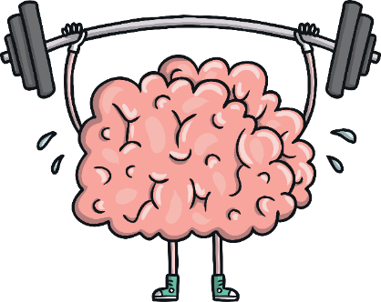
Tuesday’s Activity: Positive Mental Health Posters
Let others know what they can do to help their minds be healthy!
Create a Positive Mental Health Poster! Draw a picture and write a sentence to show one thing that people can do to look after their mental health. You might want to get the play dough out and make a brain too!

Slide 18
Wednesday: Healthy Body, Healthy Mind! Exercise is key to feeling well – Wednesday’s Activity is to get up and move! You could complete a Joe Wicks session, try a Cosmic Yoga, go for a walk, bike ride or scooter round the block! Get your friends and family to join in too! Take time to look for something new that you haven’t seen or felt before and when you’ve finished and got your breath back, time talk to talk about and reflect on how your body feels! PE With Joe 2021 | Friday 29th Jan – YouTube Cosmic Kids Yoga DANCE PARTY! – YouTube

Slide 19
Thursday: Reflecting and getting creative!

Slide 20
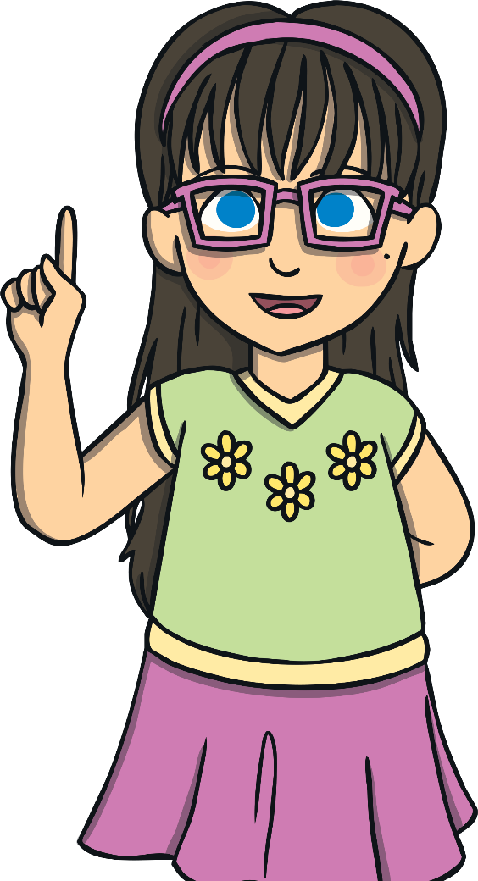
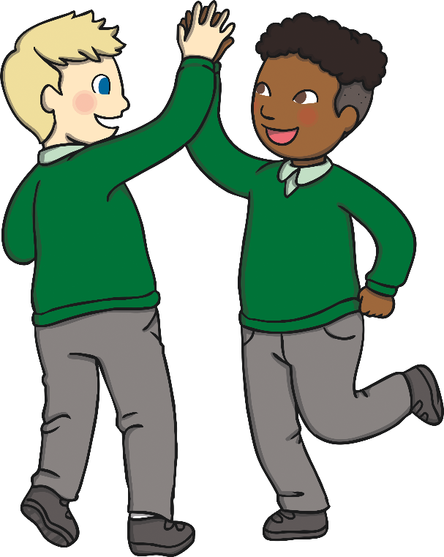
Helping Others
There is a lot we can do to help keep our minds healthy and help us cope when have uncomfortable feelings.
It is important we think, act and behave in a way that helps others feel good on the inside too.
What could you do to help others feel happy and have a healthy mind?

Slide 21
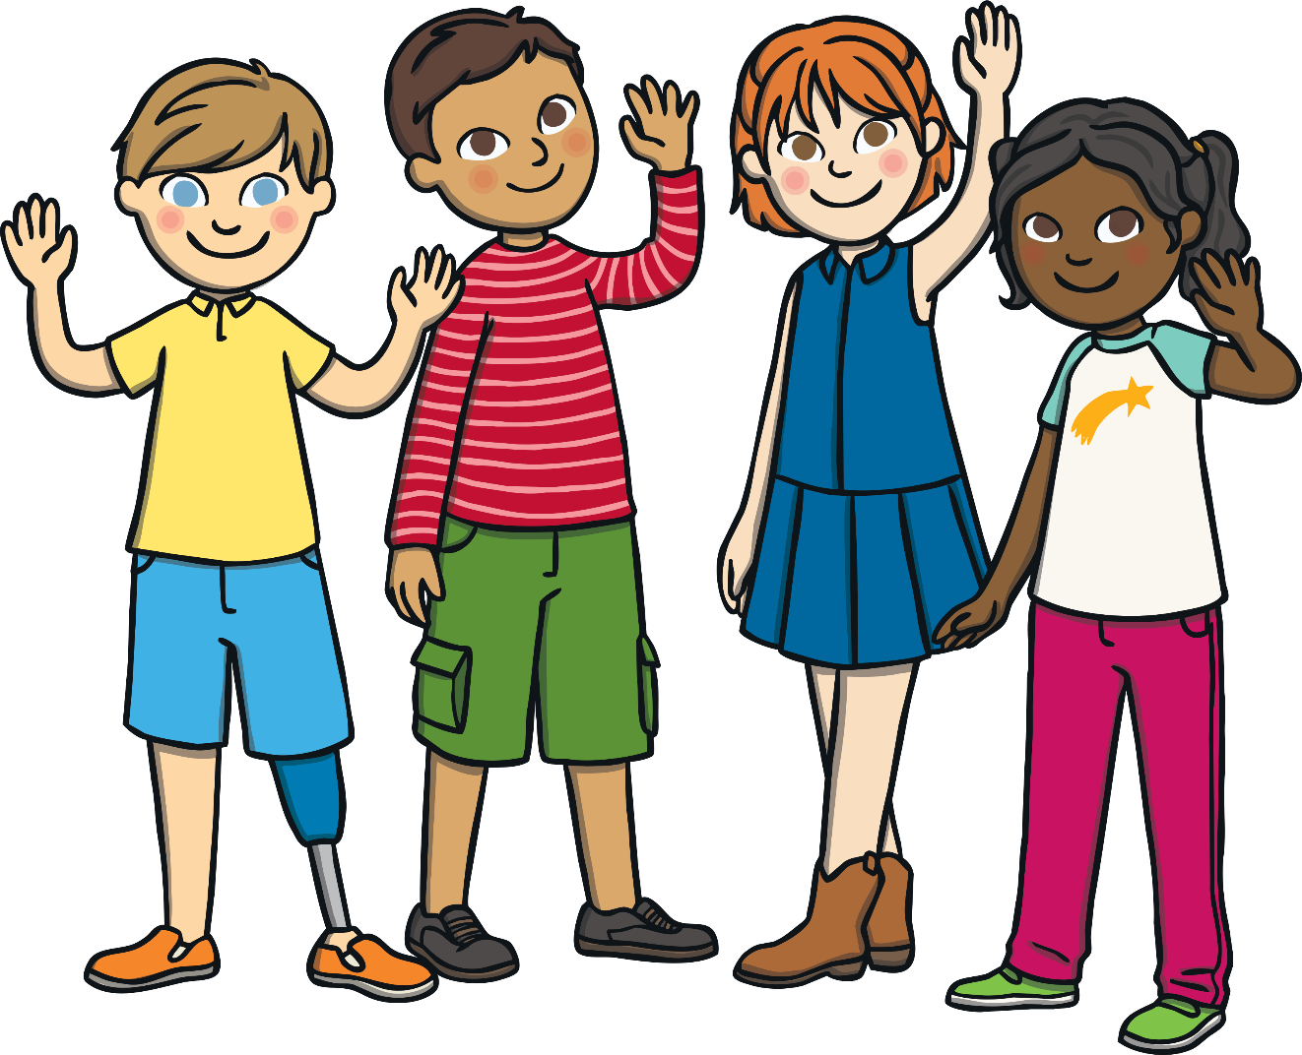
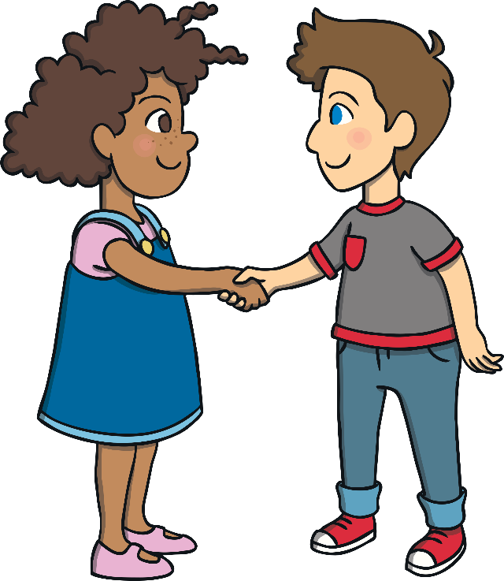
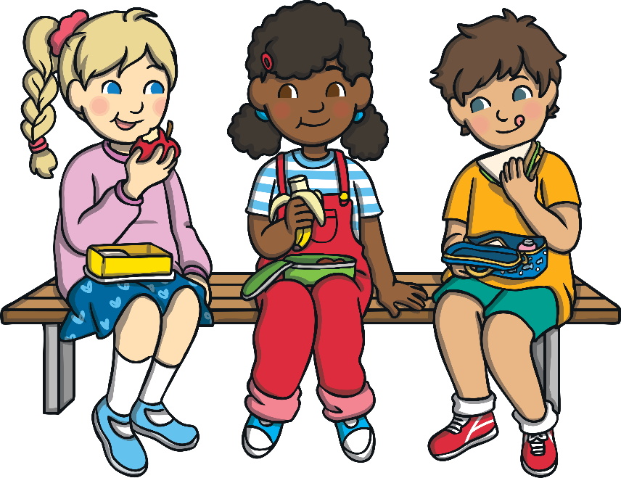
Helping Others
Take a moment of quiet to think about this and then share your thoughts.
By doing a little, we can make a big difference to how others feel on the inside.

Slide 22
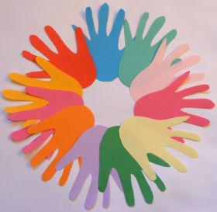
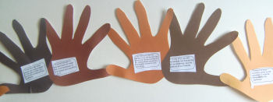
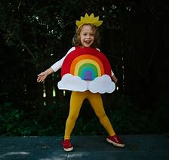
Thursday’s Activity choices: Time to Talk and get creative!
Take a moment to watch the video:
Made with Pond5: Express Yourself – YouTube
How are they being creative? How do you like to be creative?
Complete a creative activity in school or at home…
Create a dance routine:
CAN'T STOP THE FEELING! (From DreamWorks Animation's "Trolls") (Official Video) - Bing video
Create hand bunting with inspirational quotes on or ideas about how to stay mentally healthy!
Create something delicious to eat!
Create an exercise routine for others!
Create a face mask and chill! Five DIY self-care activities - BBC Bitesize
Create a design of your favourite outfit (or if you’re at home,
create an outfit that expresses how you feel!)
Enjoy yourself and get creative!

Slide 23
Friday: Think again about The Big Questions

Slide 24
The Big Questions
How can we keep our minds healthy?
What is positive mental health?
Let’s get mindful!
What is mindfulness?

Slide 25
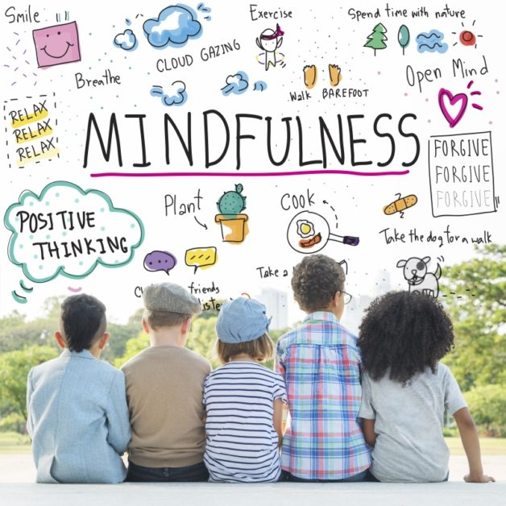
Mindfulness
Mindfulness is simply noticing what is happening right now! Mindfulness is taking notice of how your body feels and what you see, smell and taste. Maybe you even feel emotions in your body, perhaps through a tightness somewhere, or a good sensation. On the final day of Children’s Mental Health Week, we are going to practice being mindful!

Slide 26
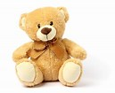
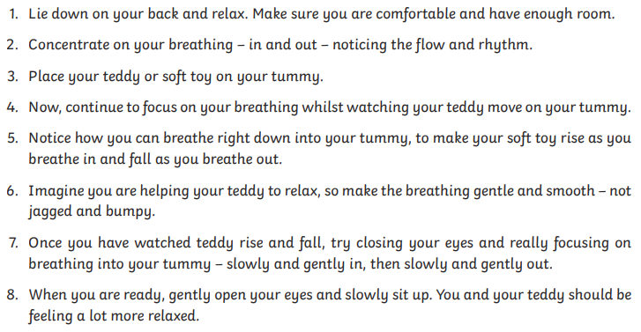
Friday’s Activities: Mindfulness
Have a go at one or all of the following activities!
Mindful breathing with a Teddy (or a toy of your choice!)

Slide 27
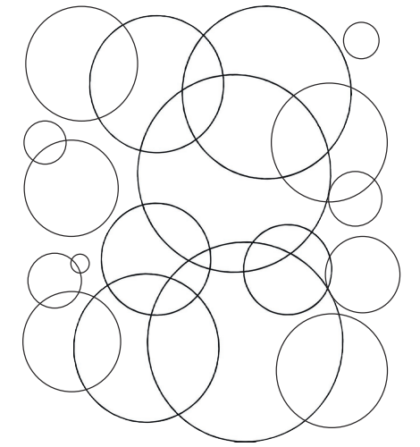
Friday’s Activities: Mindfulness
Bubbles of Gratitude!
These are bubbles of gratitude!
Cover a page with bubbles!
As you colour each bubble think about something that you are grateful for. It could be something big (like your home!) or something very small (like a special toy), something you experience often (like eating your favourite food!) or something that has just happened (like smiling at someone!).
Thinking of these things should make you feel calm and happy!
Bubbles of Gratitude Mindfulness Colouring These are bubbles of gratitude! As you colour each bubble, think of something that you are grateful for. It could be something big or something very small, something that you experience often or something that has just happened once. Thinking of these things helps make us feel calm and happy. Mindfulness | LKS2 | Mindful Scientists | Experimenting with Gratitude | Lesson 6 Mindfulness Colouring These are bubbles of gratitude! As you colour each bubble, think of something that you are grateful for. It could be something big or something very small, something that you experience often or something that has just happened once. Thinking of these things helps make us f

Slide 28
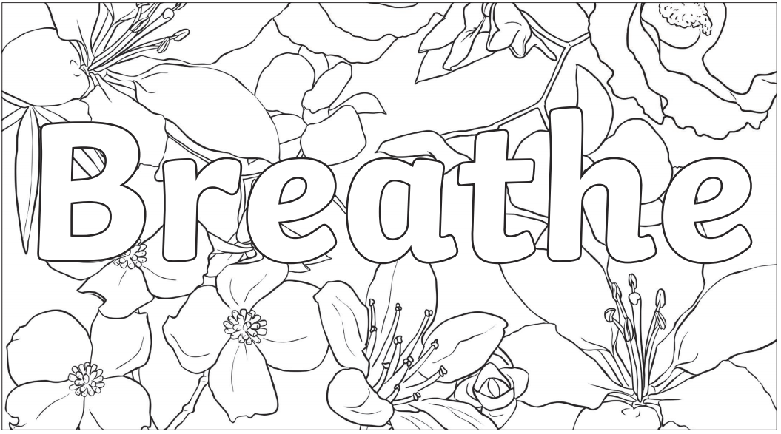
Friday’s Activities: Mindfulness
Find a mindful colouring – choose two colours and take your time! Can you focus on your breathing too? Calm and steady, relax and breathe!

Slide 29
Children’s Mental Health Week
2021
Thank you for joining in with Children’s Mental Health week. We hope you have enjoyed some of the activities – take the time now to think about how you can keep yourself and others mentally healthy every day!
And now that it is almost the weekend, make sure you get outside, eat delicious food, drink enough water and get lots of sleep!
Stay safe! ☺

