Slide 1
Guidance for Video/Audio in PowerPoints
1. Open the folder and copy all the files.
2. Paste the copied files into a new folder.
3. Open the PowerPoint file, enable editing and enter presentation mode (start the slide show).
Please note the embedded audio may not be compatible with early versions of PowerPoint.
You may wish to delete this slide before beginning the presentation.

Slide 3
Revisit and Review
Let’s revisit last week’s focus words…
I’ll say them and you write them down!

Slide 4
Revisit and Review

Slide 5
Revisit and Review
Let’s practise Sam’s Sounds and Common Exception Words!
two
Mrs
their
could
should
oh
Mr
would
ea
oy
ay
ie

Slide 6
Teach
Here are this week’s focus words for reading:
love
your

Slide 7
Pop The Balloons
Click to pop the balloons and reveal the common exception words.
love
your
love
your
your
love

Slide 8
Teach
Today, we are learning to read words that contain a_e saying /ai/.
‘a_e’ is a split diagraph. The first vowel is elongated as a result of the second vowel ‘e’. For example, the ‘a’ in ‘hat’ is short but the ‘a’ in ‘hate’ is long due to being part of the split digraph ‘a_e’.
X
Click me for Kit’s teaching tips!

Slide 9
Teach
a and e are cheeky partners. When a and e work together, they say /ai/.
a and e are too cheeky to sit together so they have to have a letter sit between them.
a
_
e

Slide 10
Teach
Let’s read these words.
ape
ate
You can teach children to say the /ai/ first and then the letter in between after i.e. /ai/ /p/. It may help some children to explain that the ‘e’ is telling the ‘a’ to say its name and that they shouldn’t make the /e/ sound.
make
X
tape
game
Click me for Kit’s teaching tips!

Slide 11
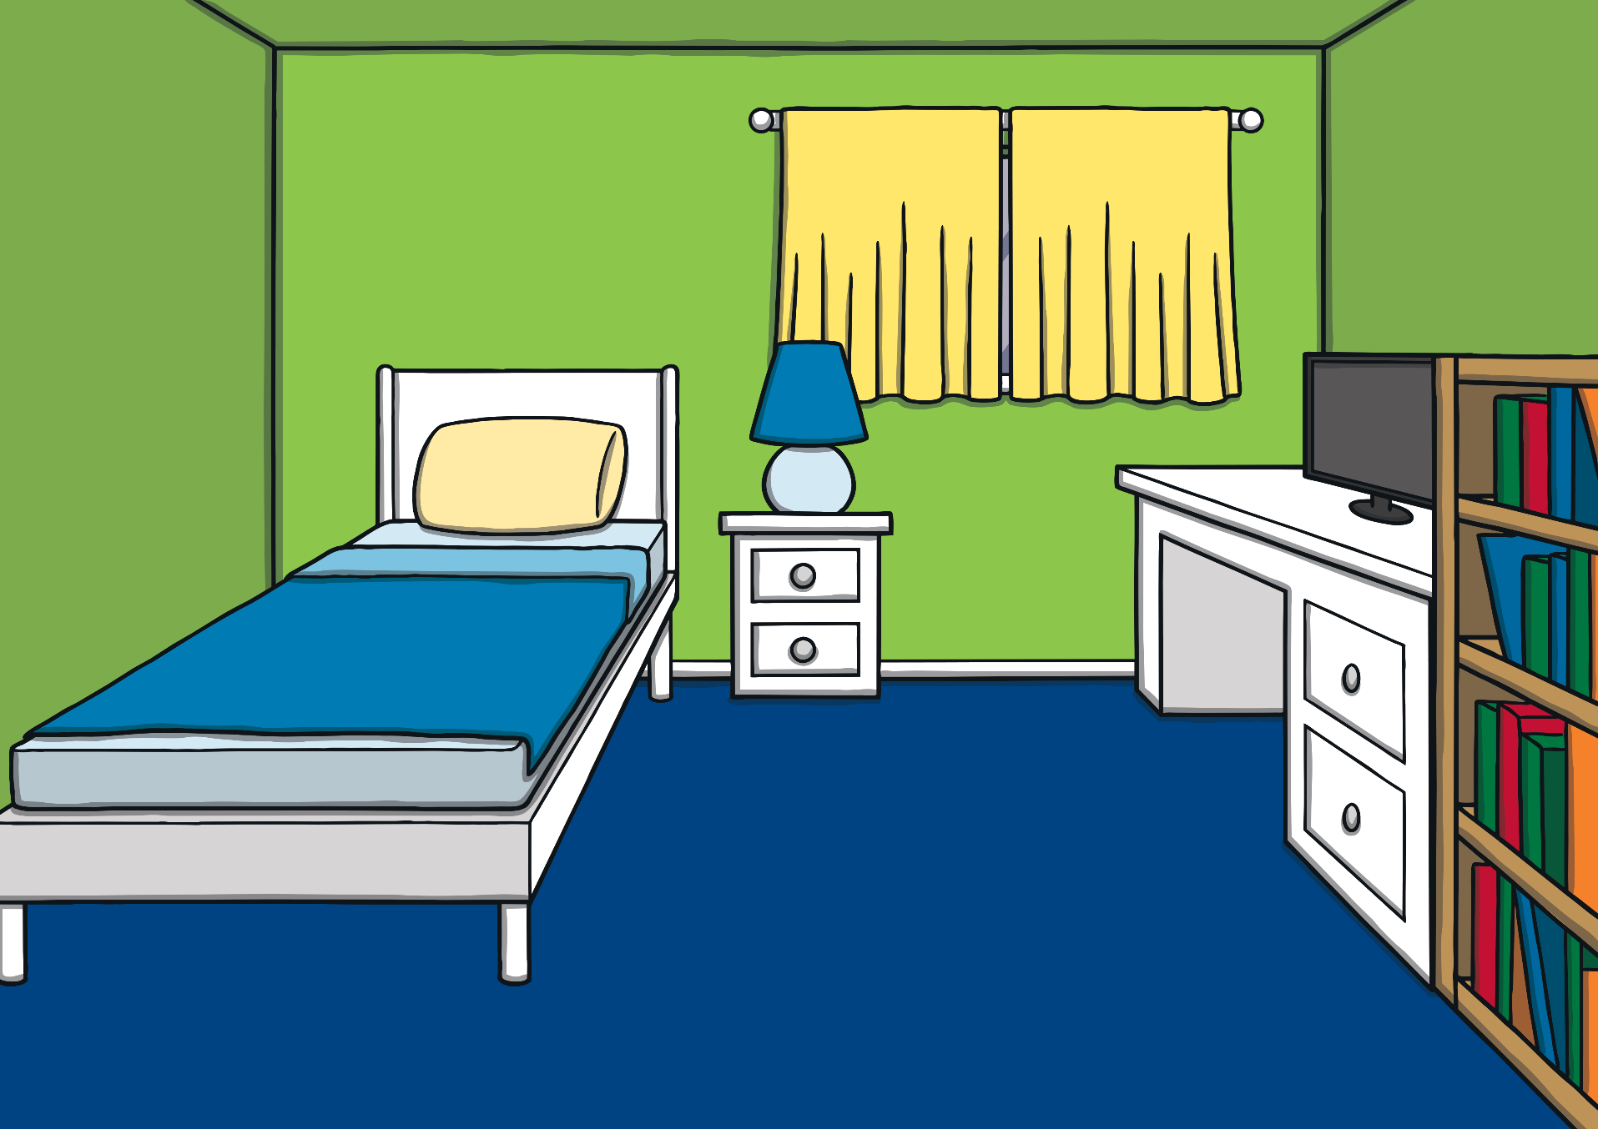
Teach
It was nearly Kit and Sam’s birthday. The twins were very excited. They were going to have a joint party!

Slide 12
Teach
Sam asked, “What would you like as a present?” “Hmm, maybe a fluffy toy? How about you?” asked Kit.
“I think I would like a race car,” replied Sam.

Slide 13
Teach
While Kit was licking his lips and thinking of birthday cake, Mum shouted from the kitchen, “Sam! Kit! Can you please help me?”

Slide 14
Teach
Mum needs Kit and Sam to check the party list. The cheeky partners a and e make the /ai/ sound. Can you read the a_e words on Mum’s list?

Slide 15
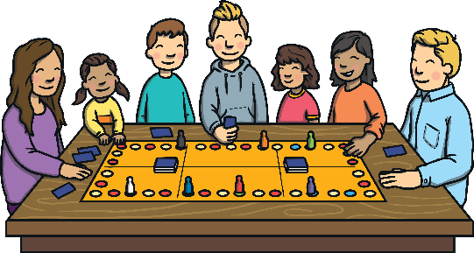
Teach
game
cake
shake
grapes

Slide 16
a e Idea Spotter
Practise
Teach
Dad had some other party ideas… Can you spot any a_e words?

Slide 17
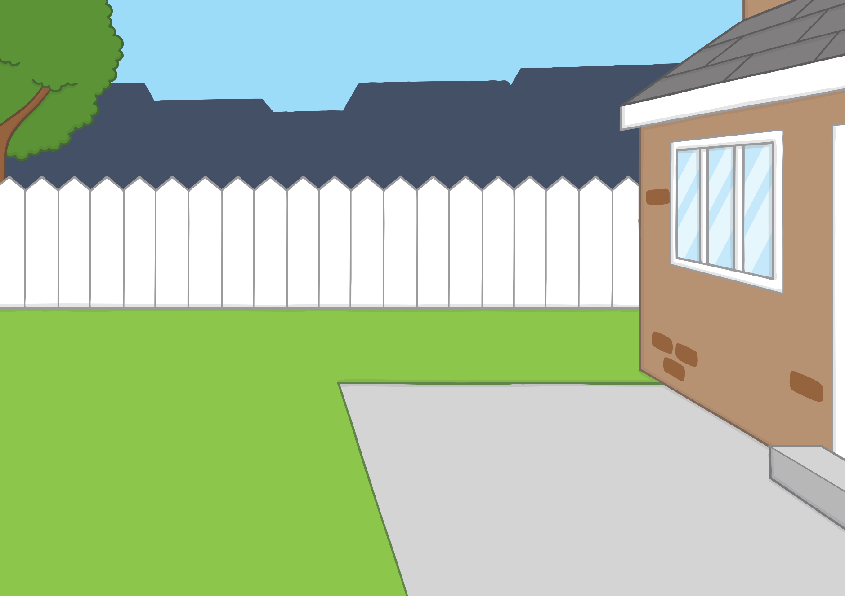
Practise
shake
bake
cake
ate
snake
grapes
game
mates
tape
plates

Slide 18
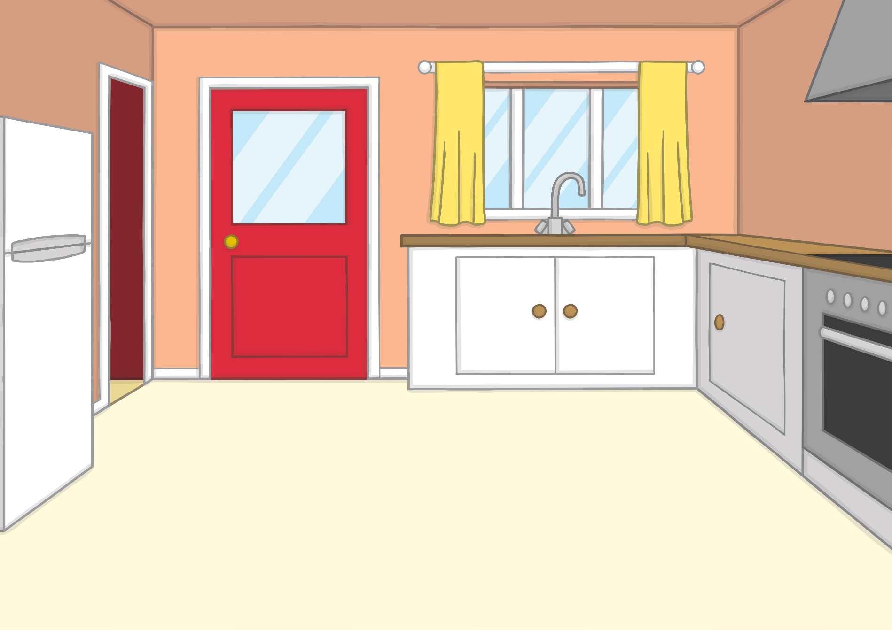
Teach
“I want to make plenty of food for the party,” said Mum. “Can we help?” shouted Kit. “I can bake the cake! That’s the most important job!” he said, licking his lips again.

Slide 19
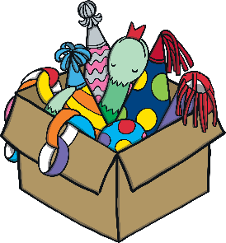
Teach
“I could do with some help too!” said Dad, who stumbled in carrying a box of decorations. “I’ll help you with those,” said Sam.

Slide 20
Apply
Sentence Time
Sam is looking at the box of party things. What does she say to Dad? Read the sentence then click ‘Show’ to reveal the answer!!

Slide 21
Apply
Is your snake game from last year in that box?
Sound Buttons On/Off
Show

Slide 22
Teach
“I think so,” said Dad as he pulled out a stripy snake. “Yay, I love to play the snake game!” cried Sam.

Slide 23
Today, we have learnt…
a_e
saying /ai/
The adventure continues next lesson!

