Slide 1
Guidance for Video/Audio in PowerPoints
1. Open the folder and copy all the files.
2. Paste the copied files into a new folder.
3. Open the PowerPoint file, enable editing and enter presentation mode (start the slide show).
Please note the embedded audio may not be compatible with early versions of PowerPoint.
You may wish to delete this slide before beginning the presentation.

Slide 3
Revisit and Review
Let’s revisit last week’s focus words…
I’ll say them and you write them down!

Slide 4
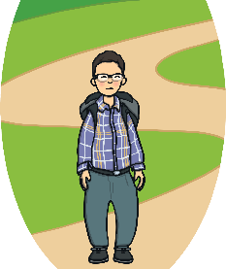
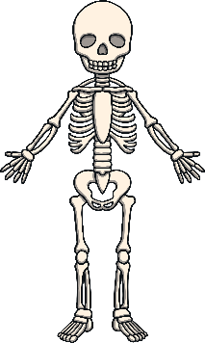
Revisit and Review

Slide 5
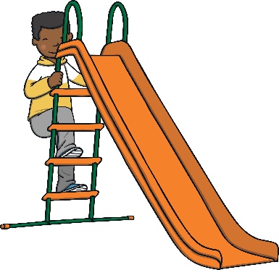
Revisit and Review
Let’s practise Sam’s Sounds and Common Exception Words!
oy
i_e
o_e
ay
a_e
ie
ea
oh
would
should
your
their
two
Mr
people
could
Mrs
love
called
asked
looked

Slide 6
Teach
Here are this week’s focus words for reading…
called
asked

Slide 7
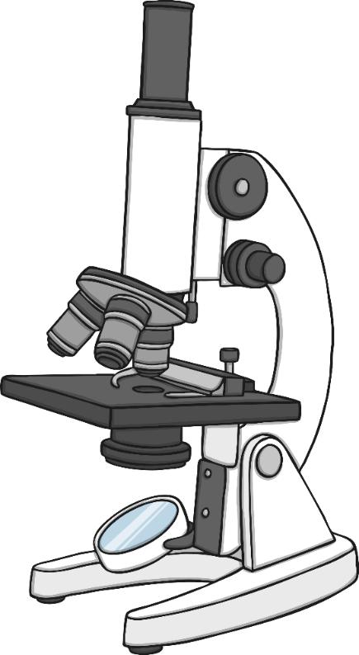
Teach
Words Under the Microscope
Click on the microscope to zoom in on a tricky word.
.
asked
called
asked
called
asked
called

Slide 8
Teach
called

Slide 9
Teach
asked

Slide 10
Teach
called

Slide 11
Teach
asked

Slide 12
Teach
called

Slide 13
Teach
asked

Slide 14
Today, we are learning to read words that contain u_e saying /yoo/.

Slide 15
Teach
u and e are cheeky partners. When u and e work together, they say /yoo/.
u and e are too cheeky to sit together so they have to have a letter sit between them.
u
_
e

Slide 16
Teach
Let’s read these words.
use
tune
You can teach children to say the split digraph first ‘u_e’ before the letter in between i.e. /yoo/ /s/. It may help some children to explain that the ‘e’ is telling the ‘u’ to say its name and that they shouldn’t make the /e/ sound.
X
cute
refuse
Click me for Kit’s teaching tips!

Slide 17
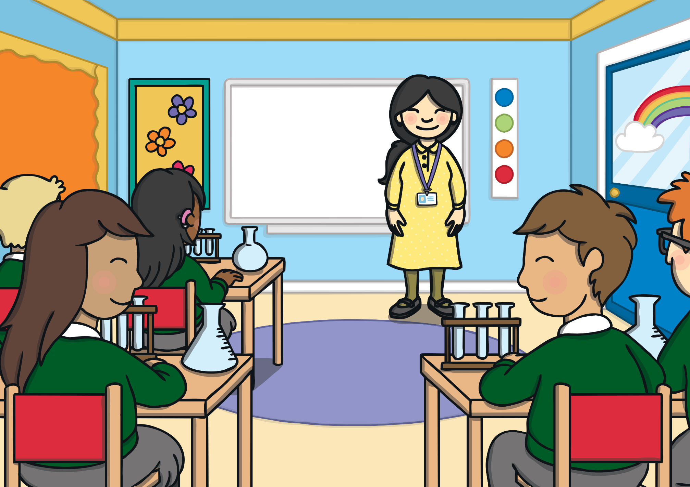
Teach
Kit and Sam were in a school science lesson. “Today, we will use a test tube to do an experiment,” said their tea ch er, Mrs Tan. “Then, you will all complete a science project for your homework. Take a test tube home as you will need to use one for your project.”

Slide 18
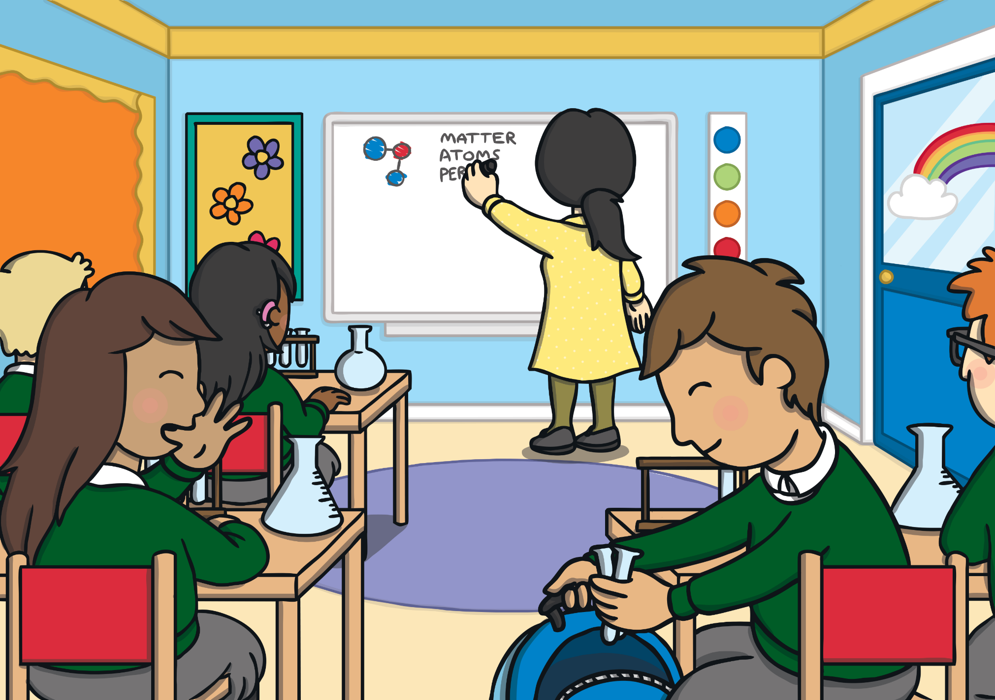
Teach
“Cool!” said Kit. “I feel just like Albert Einstein.”
“Who is he?” asked Sam. “He was a very famous scientist,” said Kit. “The world would be a diff erent place without his discoveries.”

Slide 19
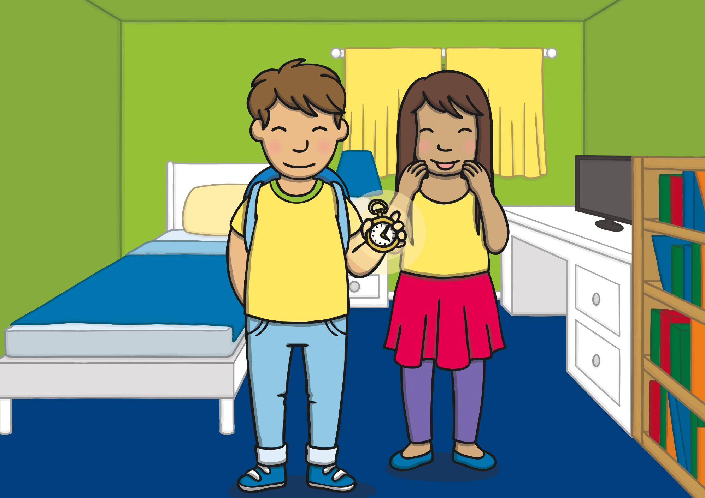
Teach
Sam wanted to find out more about Albert Einstein. “I have an idea,” said Kit and he took out the magic watch. “Let’s go and meet him…he could even help with our science projects!” The room began to fade…

Slide 20
Teach
Kit and Sam are speeding back through time to visit Albert Einstein. Can you match all the words to the images before the clock hands stop spinning backwards?
X
Overall, the ‘u_e’ spelling of this sound is most common.
Click me for Kit’s teaching tips!

Slide 21
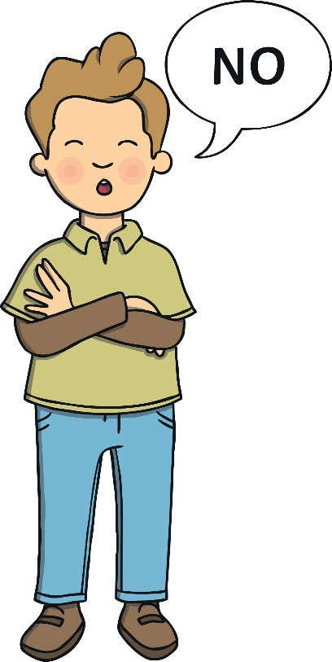
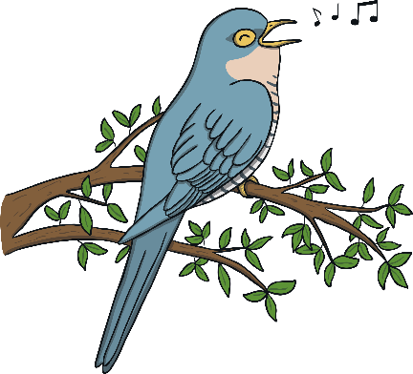
Teach
tube
refuse
use
tune
cube
Play

Slide 22
Teach
Fairytale Words
As Kit and Sam hurtle back through space and time, objects fly past them with some words on! Can you read the words before they disappear?
.

Slide 23
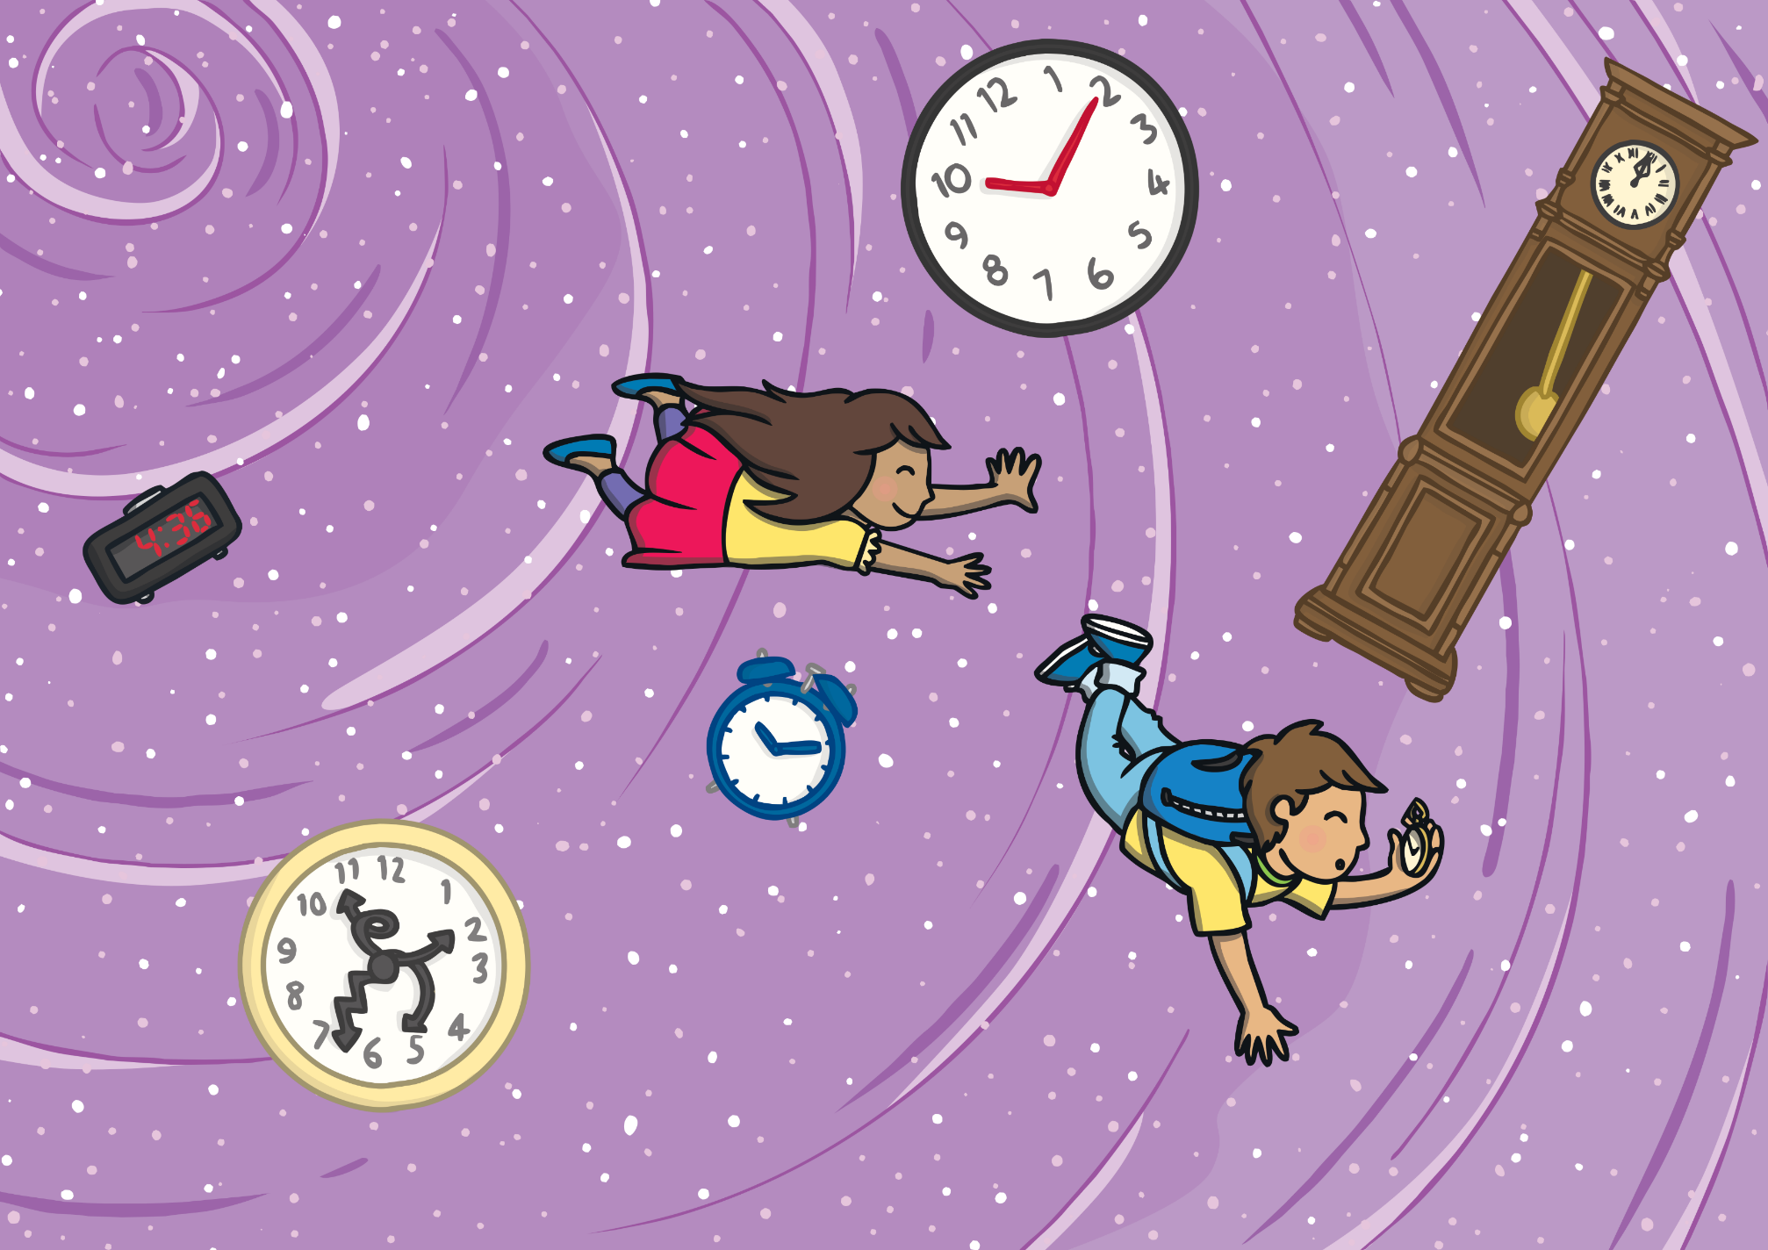
tube
Practise
fume
cube
use

Slide 24
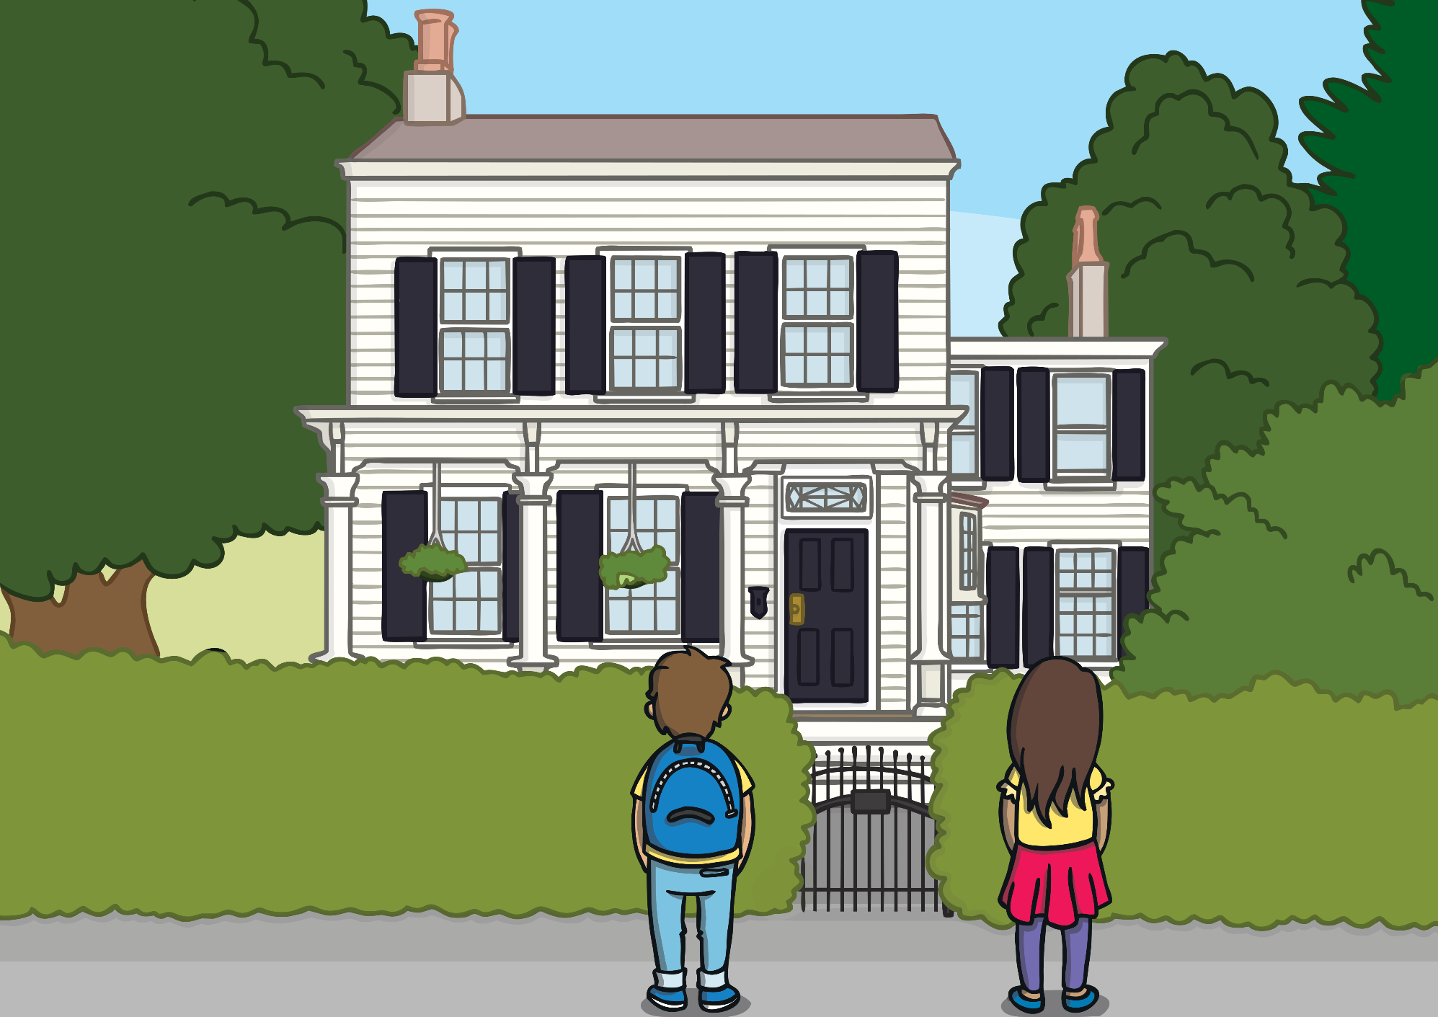
Practise
Kit and Sam found themselves outside a huge white house. “Where are we?” asked Sam.
“This is Albert Einstein’s home in America. We must be in about the year 1935. That is when he moved to this house.”

Slide 25
Apply
Sam looked around as Kit put away the magic watch. “Do you think we should have called and asked whether we could visit first?” asked Sam nervously.

Slide 26
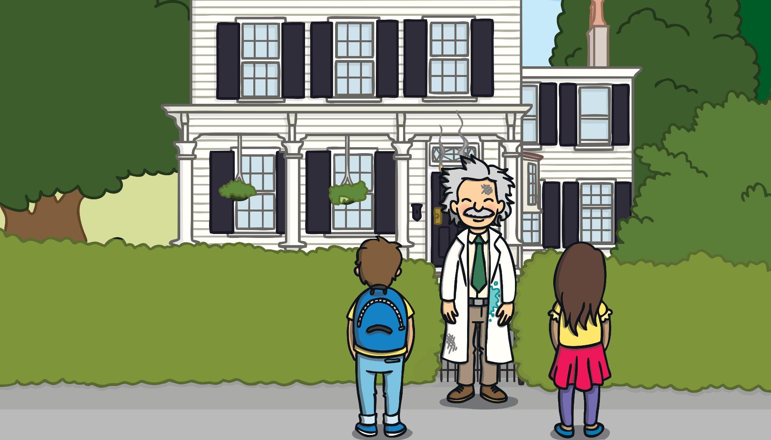
Apply
Sentence Time
Suddenly, a grumpy-looking man appears from the house and looks up and down the road. What does he say?

Slide 27
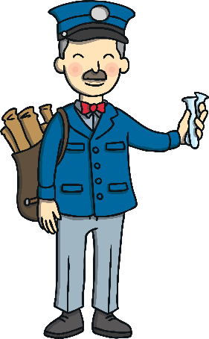
Apply
Apply
“I asked for a test tube but the mailman has not called yet!”
Sound Buttons On/Off
Show

Slide 28
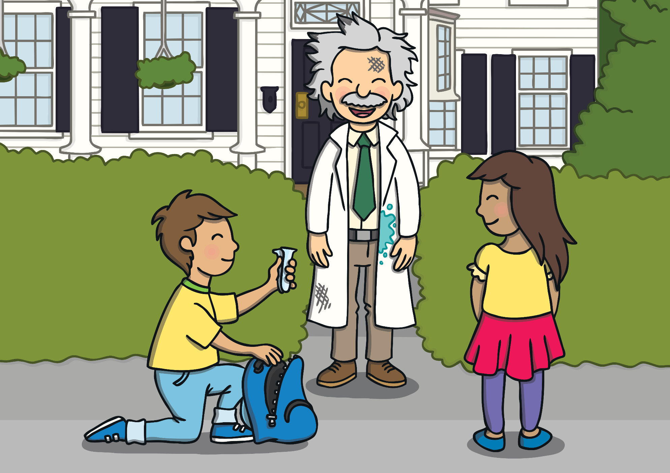
Apply
The man saw Kit and Sam standing outside his house. “Are you the mailman with the test tube I need to use?” he asked Kit.
“No,” replied Kit. “But I might be able to help you…”

Slide 29
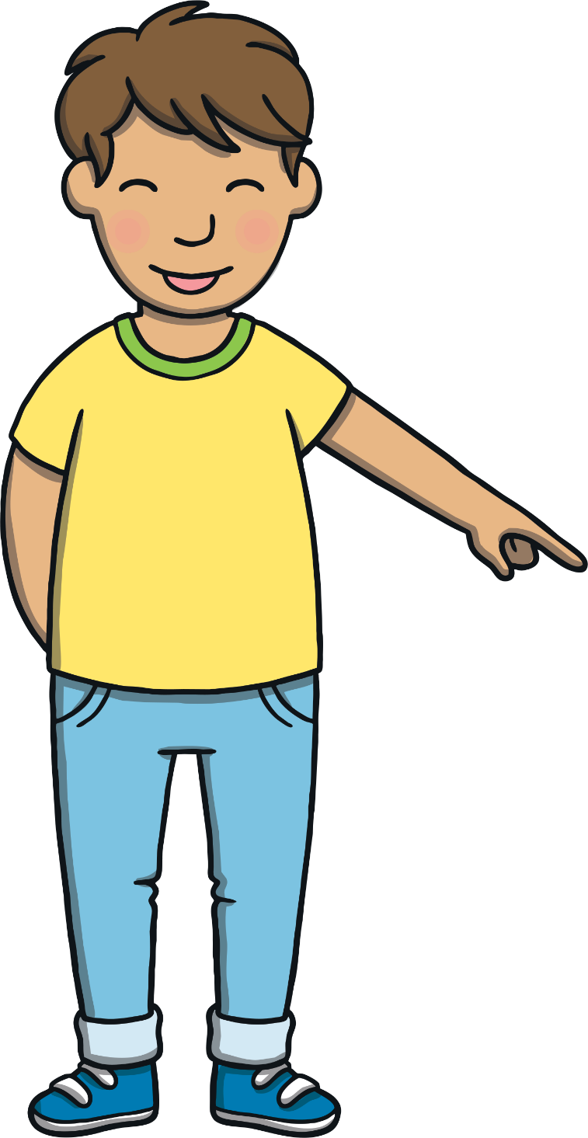
Apply
Today, we have learnt…
u_e
saying /yoo/
The adventure continues next lesson!

