Slide 2
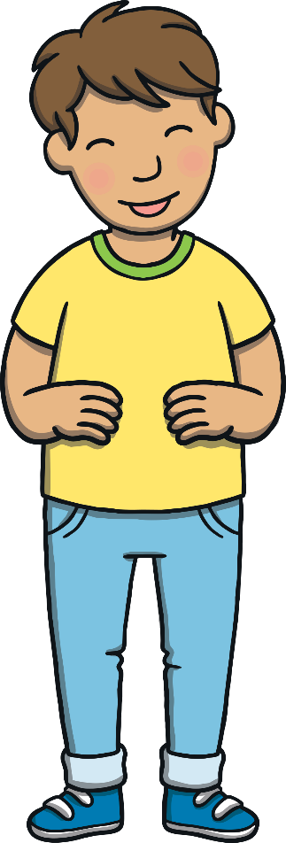
This is Kit.
Teach

Slide 3
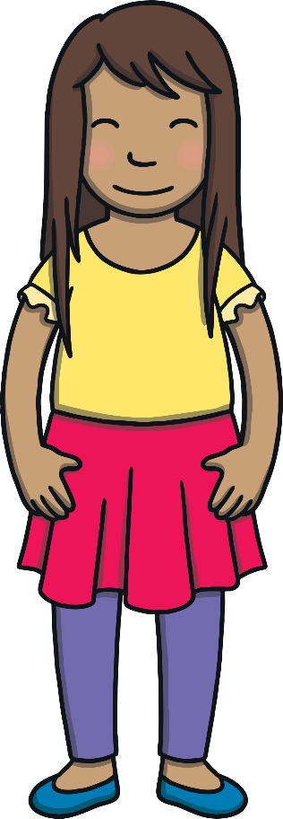
This is Sam.
Teach

Slide 4
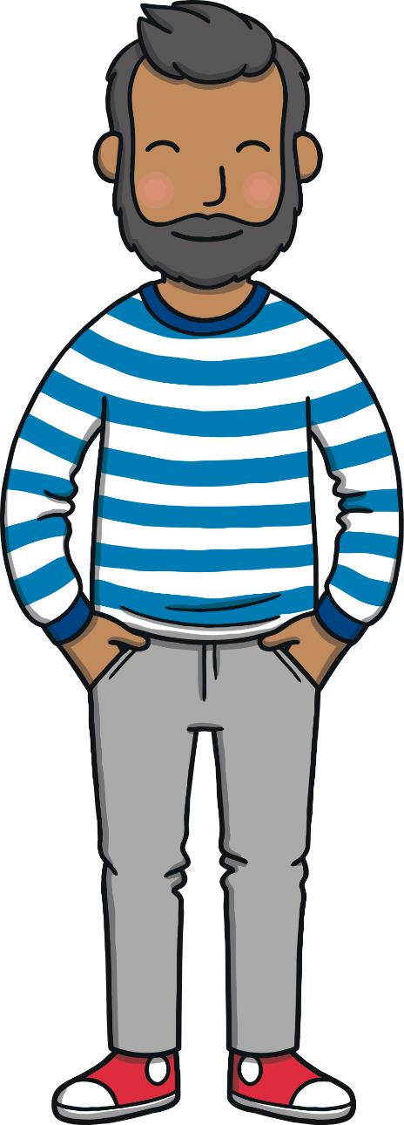
Teach
This is Mum and Dad.

Slide 5
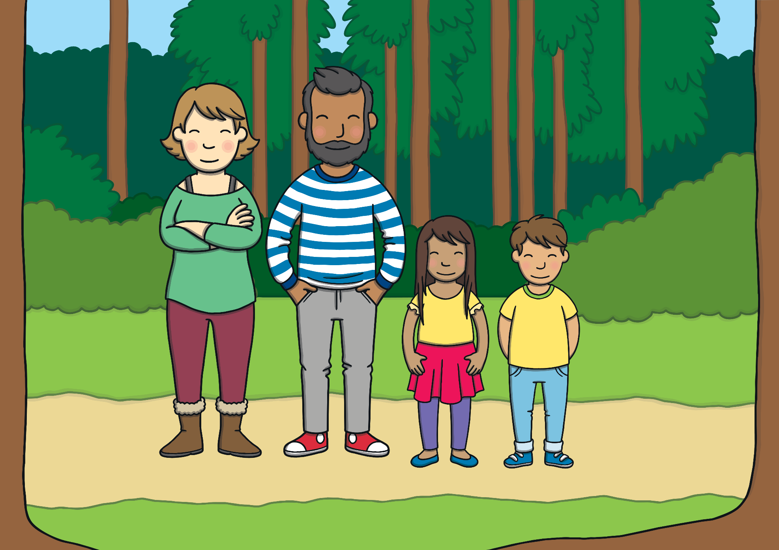
One day, the family went out for a walk in the woods.
Teach

Slide 6
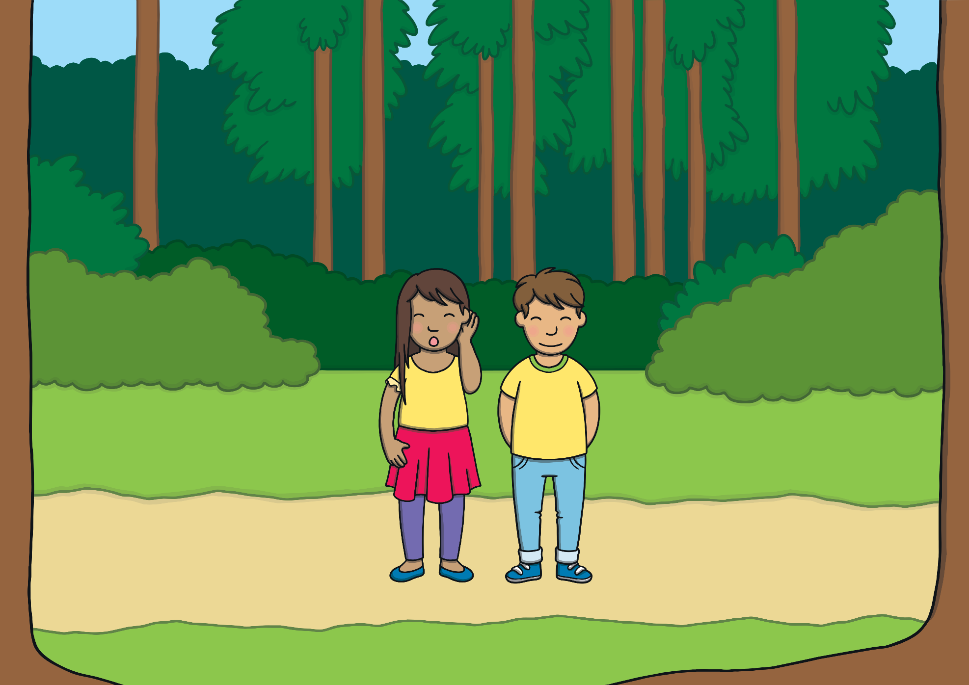
Teach
They had not gone far when Sam heard a strange noise. It was a s sound.

Slide 7
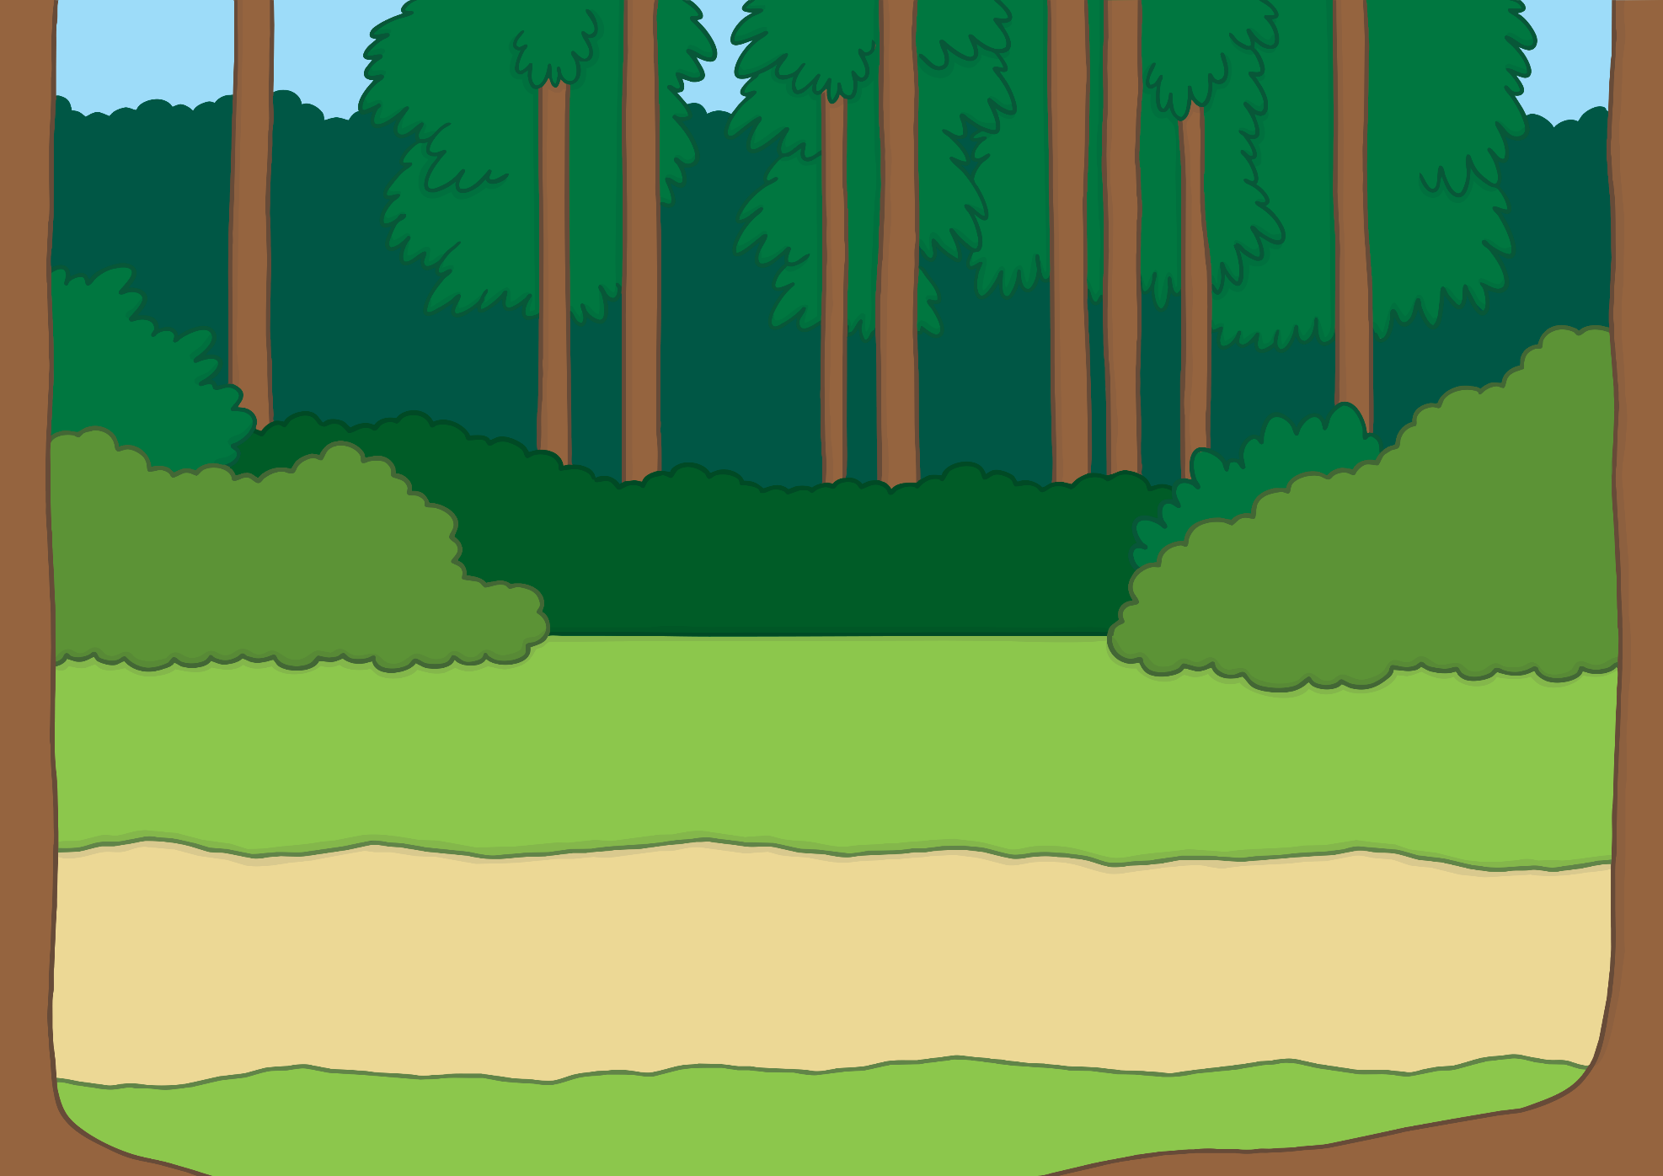
Teach
Kit and Sam went to look. There was a beautiful snake! It hissed s again.

Slide 8
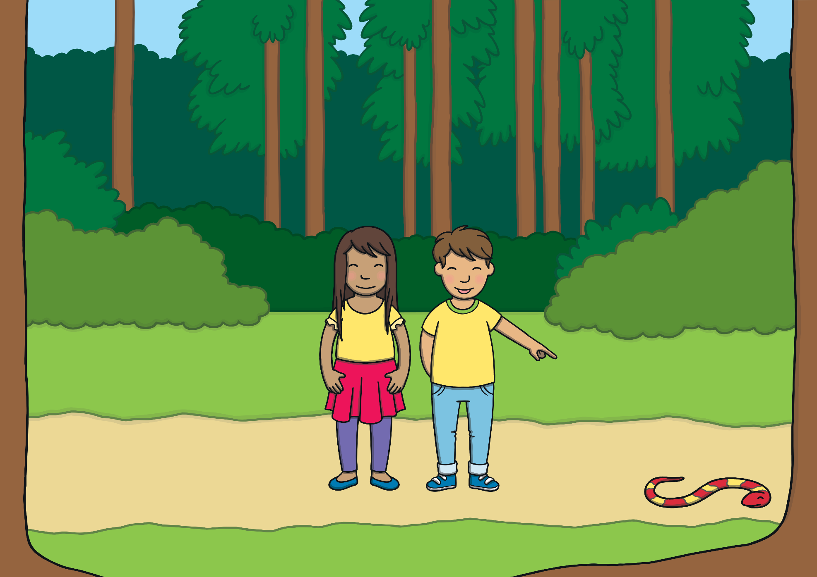
Teach
“Look!” said Kit. “The snake looks like a letter ‘s’ and it makes the same sound s”.

Slide 9
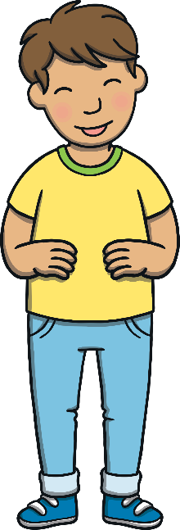
Teach
“Yes!” said Sam. “Snake begins with the letter s too!”

Slide 10
s
Teach

Slide 11
Teach
s

Slide 12
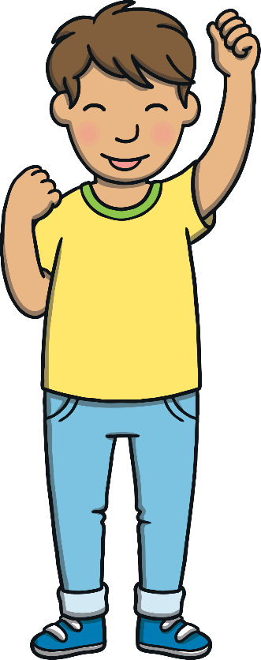
Action
Teach
Make a snake’s head with your hands and
wiggle your body like a snake!
Say ‘sssss’.

Slide 13
Write the Letter
Teach
s
Start at the bottom, up the ramp, curl around and around the snake’s body.
Play

Slide 14
Let’s Sing!
Teach
(To the tune of ‘Aiken Drum’)
We saw a snake out in the woods,
s - s - s
s - s - s
We saw a snake out in the woods,
And the snake went s, s, s.
Play Song

Slide 15
Snake Phoneme Spotter
Practise
Watch the snakes slither across the screen. If they are pulling a balloon with a s on, say the sound and do the action.
Linking the phoneme, grapheme, mnemonic and action helps children to make learning links.
X
Click me for Kit’s teaching tips!

Slide 16
i
e
s
Practice
s
s
s
s
s
u
t

Slide 17
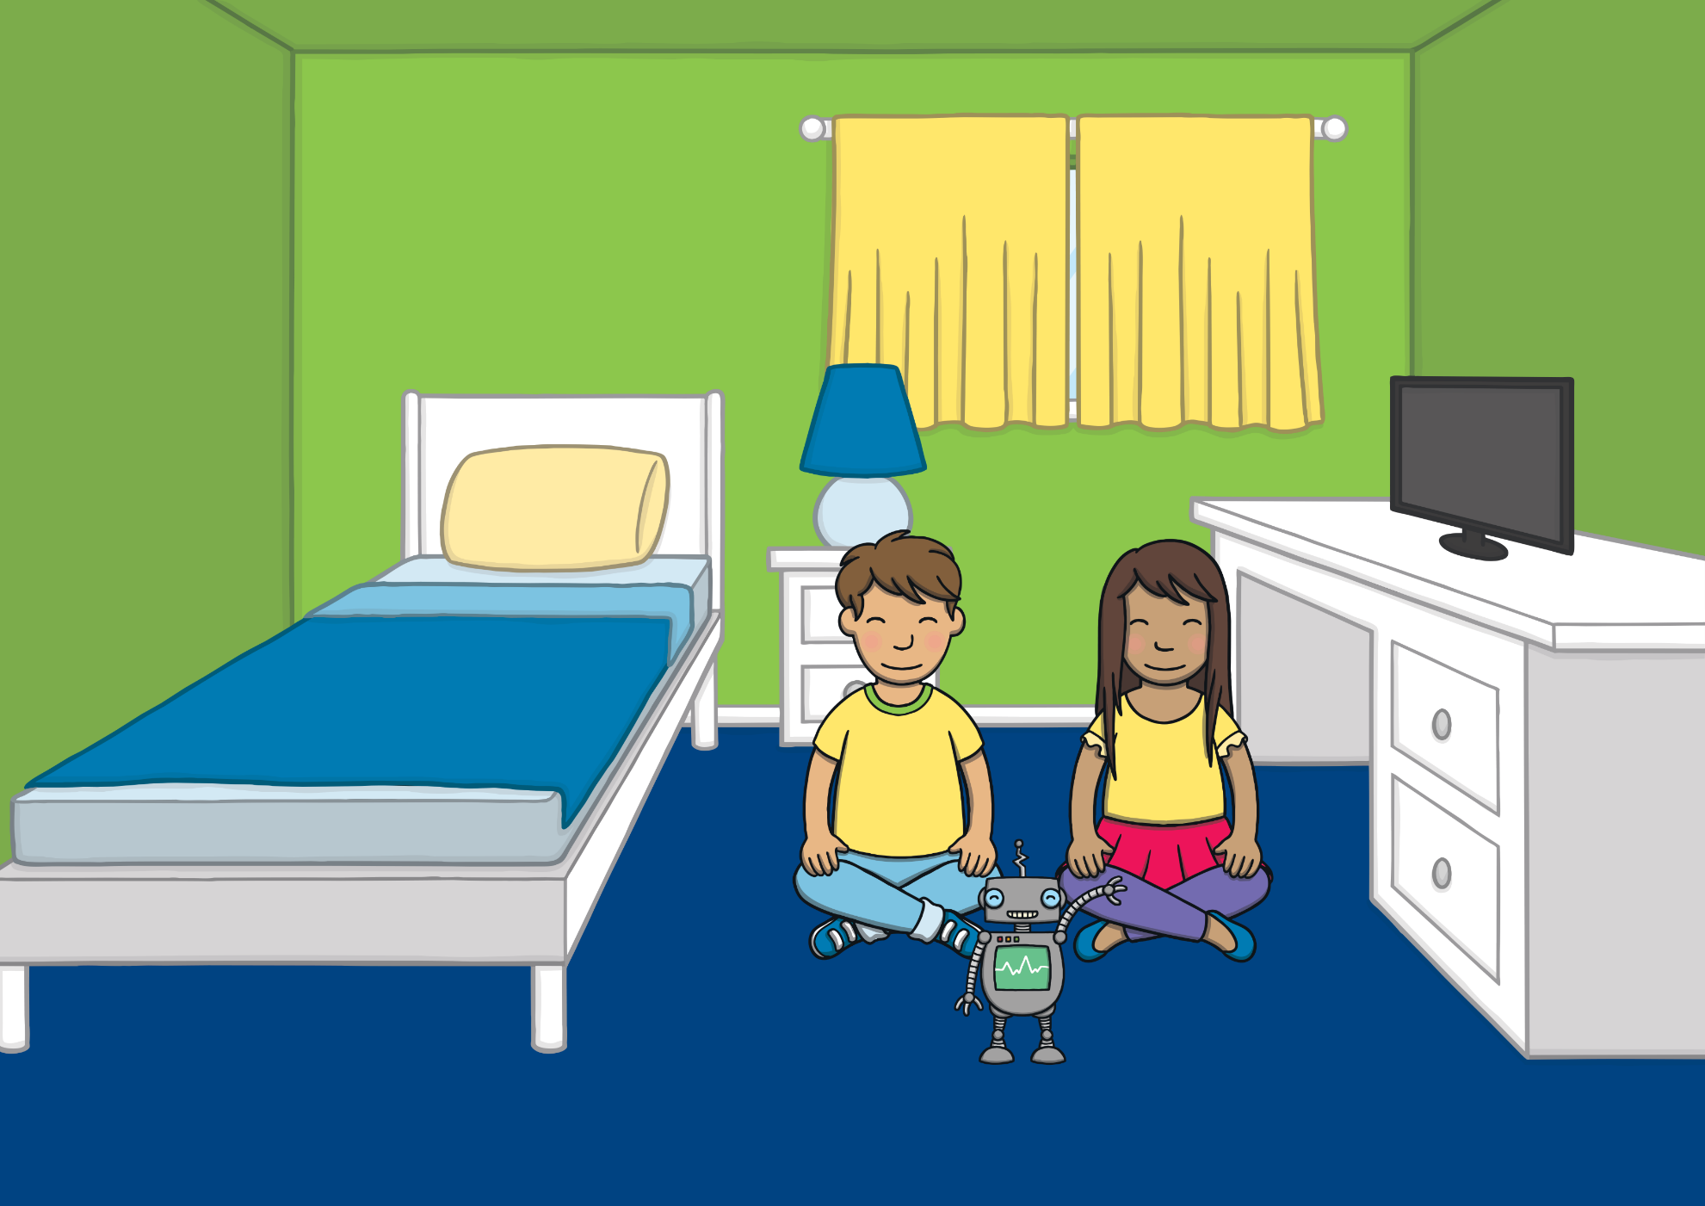
Apply
When Kit and Sam got home, they looked for other things around the house that had a s sound in their name.

Slide 18
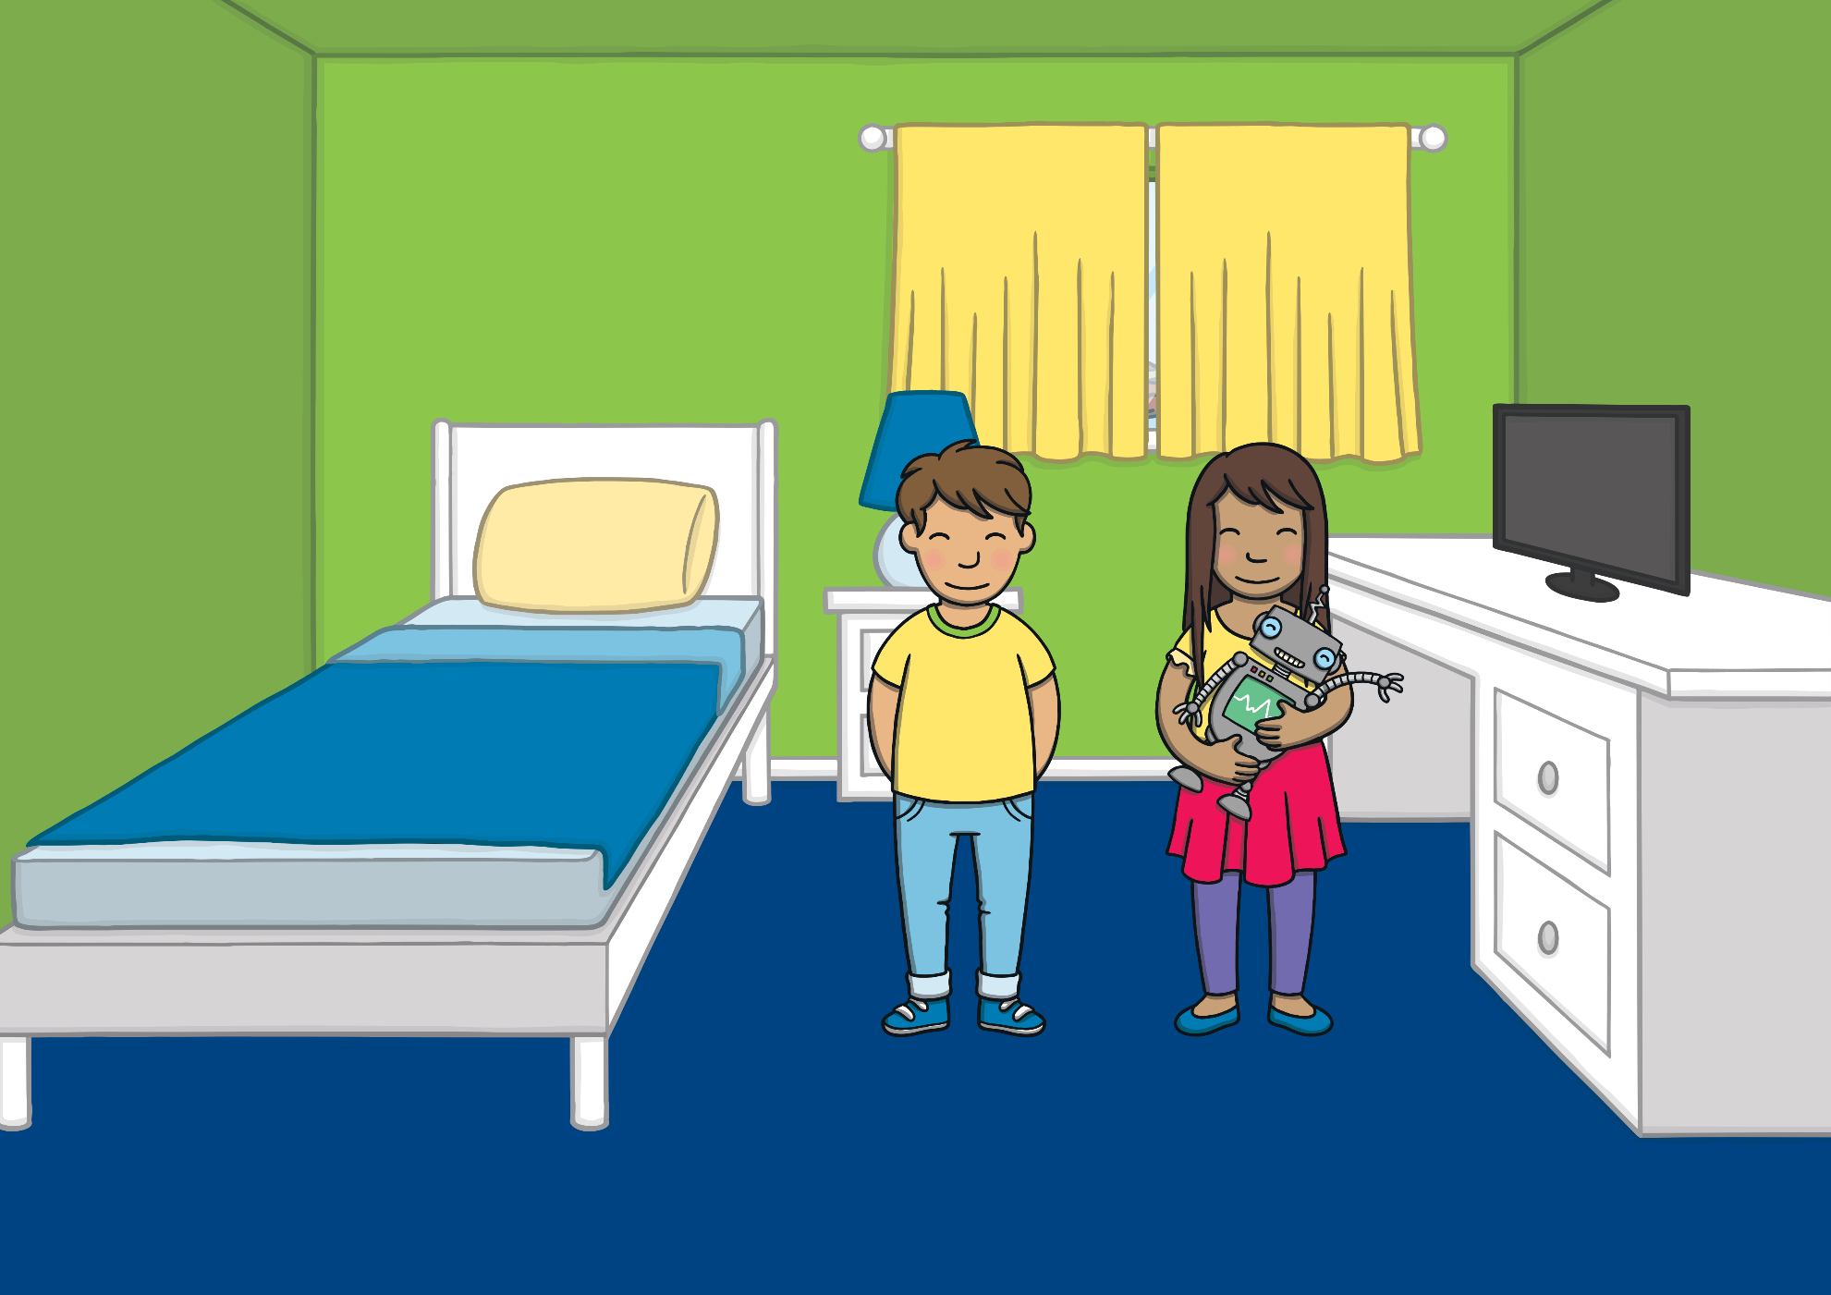
Apply
“Hey, my toy robot is good at saying words”, said Sam. “I wonder if he can say any words with the s sound in them.”

Slide 19
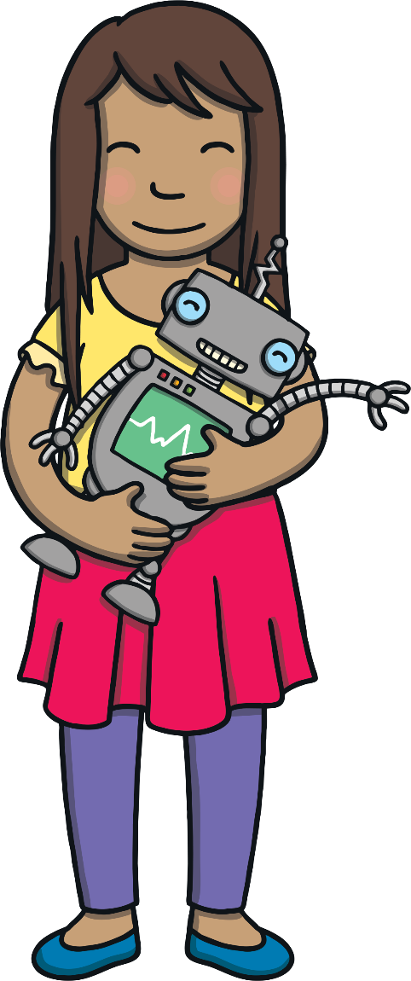
s Picture Spot
Apply
Sam’s robot talks in ‘robot talk’. Listen to Sam’s robot say a word. Can you work out which picture matches the word he is saying?
Some children may be able to tell you whether the s sound appears at the beginning or the end of the word.
X
Click me for Kit’s teaching tips!

Slide 20
Apply
Play

Slide 21
Apply
Well done!

Slide 22
Apply
Play

Slide 23
Apply
Well done!

Slide 24
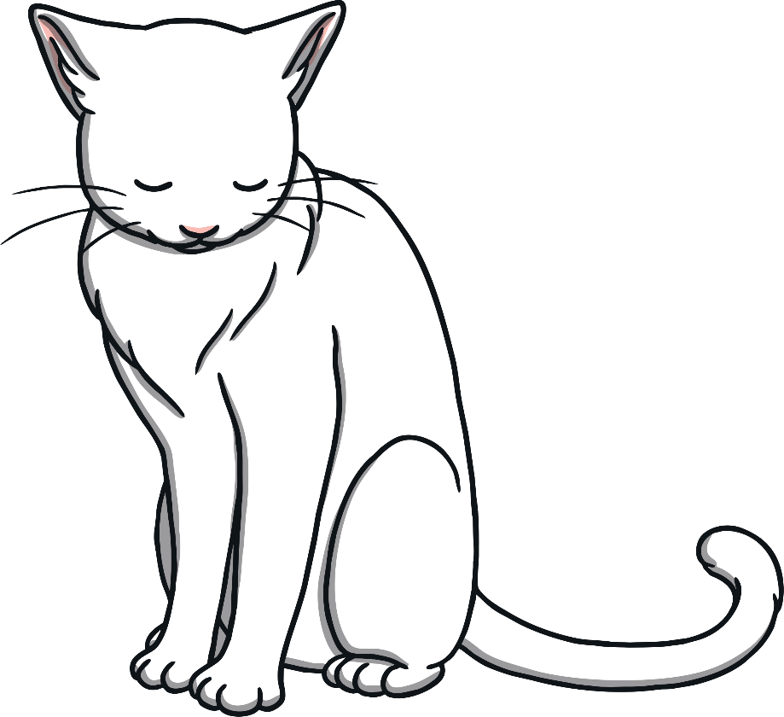
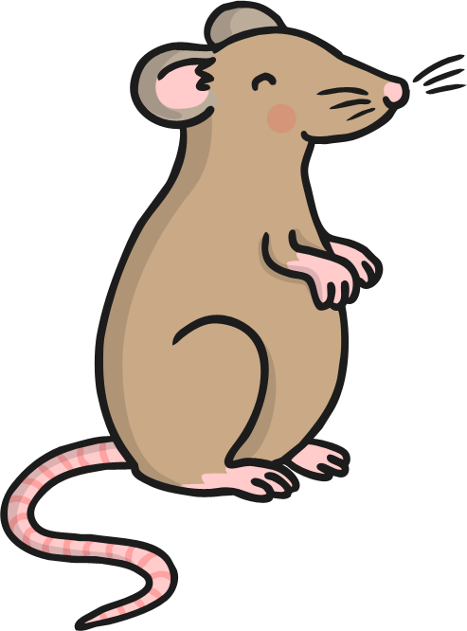
Apply
Play

Slide 25
Apply
Well done!

Slide 26
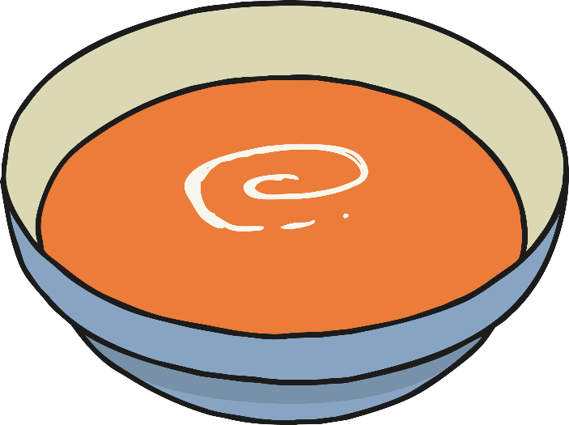
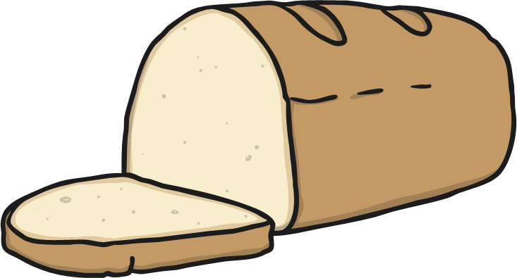
Apply
Play

Slide 27
Apply
Well done!

Slide 28
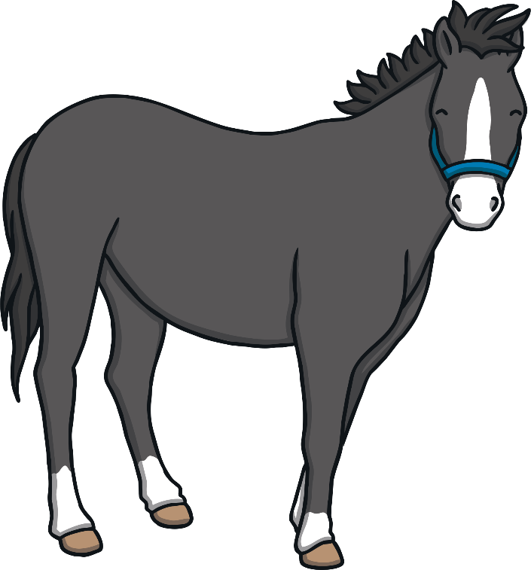
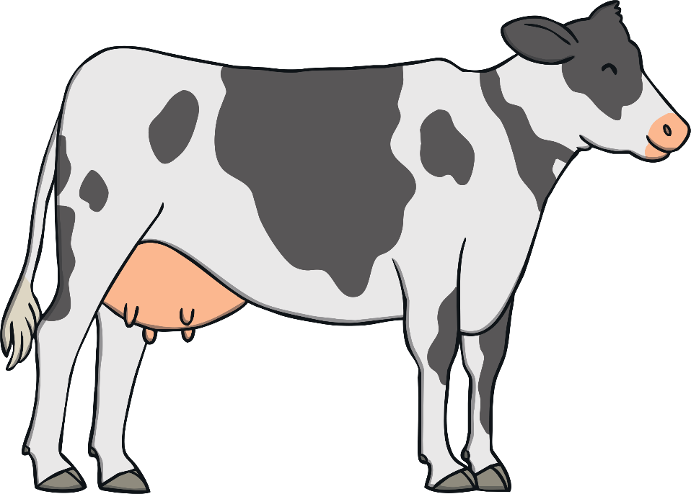
Apply
Play

Slide 29
Apply
Well done!

Slide 30
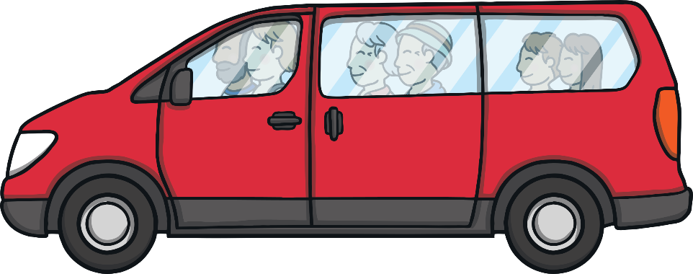
Apply
Play

Slide 31
Apply
Well done!

Slide 32
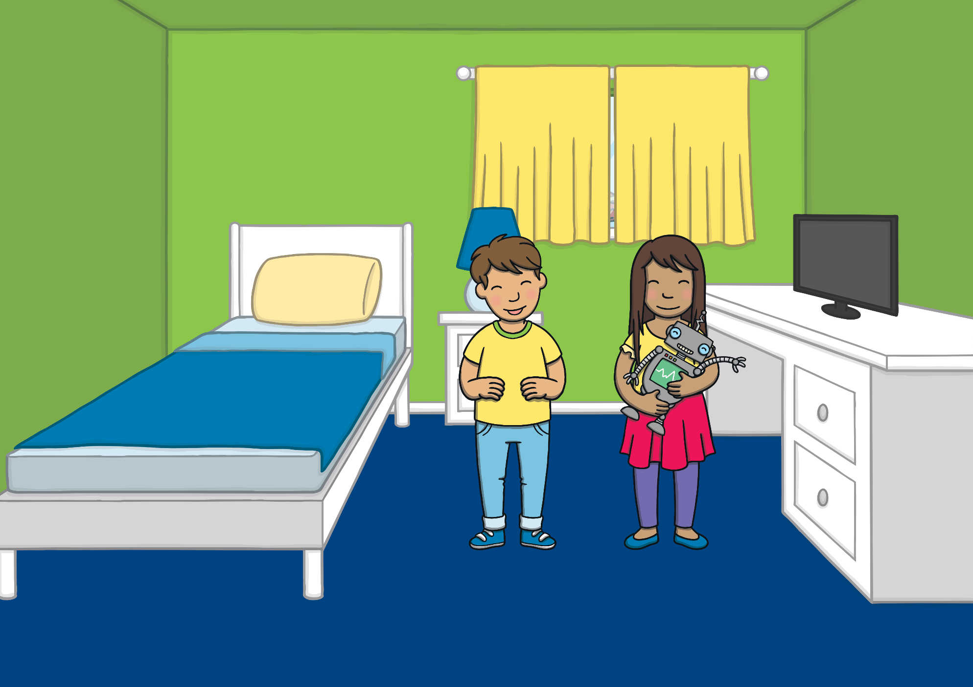
Apply
“He is good!” laughed Kit. “If only the snake in the woods were here too, they could make s sounds together!”

Slide 33
Today, we have learnt…
s

