Slide 2
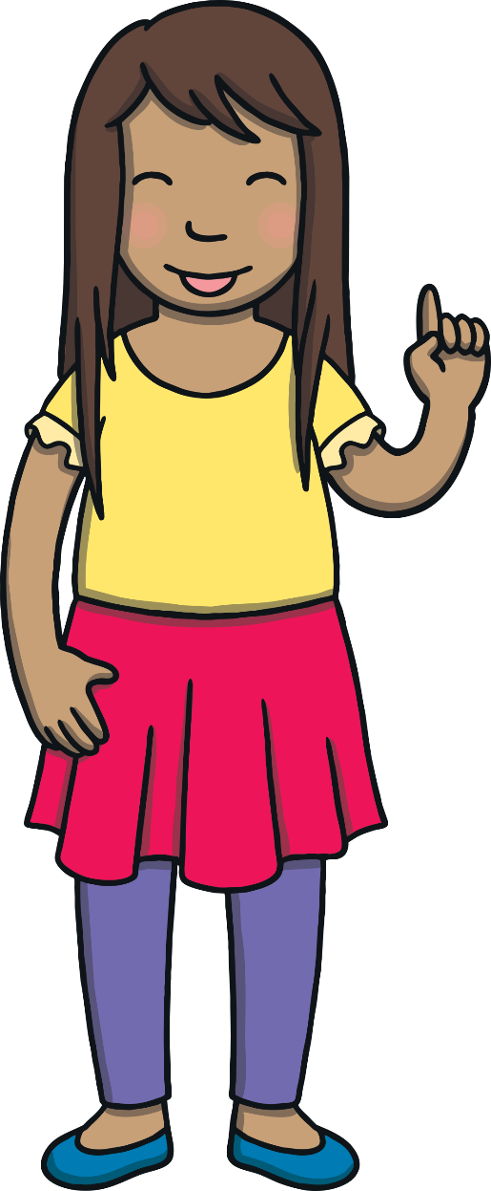
Revisit and Review
Let’s practise Sam’s Sounds!
s

Slide 3
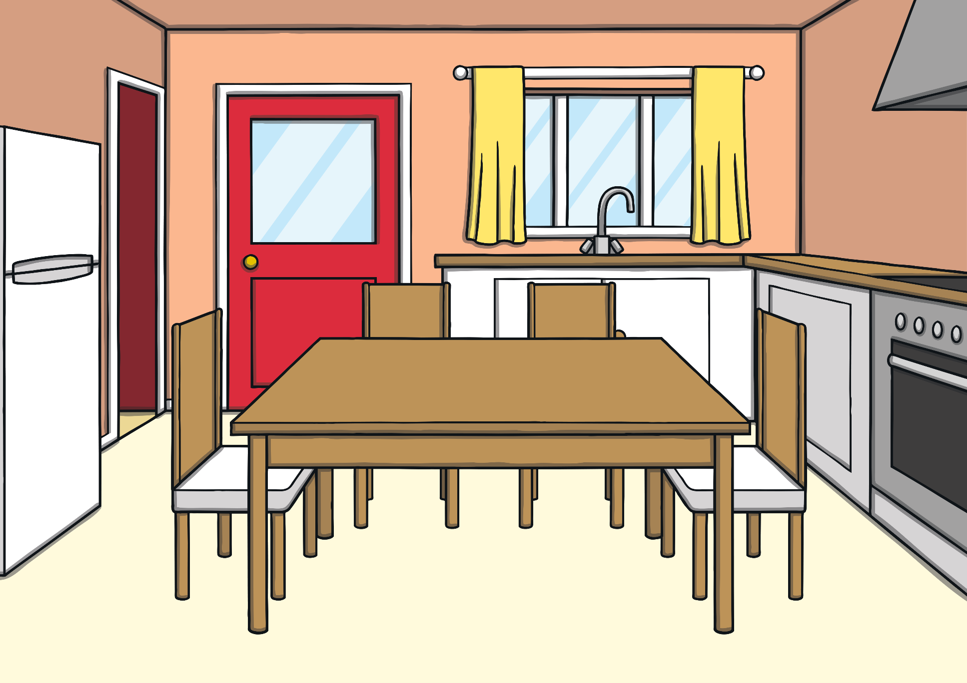
Teach
Kit and Sam had just got home from school and they were hungry.

Slide 4
“You can have an apple,” said Mum.
“Great, my favourite fruit!” smiled Sam.
Teach

Slide 5
Teach
“Hey Sam, apple starts with the a sound, ” said Kit. He took a big bite. “Listen, a, a, a!”

Slide 6
a
Teach

Slide 7
Teach
a

Slide 8
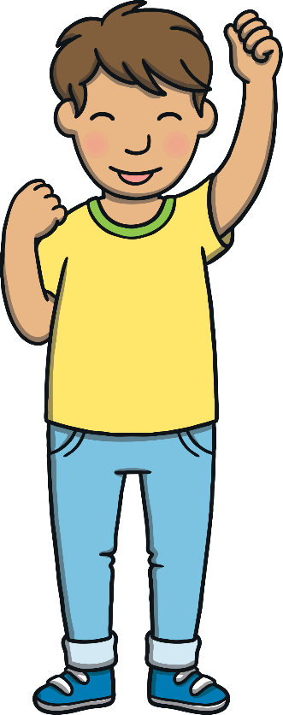
Action
Teach
Pretend to bite into a crunchy apple.
Say ‘a, a, a’.

Slide 9
Write the Letter
Teach
a
Start at the bottom, up the ramp, around the apple, up the stalk and down the leaf.
Play

Slide 10
Let’s Sing!
Teach
(To the tune of ‘Cockles and Mussels’)
We like to eat apples, we like to eat apples,
We like to eat apples at break time and lunch.
We like to eat apples,
a - a - a - a, apples.
Red apples, green apples,
a - a, they go crunch!
Play Song

Slide 11
Apple Phoneme Spotter
Practise
Watch carefully as Kit and Sam take bites of their apples. If you see a letter a or a letter s appear, say the sound and do the action.
Linking the phoneme, grapheme, mnemonic and action helps children to make learning links.
X
Click me for Kit’s teaching tips!

Slide 12
Practise
s
a
t

Slide 13
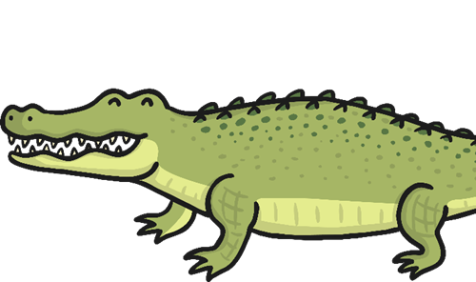
Apply
“Hey Sam,” said Kit, “do you think we can find any other things that have an a sound in them?”

Slide 14
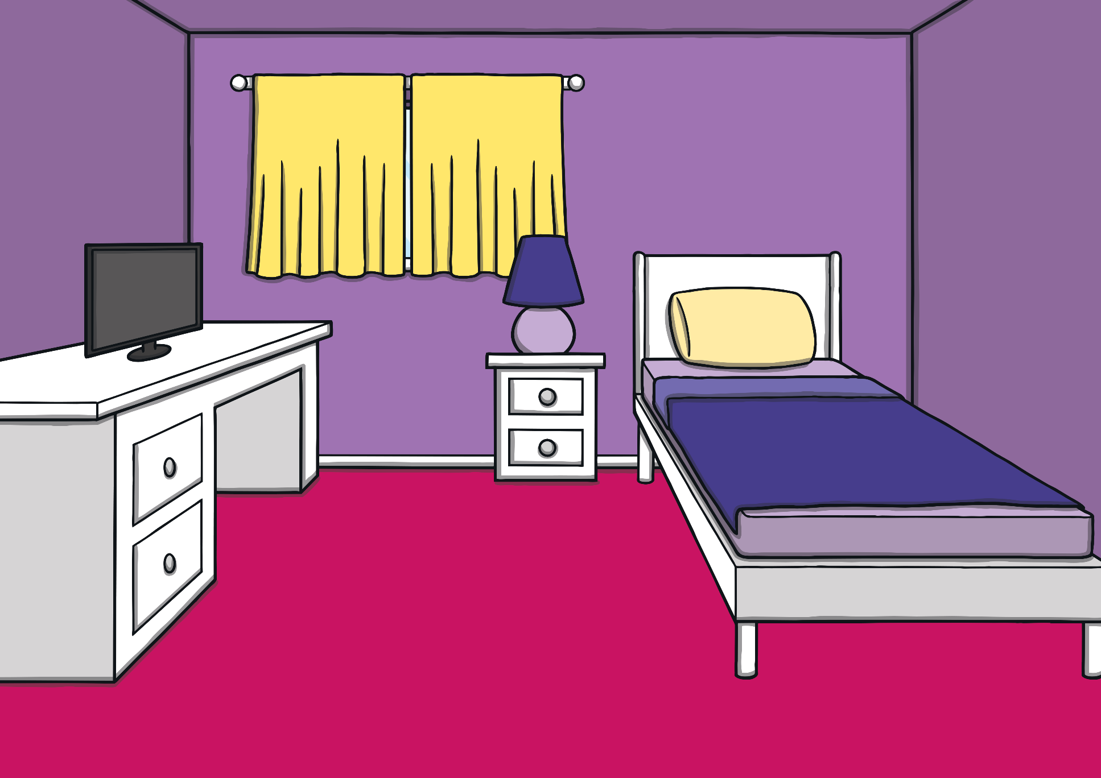
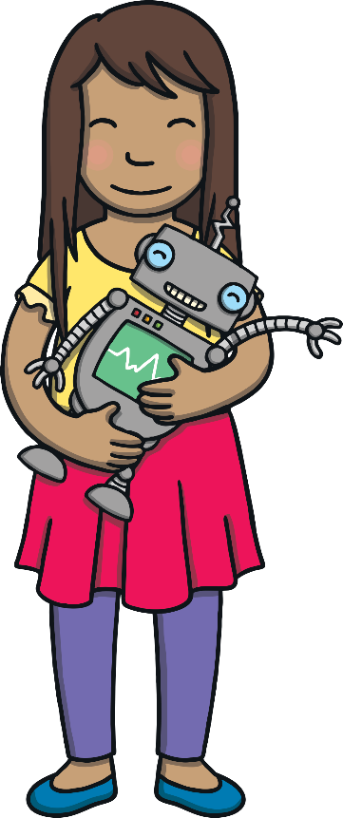
“Why don’t we try my toy robot again!” said Sam. “I bet he can say some words with a in them.”
Apply

Slide 15
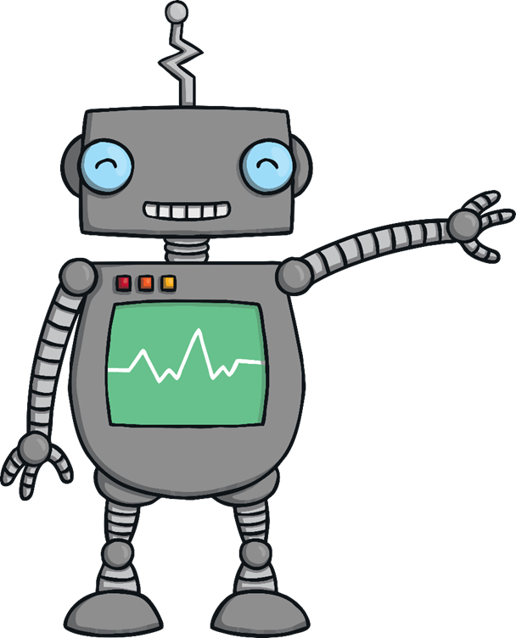
a Picture Spot
Apply
Sam’s robot talks in ‘robot talk’. Listen to Sam’s robot say a word. Can you work out which picture matches the word he is saying?
X
Some children may be able to tell you whether the /a/ sound appears at the beginning or the end of the word.
Click me for Kit’s teaching tips!

Slide 16
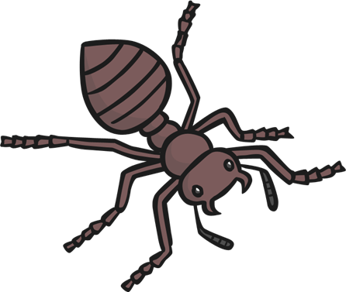
Apply
Play

Slide 17
Apply
Well done!

Slide 18
Apply
Play

Slide 19
Apply
Well done!

Slide 20
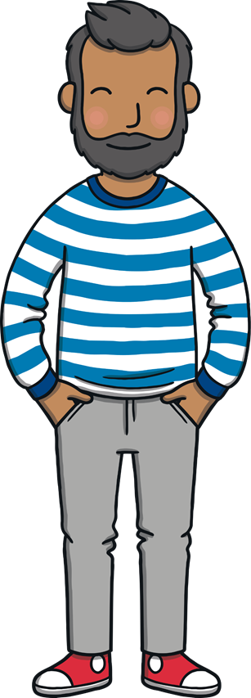
Apply
Play

Slide 21
Apply
Well done!

Slide 22
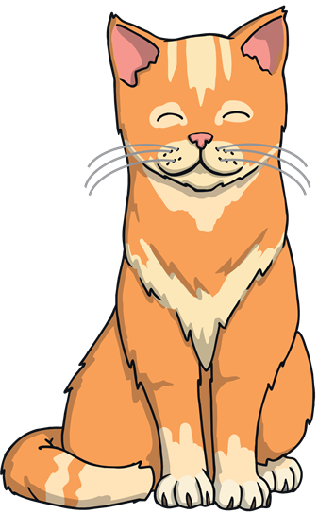
Apply
Play

Slide 23
Apply
Well done!

Slide 24
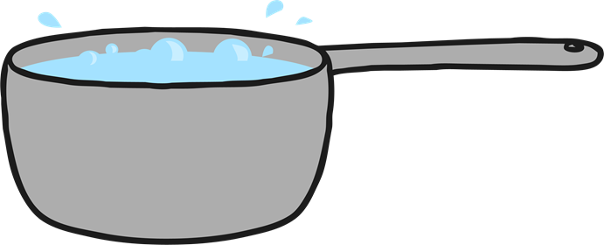
Apply
Play

Slide 25
Apply
Well done!

Slide 26
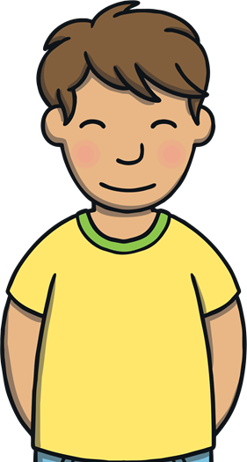
Teach
“My apple was yummy!” said Sam.
“So was mine,” said Kit. “I wonder how long it is until dinner time?”

Slide 27
Today, we have learnt…
a

