Slide 1
Guidance for Video/Audio in PowerPoints
1. Open the folder and copy all the files.
2. Paste the copied files into a new folder.
3. Open the PowerPoint file, enable editing and enter presentation mode (start the slide show).
Please note the embedded audio may not be compatible with early versions of PowerPoint.
You may wish to delete this slide before beginning the presentation.

Slide 3
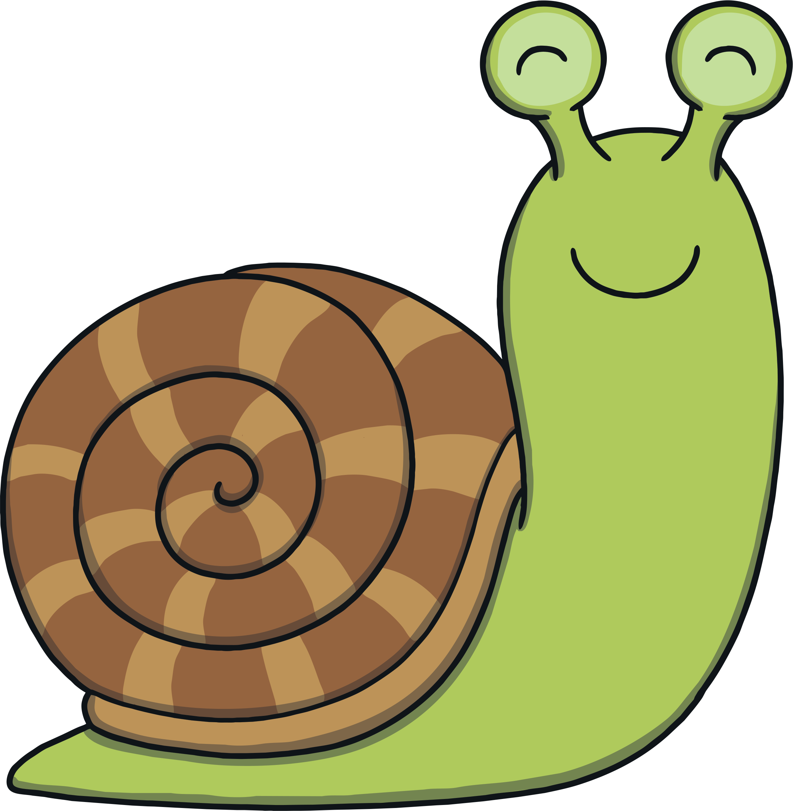
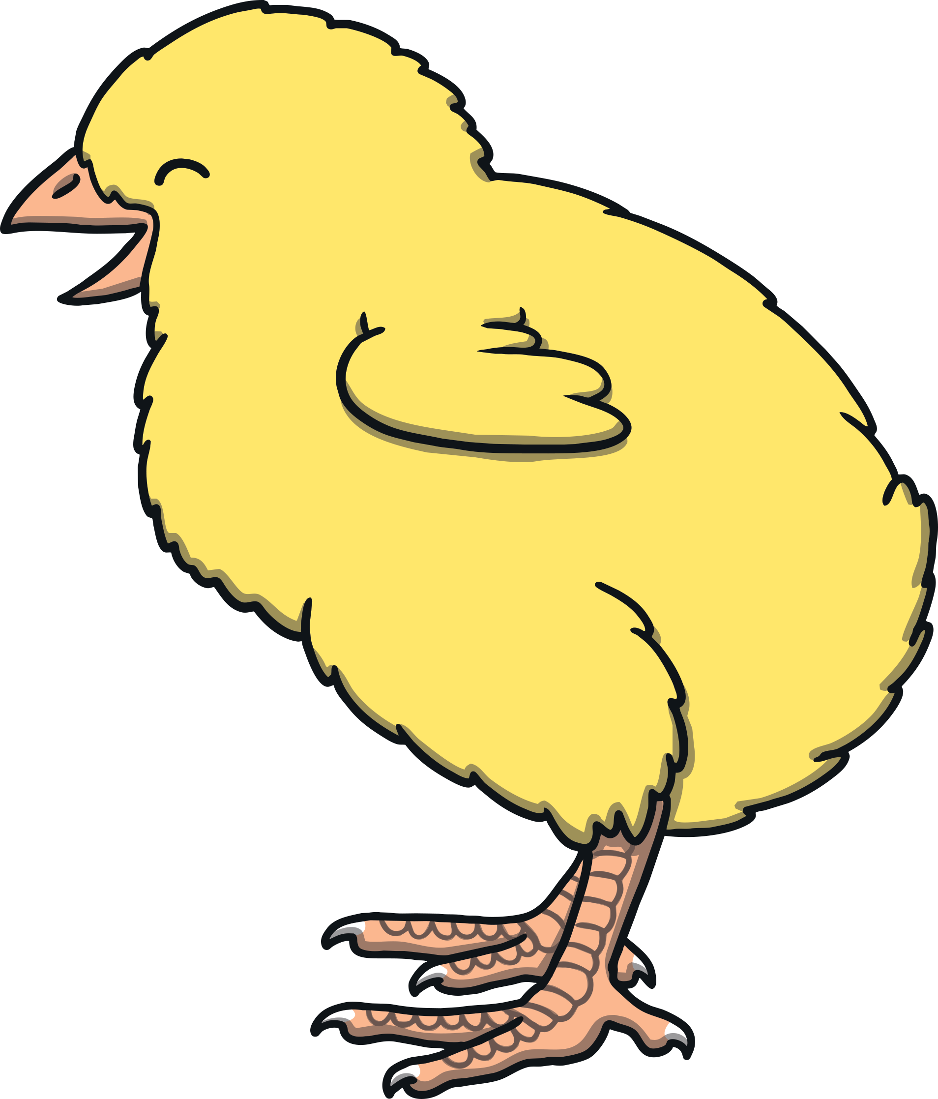
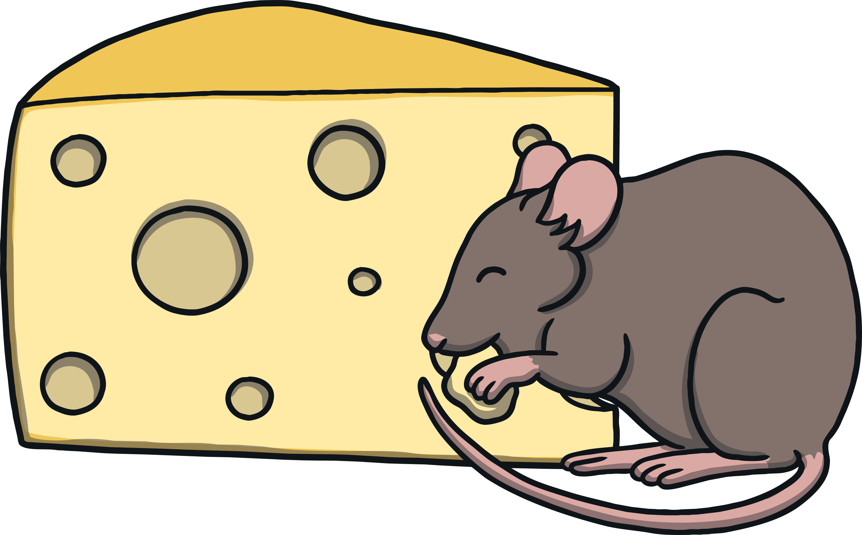
Revisit and Review
Let’s practise Sam’s Sounds and Tricky Words!
j
zz
oo
ar
oo
or
v
ch
ng
z
igh
y
qu
x
th
ai
ee
oa
w
th
sh
was
he
she
we
me
be
my

Slide 4
Teach
This week, we meet our next tricky word – you.
Tricky words are words that can’t be sounded out. We just have to learn them off by heart!

Slide 5
Tricky Cars
Teach
Shout out the tricky words on the cars – watch out for tricky word you!
X
Remember, tricky words from this level are shown in red in the story and decodable or familiar words are in purple. Digraphs and trigraphs are underlined.
Click me for Kit’s teaching tips!

Slide 6
was
my
you
Teach
was
my
you
you
my
was
my
was
you

Slide 7
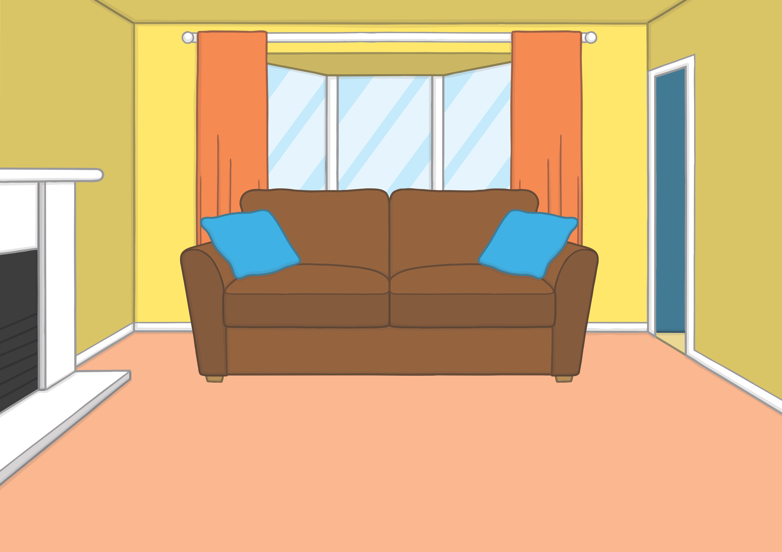
Teach
Saturday was treat day at Kit and Sam’s house. If they did their reading and helped out at home, Mum and Dad gave them both pocket money to spend however they liked.

Slide 8
Teach
“Here you go,” said Dad, as he handed Kit and Sam their cash.
“Well done,” said Mum. “You have worked hard to earn it. Spend it wisely!”
“I will,” replied Sam. “I’m saving up for a new cricket ball.”

Slide 9
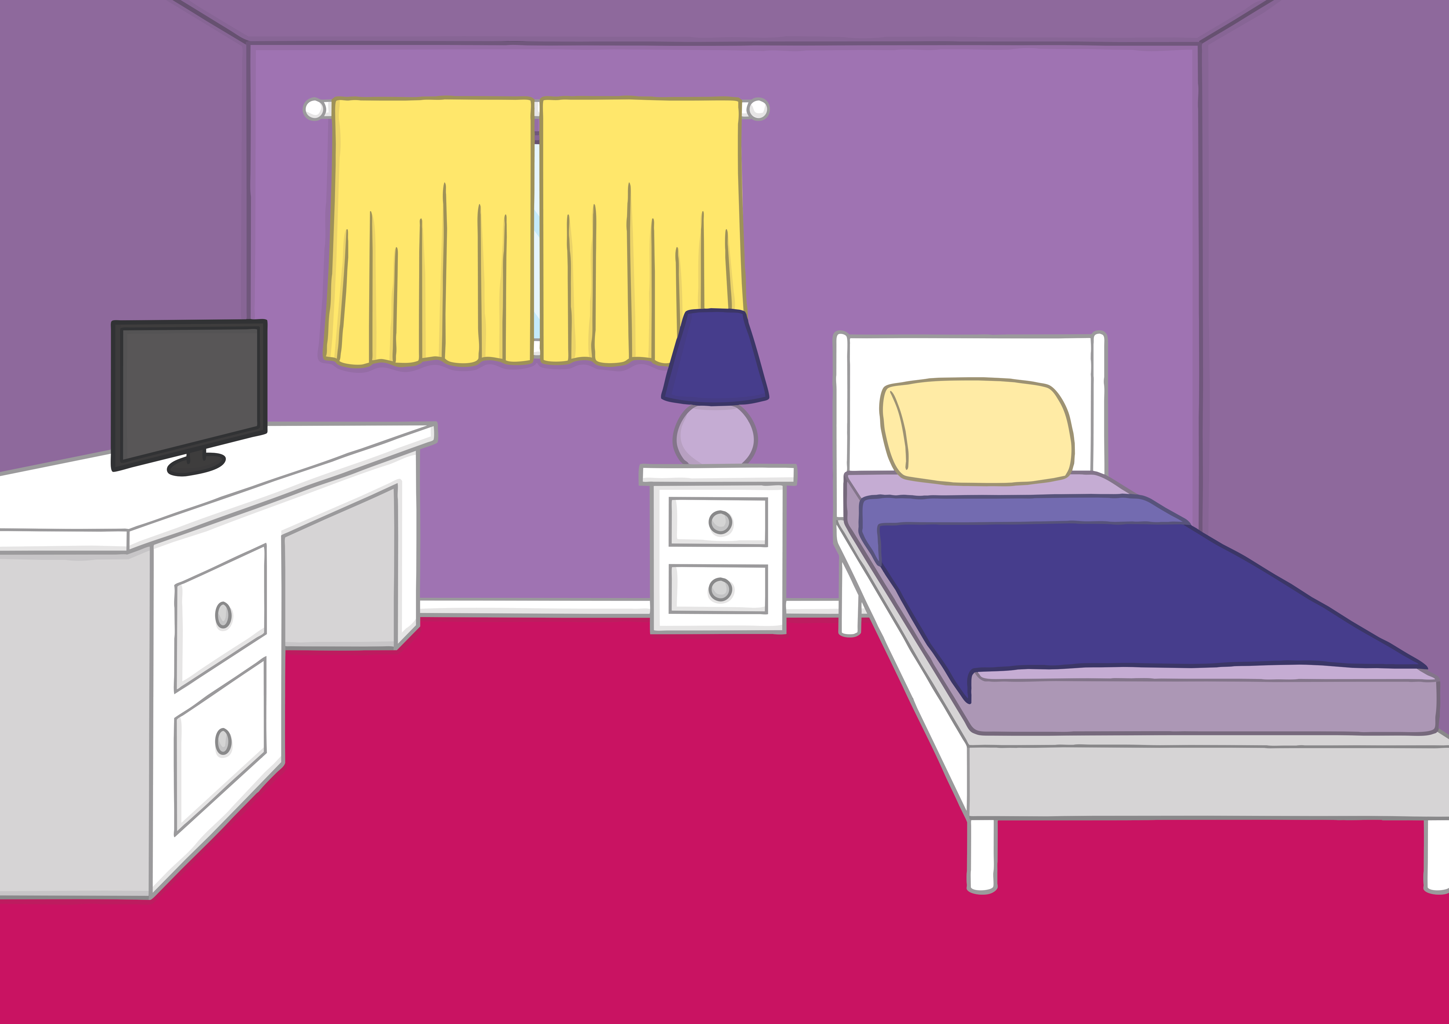
Teach
Sam carefully put all of her pocket money in a purse in her room. She liked to open it regularly to check how much money she had saved.
“That’s it! I’ve saved enough for the ball!” she exclaimed, as she burst into Kit’s room.

Slide 10
u
r
Teach
u and r are partners. They say ur.

Slide 11
Teach
Teach
ur

Slide 12
Teach
Teach
Action
Pretend to open a purse.
Say ‘ur, ur, ur’.

Slide 13
Teach
Teach
Write the Letters
ur
Down one umbrella handle, up and down the other.
Down the robot’s body, up and over it’s arm.
Play

Slide 14
Let’s Sing!
Teach
(To the tune of ‘Merrily We Roll Along’)
We are saving up for things,
ur - ur - ur
ur - ur - ur
We are saving up for things,
Money in our purse.
Play Song

Slide 15
Spending Time
Practise
Sam is at the shop, ready to buy her new cricket ball but has seen some other things she might spend her money on. Can you read the labels in the shop?

Slide 16
Practise
turnip
Show

Slide 17
Practise
surf top
Show

Slide 18
Practise
Teah
urn
Show

Slide 19
Practise
fur coat
Show

Slide 20
Practise
turf
Show

Slide 21
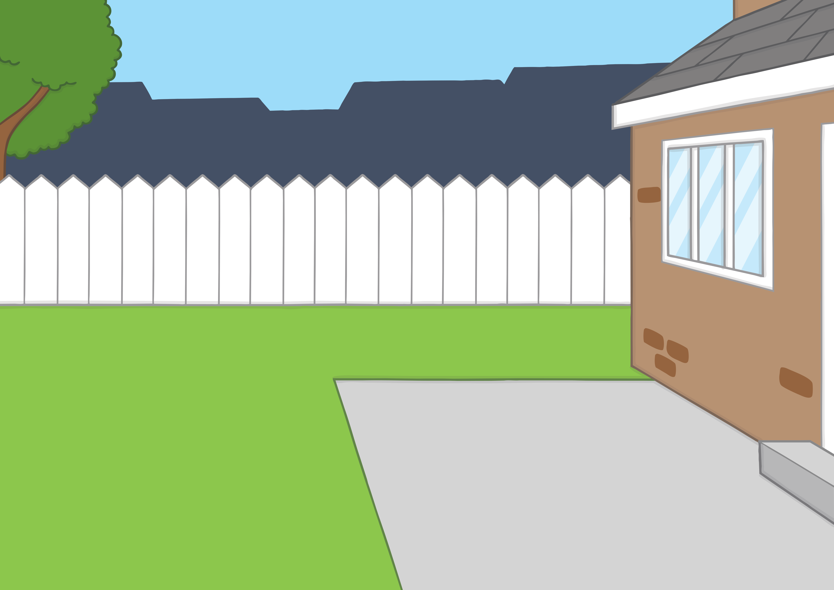
Apply
Kit and Sam were ready to play cricket in the garden with Sam’s brand new ball. “Go on, Sam, hurl it!” shouted Kit. Sam threw the ball as hard as she could.

Slide 22
Apply
Sentence Time
What happened when Sam threw her new ball? Read the sentence then click ‘Show’ to reveal the answer!
X
Click ‘Sound Buttons On/Off’ to select whether you want to show sound buttons under the caption.
Click me for Kit’s teaching tips!

Slide 23
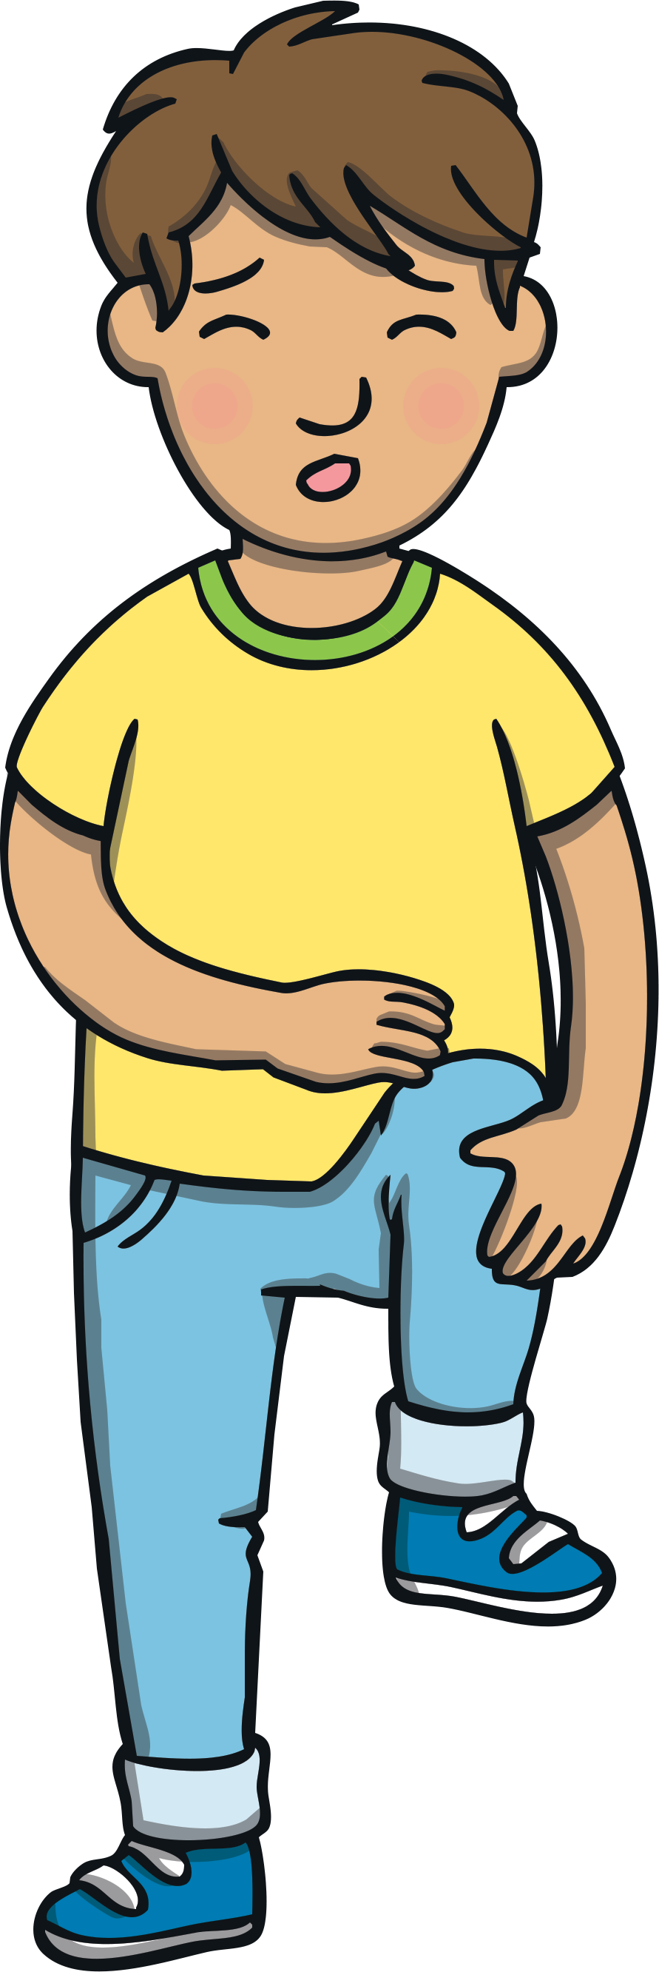
Apply
Kit got hurt on the foot.
Sound Buttons On/Off
Show

Slide 24
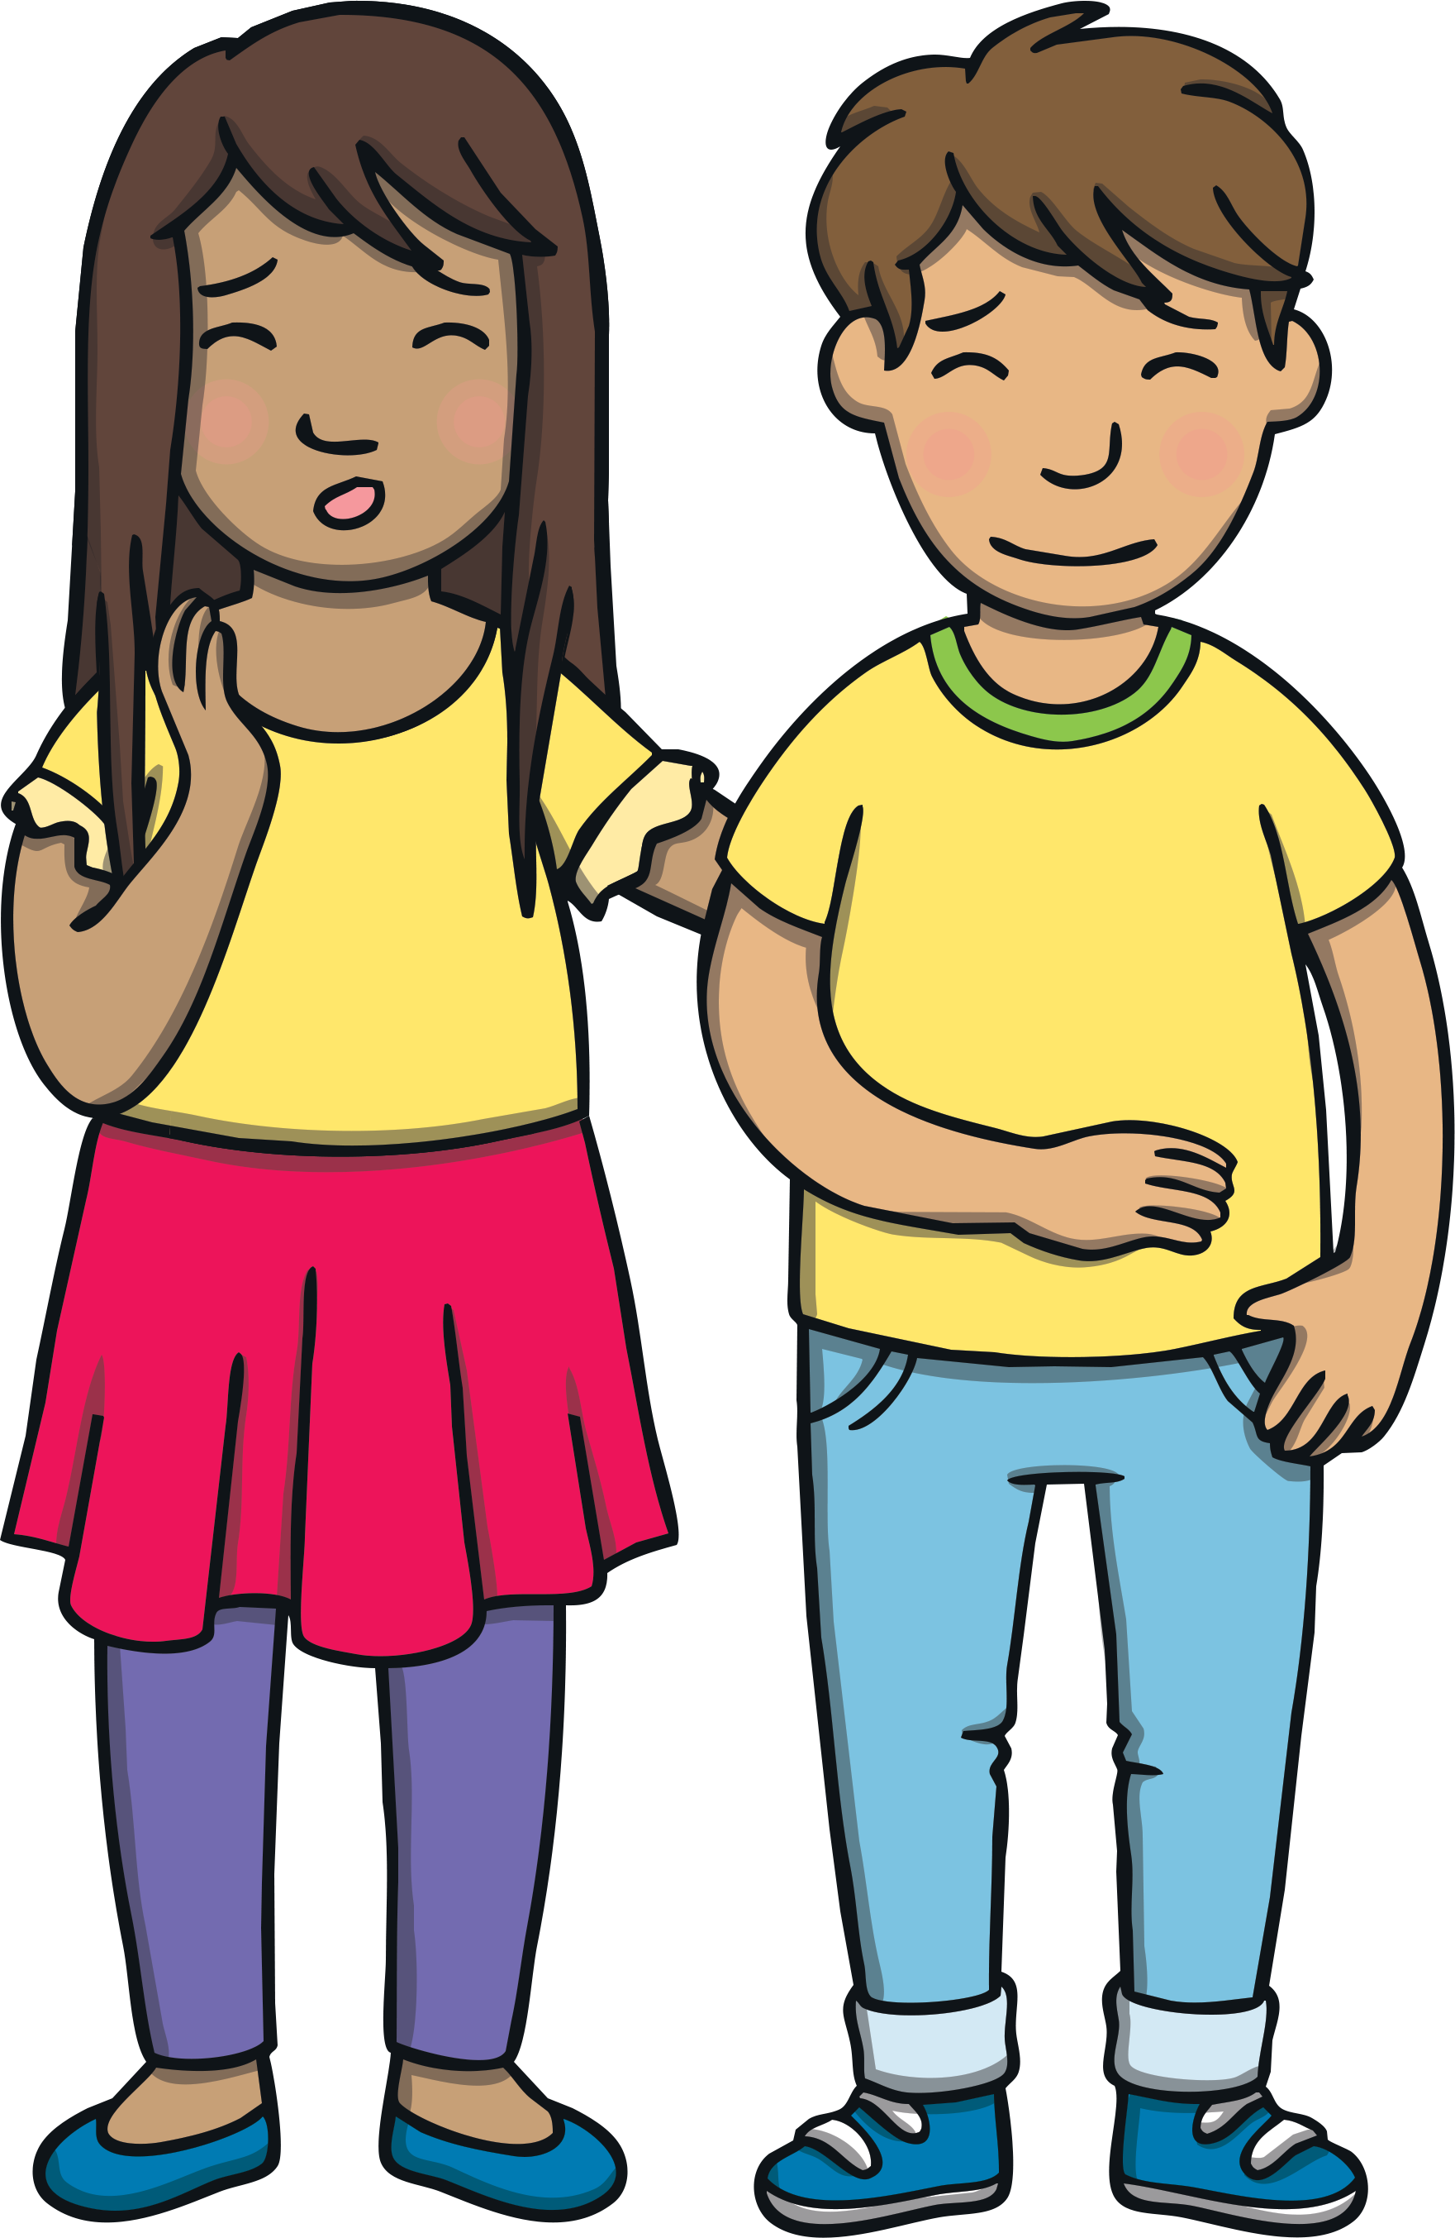
Apply
“I’m so sorry!” said Sam, as she ran over to help.
“It’s okay,” said Kit. “I just need to rest it for a minute.”
“You can have the next turn when your foot feels better,” said Sam kindly. “I’ll try not to throw it as hard next time!”

Slide 25
Today, we have learnt...
ur

