Slide 1
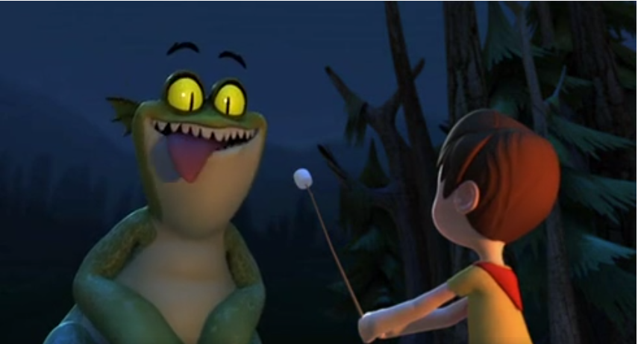
Year 4 English Unit 3
Non chronological reports - Marshmallows

Slide 2
A note from Miss McCann
Resource sheets are provided to support you with the tasks in this unit of work.
There are also sheets to help you to organise your work. You can either work on the worksheets provided or create a word document and type up your work.
Don’t forget to share anything you’ve done, or ask any questions:
year4homelearning@hillsideprimary.org.uk
and I’ll send you a reply! Keep in touch!

Slide 3
8.2.21- Spellings
Review
Last time we were looking at ‘ch’ in words that sounded like ‘sh’. How many of these words follow this spelling rule?
champagne chocolate chute
chalet parachute
moustache character brochure
school crochet
chef exchange machine

Slide 4
How many did you find?
There were 9.
champagne chocolate chute
chalet parachute
moustache character brochure
school crochet
chef exchange machine

Slide 5
Teach
Today we are going to be looking at a different spelling pattern. We are going to learn about where the ‘s’ phoneme/sound is spelt with ‘sc’ and the ‘c’ is silent.
Watch this short video clip… When is the 's' sound spelt with 'sc'? - BBC Bitesize
These are usually words which have originated from the Latin language!

Slide 6
Here are some more words where this spelling rule is used as well as the ones we’ve just looked at.
Read them aloud with me
science scientist
crescent discipline
ascent scent
fascinate scissors
scenery descent

Slide 7
Practise
Use spelling sheet 1 in your work pack to produce a scribble spelling to practise your words.

Slide 8
Apply
Using resource sheet 2 to complete the work using the ‘sc’ spelling words.
There are also some other spelling activity sheets (resource sheets 3 and 4) included in your pack to help you to practise your spellings in different ways over the next two weeks.
Don’t forget to practise on Spelling Frame too!

Slide 9
Sit back, relax and enjoy…
Use the following link to watch the clip ‘Marshmallows’.
I.f the first link doesn’t work, try the next one.
Marshmallows on Vimeo
marshmallows short film - YouTube
You will need to watch the clip more than once while completing your lockdown English work to focus on different aspects from it throughout the two weeks.

Slide 10
Tuesday 9th February- Initial thoughts…
Think about the following questions and answer the questions on the sheet.
What causes the monster’s attitude to change at 1min 17 secs into the film?
Where do think the story is set? Why do you think this?
Why do you think the boy is camping on his own?
Where do you think the boy is running to at the end of the film?
Use resource sheet 5 to record your answers.

Slide 11
Wednesday 10th February – Word class
Understanding word class is extremely important during Year Four. We should confidently be able to identify nouns, verbs, adjectives, adverbs and prepositions.
Grammar - KS2 English - BBC Bitesize
On the next page is a setting description from the film. You need to go on a word hunt through the text and find the different classes of words. Choose bronze, silver or gold level to find the different words.
Can you spot the nouns (person, place or thing), adjectives (words that describe the noun), the verbs (the action words), adverbs (describe the verb) and the prepositions (the words that tell you where, when or how something is happening)?
Use resource sheets 6 and 7 during this lesson.
Notes:
https://www.literacywagoll.com/mystery.html

Slide 12
Wednesday 10th February – Word class
It was a clear, warm night. An owl hooted softly. A small boat bobbed on the lake and from time to time the water gently lapped against it. Moonlight hit the ripples on the lake, reflecting little sparks of light like diamonds on the water. In the distance, the outline of the towering mountains cast dark shadows, menacingly across the tranquil lake. Tall trees with thick trunks edged the water and birds roosted in their tangled branches. A short pathway led to a camping area. In the middle of the camp, a fire crackled with red embers. By the fire, a fallen log was being used as a seat, by a young boy, who had pitched his tent for the night.
Use resource sheets 6 and 7 during this lesson.
Notes:
https://www.literacywagoll.com/mystery.html

Slide 13
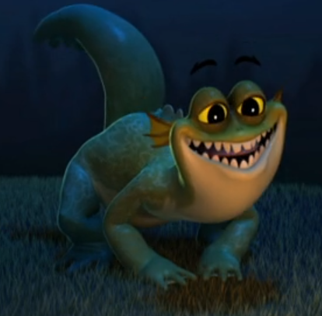
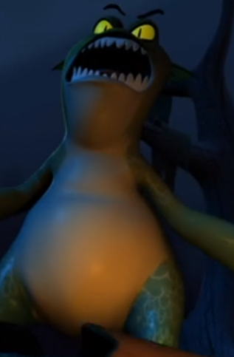
Thursday 11th February – Character details
Today we are going to look at the monster in more detail. By watching the film, what do we know about him?
How do different parts of his body look?
How does he behave? What does he like? What sounds does he make? How does he move? You are going to record your ideas on resource sheet 8. Remember to include lots of adjectives and adverbs for description.
Use resource sheet 8 to record everything you know about the monster from watching the video.

Slide 14
Friday 12th February – Improving sentences.
Today we are going to improve sentences which give some information about the monster from the story. To do this, we are going to practise using a range of different sentence openers, to make sure each sentence does not begin with ‘The monster….’ or ‘It…’
Using your own ideas or the suggestions from resource sheet 9, rewrite my sentences with improved openers. You can also change the structure or order of the sentence as long as the information stays the same.
Use resource sheet 9 for ideas and resource sheet 10 to write improved sentences with varied openers.

Slide 15
Monday 22th February – Non chronological reports
At the end of last term, we had looked at non-chronological reports and all of the features that they contain. Can you remember them?
What is a non chronological report?
A non-chronological report is a piece of writing that provides the reader with factual information about a chosen topic. The information provided in the report is not in any certain order so individuals can use reading techniques such as scanning and skim reading to find out the information they need.
Have a look through the following slides to recap your mind on the features.
Have a look at resource sheets 11 and 12 for examples of simple non-chronological reports about animals.

Slide 16
Features of a non-chronological report
Heading
Introduction
Subheadings
Diagrams/ images
Captions/labels
Paragraphs
Factual information.
Conclusion
Technical vocabulary

Slide 17
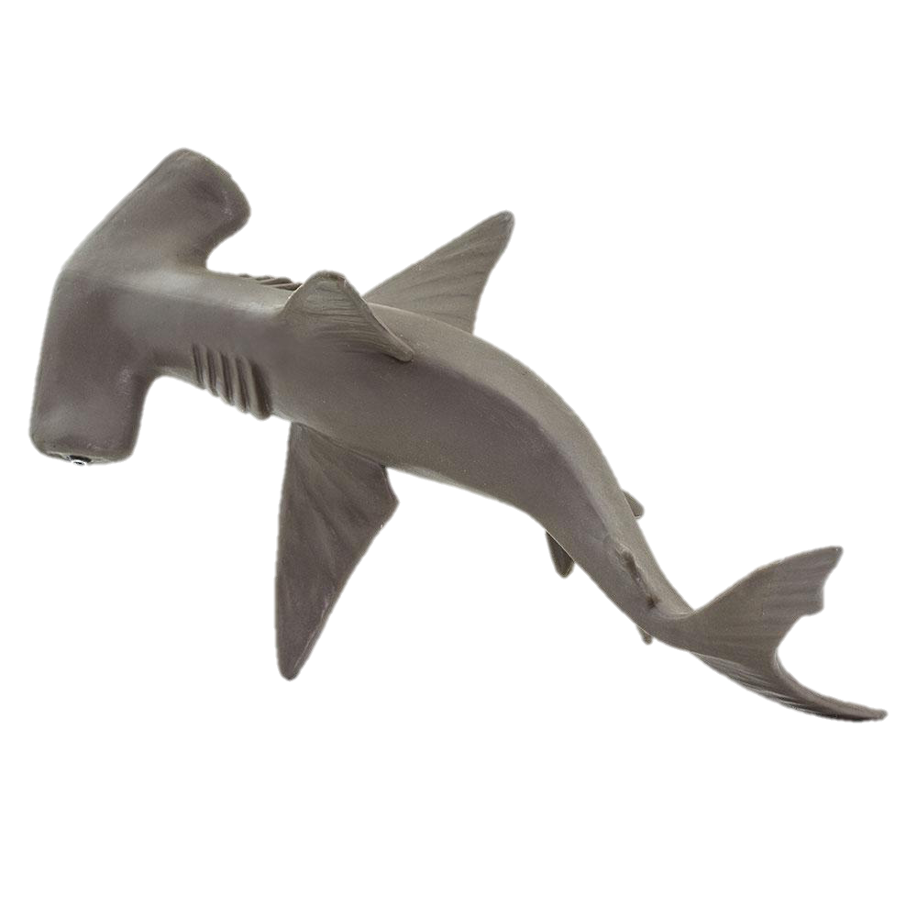
Heading
The heading of a non-chronological report is often found at the top of the report. This informs the reader what the report is about.
Hammerhead sharks
Mosques

Slide 18
Introduction
The introduction tells the reader about what they we will be reading about. This part of the report is extremely important to set the tone of the report. The text should be written in a formal tone.
The Emperor Penguin
The Emperor Penguin, the largest species of penguin at 1.15m tall, is the only animal to inhabit the open ice of Antarctica during the winter months. With raising temperatures (caused by global warming), the Emperor Penguin is considered near threatened by human activity.

Slide 19
Subheading
A subheading separates your information into easier chunks of information. This allows the reader to successfully scan and skim read the non-chronological report to find the information they want to learn about.
Have a think…. What could be the subheadings for the heading ’Ultimate Frisbee’?

Slide 20
Subheading
A subheading separates your information into easier chunks of information. This allows the reader to successfully scan and skim read the non-chronological report to find the information they want to learn about.
Have a think…. What could be the subheadings for the heading ’Ultimate Frisbee’?
The Rules Playing safely
Throwing the Frisbee Correct clothing
Playing defense
Catching the Frisbee

Slide 21
Diagrams/images
Often we find diagrams or pictures in non-chronological reports to support the facts written in the report.
For example, if it was a report on dinosaurs , you might find a diagram about the different bones they have:

Slide 22
Captions and labels
Captions appear underneath photos or diagrams in your report. Labels point out specific parts of the image. This gives the reader a little bit more information about what they are seeing.
Have a go with the photos below:

Slide 23
Conclusion
At the end of the report is a paragraph summarising everything that has been spoken about in the report as a whole. It is often the last thing the reader reads, therefore, often the author leaves the reader with the final message that they want to give over.

Slide 24
Features of a non-chronological report
Heading
Introduction
Subheadings
Diagrams/ images
Captions and labels
Paragraphs
Factual information
Conclusion
Technical vocabulary

Slide 25
Additional features
Written in the 3rd person – they, it,
Written in present tense – are, is
Written in a formal tone – as though you don’t know the reader
Need to make it interesting to read
Varied sentence openers
Sentences need extending with additional information

Slide 26
Monday 22nd February (2)
Now that you have recapped and hopefully remembered the features of non-chronological reports, you are going to identify them within a text.
I have written a non chronological report about a new species of animal, on resource sheet 13
A Donriphant!
You are going to read the non-chronological report and identify the different feature within it by underlining, circling or labelling with coloured crayons or felt tips, then colour coding the chart on the resource sheet 14 to create a key.
Choose the appropriate chart to complete – bronze, silver or gold.
Use resource sheets 13 and 14 to identify the features and create your key using colours.

Slide 27
Tuesday 23rd February – Creation of a monster
In the film clip ‘Marshmallows’, the monster has been created as a new species that eats marshmallows, lives in water and on the land within a woodland habitat. We can see the appearance of the monster and the way it behaves from watching the film.
Today, you are going to create your own ‘new’ species of monster, ready for your non-chronological writing at the end of this week.
Think of ideas for your monster. What will it look like? How big will it be? Does it have skin, scales, fur or a shell? Where will it live? What will it eat? Is it a herbivore, carnivore or omnivore? How will it move? How will it behave? Does it live solitary (on it’s own) or within a group? Will it be nocturnal? Is it dangerous? What will it be called? YOU DECIDE!
Use resource sheet 15 to draw your creature and resource sheet 16 to record information about it.
Add lots of detail about all aspects of your creature.

Slide 28
Wednesday 24th February – Planning writing
Today, you are going to use all the learning so far to plan your non chronological report about your new creature.
You are going to organise your information into different paragraphs, decide on your heading, subheading, pictures/images, whether to include a fact box, or a did you know section.
You are also going to think about how you will present your work.
Use resource sheets 17 and 18 to plan your non-chronological report.

Slide 29
Wednesday 24th February – Planning writing
What subheadings will you choose? Here are some ideas:
Appearance Habitat Communication
Movement Sleeping habits
Family group Likes/dislikes Diet
Use resource sheets 17 and 18 to plan your non-chronological report.

Slide 30
Thurs 25th February – Time to write a non-chronological report!
You have now learned about the features of a non-chronological report, seen examples of them, identified the features in one, created your own creature to write one about and planned out you report on your planning sheet, including vocabulary to use.
Use resource sheets 9, 13, 17-20 to support your writing and resource sheet 21 to write your non-chronological report.

Slide 31
Thurs 25.2.21 – Time to write a non-chronological report!
You should now feel ready to start writing a non-chronological report about your new creature from Tuesday’s lesson. This will take two lessons to write.
Have a look at the success criteria and choose the level which is most suitable for you.
Don’t forget to use your planning sheet to structure your non-chronological report and include all the features you have learned about! Have a read through my example report of the Donriphant.
Can you see how I have included all the features of a non-chronological report, including technical vocabulary and extended sentences?
Use resource sheets 9, 13, 17-20 to support your writing and resource sheet 21 to write your non-chronological report.

Slide 32
Modelled introductory paragraph…
(From Donriphant report)
The donriphant is a large land mammal, usually found on the African continent, though fossils of a mammal similar to the donriphant have been found in South America.

Slide 33
Modelled paragraph…
Feeding
The creature’s neck is designed to reach the leaves and branches from the top of trees. Typically, an adult male will eat around 30-35kg of leaves a day. Leaves provide the donriphant with some of its water and the rest is consumed at the watering holes, often in large groups. Mainly found living in herds, the donriphant is well adapted to live in a hot, dry climate and, like a camel, it can store fat to keep it nourished on long journeys.
Did you know?
Due to its large size, the donriphant has very few predators. Adult deaths are more likely to be caused by crocodiles, which strike in the rivers and watering holes.

Slide 34
Added extras…
Images and pictures
While writing your report, think about the organisation of your work. You could draw images of your creature or it’s habitat onto plain paper and add these onto the writing sheets with glue, then organise your writing around these.
Also, think about the best position for your text box.
Make sure your heading and subheadings are clear to the reader.
Did you know?
Due to its large size, the donriphant has very few predators. Adult deaths are more likely to be caused by crocodiles, which strike in the rivers and watering holes.

Slide 35
Fri 26.2.21 – Continuing your non-chronological report!
Hopefully, you have got off to good start with your non-chronological report. Today is you second day of writing to complete your report.
Have a look at the success criteria and check the features you have already included and what you now need to include.
Continue to use your planning sheet, working through it as you write.
Complete your report by including a fact/did you know box and images of your creature.
Use resource sheets 9, 13, 17-20 to support your writing and resource sheet 21 to write your non-chronological report.

Slide 36
Is your report complete?
Once you have finished your writing, check through carefully for accurate spelling and punctuation.
Have you achieved all of your success criteria?
Leave a self assessment and send me a photo of your finished non-chronological report, or if you chose to work process, email it through to me.
I can’t wait to learn all about these new creatures!

