Slide 1
Document 1:

Slide 2
Document 2:
Bronze:
Pause the video at 0:10. What clues does this page give you about what the story is going to be about?
How does the boy come by the camera?
What is the name of the camera?
Pause the video at 0:54, how do you know that the camera has been in the water for quite some time?
Why does it take a while for the girl to develop the images at 1:15?
Has this camera been picked up by anyone else before? Why? Why not?
What evidence at 2:50 is there that the boy spends a lot of time analysing these photos?
What is the boy doing at 2.57?
At 3:14 the boy throws the camera back into the sea. Was he right to do this?
List three ways in which the camera is carried to different locations
Gold:
At 0:30 we can see a lot of props that the boy has taken to the beach. What do these props tell us about the boy?
Summarise the events that happen in the page on 0:38.
Pause the video at 0:54. Do you think the camera has been in the water a long time or not? Why/Why not?
What is the boy holding in his hand in the last picture (1:04)?
Do you think the images from the camera took a while to develop? Why? Why not? Use 1:15 to support your evidence.
How does the boy feel when he sees the first image from the camera? How do you know?
Pause at 2:40. Which character was the first one to put the camera in the sea? How do you know?
What evidence at 2:50 is there that the boy is intrigued by the photographs?
At 3:15 we see the camera wash up on a beach. Is this the same beach or a different beach than the one its washed up on at the beginning? How do you know?
Predict what you think the girl in the final clip will do with the camera.
Silver:
1). At 0:30 we can see a lot of props that the boy has taken to the beach. What do these props tell us about the boy?
2). How does the boy come by the camera?
3). Pause the video at 0:54. Do you think the camera has been in the water a long time or not? Why/Why not?
4). What is the boy holding in his hand in the last picture (1:04)?
5). It takes a while for the girl to develop the images on the camera. How do we know this using the images on 1:15?
6). How does the boy feel when he sees the first image from the camera? How do you know?
7). What evidence at 2:50 is there that the boy spends a lot of time analysing these photos?
8). Why does the boys take a photograph of himself at 2.57?
9). At 3:14 the boy throws the camera back into the sea. Was he right to do this?
10). List three ways in which the camera is carried to different locations
Platinum:
At 0:30 we can see a lot of props that the boy has taken to the beach. What do these props tell us about the boy?
Summarise the events that happen in the page on 0:38?
Do you think the images from the camera took a while to develop? Why? Why not? Use 1:15 to support your evidence.
Who are the characters we see at 2:07? Explain why you think this.
Pause at 2:40 Compare two of the characters that you can see. What is the same/ different?
What era is the first person who put the camera into the sea from? Why do you think this?
What evidence at 2:50 is there that the boy is intrigued by the photographs?
At 3:15 we see the camera wash up on a beach. Is this the same beach or a different beach than the one its washed up on at the beginning? How do you know?
Predict what you think the girl in the final clip will do with the camera.
Sum up the ‘Flotsome’ story in under 50 words.

Slide 3
Document 3:
Waves crashed against the shore like white stallions as the incoming tide gradually climbed up the broad white strip of sand. Children and their parents pranced about in the shallows, running and splashing, consumed in laughter as gulls screeched above me in the cloudless sky. Gently, a light breeze tickled my skin as I lay, preoccupied with my latest beach discovery: a crab.
Eyes wide, I glared inquisitively, analysing every part of this peculiar crustacean through a magnifying glass. Consumed by an overwhelming desire to discover more of these ten legged creatures, I picked up my spade and began to dig, unaware that I was precariously close to the incoming tide. In one fell swoop, waves descended down on top of me, lifted me off the floor and carried me further inland. Letting go of my spade and the bucket which contained the crab, I flapped my arms furiously to keep my head above the thrashing water which engulfed me.
Soaked and somewhat dishevelled, I arrived approximately ten feet up the beach face down in the sand which stuck to my drenched body. Brushing myself down and wiping the salt water from my eyes, I stood upon my feet and began to collect up the equipment that had been so abruptly swept from my grasp. It was at this point I noticed something entirely foreign. Something I was sure I had not seen before and most certainly did not belong to me: a metal box with a small glass cylinder on the front. Being as naturally curious as I am, I approached the box and picked it up. ‘Melville Underwater Camera’ it read. A rush of excitement coursed through my veins as I felt I had stumbled upon the ultimate discovery. Somewhat flustered, I opened the back of the camera to find the film that was kept inside. I just had to get the images developed.
In a hurry, I put on my sandals and rushed into town, found the nearest photograph shop and requested that the photos be developed. I waited. I waited some more. And still, I waited. After what felt like an age, the photographs were finally ready. I snatched them from the shop assistant’s hand and sprinted back to the beach, where I tore open the wallet that they were in and stared in awe at the photographs.

Slide 4
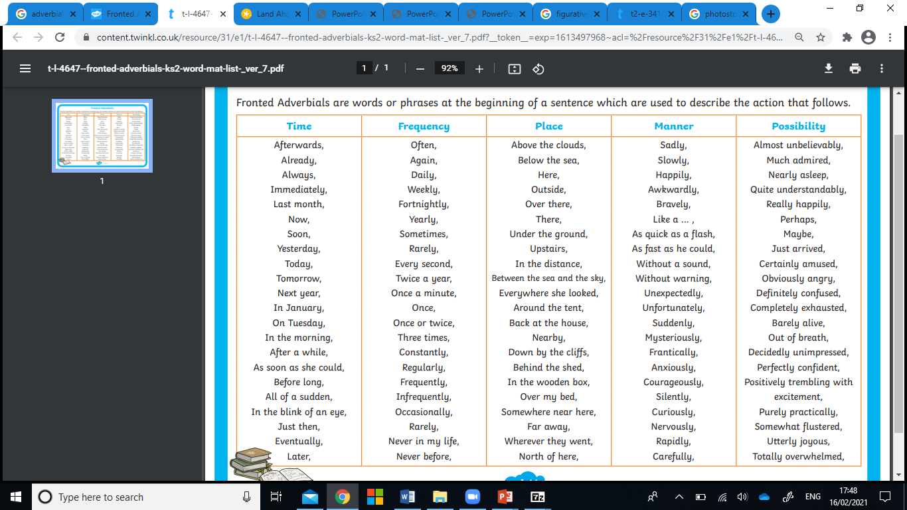
Document 4:

Slide 5
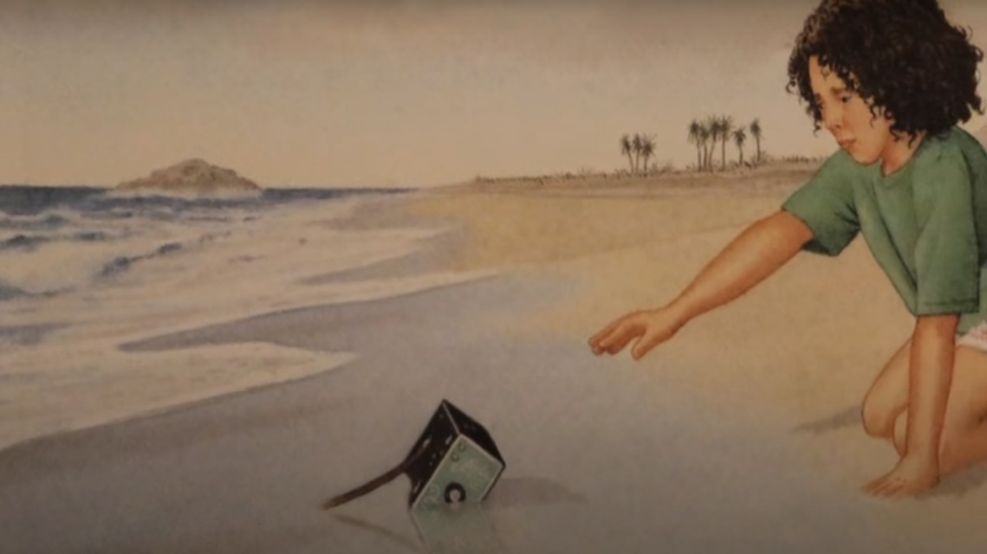
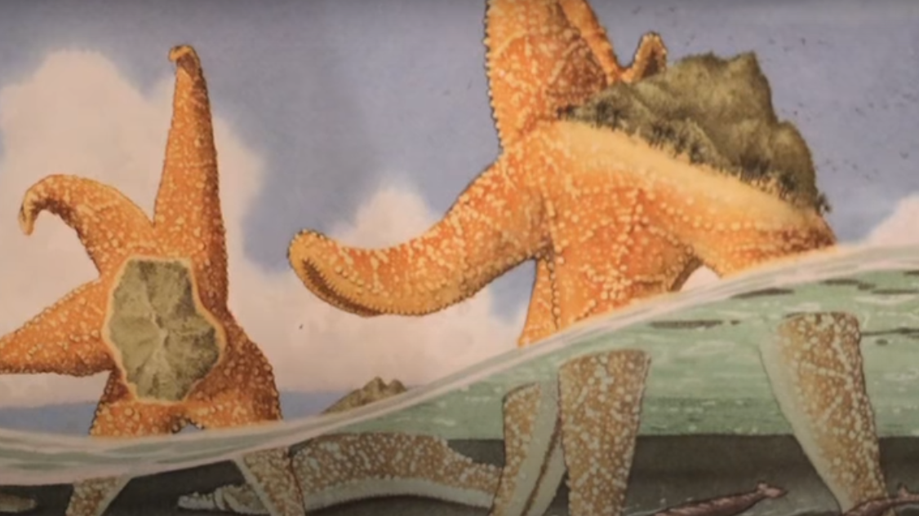
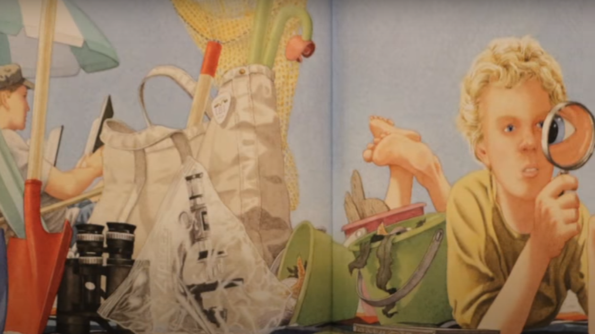
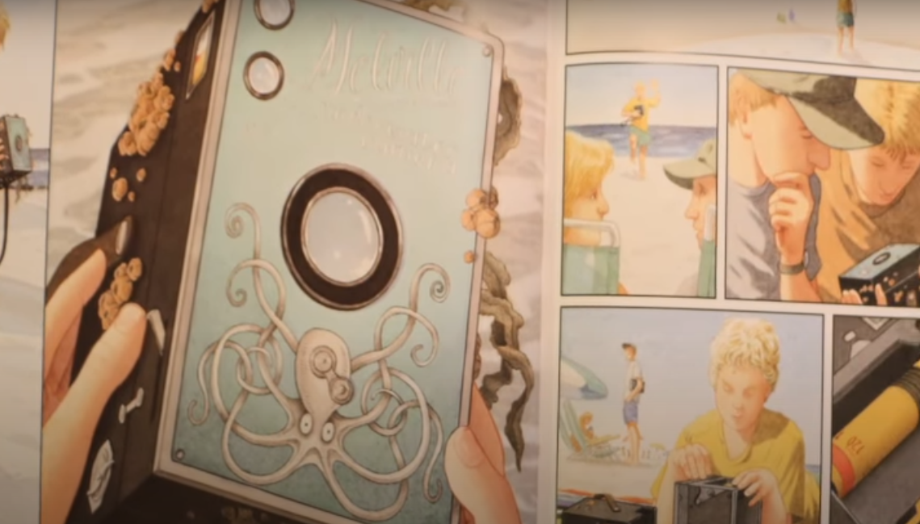
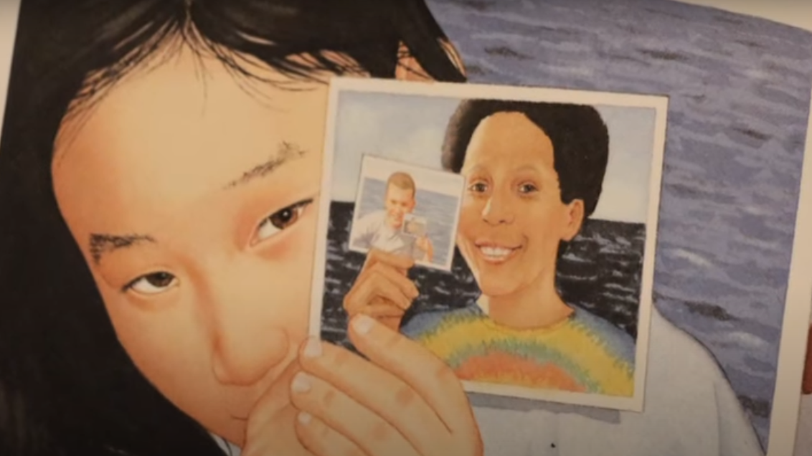
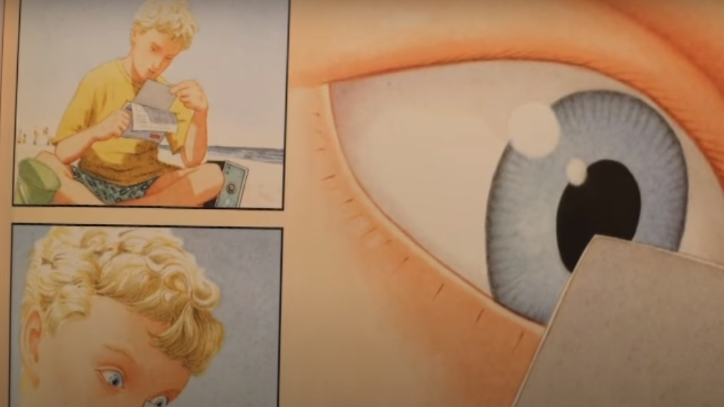
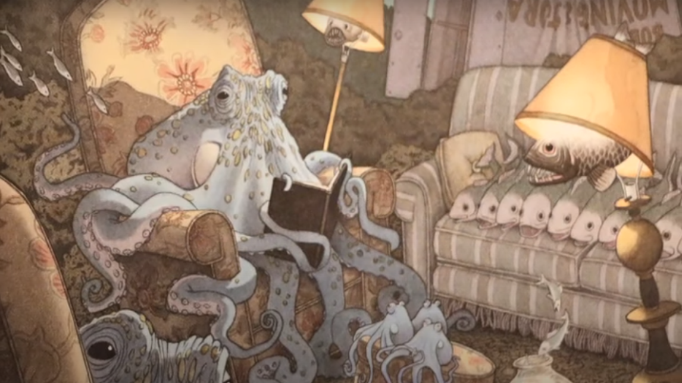
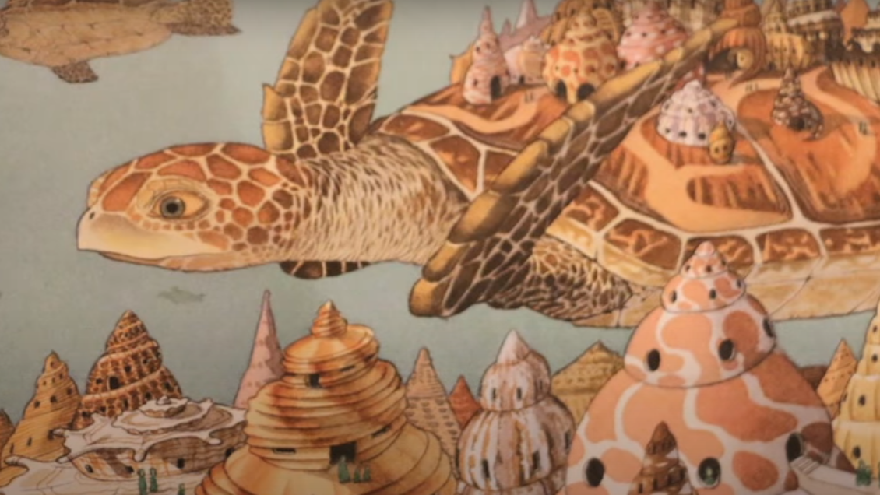
Document 5:

Slide 6
Document 6:
Conjunctions
Newspaper report planning frame

Slide 7
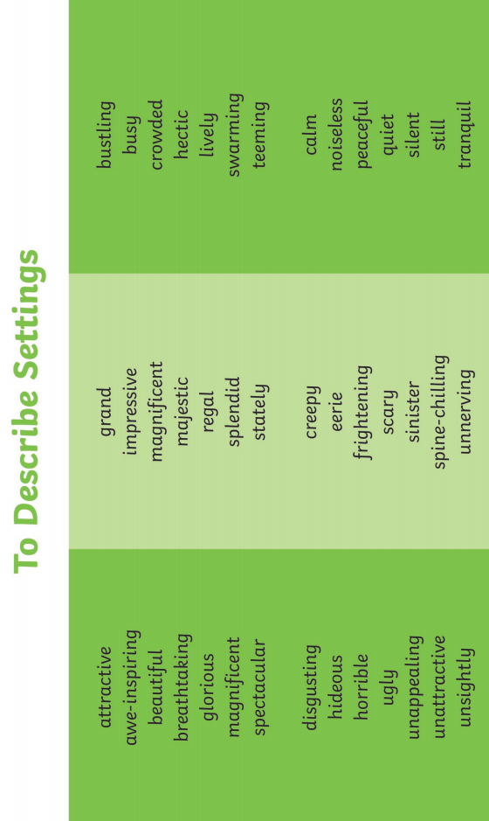
Document 6:

Slide 8
Document 6:

