Slide 1
Year 6 – Book week
Flotsam by David Wiesner
Notes:
Our new writing unit for this cycle of learning is to create a chapter recount. We will be basing our chapter recount off the popular children’s book/film: The Lion, The Witch and The Wardrobe. We are going to build up to our chapter recount by completing a range of different activities throughout the next fortnight, these will focus on building description using different techniques. This unit will also see us revisit direct speech and all of the specific rules.

Slide 2
End Result: To write a description of the journey which the camera has within the magical oceans or the world.
The following slides will support you in writing a short descriptive piece. The setting will be based on our themed book for the week – Flotsam by David Wiesner.

Slide 3
Sit back, relax and enjoy…
Use the following link to look at our book for the week ‘Flotsam’ by David Wiesner. If the link does not work, type into YouTube
‘’Flotsam by David Wiesner’
https://www.youtube.com/watch?v=3MTKWnxzqvM
You may want to look at the book more than once to ensure you haven’t missed anything.

Slide 4
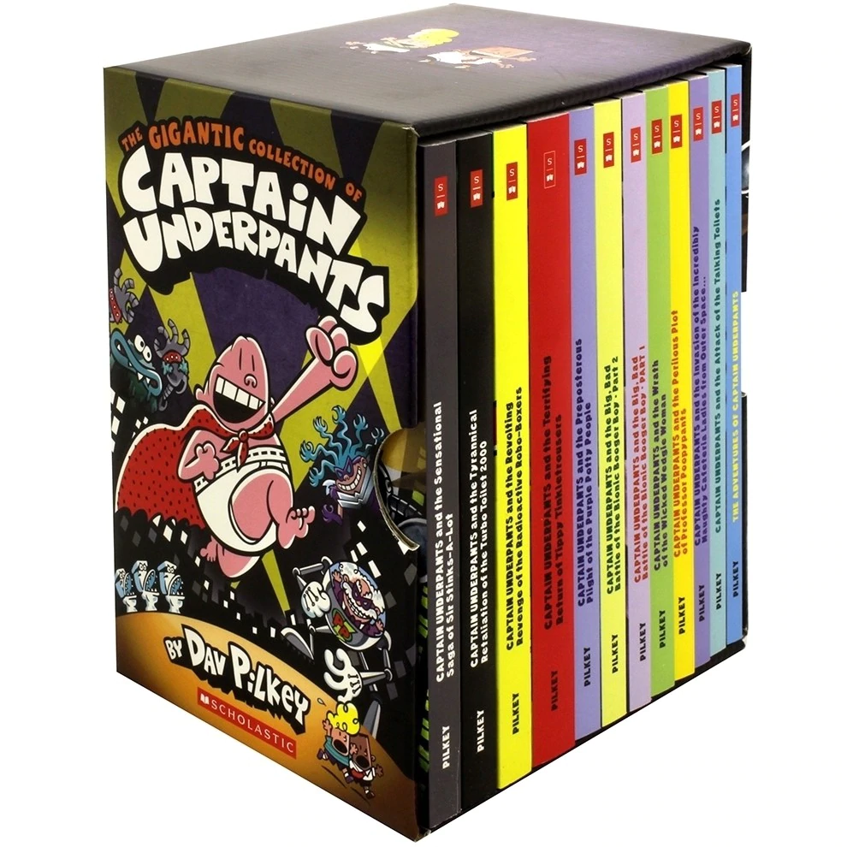
Book tasting of your gifted book
Lesson 1
As part of book week, you have all been gifted a book.
Your book in Year Six is either one of the ‘Jamie Johnson Football Series’ or ‘The Adventures of Captain Underpants’

Slide 5
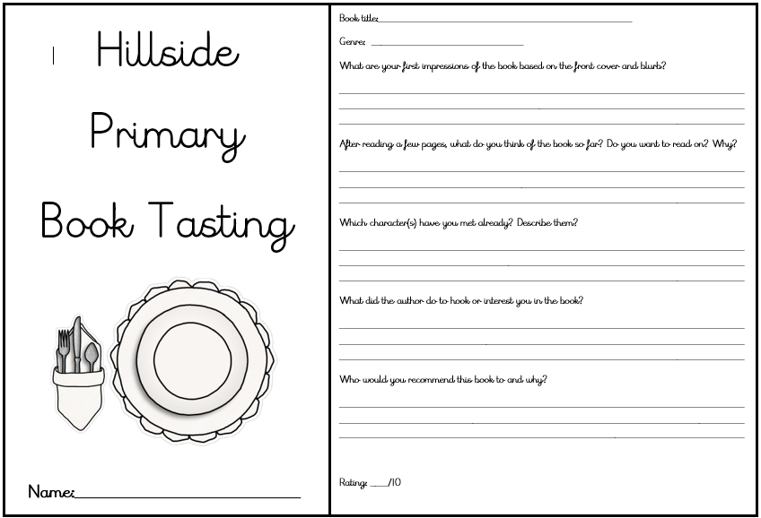
Book tasting of your gifted book
Lesson 1
TASK: Complete the book tasting document for your new book from the Jamie Johnson Football Series or The Adventures of Captain Underpants Series. Remember to answer all of the questions in full sentences and support them with evidence. When you have completed your book tasting, spend some time beginning to read your book for pleasure.
Notes:
Read the first few pages of your book. You will have been given a book from ‘Jamie Johnson Football Series’ or ‘The Adventures of Captain Underpants’ series. Once you’ve read the first 6 or 7 pages, think carefully about what it is you’ve learnt so far about the story. Then fill in the Book Tasting Document. This document is not included in the English resources PowerPoint, but will be in your pack. It is also a separate document on the school website and can be found under the English section of this week’s home-learning titled ‘Book Tasting Document’ if you want a digital copy.

Slide 6
Summarise your initial ideas from our themed book – ‘Flotsam’ by David Wiesner
Lesson 2
Who is the boy?
What is he doing at the beach?
What did the camera see on its journey?
Did any of the images surprise you?
Where has the camera come from?
Who does the camera belong to?
What animals carried the camera across the ocean?
Did you see some creatures which you did not expect?
Watch: https://www.youtube.com/watch?v=3MTKWnxzqvM
TASK 1: First watch the clip again. Secondly, record any details you pick up in the clip. you may wish to use the spider diagram in Document 1 for ideas.
Notes:
It is important that you watch the clip below again before today’s lesson. I would advise watching the video through once uninterrupted, then watching it again whilst considering and making notes regarding these questions. You may wish to present your notes on a spider diagram. A template can be found in Document 1 of the resources.

Slide 7
Spider Diagram
Lesson 2
FLOTSAM
TASK 2: Add more information to your spider diagram about anything else you notice. This could include the five senses, what is happening, who the eldest/ youngest is, what information we find out about the characters, where the video is set.
.
Notes:
Continue to make notes about the video. You may need to continuously watch and pause the video to ensure any key details are not missed.

Slide 8
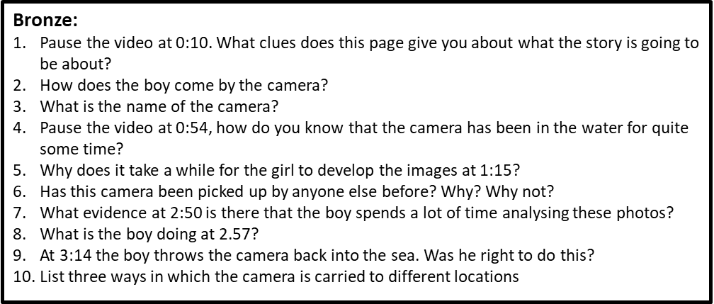
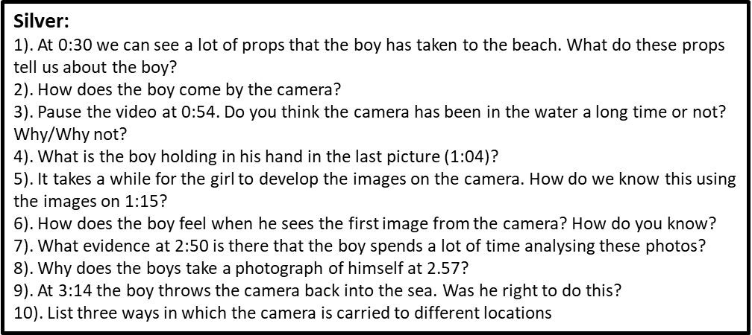
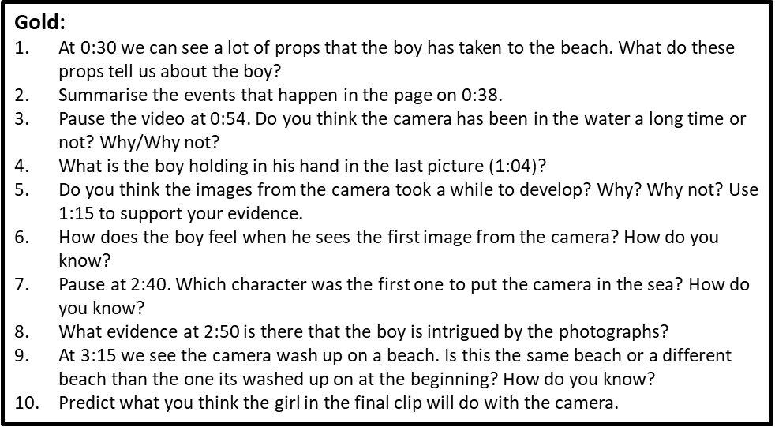
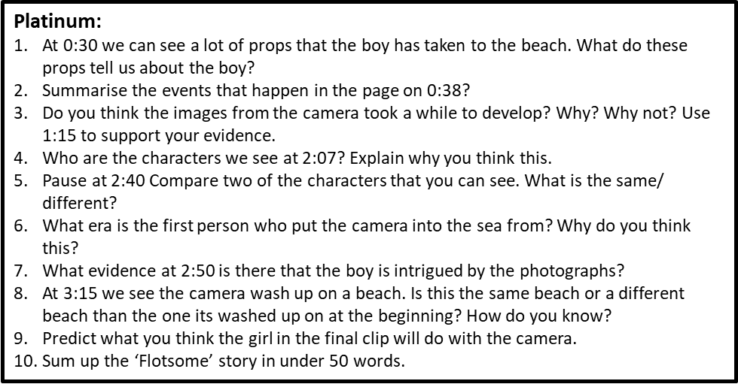
Comprehension
Lesson 2
Watch again: https://www.youtube.com/watch?v=3MTKWnxzqvM
TASK 3: Go to Document 2. Choose the Bronze, Silver, Gold or Platinum comprehension questions. You must have the video loaded so that you can keep referring back to it.
Notes:
Rewatch the video and have it loaded ready to refer to. Look at Document 2. Choose a set of questions to work on in today’s lesson. Remember, where possible, support your answers with evidence from the video.

Slide 9
Lesson 3
Golden Lines
Success Criteria | Check
Have I used personification? | 1
Have I used similes? | 2
Have I used ISPACE openers? | 3
Have I used multi-sensory writing? | 4
Have I used show-not-tell? | 5
Have I used metaphors? | 6
Silver
Gold
Platinum
TASK 1: Using Document 3, identify the skills appropriate to your task level in this success criteria. You can either highlight the skills in the text using the colour coded system in the success criteria, or underline them and label them with the appropriate number from the success criteria.
Notes:
For today’s lesson, you need to look at the text on Document 3. Identify the skills within this document that are listed in the success criteria.
Personification is giving a human action to something non-human. For example, the wind howled.
Similes involve the writer comparing something to something else more familiar. They often use the words ‘like’ or ‘as’. For example, the fog made the houses appear like mere phantoms. Or the windows were as bright as beacons in a black sea.
ISPACE openers include ‘ing words’, ‘similes’, ‘prepositions’, ‘adverbs’, ‘conjunctions’ or ‘ed words’ placed at the beginning of the sentence to add more description to that sentences. More information on, and examples of, ISPACE openers can be found in Document 4 of the resources pack.
Multi-sensory writing, is any writing which appeals to the senses. These are taste, smell, sight, feel and hear.
Show-not-tell involved the writer describing something, rather than them telling you directly. For example, rather than saying someone is sad, a writer might say that they sat head down blubbering.
Metaphors describe something as being something else. For example, the sapphire ocean lapped upon the white frame of the island. The ocean is not a sapphire but it has similarities. The white frame of the island refers to the sand – the ocean is not an actual sapphire nor is the sand an actual frame. They are metaphors.

Slide 10
Lesson 3
Waves crashed against the shore like white stallions as the incoming tide gradually climbed up the broad white strip of sand. Children and their parents pranced about in the shallows, running and splashing, consumed in laughter as gulls screeched above me in the cloudless sky. Gently, a light breeze tickled my skin as I lay, preoccupied with my latest beach discovery: a crab.
Eyes wide, I glared inquisitively, analysing every part of this peculiar crustacean through a magnifying glass. Consumed by an overwhelming desire to discover more of these ten legged creatures, I picked up my spade and began to dig, unaware that I was precariously close to the incoming tide. In one fell swoop, waves descended down on top of me, lifted me off the floor and carried me further inland. Letting go of my spade and the bucket which contained the crab, I flapped my arms furiously to keep my head above the thrashing water which engulfed me.
Soaked and somewhat dishevelled, I arrived approximately ten feet up the beach face down in the sand which stuck to my drenched body. Brushing myself down and wiping the salt water from my eyes, I stood upon my feet and began to collect up the equipment that had been so abruptly swept from my grasp. It was at this point I noticed something entirely foreign. Something I was sure I had not seen before and most certainly did not belong to me: a metal box with a small glass cylinder on the front. Being as naturally curious as I am, I approached the box and picked it up. ‘Melville Underwater Camera’ it read. A rush of excitement coursed through my veins as I felt I had stumbled upon the ultimate discovery. Somewhat flustered, I opened the back of the camera to find the film that was kept inside. I just had to get the images developed.
In a hurry, I put on my sandals and rushed into town, found the nearest photograph shop and requested that the photos be developed. I waited. I waited some more. And still, I waited. After what felt like an age, the photographs were finally ready. I snatched them from the shop assistant’s hand and sprinted back to the beach, where I tore open the wallet that they were in and stared in awe at the photographs.
TASK 2: Write down 8 of your favourite Golden Lines (or more if you wish) from Document 3 (the document shown in this slide).
Notes:
For the next part of today’s lesson you can either highlight, or copy down 8 Golden Lines from the WAGOLL found in Document 3. The text on this Slide is the same as that found in Document 3. Consider which language is the most sophisticted and would suit your story well.

Slide 11
Lesson 3
Alive with creatures…
A broad, white sweep of sand…
A green jewel of an island framed in white…
Breath of wind…
A fearful crescendo of screeching that died away in its own echoes...
Trees grew thick and lush behind me…
The wide blue sea was as empty as the cloudless sky above…
The forest grew more sparsely up the side of a great hill someway inland…
The bare rocky outcrop…
I set off at a run…
The cold, briny sea beckoned…
The dazzling yellow sun…
Touched tentatively…
Vibrantly coloured birds…
There was a long swathe of brilliant white beach…
So far as I could see, there was no sign of human life…
The sea all about it in a silken shimmering blue…
The intertwining canopy provided some welcome relief from the heat of the day…
Shiver of leaves, the cracking of twigs, sudden surreptitious rustlings…
Alive with creatures…
Birds cackled and screeched high above me…
Howling wailed and wafted through the trees…
Coarse jagged rocks protruded…
Hard shelled leathery turtles…
Rainbow coloured fish…
TASK 3: Tweak the language or ending in 7 of these Golden Lines to fit your own writing.
Notes:
For your final task this lesson, I want you to choose 7 of the Golden Line teasers on this page. Then, change the ending or tweak the language in the lines to suit your own story.

Slide 12
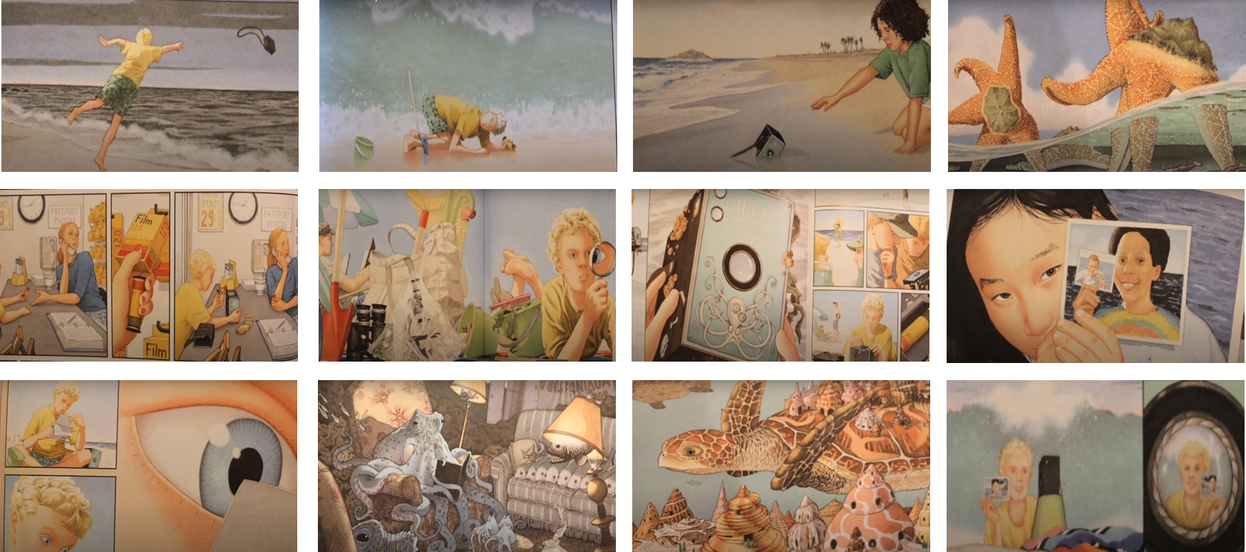
Planning
Lesson 4
TASK 1: Choose 5 of these images (in Document 4) to place in order in which they happen in the text. Then, using the ISPACE and openers support mat on Document 4, describe each of your pictures with varied openers.
Notes:
Once you have ordered 5 of the images from Document 5 in chronological order, I want you to use ISPACE openers, which can be found in Document 4, to start a sentence about each of the pictures. Try and include some language from the Golden lines in your sentences too, but you must start each sentence with an ISPACE opener.

Slide 13
Lesson 5
WRITING COMPETITION
WIN AN AMAZON VOUCHER!
Today you are free to write about the story of Flotsam in whichever way you wish. Some ideas for your writing could be:
- A recount of journey of the camera;
- A newspaper report about the new-found camera highlighting its journey;
- A setting description of some of the places that the camera visits;
- A diary entry from the perspective of the boy, recapping on the day’s events;
- You could describe the next journey that the camera goes on and what it sees;
- Imagine you have been sat inside the camera since it was first put in the water. Keep a diary entry about everything that you see on your journey.
TASK 1: Consider what you want to write your story about. Above are just some ideas what you could write about.
Notes:
Look at some of the suggestions for writing above. You may wish to write one of these texts today, it is up to you. You may also wish to write your own text today. You are given freedom to write whatever you want today. The only rule is that it has to be centred around the Flotsam video we have spent the week analysing.
Use the writing resources throughout Document 6 and the ISPACE and sentence openers from Document 4. You have both today’s English lesson and this afternoon’s lesson time to complete this piece of writing. That means there should be enough writing evident which constitutes around three hours worth. This includes planning and editing your work. Your writing will be judged in school and the winner will be awarded an Amazon Voucher. The writing will be judged on the effort, quality and creativity evident. I look forward to seeing what you produce when given freedom to write!

