Slide 1
Year 5 – Book week
Flotsam by David Wiesner
Notes:
This week we are celebrating book week at Hillside Primary. Book week is a time where we celebrate lots of different authors and lots of different genres of books. The book which we shall focus on this time is ‘Flotsam’ by David Wiesner. This is an illustrated book which has a very interesting story about the journey of an underwater camera through the ocean. We will analyse this book throughout the next few days and you will produce your own piece of writing inspired by it on Friday. As always, as this is book week, the piece of writing which you produce will be your decision. For example, you may decide to write a recount about the journey in which the camera takes, a diary entry written from the perspective of somebody hidden in the camera or a setting description based on some of the magical destinations in the ocean which the camera visits. The choice is yours!

Slide 2
End Result: To create your own piece of writing inspired by the book Flotsam by David Wiesner. You may choose to write a recount of the magical journey which the camera has been on, a setting description of some of the striking settings which the camera visits or describe the next magnificent journey the camera will go on.
The following slides will support you in writing a piece based on our themed book for the week – Flotsam by David Wiesner.

Slide 3
Sit back, relax and enjoy…
Use the following link to look at our book for the week ‘Flotsam’ by David Wiesner. If the link does not work, type into YouTube
‘’Flotsam by David Wiesner’
https://www.youtube.com/watch?v=3MTKWnxzqvM
You may want to look at the book more than once to ensure you haven’t missed anything.
Notes:
Now it’s time to introduce our themed book for this week, ‘Flotsam’ by David Wiesner. To view this book, click the YouTube link or follow the alternative instructions on screen. Remember, there are no words written in this book, so ensure you are looking closely at all of the wonderful illustrations. You may wish to look through the book a couple of times in order that you are secure with the story and characters.

Slide 4
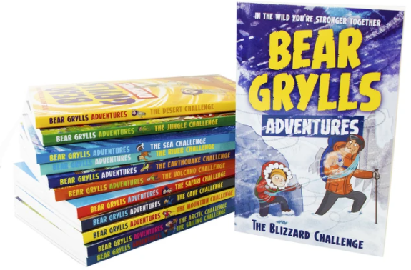
Book tasting of your gifted book
Lesson 1
As part of book week, you have all been gifted a book.
Your book in Year Five is part of the Bear Grylls adventure series.
Each book in the series takes you on an adventure with Bear Grylls to a different biome from around the world.
Which type of environment and challenge do you face in your book?
Notes:
LESSON ONE - As part of book week, we have gifted you all a book which we hope that you will all enjoy. Your book is part of the Bear Grylls adventure series where each book focuses on a different challenging environment. Each book see’s Bear tackle an environment using his vast range of skills which he has developed throughout his adventurous life. For example, some books focus on mountainous environments and some focus on desert lands.

Slide 5
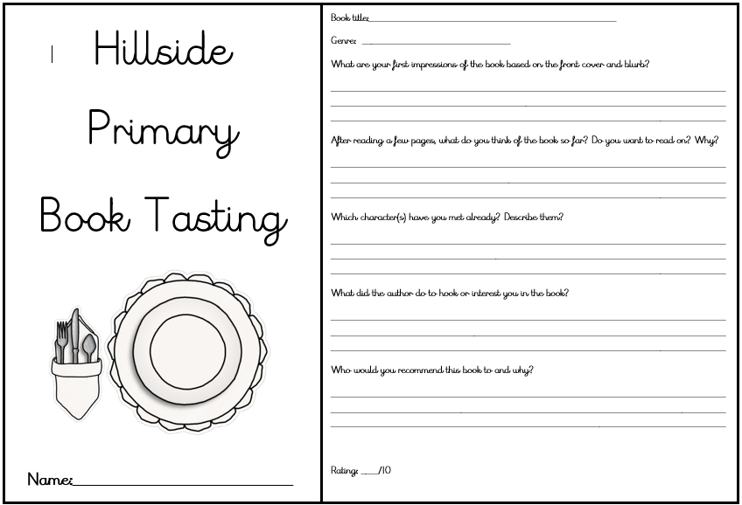
Book tasting of your gifted book
Lesson 1
TASK: Complete the book tasting document for your new book from the Bear Grylls adventure series. Remember to answer all of the questions in full sentences and support them with evidence. When you have completed your book tasting, spend some time beginning to read your book for pleasure.
Notes:
Your task today is to complete our book tasting activity. Your book tasting will be based on our new book from the Bear Grylls adventure series. Before you begin to read your new book at length, work your way through the questions on your book tasting menu. It might be a good idea to complete this task with your grown-up who you live with as you can discuss the questions about your new book. Ensure that you answer the questions on your tasting menu in full sentences. After you have completed your book tasting activity, spend some time beginning to read your new book for pleasure.

Slide 6
Summarise your initial ideas from our themed book – ‘Flotsam’ by David Wiesner
Lesson 2
Who is the boy?
What is he doing at the beach?
What did the camera see on its journey?
Did any of the images surprise you?
Where has the camera come from?
Who does the camera belong to?
What animals carried the camera across the ocean?
Did you see some creatures which you did not expect?
Watch: https://www.youtube.com/watch?v=3MTKWnxzqvM
TASK 1: First watch the clip again. Secondly, record any details you pick up in the clip. You may wish to use the spider diagram in Document 1 for your layout.
Notes:
LESSON TWO – This lesson should begin with you looking through our themed book for the week – ‘Flotsam’ by David Wiesner. This will be our book focus for the rest of book week. Once you have looked through the book and are confident with the story, think about the questions in the thought bubbles on the screen. If possible, discuss these with your trusted grown-up who you live with. Record your initial thoughts of the book on a spider diagram. Use document one as an example of the layout for your spider diagram, you may wish to complete your notes on this sheet.

Slide 7
Spider Diagram
Lesson 2
FLOTSAM
TASK 2: Add more information to your spider diagram about anything else you notice. This could include the five senses, what is happening, which creatures do we see in the ocean, what information we find out about the characters, where the story is set.
.
Notes:
Once you have completed your initial observations on the spider diagram. Have a think to see if you can add any more information. Perhaps look at the book another time. Can you describe the five-senses throughout the book, what creatures do you see and where do you think the story is set? These questions are only to start you off, what other interesting observations, predictions and summaries can you place on the spider diagram?

Slide 8
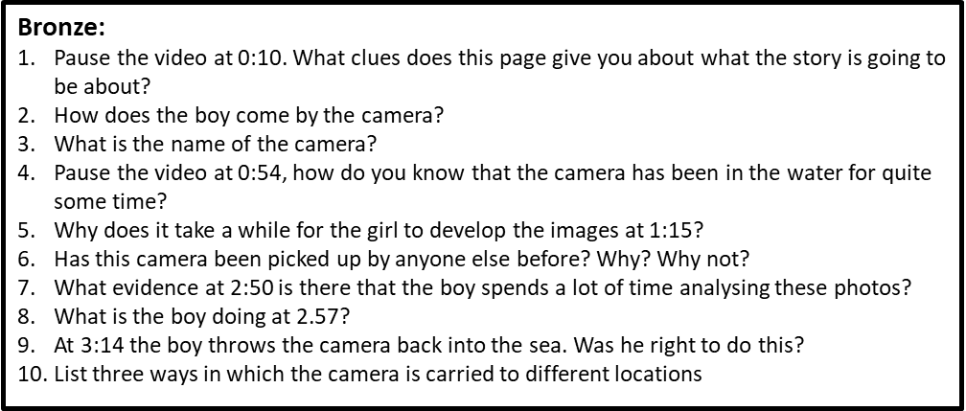
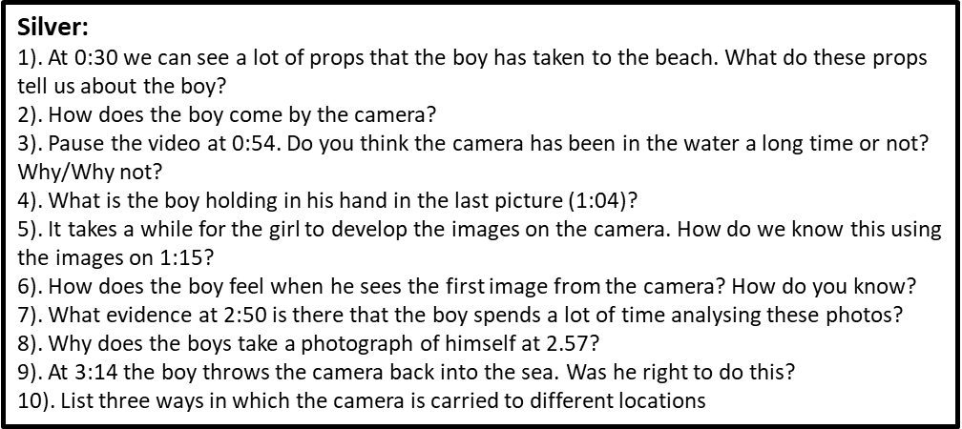
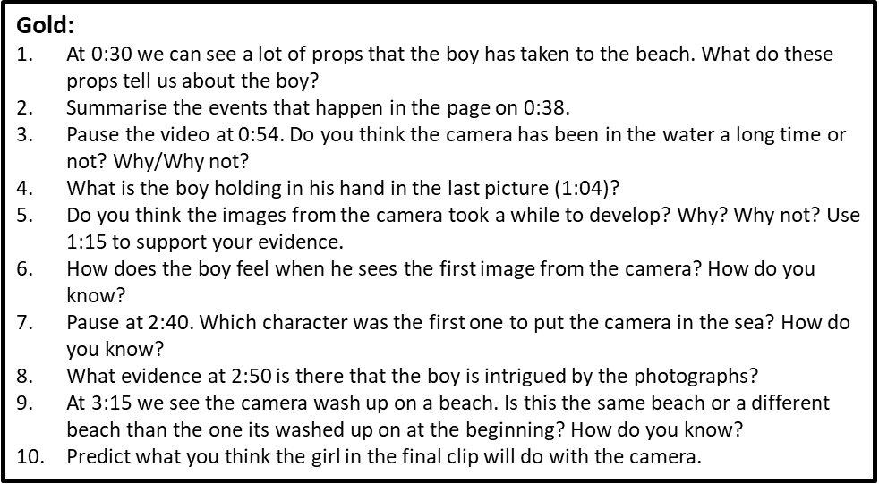
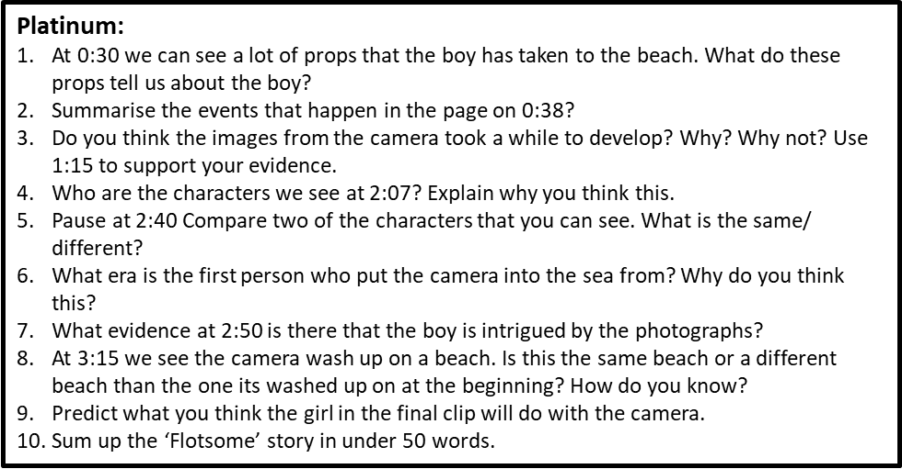
Comprehension
Lesson 2
Watch again: https://www.youtube.com/watch?v=3MTKWnxzqvM
TASK 3: Go to Document 2. Choose the Bronze, Silver, Gold or Platinum comprehension questions. You must have the video loaded so that you can keep referring back to it.
Notes:
For our final task of this lesson, we want you to answer some questions which are based on our story of ‘Flotsam’. Go to document two in your English resource pack and select which set of questions you would like to answer. Remember, we must always answer our questions in full sentences and refer to evidence from the story throughout.

Slide 9
Lesson 3
Golden Lines
Success Criteria | Check
Have I used personification? | 1
Have I used similes? | 2
Have I used ISPACE openers? | 3
Have I used multi-sensory writing? | 4
Have I used show-not-tell? | 5
Have I used metaphors? | 6
Silver
Gold
Platinum
TASK 1: Using Document 3, identify the skills appropriate to your task level in this success criteria. You can either highlight the skills in the text using the colour coded system in the success criteria, or underline them and label them with the appropriate number from the success criteria. Use document 5 to help you to identify ISPACE openers.
Notes:
LESSON THREE – Today we are going to identify some key literacy features you may wish to put into your text, for example, personification and similes. We are also going to identify some golden lines you may wish to put into your writing on Friday. For your first task, you must read document three carefully. Document three provides an example of a first person recount of the boy finding the camera on the beach and taking it to the camera store to develop the photographs. Once you have read the document, highlight the different literacy features in the text using the coded system in the success criteria. If you have not got all of these colours, you may select your own and make your own key to support your highlighting. The more features which you highlight, the higher level which you will achieve in this task. Refer to document five if you require some examples of ISPACE openers.

Slide 10
Lesson 3
Waves crashed against the shore like white stallions as the incoming tide gradually climbed up the broad white strip of sand. Children and their parents pranced about in the shallows, running and splashing, consumed in laughter as gulls screeched above me in the cloudless sky. Gently, a light breeze tickled my skin as I lay, preoccupied with my latest beach discovery: a crab.
Eyes wide, I glared inquisitively, analysing every part of this peculiar crustacean through a magnifying glass. Consumed by an overwhelming desire to discover more of these ten legged creatures, I picked up my spade and began to dig, unaware that I was precariously close the incoming tide. In one fell swoop, waves descended down on top of me, lifted me off the floor and carried me further inland. Letting go of my spade and the bucket which contained the crab, I flapped my arms furiously to keep my head above the thrashing water which engulfed me.
Soaked and somewhat dishevelled, I arrived approximately ten feet up the beach face down in the sand which stuck to my drenched body. Brushing myself down and wiping the salt water from my eyes, I stood upon my feet and began to collect up the equipment that had been so abruptly swept from my grasp. It was at this point I noticed something entirely foreign. Something I was sure I had not seen before and most certainly did not belong to me: a metal box with a small glass cylinder on the front. Being as naturally curious as I am, I approached the box and picked it up. ‘Melville Underwater Camera’ it read. A rush of excitement coursed through my veins as I felt I had stumbled upon the ultimate discovery. Somewhat flustered, I opened the back of the camera to find the film that was kept inside. I just had to get the images developed.
In a hurry, I put on my sandals and rushed into town, found the nearest photograph shop and requested that the photos be developed. I waited. I waited some more. And still, I waited. After what felt like an age, the photographs were finally ready. I snatched them from the shop assistant’s hand and sprinted back to the beach, where I tore open the wallet that they were in and stared in awe at the photographs.
TASK 2: Write down 8 of your favourite Golden Lines (or more if you wish) from Document 3 (the document shown in this slide).
Notes:
For your next task today, identify at least eight golden lines from document three which you could place within your writing on Friday. It may be useful to have another close read of the text in document three to select the most effective golden lines. You may select your golden lines for a range of reasons, including descriptive vocabulary or sentence starters.

Slide 11
Lesson 3
Alive with creatures…
A broad, white sweep of sand…
A green jewel of an island framed in white…
Breath of wind…
A fearful crescendo of screeching that died away in its own echoes...
Trees grew thick and lush behind me…
The wide blue sea was as empty as the cloudless sky above…
The forest grew more sparsely up the side of a great hill someway inland…
The bare rocky outcrop…
I set off at a run…
The cold, briny sea beckoned…
The dazzling yellow sun…
Touched tentatively…
Vibrantly coloured birds…
There was a long swathe of brilliant white beach…
So far as I could see, there was no sign of human life…
The sea all about it in a silken shimmering blue…
The intertwining canopy provided some welcome relief from the heat of the day…
Shiver of leaves, the cracking of twigs, sudden surreptitious rustlings…
Alive with creatures…
Birds cackled and screeched high above me…
Howling wailed and wafted through the trees…
Coarse jagged rocks protruded…
Hard shelled leathery turtles…
Rainbow coloured fish…
TASK 3: Tweak the language or ending in 7 of these Golden Lines to fit your own writing.
Notes:
Your final task for today is to challenge yourself by tweaking the language or ending of the golden lines on the screen or those you have selected to fit your own writing. Therefore, you may wish to spend some time thinking about what type of writing you want to produce on Friday. An example taken from the screen could be as follows - Alive with vibrant creatures, the ocean glowed like a soulful waterfall. We cannot wait to read all of your creative sentences which have been inspired by golden lines!

Slide 12
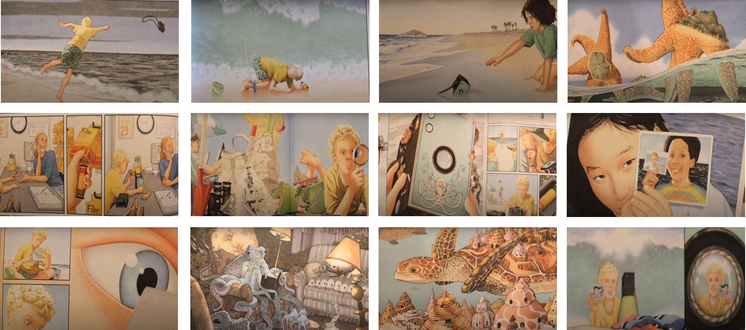
Planning
Lesson 4
TASK 1: Choose 5 of these images to place in order in which they happen in the text. Then, using the ISPACE and openers support mat on Document 5, describe each of your pictures with varied openers.
Notes:
LESSON FOUR – For your lesson today, you are going to look at the images on the screen and in document four. You must choose five of them and place them in the order of which they happened. You could carefully cut these out and glue them into your home learning book or simply number the images you have selected from 1-5. Once you have done this, using the ISPACE and openers support mat on document five, describe each of the images with varied sentence openers. You may also wish to use other literacy features we have looked closely at in Year Five such as similes, metaphors and powerful adjectives.

Slide 13
Lesson 5
Today you are free to write about the story of Flotsam in whichever way you wish. Some ideas for your writing could be:
- A recount of the journey of the camera;
- A newspaper report about the new-found camera highlighting its journey;
- A setting description of some of the places that the camera visits;
- A diary entry from the perspective of the boy, recapping on the day’s events;
- You could describe the next journey that the camera goes on and what it sees;
- Imagine you have been sat inside the camera since it was first put in the water. Keep a diary entry about everything that you see on your journey.
TASK 1: Consider what you want to write your story about. Above are just some ideas what you could write about.
Notes:
LESSON FIVE – Today we will complete our piece of writing for book week which has been inspired by our book ‘Flotsam’ by David Wiesner. What you write is up to you, the power is in your hands! There must be a clear link between your writing and that of our book and you should aim to include some of the key features which we have focused on and analysed this week. Remember, you choose what you will produce, examples include a recount of the journey of the camera or a setting description for some of the places that the camera visits. There are more ideas of what you may wish to write above. We cannot wait to read what you all produce, good luck everyone!

