Slide 1



Year 4 English
Hillside’s Book Week
(including World Book Day 2021)

Slide 2
A note from Miss McCann
Resource sheets are provided to support you with the tasks in this unit of work.
There are also sheets to help you to organise your work. You can either work on the worksheets provided or create a word document and type up your work.
Don’t forget to email your work and if you have any questions, please ask!
year4homelearning@hillsideprimary.org.uk

Slide 3
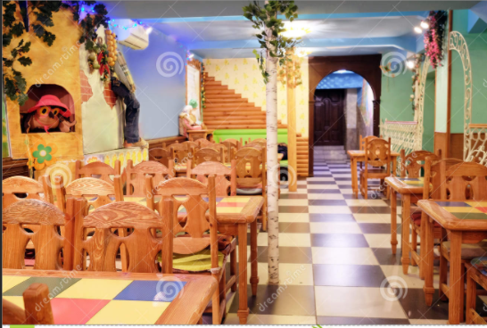
Monday 1st March – Book Tasting
Each year, to kick start the events of Book Week, we turn our classroom into a ‘book café’ and have our own ‘book tasting’ session, where we ‘taste’ books and complete a book menu on what we have sampled.
This year will be slightly different, but we will still be ‘book tasting’ our own book.
Use resource sheet 1 to record your answers.

Slide 4
Monday 1st March – Book Tasting
This year, you are going to use your gifted book to:
Course 1 - have a look at and feel of
Course 2 - glance over the cover
Course 3 - read the blurb
Course 4 - flick through the chapters
Course 5 - read the first chapter
After each ‘course’, complete your menu to give details about all aspects of your book.
Use resource sheet 1 to record your answers.

Slide 5
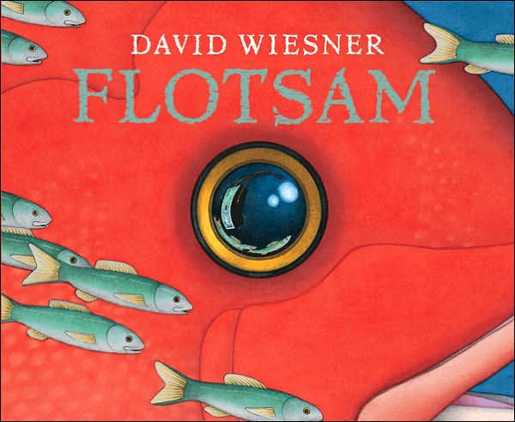
Tuesday 2nd March
Introducing Flotsam by David Weisner
This year’s writing competition for Book Week is based around the book Flotsam. Flotsam is a wordless picture book which tells the story through pictures.
This week you are joining the ‘Flotsam’ on a underwater adventure and are going to be writing a short story about your adventures in an imaginary underwater city and/or with an amazing underwater invention!

Slide 6
Sit back, relax and enjoy…
Use the following link to watch the wordless book
‘Flotsam’.
The different links are different versions, which you might find useful.
https://www.youtube.com/watch?v=3MTKWnxzqvM&safe=true
https://www.youtube.com/watch?v=N1v9-UT93R4
https://vimeo.com/430640419
You will need to watch the clip more than once during Book Week to focus on different aspects from it throughout the week.

Slide 7
Tuesday 2nd March - Initial thoughts…
Think about the following questions and answer the questions on the sheet.
What is unusual/surprising in the story?
Where is the setting? Who is the main character?
Which object is the whole story based around?
Why are there other children in the photos?
What would you do if you found the camera?
Use resource sheet 2 to record your answers.

Slide 8
Tuesday 2nd March – Wow!
Look at this!
Click on the link to read about a real life news story of a lost camera being found!
The incredible journey of a camera lost at sea - BBC News

Slide 9
Wednesday 3rd March –
Imaginary worlds
Now that you have looked at the video clips of the book a few times, read resource sheet 3 to ensure you understand what happens in the story.
Today, we are going to look at the imaginary underwater worlds in more detail.
Choose one image from resource sheet 4, stick it onto resource sheet 5 and think about the three headings.
What you OBSERVE – write down the things you see in the image
What you WONDER – write down what you wonder about the things or events in the image
What you can INFER – write down what you THINK you MIGHT know about from clues in the book.
Use resource sheets 3 - 6 during this lesson.
Notes:
https://www.literacywagoll.com/mystery.html

Slide 10
Thursday 4th March –
Ideas for Writing
Today we are going to be planning our ideas for our competition entry that we will write tomorrow.
As this is a competition and we are looking for a winner which shows excellent imagination, description and an exciting storyline, I will not be telling you exactly what you will be writing!
All you need to know is that you will be writing a short adventure story, set beneath the ocean and based around ideas in the book Flotsam…
Use resource sheets 7 and 8 to record your ideas for your story.

Slide 11
Thursday 4th March –
Ideas for writing
You can choose to:
write your story in the 1st person (I, we, me, us) as thought it’s an adventure that you go on, OR
write your story in the 3rd person (he, she, they, them) as though you’re telling the story about an adventure that your character goes on.
You can choose whether to:
use the image you looked at in yesterday’s lesson as the setting for your adventure story
use a different image from Flotsam as the setting for your adventure story OR
create your own new underwater location (using ideas from Flotsam) for your story setting. If you create your own, it might be useful to draw and label it first to ensure you collect lots of descriptive phrases for your work.
Use resource sheet 7 and 8 to record your ideas for your story.

Slide 12
Thursday 4th March –
Planning your writing
Now you have your initial ideas, you need to plan your story in more detail, so you are ready to write it tomorrow.
Have a look at resource sheet 7 and use it to plan your story. Have a look at my example of resource sheet 8 to help you to see how much detail you need to include today.
Use resource sheet 7 and 8 to record your ideas for your story.

Slide 13
Friday 5th March –
Time for writing!
You should now feel ready to start writing your underwater adventure story for your competition entry. This will take most of today to write.
Have a look at resource sheet 9 to remind you of what I will be looking for when choosing the competition winner!
Don’t forget to use your planning sheet to structure your story. Expand each of your ideas with improved DETAIL, DESCRIPTION, VOCABULARY and SENTENCE STRUCTURE.
Use the additional resource sheets to support your writing.
Use resource sheets 9 – 13 to support your writing and resource sheet 14 to write your story.

Slide 14
Friday 5th March –
Modelled opener
As this is a competition, I can’t really give you TOO much guidance on how to write your story, so I am just simply showing you how to expand your ideas from your planning sheet to a story.
It was a beautiful, bright summers day as I relaxed on the soft, powdery sand, feeling the sun beating down and warming my bronzed skin. I felt pleasantly full as I had just swallowed the last tasty mouthful of my picnic lunch that had been prepared that morning, just before we set off for the beach. Glancing around, I noticed my Mum and Dad looking as relaxed as I was feeling. Spotting my bucket and spade in arms reach, I decided to build a sandcastle.
Use resource sheets 9 – 13 to support your writing and resource sheet 14 to write your story.

Slide 15
Is your story complete?
Once you have finished your story, re-read to make sure that your sentences all make sense. Check through carefully for accurate spelling and punctuation.
Is there anything that can be improved?
Are you happy with how your story has turned out?
Do you think you have a good chance of winning? If not, why not?
I can’t wait to judge these wonderful stories!

