Slide 1
Book Week Tasks
1st March 2021

Slide 2
World Book Week
This power point details the different tasks set for Hillside’s World Book week in Nursery.
These tasks have been chosen to be fun, engaging and to continue to develop your child’s love of reading.
We hope you enjoy them.

Slide 3
Monday 1st March – Book Tasting
Today we would like you to explore the new book that you have been gifted from school
Read the story over and over again
Retell the story
Act out the story
Talk about your favourite part in the story
Parents: You could use the prompt cards with things to discuss for before, during and after reading the story (sent home a few weeks ago)

Slide 4
Tuesday 2nd March –
Flotsam by David Weisner
Watch the story again on youtube: https://www.youtube.com/watch?v=3MTKWnxzqvM&safe=true
Talk with your grown up about what is happening in the pictures. Have you ever been to the beach? Did you find
anything? Use the pictures to
help you think about your own adventures at the beach.

Slide 5
Wednesday 3rd March
Have a look at the pictures on the following few slides – these were taken with the underwater camera. What can you see? Talk about the different sea creatures, the colours etc.
Introduce new vocabulary such as…….

Slide 6
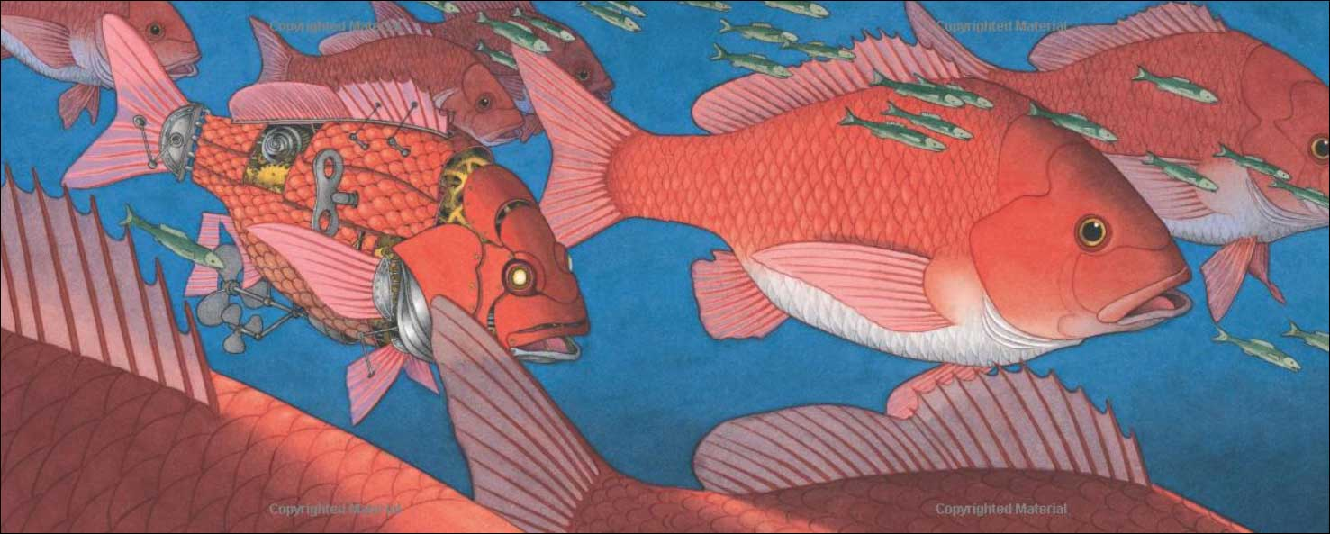
fish
fins
scales
small
big
cogs
key

Slide 7
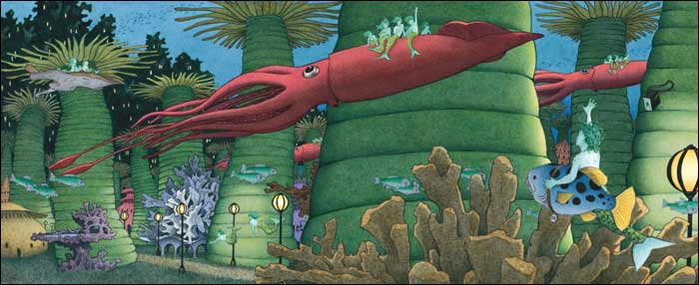
tall
lamps
long
creatures
spiky
coral

Slide 8
Talk about the picture

Slide 9
WOW!
Thursday 4th March
Look at what has just been found………
Notes:
OH MY WORD!!! WOW … you would not believe what has just been found…

Slide 10
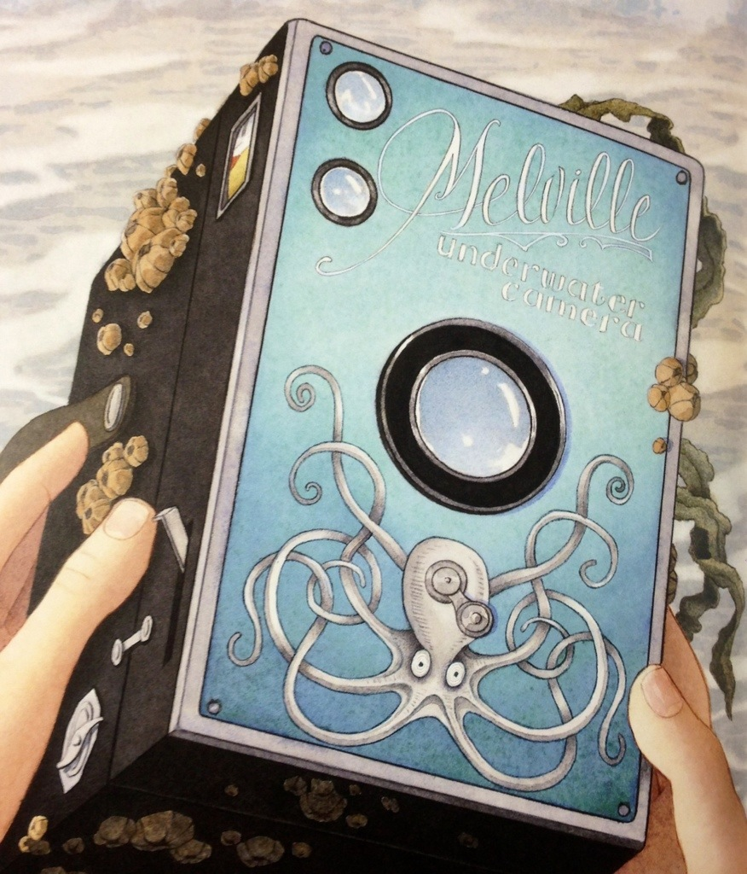
Notes:
Gasp…. It’s an underwater camera – just for you!!

Slide 11
It is your very own underwater camera! You are going to go on your own adventure….
What will you find under the sea?
Use the pictures on the next few slides to get some ideas of the pictures your camera might take.

Slide 12
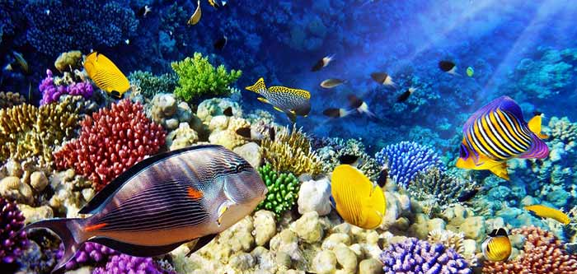

Slide 13
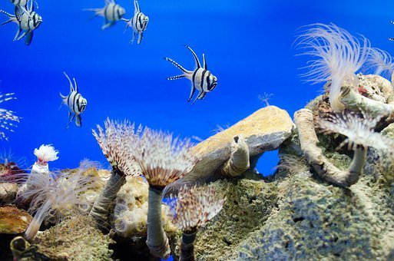

Slide 14
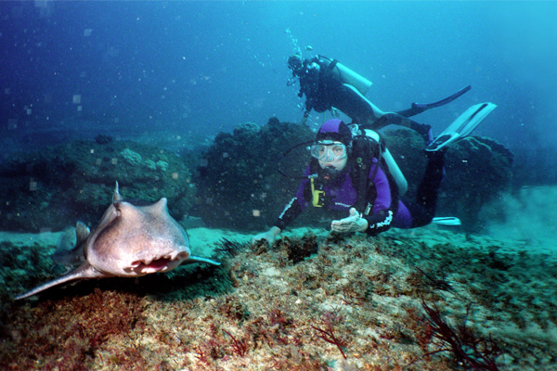

Slide 15
Thursday 4th March - COMPETITION TASK PART 1
Create a sea scene to show one of the pictures you have taken…. Be as creative as you can – this will be used tomorrow to tell a story!
This is all yours – you can choose whatever you would like!
You might have sharks, sea creatures and scuba divers OR you could find an under the sea school, a land of underwater dinosaurs, mermaids and castles – just remember that they are all underwater!

Slide 16
Friday 5th March – COMPETITION PART 2
Look at your sea scene picture that you have created (the one you took with your underwater camera). Use this to tell a story – who is there? Where is it? What does it feel like? What can you hear? What happens there?
Parents: Please write down or video what your child says and send in accompanying the picture.

