Slide 1
Year 6
Anne Frank Diary Entry

Slide 2
End Result:
To write a diary entry as Anne Frank in the secret Amsterdam annex during World War Two

Slide 3
Lesson 1
Spellings
Review of last fortnight’s spellings: word-search
apparent appreciate attached available average
accompany
according
achieve
aggressive
amateur
ancient
A
A
N
A
N
C
A
N
C
I
ANCIENTT
A
N
C
I
E
A
N
C
I
E
N
A
N
C
I
E
N
T
TASK: Complete the pyramids found in Document 1 which includes the spellings from the last fortnight.

Slide 4
Lesson 1
Spellings
New spellings to practise:
Awkward
Bargain
Bruise
Category
Cemetery
Committee
Communicate
Community
Competition
Conscience
Conscious
Controversy
TASK: Log on to spelling frame and complete the ‘Segment cards’ activity, then complete 2 games of your choice.

Slide 5
Lesson 1
Spellings
Spelling application:
AWKWARD
AWKWARD
AWKWARD
AWKWARD
TASK: Complete the Spelling Web activity. Only write three spellings in a row. Each box must be written in in a different way. See above to find out how you should write your word.

Slide 6
Comprehension
Lesson 2
Remember, when appropriate, to support your answers with evidence to show the marker how you know your answer. This is done by ‘copy and pasting’ words from the text which support your point.
Q: What was life like for Anne before she went into hiding.
P: Life was good for Anne
E: “had many friends”/ “enjoyed riding her bike”/ “going on family trips to the seaside”
A: Life for Anne before going into hiding was good. I know this because in the text it says that she “had many friends”, she “enjoyed riding her bike” and she “enjoyed going on family trips to the seaside”
TASK: There are 7 pages to document 3. Choose the Silver’, ‘Gold’ or ‘Platinum’
levelled task to complete and read the correct text in line with the questions. Once completed, mark your answers using the final page of document 3 (page 9 of the English resource pack)

Slide 7
Lesson 3
A typical day in the Secret Annex
Anne Frank spent 761 days in the Secret Annex. Although each day was different from the last, there was a certain rhythm to life in the Secret Annex. Based on Anne's diary and a few of her short stories, we can reconstruct what typical weekdays and Sundays in the Secret Annex would have been like.
In the morning
At 6:45 am, the alarm of Mr and Mrs Van Pels went off (they lived in the annex with the Frank family). Hermann van Pels got up, put the kettle on, and went to the bathroom. After fifteen minutes, the bathroom was free again and it was Fritz's turn. Anne got up and removed the blackout screens from the windows. The people in hiding took turns using the bathroom.
At 8:30 am, a risky half hour started. The men in the warehouse started their working day, while the office helpers had not yet arrived. Any noise from the people in hiding was dangerous, as the warehouse was located below the hiding place and the warehouse staff were unaware of the people in hiding.
At 9:00 am, the helpers started working in the office above the warehouse. The people in hiding walked around in socks and still had to be quiet, but sounds from above now caused less suspicion. The rest of the morning was devoted to reading, studying, and preparing for their lunch break.
TASK 1: The next few slides take you through a typical day in the annex. Write down any important/ interesting information you find in the extract as you go. You could do this as a spider diagram or in bullet point note form.

Slide 8
Lesson 3
The lunchbreak
At 12:30 pm, the warehouse workers went home for lunch, and the helpers and people in hiding had the place to themselves for a while. At 12:45 pm, a few of the helpers came up to the Secret Annex to have lunch. They had a few helpers on the outside who would bring them food, drink and other necessities.
Miep Gies (the family friend on the outside who worked in the office) usually stayed in the office to keep an eye on things. For the people in hiding, it was nice to see other people and to hear the latest news from the city. At 1 pm, the radio was switched on for the BBC news. At 1:15 pm, they had lunch and at 1:45 pm, the helpers went back to work.
In the afternoon
After the people in hiding had cleared everything away, most of them took an afternoon nap. Anne used that time for studying or writing. Around four o’clock, they had coffee and then started on the preparations for dinner.
At 5:30 pm, the warehouse workers went home. A helper called Bep usually came by to see if the people in hiding needed anything. After she had gone home at a quarter to six, the people in hiding were no longer restricted to the Secret Annex and they spread out through the building.
TASK 1: Write down any important/ interesting information you find in the extract as you go. You could do this as a spider diagram or in bullet point note form.

Slide 9
Lesson 3
In the evening
In the evening, Hermann van Pels looked at the day’s post, Peter van Pels fetched the bread that had been left for them in the office (the van Pels family also lived in the annex with the Frank family), Otto Frank (Dad) wrote business letters on the typewriter, Margot (Sister) and Anne did chores and Auguste van Pels and Edith Frank cooked dinner. After dinner, they read, talked, or listened to the radio.
Around 9 pm, they started preparing for the night. Pieces of furniture had to be moved, for instance in the room of Hermann and Auguste van Pels. Just like in the morning, they took turns using the bathroom. Every day when the sun went down, the windows had to be blacked out. After that, the Secret Annex went quiet. The next morning, the alarm went off at 6:45 am again.
TASK 1: Write down any important/ interesting information you find in the extract as you go. You could do this as a spider diagram or in bullet point note form.

Slide 10
Ordering events
Lesson 3
Watch this video:
https://www.youtube.com/watch?v=yLSvdEUA2wI&feature=emb_logo
Then, order the events of Anne’s life in chronological order. Find the events on Document 4 of the English Resource Pack
TASK: Watch the video and order events on Document 4 so they’re in chronological order
.

Slide 11
Lesson 3
Anne Frank’s emotions graph – the words on the left of the graph are powerful adjectives to describe how Anne may have felt at different points in her life.
Find the meaning of these words
TASK: First of all you must research the definitions of the words on the left-hand side of Document 4. You may use a dictionary or Google (simply type the word followed by ‘definition’ into Google search engine). You don’t have to write these definitions anywhere but it may help as you will need to remember them for the next task.

Slide 12
Lesson 3
Earliest event Latest event
TASK 2: Using the events ordered in the first part of the lesson, choose seven to go into the boxes along the bottom of this graph. Be careful though, you should ensure that the events you are choosing can be matched to one of Anne’s emotions on the left hand-side of the graph. Order the events from left to right in chronological order.

Slide 13
Lesson 3
X
X
X
X
X
X
X
Event 2
Event 3
Event 4
Event 5
Event 6
Event 7
Event 8
TASK 2: Using the events ordered in the first part of the lesson, choose seven to go into the boxes along the bottom of this graph. Be careful though, you should ensure that the events you are choosing can be matched to one of Anne’s emotions on the left hand-side of the graph. Order the events from left to right in chronological order.

Slide 14
Formal and informal
Lesson 4

Slide 15
Lesson 4

Slide 16
Lesson 4

Slide 17
Lesson 4

Slide 18
Lesson 4
TASK 1: Complete document 5, by saying whether each of the text types is formal, informal or both.
Silver: Tick whether formal, informal or both and give a reason why
Gold: Same as Silver but also give an example sentence which may go into that piece of text which is written in the style that you have ticked.

Slide 19
Lesson 4
Impersonal as don’t know the person who it is addressed to
Single word verb instead of multi-word e.g. inform you rather than ‘let you know’
Specific vocabulary for the subject
Specific vocabulary for the subject
More sophisticated adjectives

Slide 20
Lesson 4
Personal because we know the person who we are addressing and they are a friend
Multi-word: really cool instead of ‘magnificent’ for example
Common adjective – not sophisticated
Incorrect use of capital letter and hyphen. Text message style
Personal style – ‘you’

Slide 21
Lesson 4
Choosing your task:
TASK 2: Silver: Complete the table by cutting around the different phrases and placing them in the formal or informal side of the table (page 1 of Document 6). Gold: Identify, using two different colours or using straight and squiggly lines, the informal and formal language in the diary extract (page 2 of Document 6)
Platinum: Rewrite the informal text so that it is all formal (page 2 of Document 6)

Slide 22
Lesson 5
Identifying Language Features
Identify lines, phrases or words which illustrate:
Emotions
The setting (the annex)
Appearance of people
Specific factual information
Other powerful language
TASK: Using Document 8 as a template, write any Golden Lines that you find in Document 7 under the correct headings.
Silver: Identify words for emotions, appearance of people and the setting
Gold: Identify examples of lines which represent emotions, the setting, appearance of people, specific, factual information and other powerful language
Platinum: Complete the above then write three sentences which use the language you have picked up but is tweaked for yourself.

Slide 23
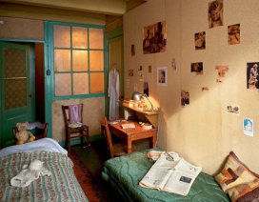
Watch: https://www.annefrank.org/en/about-us/what-we-do/publications/anne-frank-house-virtual-reality/
Lesson 6
Setting Description
ISPACE opener
Colons or Parenthesis
Golden Lines
Beside my bed, a lamp – my only source of light- spills a blotch of yellow light across the room. My night robe hangs from the door, which I always leave ajar: it helps me to better hear any commotion going on outside. Strewn across my wooden desk, newspapers detailing only dismal and depressing news of the outside. Across the beige walls, I have peppered images of my favourite things: film stars, royal families and famous artists.
TASK: For this task, you will need to use the support mat on Document 10 for examples of ISPACE openers. You will need Document 5 for the images that you are describing today.
Silver: Use ISPACE openers and to write sentences for 5 images.
Gold: Use fronted adverbials and figurative language picked up from Golden Lines for 4 images
Platinum: Use the same features as gold and include at least one colon or parenthesis in your descriptions for 3 images

Slide 24
Identifying Features of the Text
Lesson 7
Platinum Success Criteria | Tick
Have I started with Dear Kitty? (the name of the diary) | 1
Have I used parenthesis to add extra information? | 2
Have I written in first person? (me, I, us, our, mine) | 3
Have I used colons for clauses? | 4
Have I used ISPACE openers? | 5
Have I used Golden Lines? | 6
Have I used my senses to describe the setting? | 7
Have I written in an informal voice? | 8
SILVER
GOLD
PLATINUM
TASK: Look at the WAGOLL examples in the Resource PowerPoint, Document 11
Silver: Identify only the skills in the ‘silver’ bracket
Gold: Identify only the skills in the ‘gold’ bracket
Platinum: Identify the skills in the ‘platinum’ bracket

Slide 25
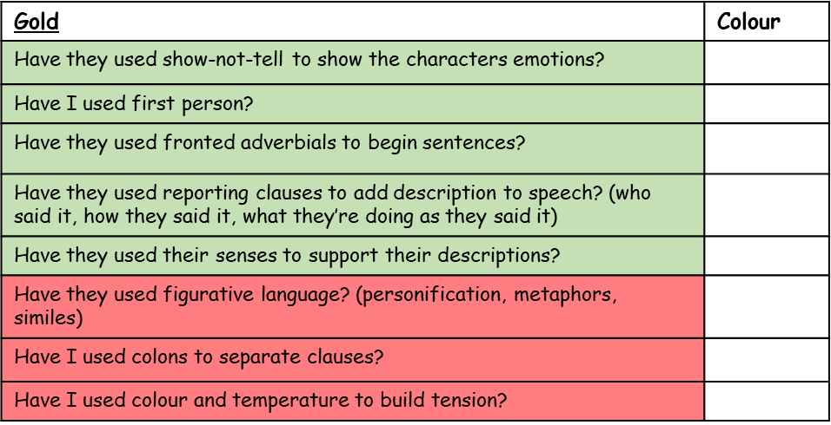
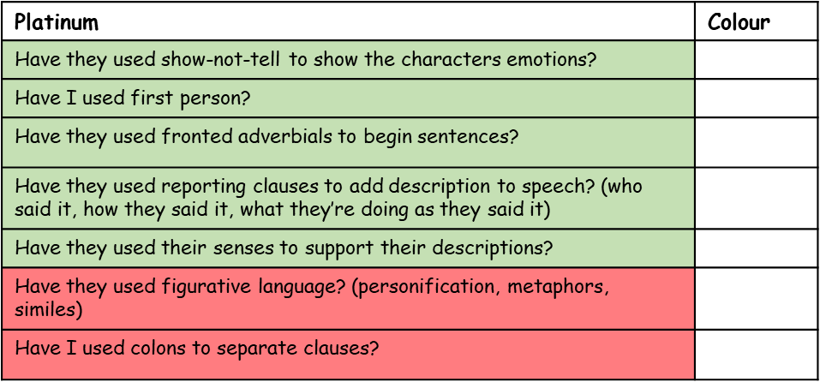
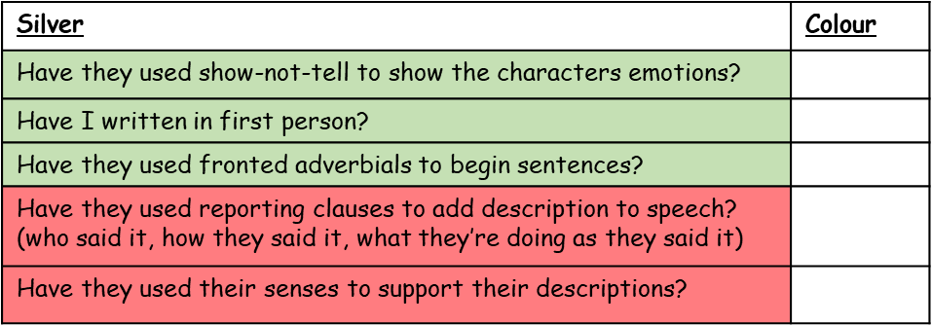
Writing – Choosing your Success Criteria
Lesson 8
Now it’s time to write in the style of Anne Frank. Over the next three lessons we will write three entries outlining the details of three key events in Anne’s diary. First of all, we must choose a Success Criteria. Open Document 11 and choose an appropriate Success Criteria
TASK 1: Choose an appropriate Success Criteria, cut it out and stick it into your workbook.

Slide 26
Writing - WAGOLL
Lesson 8
Now it’s time to write in the style of Anne Frank. Over the next three lessons we will write three diary entries outlining the details of three key events in Anne’s life. The first of these events is the day that Anne finds out she is going into hiding. You may want to refer back to Document 7 as well as using this WAGOLL for ideas.
Dear Kitty,
Looking agitated and somewhat shocked, Margot appeared in front of me in the kitchen doorway this morning. “Father has received a call-up notice from the SS,” she whispered. (The SS are like the Nazi police; they have been rounding up Jews and taking them away). A wave of emotions coursed through my veins – I couldn’t believe it! Everyone knew what a call-up from the SS meant: being transported miles across Europe away from home. Dejected, subdued and motionless, I sat in silence pondering my seemingly inevitable fate – surely there had to be another way.
Eventually mother came home and I confronted her about the issue. Reassuringly, she told me that there really was another way! Apparently, Father has a secret annex behind the offices where he works. We have to get our stuff together and prepare to live there for the foreseeable future. I don’t know if I’m excited or scared: I haven’t worked it out yet. Anyway, lots to do so I’d better get on with it…

Slide 27
Writing
Lesson 8
Diary Entry 1: Start with Dear Kitty then describe your feelings as Margot (your sister) breaks the news to you about Father’s call up from the SS.
Start with ISPACE openers and explain any unfamiliar language using parenthesis (for example, an explanation about who the SS are).
Talk about your emotions as your mother returns home and explains that you’re going into hiding.
TASK 2: Write diary entry. Use the guide on the left to give you an idea of what you should include in your writing. Refer to your Success Criteria to know what skills you should be putting in.

Slide 28
Is this section complete?
Lesson 8
Once you have finished your writing, check through carefully and use a dictionary to check spellings (online dictionaries can be very useful during this process). Tick off your success criteria
Email your piece of writing into the school email. If taking a picture of your writing, make sure the writing is clear enough to read so that it can be marked and Fix-It/ Challenges can be set.

Slide 29
Writing - WAGOLL
Lesson 9
The second diary entry will outline a brief description of the annex. Look at the work you completed in Lesson 6 to help you today and use this WAGOLL for inspiration.
Dear Kitty,
Admittedly, the prospect of going into hiding was something I was pessimistic about, however, I must confess I have been slightly comforted by the transformation that me and Margot have made to our room. Beside my bed, a lamp – my only source of light- spills a blotch of yellow light across the room. My night robe hangs from the door, which I always leave ajar: it helps me to better hear any commotion going on outside. Strewn across my wooden desk, newspapers detailing only dismal and depressing news of the outside. Across the beige walls, I have peppered images of my favourite things: film stars, royal families and famous artists. Nevertheless, two months on from moving into our annex (or secret hiding place as I call it), I am beginning to understand the extent of what it truly means to be in hiding. Longingly, I dream of once more feeling the chill of wind as it drifts through my hair; listening to the birds singing melodiously in the sky; and even the rain drops streaming down my face - I never thought I'd say that!

Slide 30
Writing
Lesson 9
Diary Entry 2: Start with Dear Kitty.
Write a short sentence to describe your feelings whilst in the annex.
Then, describe a couple of rooms in your annex using the images and descriptions from Lesson 6.
Use prepositional openers to describe where things are in the rooms.
End with a short sentence explaining what you miss from the outside world.
TASK 1: Write diary entry. Use the guide on the left to give you an idea of what you should include in your writing. Refer to your Success Criteria to know what skills you should be putting in.

Slide 31
Is this section complete?
Lesson 9
Once you have finished your writing, check through carefully and use a dictionary to check spellings (online dictionaries can be very useful during this process). Tick off your success criteria
Email your piece of writing into the school email. If taking a picture of your writing, make sure the writing is clear enough to read so that it can be marked and Fix-It/ Challenges can be set.

Slide 32
Writing - WAGOLL
Lesson 10
Today’s entry will detail the day that the annex is almost found by the carpenter. You will build tension and describe your feelings as the event unfolded. For the actual diary extract of this event, go to page 2 of Document 7 in the Writing Resources PowerPoint
Dear Kitty,
Shaking uncontrollably, I am finding writing particularly difficult today. Idiotically, the office staff failed to tell us that builders were coming to fix the fire extinguishers!
At about 9:15, an ominous thudding sound emanated from the stairs outside, gradually getting closer to our entrance before stopping. Freezing in our tracks, we all looked at each other, eyes wide and pale faced. Tip-toeing silently, Father went over to the entrance and put his ear to the wall, signaling a ‘shush’ sign to us as he did so. Eventually, he laid his tools on the top of the bookcase, which covers the entrance, and began to bang frightfully on it as if expecting someone to come out. My heart beat pulsated in my ears as I turned white with fear. Pulling, pushing and jerking on the bookshelf, the worker (at least that’s what I’m assuming he was) seemed intent on getting into our hiding place. Did he know that we were hiding in here? Had he had a tip-off? A shiver seemed to pass from one to the other as my teeth chattered. After what felt like a lifetime, we heard the footsteps withdraw down the staircase outside. No one said a word for another ten minutes, fearful that any mere noise would be heard.

Slide 33
Writing
Lesson 10
Diary Entry 3: Start with Dear Kitty.
Work through the events as the worker comes up the stairs, starts to work and pulls on the bookshelf.
As you’re writing, continuously refer to your own emotions and use show-not-tell to show how scared you are.
Multi-sensory writing could be used to describe yours and everyone else’s feelings.
See the guides on the left for support with what to write for each paragraph.
TASK 1: Write diary entry. Use the guide on the left to give you an idea of what you should include in your writing. Refer to your Success Criteria to know what skills you should be putting in.

Slide 34
Is this section complete?
Lesson 10
Once you have finished your writing, check through carefully and use a dictionary to check spellings (online dictionaries can be very useful during this process). Tick off your success criteria
Leave a self assessment and email your piece of writing into the school email. If taking a picture of your writing, make sure the writing is clear enough to read so that it can be marked and Fix-Its can be set.

