Slide 1
Guidance for Video/Audio in PowerPoints
1. Open the folder and copy all the files.
2. Paste the copied files into a new folder.
3. Open the PowerPoint file, enable editing and enter presentation mode (start the slide show).
Please note the embedded audio may not be compatible with early versions of PowerPoint.
You may wish to delete this slide before beginning the presentation.

Slide 3
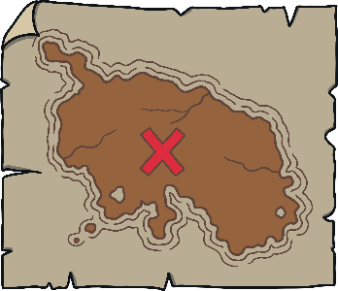
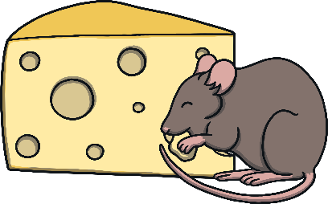
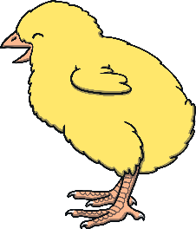
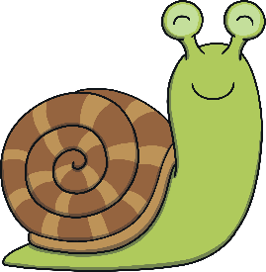
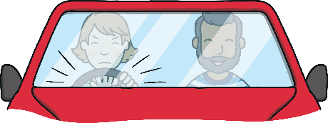
Revisit and Review
Let’s practise Sam’s Sounds and Tricky Words!
v
j
y
x
qu
ch
w
zz
z
ng
th
oa
th
igh
oo
ar
ee
oo
or
sh
ai
was
my
be
me
she
we
he

Slide 4
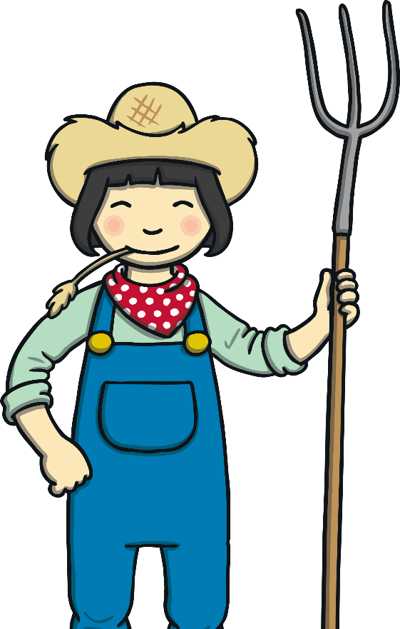
Letter Sheep
Revisit and Review
Can you sing this alphabet song along with Kit? (To the tune of the traditional alphabet song)
A, B, C, D, E, F, G,
Sing the alphabet with me.
H, I, J, K, L, M, N,
Have a rest and start again.
O, P, Q, R, S, T, U,
Come along and sing it too.
Sing V, W, X and Y,
Z is last so say goodbye.
Farmer Gail writes letters on her animals in case they get lost. Can you find the animals she is looking for? Listen to the letter she says and find the right sheep!
A

Slide 5
Revisit and Review
Can you sing this alphabet song along with Kit? (To the tune of the traditional alphabet song)
A, B, C, D, E, F, G,
Sing the alphabet with me.
H, I, J, K, L, M, N,
Have a rest and start again.
O, P, Q, R, S, T, U,
Come along and sing it too.
Sing V, W, X and Y,
Z is last so say goodbye.
H
A
J

Slide 6
Revisit and Review
Can you sing this alphabet song along with Kit? (To the tune of the traditional alphabet song)
A, B, C, D, E, F, G,
Sing the alphabet with me.
H, I, J, K, L, M, N,
Have a rest and start again.
O, P, Q, R, S, T, U,
Come along and sing it too.
Sing V, W, X and Y,
Z is last so say goodbye.
N
M
E

Slide 7
Revisit and Review
Can you sing this alphabet song along with Kit? (To the tune of the traditional alphabet song)
A, B, C, D, E, F, G,
Sing the alphabet with me.
H, I, J, K, L, M, N,
Have a rest and start again.
O, P, Q, R, S, T, U,
Come along and sing it too.
Sing V, W, X and Y,
Z is last so say goodbye.
S
F
X

Slide 8
Revisit and Review
Can you sing this alphabet song along with Kit? (To the tune of the traditional alphabet song)
A, B, C, D, E, F, G,
Sing the alphabet with me.
H, I, J, K, L, M, N,
Have a rest and start again.
O, P, Q, R, S, T, U,
Come along and sing it too.
Sing V, W, X and Y,
Z is last so say goodbye.
B
P
D

Slide 9
Revisit and Review
Can you sing this alphabet song along with Kit? (To the tune of the traditional alphabet song)
A, B, C, D, E, F, G,
Sing the alphabet with me.
H, I, J, K, L, M, N,
Have a rest and start again.
O, P, Q, R, S, T, U,
Come along and sing it too.
Sing V, W, X and Y,
Z is last so say goodbye.
C
G
V

Slide 10
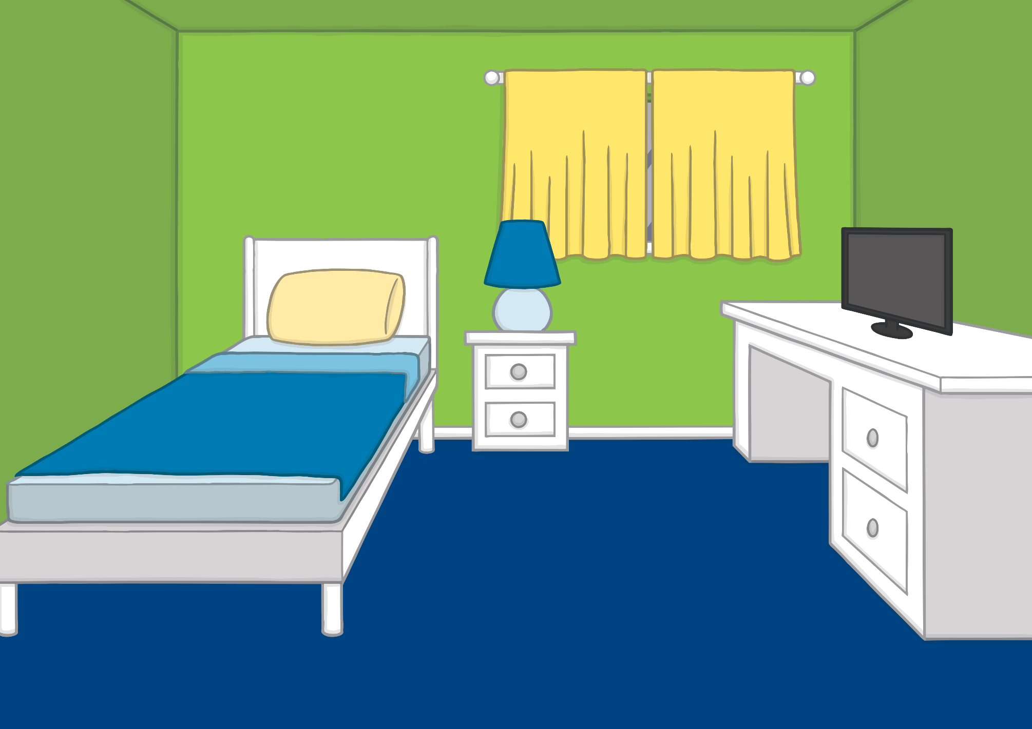
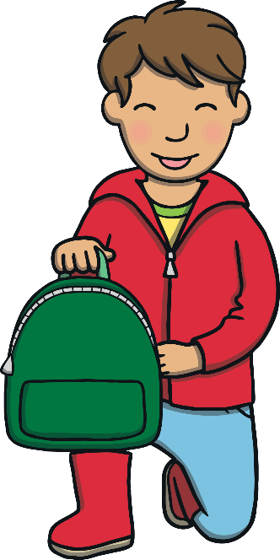
It was the school holidays and Kit and Sam were off to the farmyard to help out. “I can’t wait to see what Farmer Gail has got planned for us!” said Kit as he began to pack his rucksack.
Teach

Slide 11
Pack My Rucksack
Teach
Can you sing this alphabet song along with Kit? (To the tune of the traditional alphabet song)
A, B, C, D, E, F, G,
Sing the alphabet with me.
H, I, J, K, L, M, N,
Have a rest and start again.
O, P, Q, R, S, T, U,
Come along and sing it too.
Sing V, W, X and Y,
Z is last so say goodbye.
Kit and Sam are thinking of all the things they might need to take with them for the day. Can you help to read what is in their rucksacks?
X
Support the children by ‘robot talking’ the words aloud and asking them to orally blend the sounds to tell you the word.
Click me for Kit’s teaching tips!

Slide 12
Teach
thin socks
cash
hat
boots
tool
Can you sing this alphabet song along with Kit? (To the tune of the traditional alphabet song)
A, B, C, D, E, F, G,
Sing the alphabet with me.
H, I, J, K, L, M, N,
Have a rest and start again.
O, P, Q, R, S, T, U,
Come along and sing it too.
Sing V, W, X and Y,
Z is last so say goodbye.

Slide 13
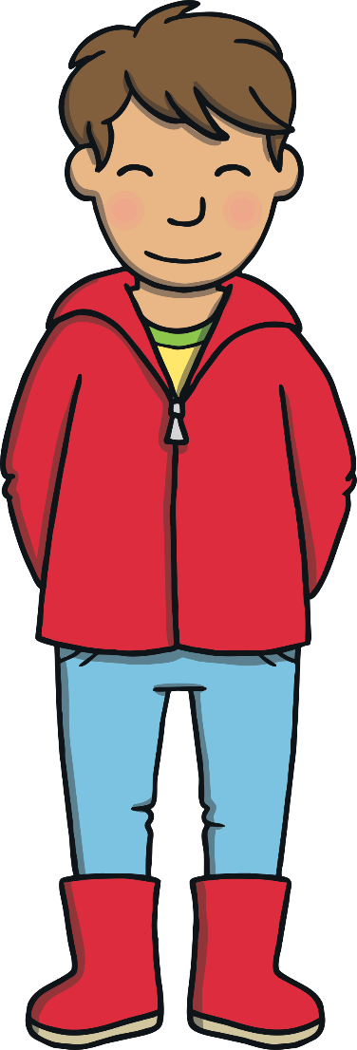
“I’m glad we wrote notes the last time we went,” said Kit.
“Me too,” said Sam. “Can you remember what Farmer Gail taught us?”
“Let’s check,” said Kit.
Teach

Slide 14
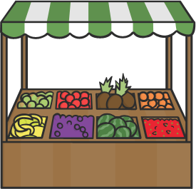
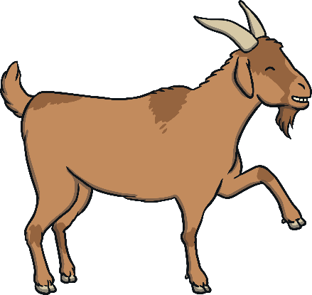
Farm School
Practise
Can you sing this alphabet song along with Kit? (To the tune of the traditional alphabet song)
A, B, C, D, E, F, G,
Sing the alphabet with me.
H, I, J, K, L, M, N,
Have a rest and start again.
O, P, Q, R, S, T, U,
Come along and sing it too.
Sing V, W, X and Y,
Z is last so say goodbye.
Can you help Kit and Sam read the notes they made last time they visited Farmer Gail?

Slide 15
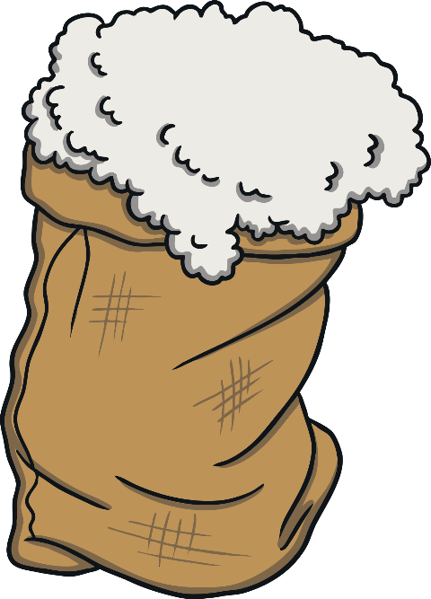
Practise
Can you sing this alphabet song along with Kit? (To the tune of the traditional alphabet song)
A, B, C, D, E, F, G,
Sing the alphabet with me.
H, I, J, K, L, M, N,
Have a rest and start again.
O, P, Q, R, S, T, U,
Come along and sing it too.
Sing V, W, X and Y,
Z is last so say goodbye.
wool
Check

Slide 16
Practise
Can you sing this alphabet song along with Kit? (To the tune of the traditional alphabet song)
A, B, C, D, E, F, G,
Sing the alphabet with me.
H, I, J, K, L, M, N,
Have a rest and start again.
O, P, Q, R, S, T, U,
Come along and sing it too.
Sing V, W, X and Y,
Z is last so say goodbye.
hoof
Check

Slide 17
Practise
Can you sing this alphabet song along with Kit? (To the tune of the traditional alphabet song)
A, B, C, D, E, F, G,
Sing the alphabet with me.
H, I, J, K, L, M, N,
Have a rest and start again.
O, P, Q, R, S, T, U,
Come along and sing it too.
Sing V, W, X and Y,
Z is last so say goodbye.
cart
Check

Slide 18
Practise
Can you sing this alphabet song along with Kit? (To the tune of the traditional alphabet song)
A, B, C, D, E, F, G,
Sing the alphabet with me.
H, I, J, K, L, M, N,
Have a rest and start again.
O, P, Q, R, S, T, U,
Come along and sing it too.
Sing V, W, X and Y,
Z is last so say goodbye.
market
Check

Slide 19
Practise
Can you sing this alphabet song along with Kit? (To the tune of the traditional alphabet song)
A, B, C, D, E, F, G,
Sing the alphabet with me.
H, I, J, K, L, M, N,
Have a rest and start again.
O, P, Q, R, S, T, U,
Come along and sing it too.
Sing V, W, X and Y,
Z is last so say goodbye.
fork
Check

Slide 20
Practise
Can you sing this alphabet song along with Kit? (To the tune of the traditional alphabet song)
A, B, C, D, E, F, G,
Sing the alphabet with me.
H, I, J, K, L, M, N,
Have a rest and start again.
O, P, Q, R, S, T, U,
Come along and sing it too.
Sing V, W, X and Y,
Z is last so say goodbye.
corn
Check

Slide 21
Farmer Gail was waiting for Kit and Sam when they arrived at the farmyard.
“Welcome back,my young farmers in training!” she said. “I have lots for you to help with today.”
Apply
Teach

Slide 22
Farmyard Fun
Apply
Can you sing this alphabet song along with Kit? (To the tune of the traditional alphabet song)
A, B, C, D, E, F, G,
Sing the alphabet with me.
H, I, J, K, L, M, N,
Have a rest and start again.
O, P, Q, R, S, T, U,
Come along and sing it too.
Sing V, W, X and Y,
Z is last so say goodbye.
Kit and Sam are learning how to help on the farm. Find out what they get up to by reading the sentences!

Slide 23
Farmyard Fun
Apply
Can you sing this alphabet song along with Kit? (To the tune of the traditional alphabet song)
A, B, C, D, E, F, G,
Sing the alphabet with me.
H, I, J, K, L, M, N,
Have a rest and start again.
O, P, Q, R, S, T, U,
Come along and sing it too.
Sing V, W, X and Y,
Z is last so say goodbye.
A ‘Let’s Read Together!’ Book

Slide 24
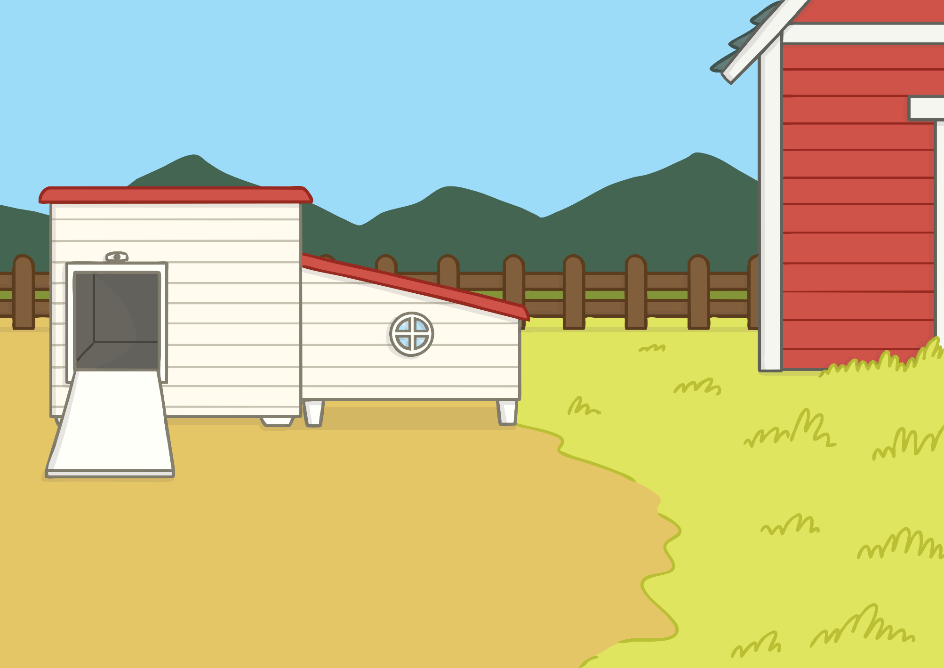
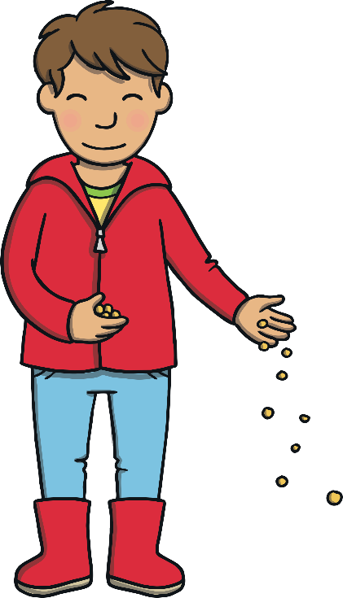
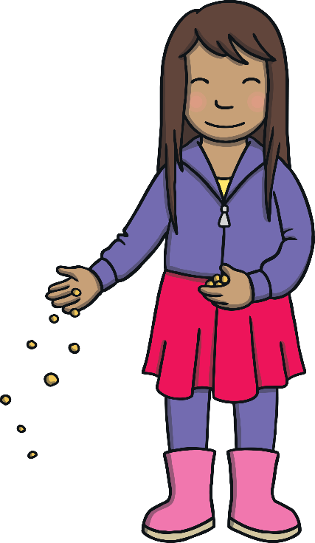
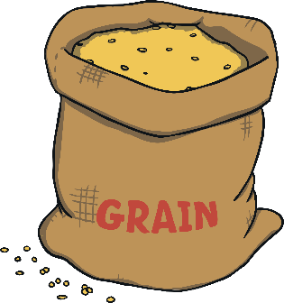
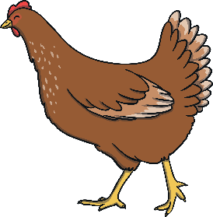
Apply
Sound Buttons On/Off
We need to feed the chicken with corn.

Slide 25
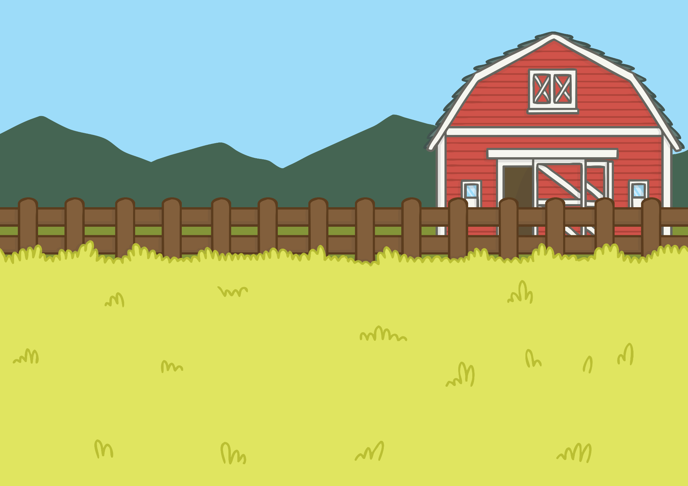
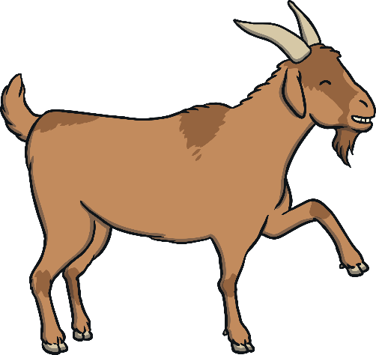
Apply
Good goat!
Sound Buttons On/Off
Check the hoof of the goat.

Slide 26
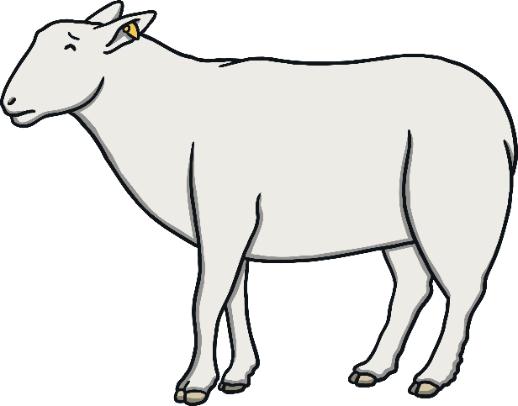
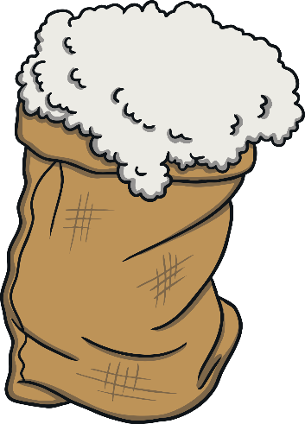
Apply
Sound Buttons On/Off
Get the wool off the sheep.

Slide 27
Apply
Sound Buttons On/Off
Chop up the wood.

Slide 28
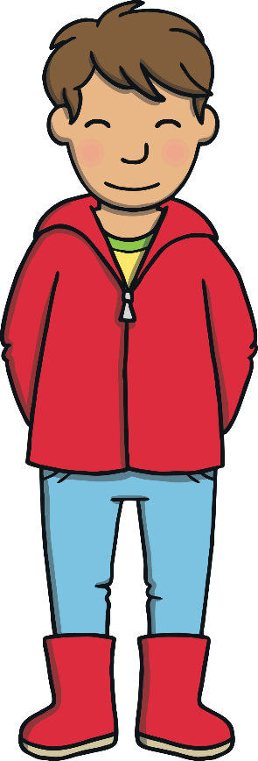
Apply
Sound Buttons On/Off
Get my cart.

Slide 29
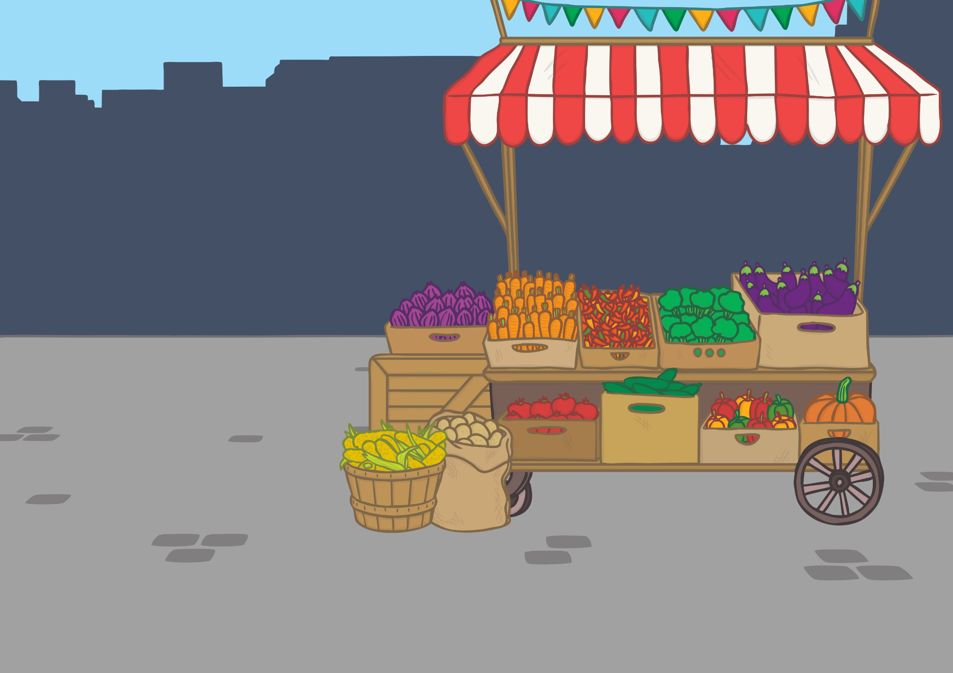
Apply
Sound Buttons On/Off
Sell the pig at the market.

Slide 30
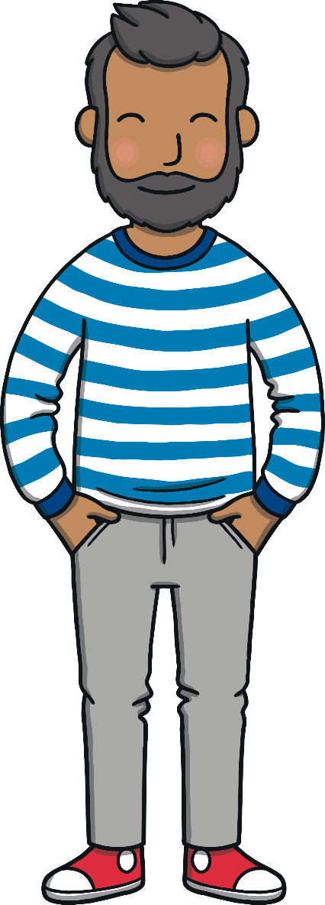
“Thank you for all your help today,” said Farmer Gail.
“Please may we come back again soon?” said Kit and Sam.
“Anytime you like!” said Farmer Gail. Kit and Sam cheered!
Teach

Slide 31
Today, we have blended sounds in words to read a book together.
Apply

