Slide 1
Guidance for Video/Audio in PowerPoints
1. Open the folder and copy all the files.
2. Paste the copied files into a new folder.
3. Open the PowerPoint file, enable editing and enter presentation mode (start the slide show).
Please note the embedded audio may not be compatible with early versions of PowerPoint.
You may wish to delete this slide before beginning the presentation.

Slide 3
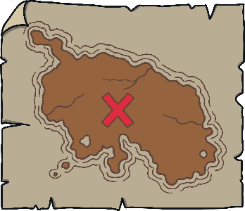
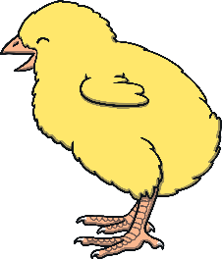
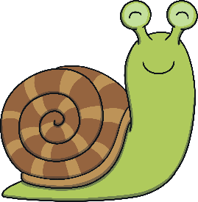
Revisit and Review
Let’s practise Sam’s Sounds and Tricky Words!
v
j
y
x
qu
ch
w
zz
z
ng
th
th
sh
igh
oo
oa
ai
oo
was
my
be
me
she
we
he

Slide 4
Ordering the Books
Practise
Kit and Sam are putting their books back on the shelf, in alphabetical order. Can you help them by saying the letter names on each book?

Slide 5
Practise
Q
G
A
R
H
I
Y
D
E
B

Slide 6
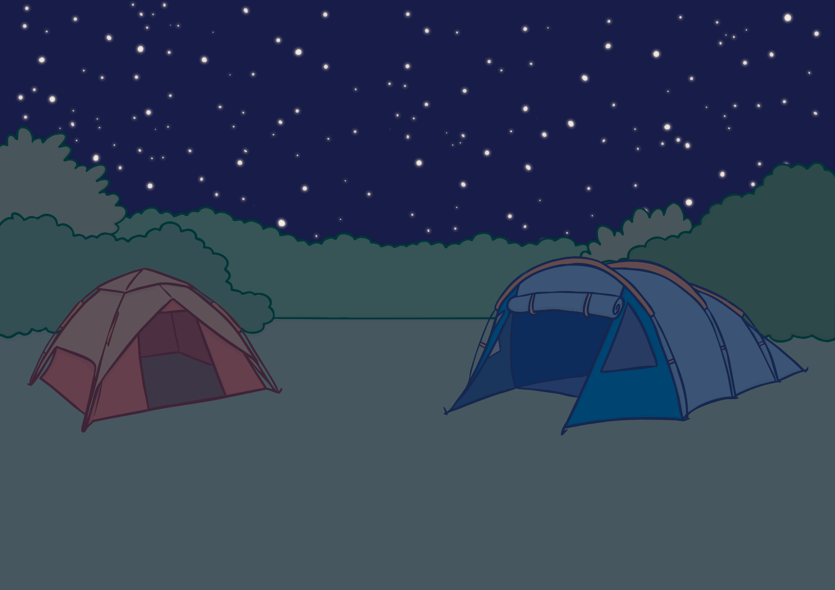
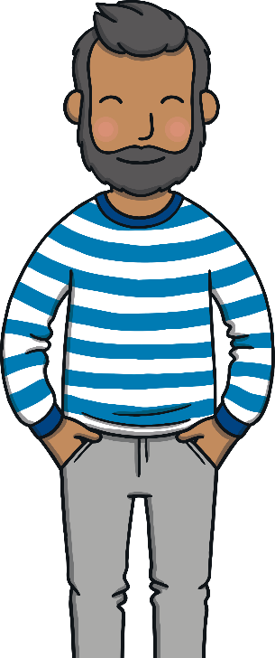
Kit, Sam, Mum and Dad were camping in the woods. After a lovely day playing, it was beginning to get dark.
Teach

Slide 7
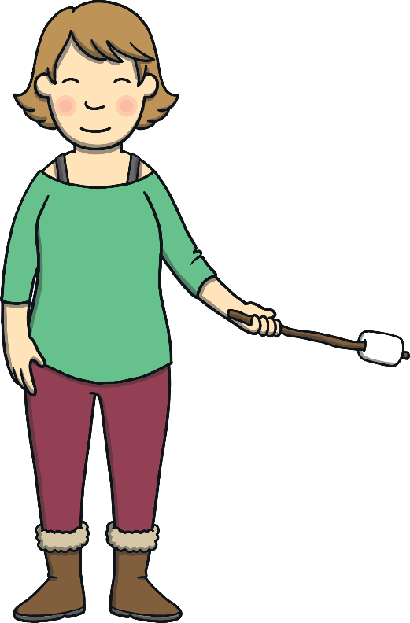
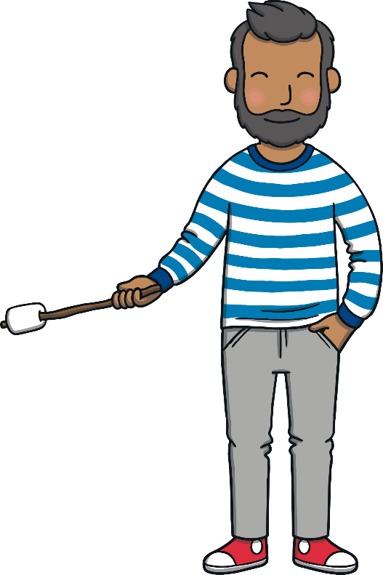
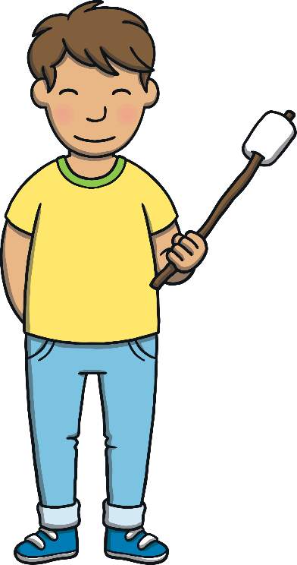
“Let’s light a camp fire tonight,” said Dad. The family collected some sticks and Dad lit a fire. They had toasted marshmallows and looked up at the twinkling stars.
Teach

Slide 8
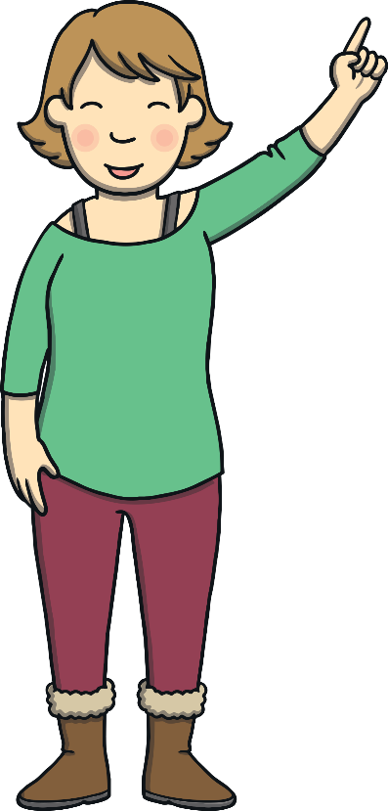
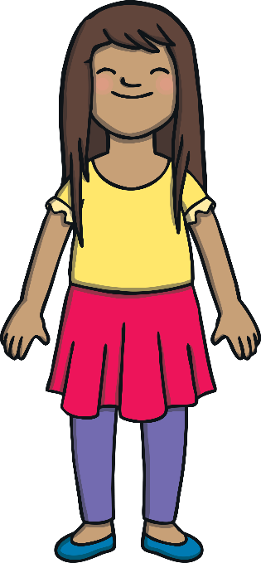
Teach
Mum pointed up into the night sky. “See that bright star?” she said to the children. “It’s called the North Star.”
“Ahh,” said the children, looking up in amazement.

Slide 9
a
r
Teach
a and r are partners. They say ar.

Slide 10
Teach
Teach
ar

Slide 11
Action
Teach
Teach
Make twinkly star fingers.
Say ‘ar’.

Slide 12
Write the Letters
Teach
ar
Around the apple, up the stalk and down the leaf.
Down the robot's body and up and over its arm.
Play

Slide 13
Let’s Sing!
Teach
(To the tune of ‘Gypsy Rover’)
ar - ar - ar - we see a shiny star,
Sitting up there in the dark sky.
It shines so bright in the autumn night,
And more will be out by and by.
Play Song

Slide 14
The Campfire
Practise
The family are watching the campfire flames swirling and twirling. As they watch, the flames seem to be making pictures. Can you write down what shapes the fire seems to be making?

Slide 15
Practise
jar
Show

Slide 16
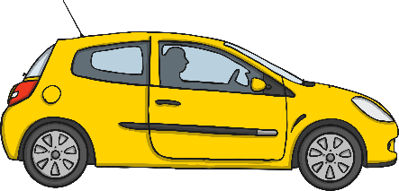
Practise
car
Show

Slide 17
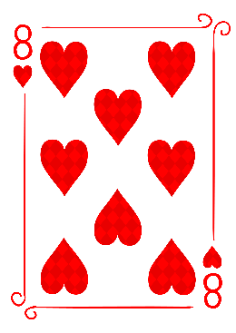
Practise
card
Show

Slide 18
Practise
shark
Show

Slide 19
Practise
dart
Show

Slide 20
Practise
cart
Show

Slide 21
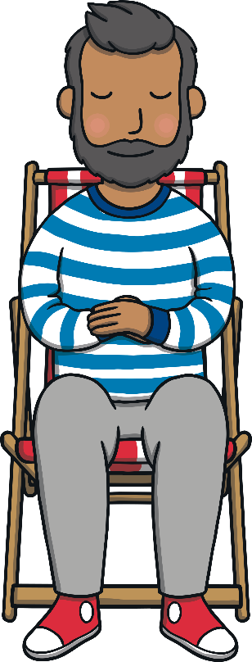
Mum told the children the names of some other stars. “Ara is my favourite constellation,” she said. It was getting late. Kit and Sam were tired. “Before you go to bed, shall we decide what to do tomorrow?” Mum asked.
Teach

Slide 22
Caption Time
Practise
What would Kit and Sam like to do on their camping trip tomorrow? Look at the picture and write a caption or sentence to match.
X
Click ‘Sound Buttons On/Off’ to select whether you want to show sound buttons under the sentence.
Click me for Kit’s teaching tips!

Slide 23
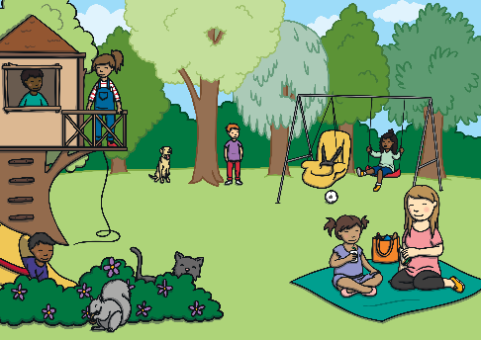
Apply
Can we go to this park?
Sound Buttons On/Off
Show

Slide 24
Teach
“That sounds good to us,” said Mum and Dad. “It isn’t too far. We can go in the car then park near the market.” Kit and Sam yawned as they climbed into their sleeping bags. Soon, they were fast asleep under the twinkling stars.

Slide 25
Today, we have learnt…
Apply
ar

