Slide 1
Put Your (insert favourite toy)… Positional Language Song (Sing to the tune of ‘If You’re Happy and you Know It

Slide 2
Put your (insert favourite toy) in your hand, in your hand,
Put your (insert favourite toy) in your hand, in your hand,
Put your (insert favourite toy) in your hand, for the song that we have planned.
Put your (insert favourite toy) in your hand, in your hand.

Slide 3
Put your (insert favourite toy) on your head, on your head,
Put your (insert favourite toy) on your head, on your head,
Put your (insert favourite toy) on your head, standing up, look straight ahead.
Put your (insert favourite toy) on your head, on your head.

Slide 4
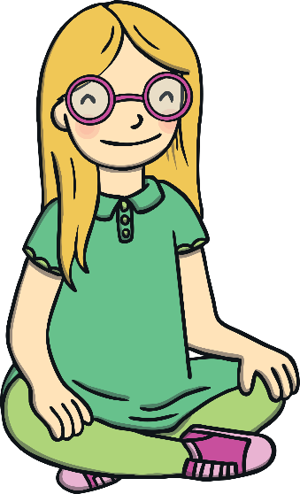
Put your (insert favourite toy) next to you, next to you,
Put your (insert favourite toy) next to you, next to you,
Put your (insert favourite toy) next to you, get your friend to do it too.
Put your (insert favourite toy) next to you, next to you.

Slide 5
Put your (insert favourite toy) underneath, underneath,
Put your (insert favourite toy) underneath, underneath,
Put your (insert favourite toy) underneath, can you cover what’s beneath?
Put your (insert favourite toy) underneath, underneath.

Slide 6
Hold your (insert favourite toy) up above, up above,
Hold your (insert favourite toy) up above, up above,
Hold your (insert favourite toy) up above, singing songs is what we love.
Hold your (insert favourite toy) up above, up above.

Slide 7
Hold your (insert favourite toy) down below, down below,
Hold your (insert favourite toy) down below, down below,
Hold your (insert favourite toy) down below, can it really touch your toe?
Hold your (insert favourite toy) down below, down below.

